Slide 1
Astea Mobile Service Bulletin Attachment (IVR)
Start

Slide 2
IVR Overview
A number of our National Account customers leverage third party providers to coordinate their facility maintenance requirements (service & maintenance calls). Each of those companies have a specific Interactive Voice Response (IVR) telephone system that requires us to use when updating and or processing Service Ticket requests within their system.
In order to reduce Customer invoice disputes, it is imperative Technician’s follow the instructions contained in the Service Bulletin.
The Service Bulletin is an Attachment on the Service Order. This training document will explain how to locate and download the Service Bulletin Attachment.
Note: to navigate throughout the training, click in the blue box to proceed to the next slide. If a blue box is not available, use the Next button to advance between slides.
Previous
Home
End
Next
2

Slide 3
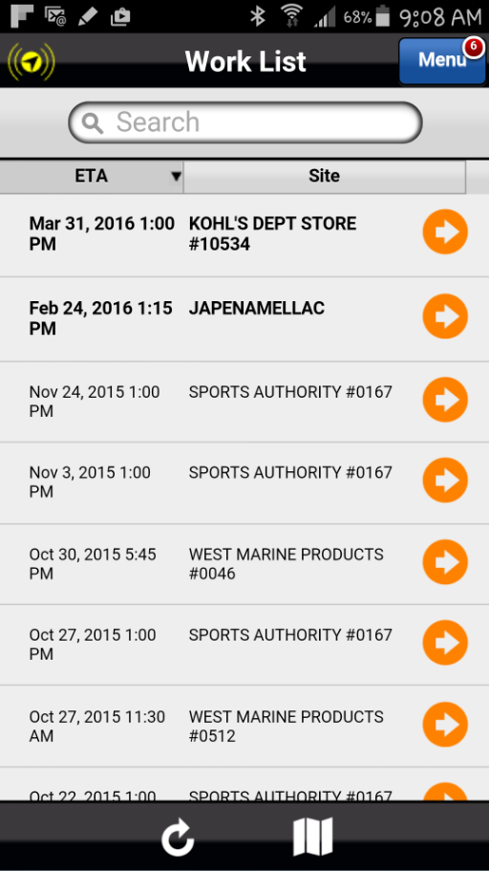
Viewing the Bulletin Attachment
The Service Bulletin is available from the Astea Mobile application by accessing Attachments.
To access the Service Bulletin from Attachments, select the orange arrow that corresponds to the following service order from the Work List: Mar 31, 2016 1:00 PM KOHL’S DEPT STORE #10534.
Previous
Home
End

Slide 4
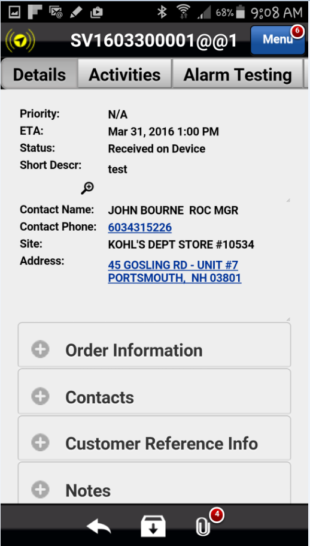
Viewing the Bulletin Attachment
Select the Attachments icon to open and view all available attachments, including the Service Bulletin.
The red circle with a number indicates the number of Attachments. This Service Order has 4 Attachments.
Previous
Home
End

Slide 5
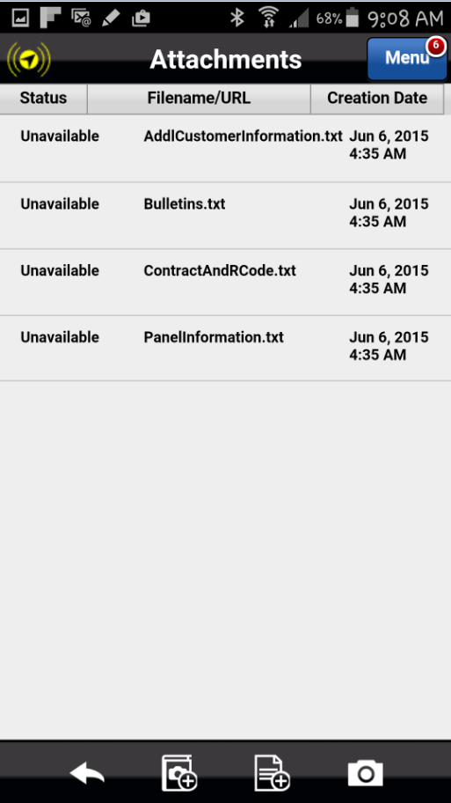
Viewing the Bulletin Attachment
A list of all Attachments appears. Attachments that are available from this section include the following:
Service Bulletin
Panel Information
Addl Customer Information
Contract & R-Codes
Previous
Home
End
Next

Slide 6
Viewing the Bulletin Attachment
Select the Attachment titled “Bulletins.txt” to view the Service Bulletin.
Previous
Home
End

Slide 7
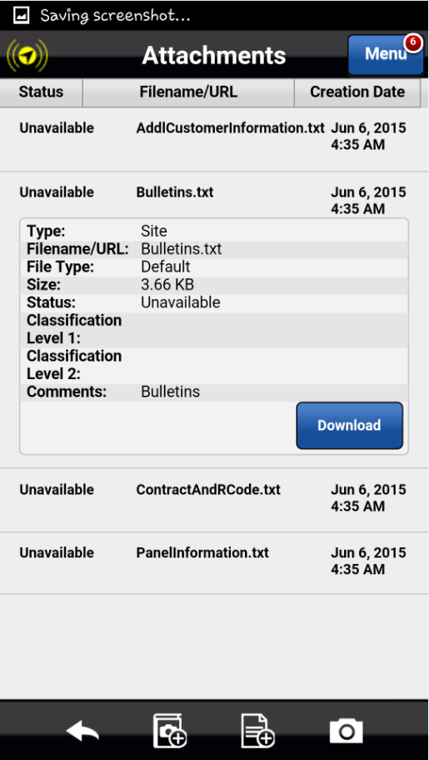
Viewing the Bulletin Attachment
The Download button is displayed for this particular file.
Previous
Home
End
Next

Slide 8
Viewing the Bulletin Attachment
Select the Download button to begin the file download process.
Previous
Home
End

Slide 9
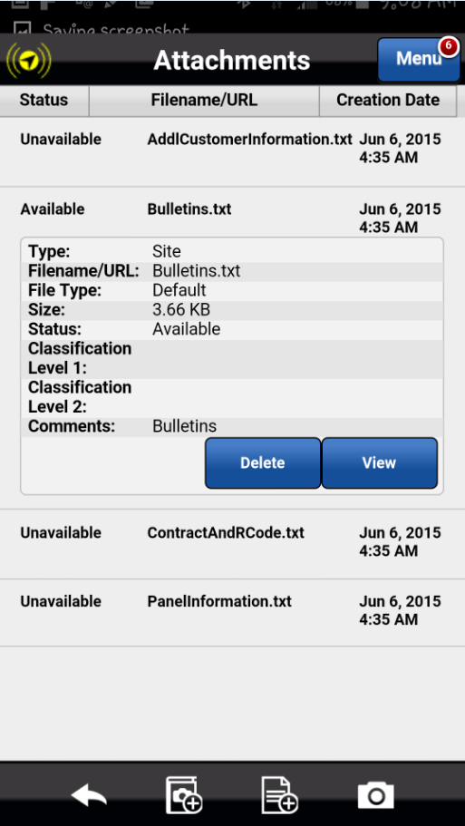
Viewing the Bulletin Attachment
The View and Delete buttons are displayed.
Previous
Home
End
Next

Slide 10
Viewing the Bulletin Attachment
Select View to view the contents of the text file.
Previous
Home
End

Slide 11
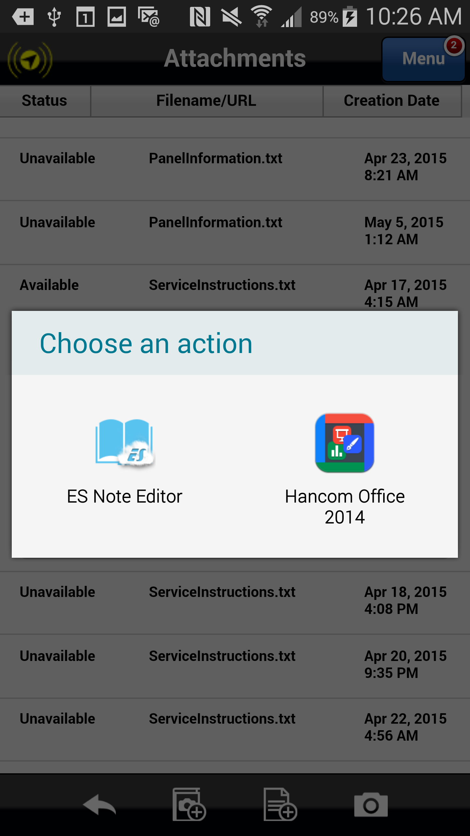
Viewing the Bulletin Attachment
The Choose an action dialog may appear displaying the applications available from which to display the text file.
Previous
Home
End
Next

Slide 12
Viewing the Bulletin Attachment
If so, select the ES Note Editor app to open the attachment.
Previous
Home
End

Slide 13
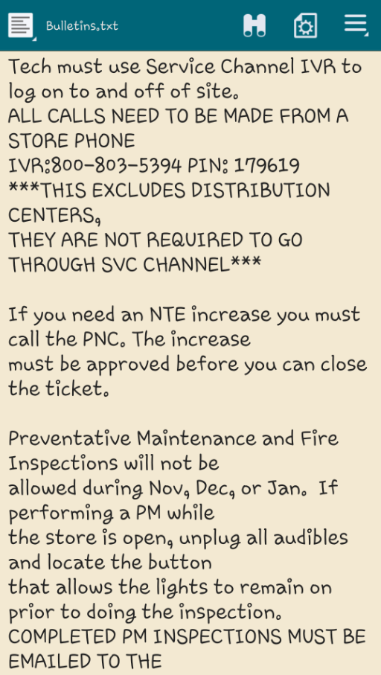
Viewing the Bulletin Attachment
The Service Bulletin is now displayed.
Notice the instructions for the Technician.
To close the attachment and return to the Astea application, select the phone’s Back button.
Previous
Home
End
Next

Slide 14
Previous
Home

