Slide 1
Astea Mobile App Training
What’s New
Start

Slide 2
What’s New
Module Overview
This module describes the new functionality with the release of DSE.
In this module you will learn how to update the duration and how to preview an appointment booking for a service order.
All of these function are performed within the activities tab within the Astea Mobile App.
Click on the Next button below
Previous
Home
End
Next
Icon Legend

Slide 3
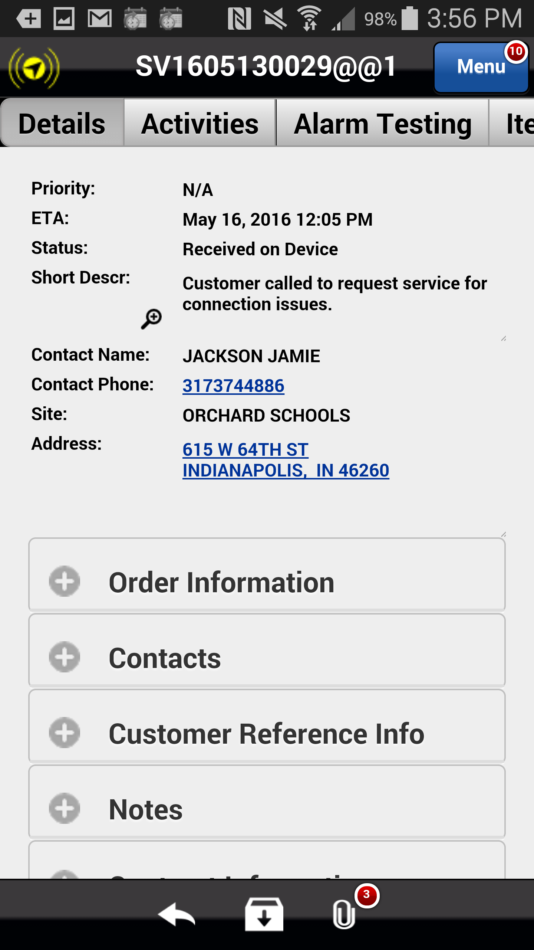
Updating Duration
All activity updates and corrections in the Astea Mobile App are done within the Activities tab.
Once a service technician gets on site, they should determine if the service can be completed within the default duration time. If it is significantly less or more time needed, the duration must be updated so that dispatch is aware of the duration changes and can reschedule/reshuffle service orders accordingly.
To update the duration of activity within the Astea Mobile App navigate to the Activities tab.
Action: Click on the Activities tab
Previous
Home
End
Icon Legend

Slide 4
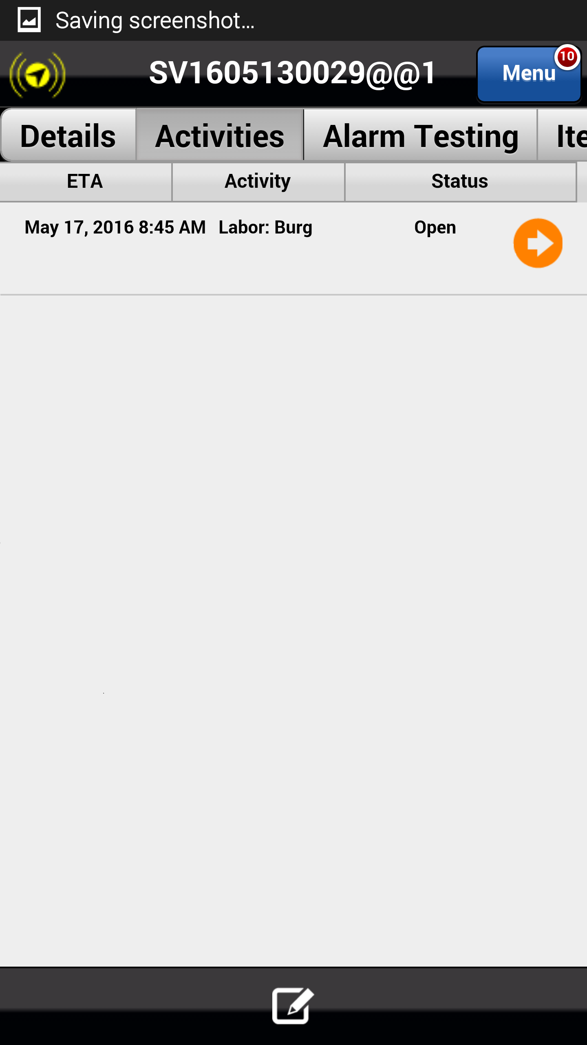
Updating Duration
To edit activity details you must select the orange arrow. This will take you to the Edit Activity screen.
Action: Click on the orange arrow within the activity you want to edit
Previous
Home
End
Icon Legend

Slide 5
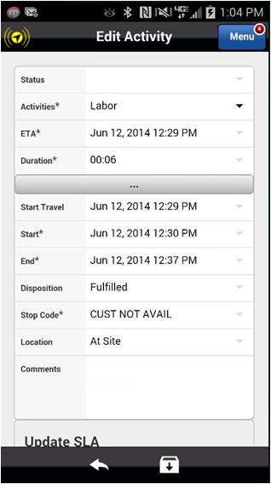
Activity Corrections
To update the duration of an activity select the Duration dropdown arrow.
Action: Click drop down arrow in the Duration field
Previous
Home
End
Icon Legend

Slide 6
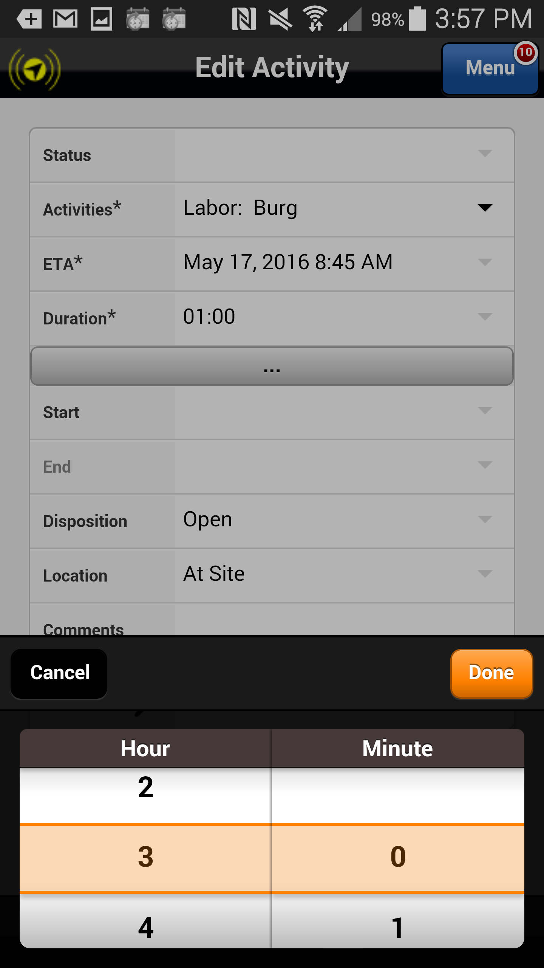
Activity Corrections
Adjust your time as needed via the calendar dialers and select done.
Action: Click on the done button
Previous
Home
End
Icon Legend

Slide 7
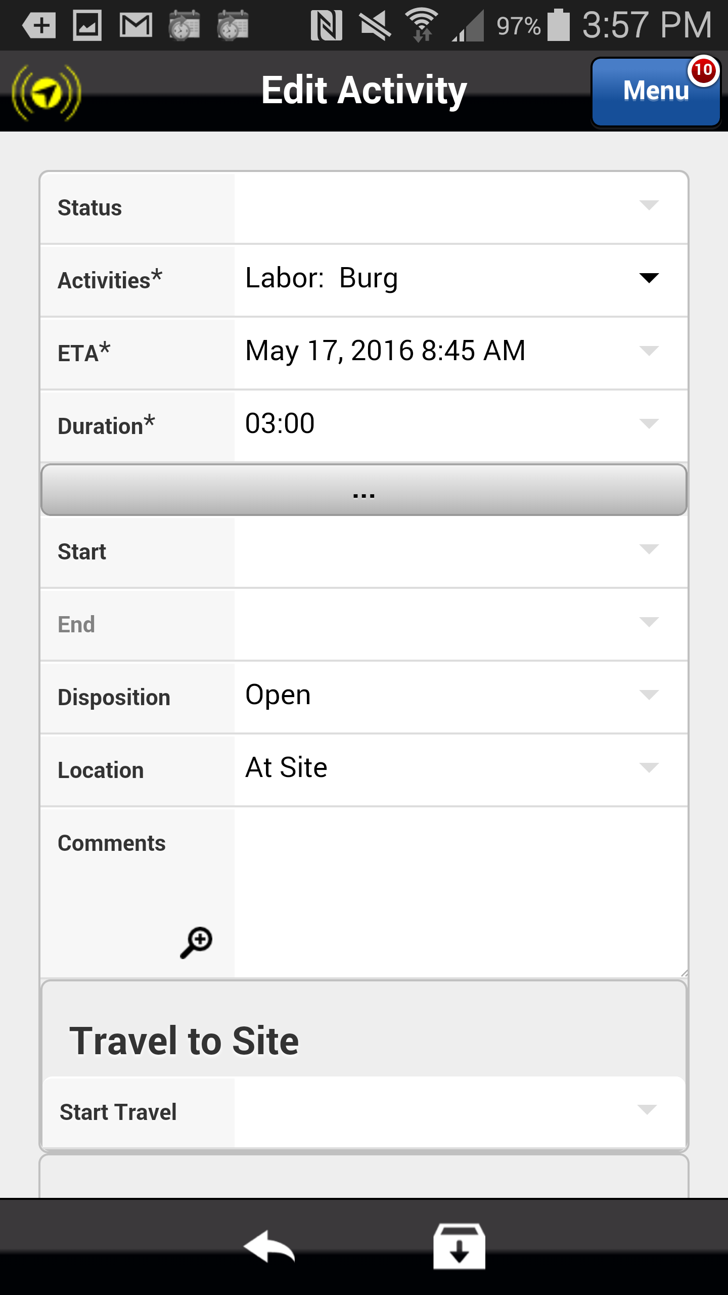
Activity Corrections
You must save your changes when complete.
Action: Click on the Save icon in the footer
Previous
Home
End
Icon Legend

Slide 8
Activity Corrections
It is imperative that you enter a note in the Comments section describing why you expect the repairs to take less time or more time than anticipated.
Action: Click in the Comments field
Previous
Home
End
Icon Legend

Slide 9
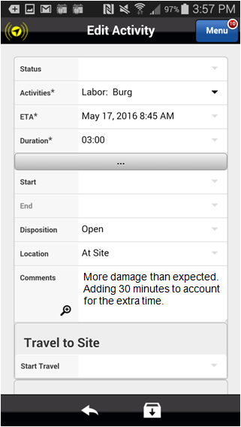
Activity Corrections
You must save your changes when complete.
Action: Click on the Save icon in the footer
Previous
Home
End
Icon Legend

Slide 10
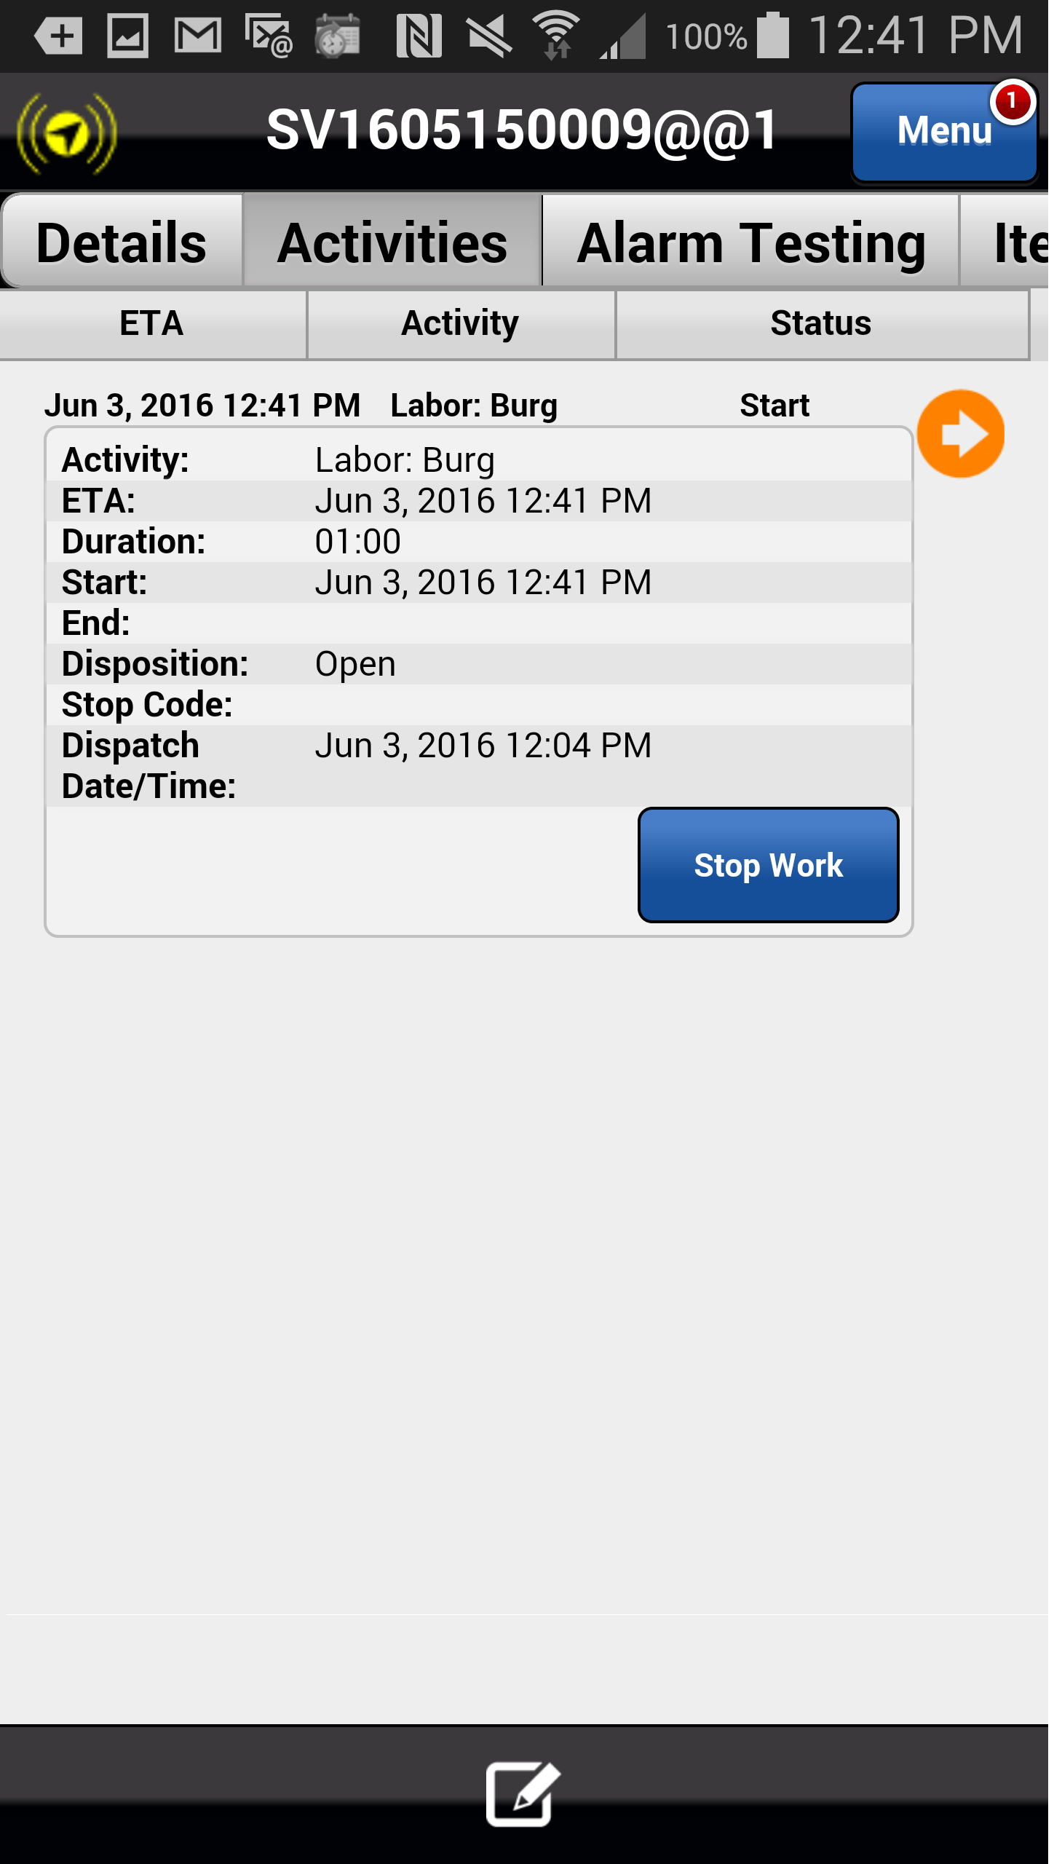
Updating ETA
Similarly, when using the stop codes Lunch or Offsite – Returning Today, the new labor activity should be updated to reflect the expected ETA. This then adjusts the activity on the service technician’s schedule board and allows DSE and/or Dispatch to then schedule additional service orders appropriately.
Select Stop Work and choose the appropriate stop code (Lunch or Offsite – Returning Today). The new labor activity will appear.
Click on the Next button below
Previous
Home
End
Next
Icon Legend

Slide 11
Updating ETA
To update the ETA, you must select the orange arrow. This will take you to the Edit Activity screen.
Action: Click on the orange arrow within the activity you want to edit
Previous
Home
End
Icon Legend

Slide 12
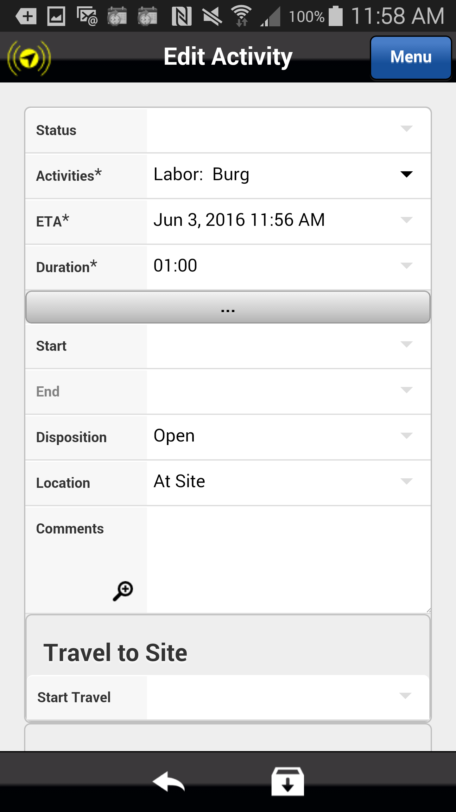
Updating ETA
To update the ETA of an activity select the ETA dropdown arrow.
Action: Click drop down arrow in the ETA field
Previous
Home
End
Icon Legend

Slide 13
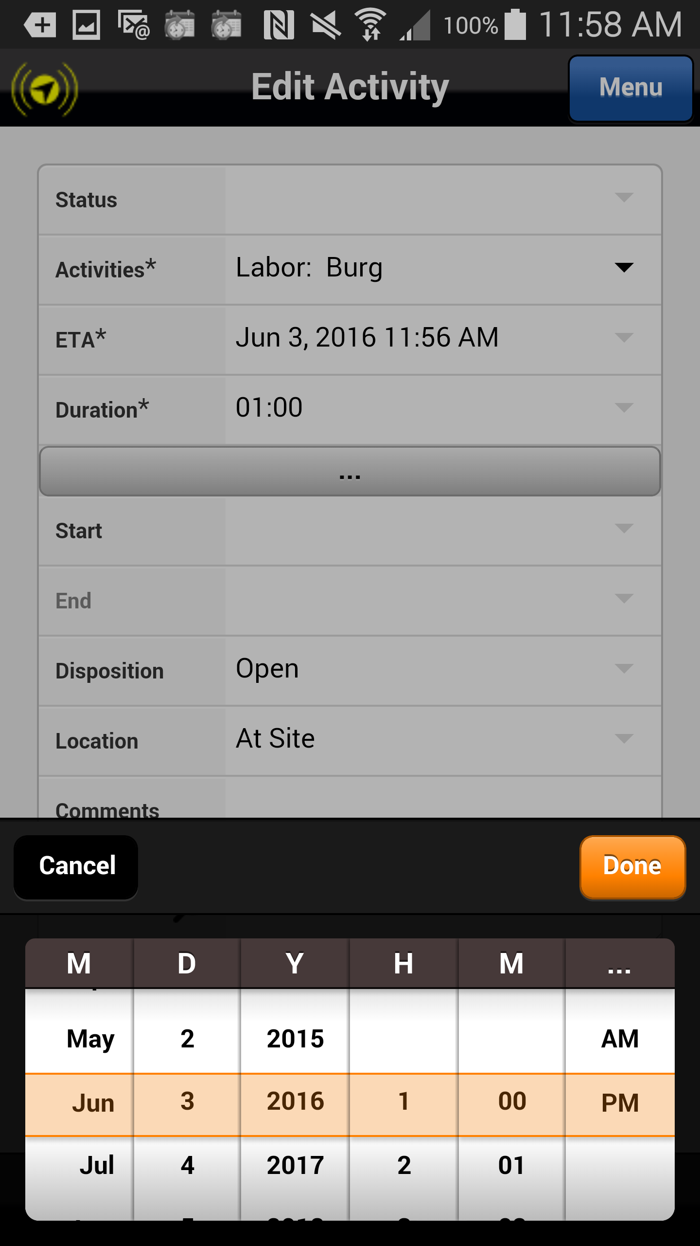
Updating ETA
Adjust your time as needed via the calendar dialers and select done.
Action: Click on the done button
Previous
Home
End
Icon Legend

Slide 14
Updating ETA
You must save your changes when complete.
Note: the Astea Training - Correcting an Activity training module has been updated with these steps.
Action: Click on the Save icon in the footer
Previous
Home
End
Icon Legend

Slide 15
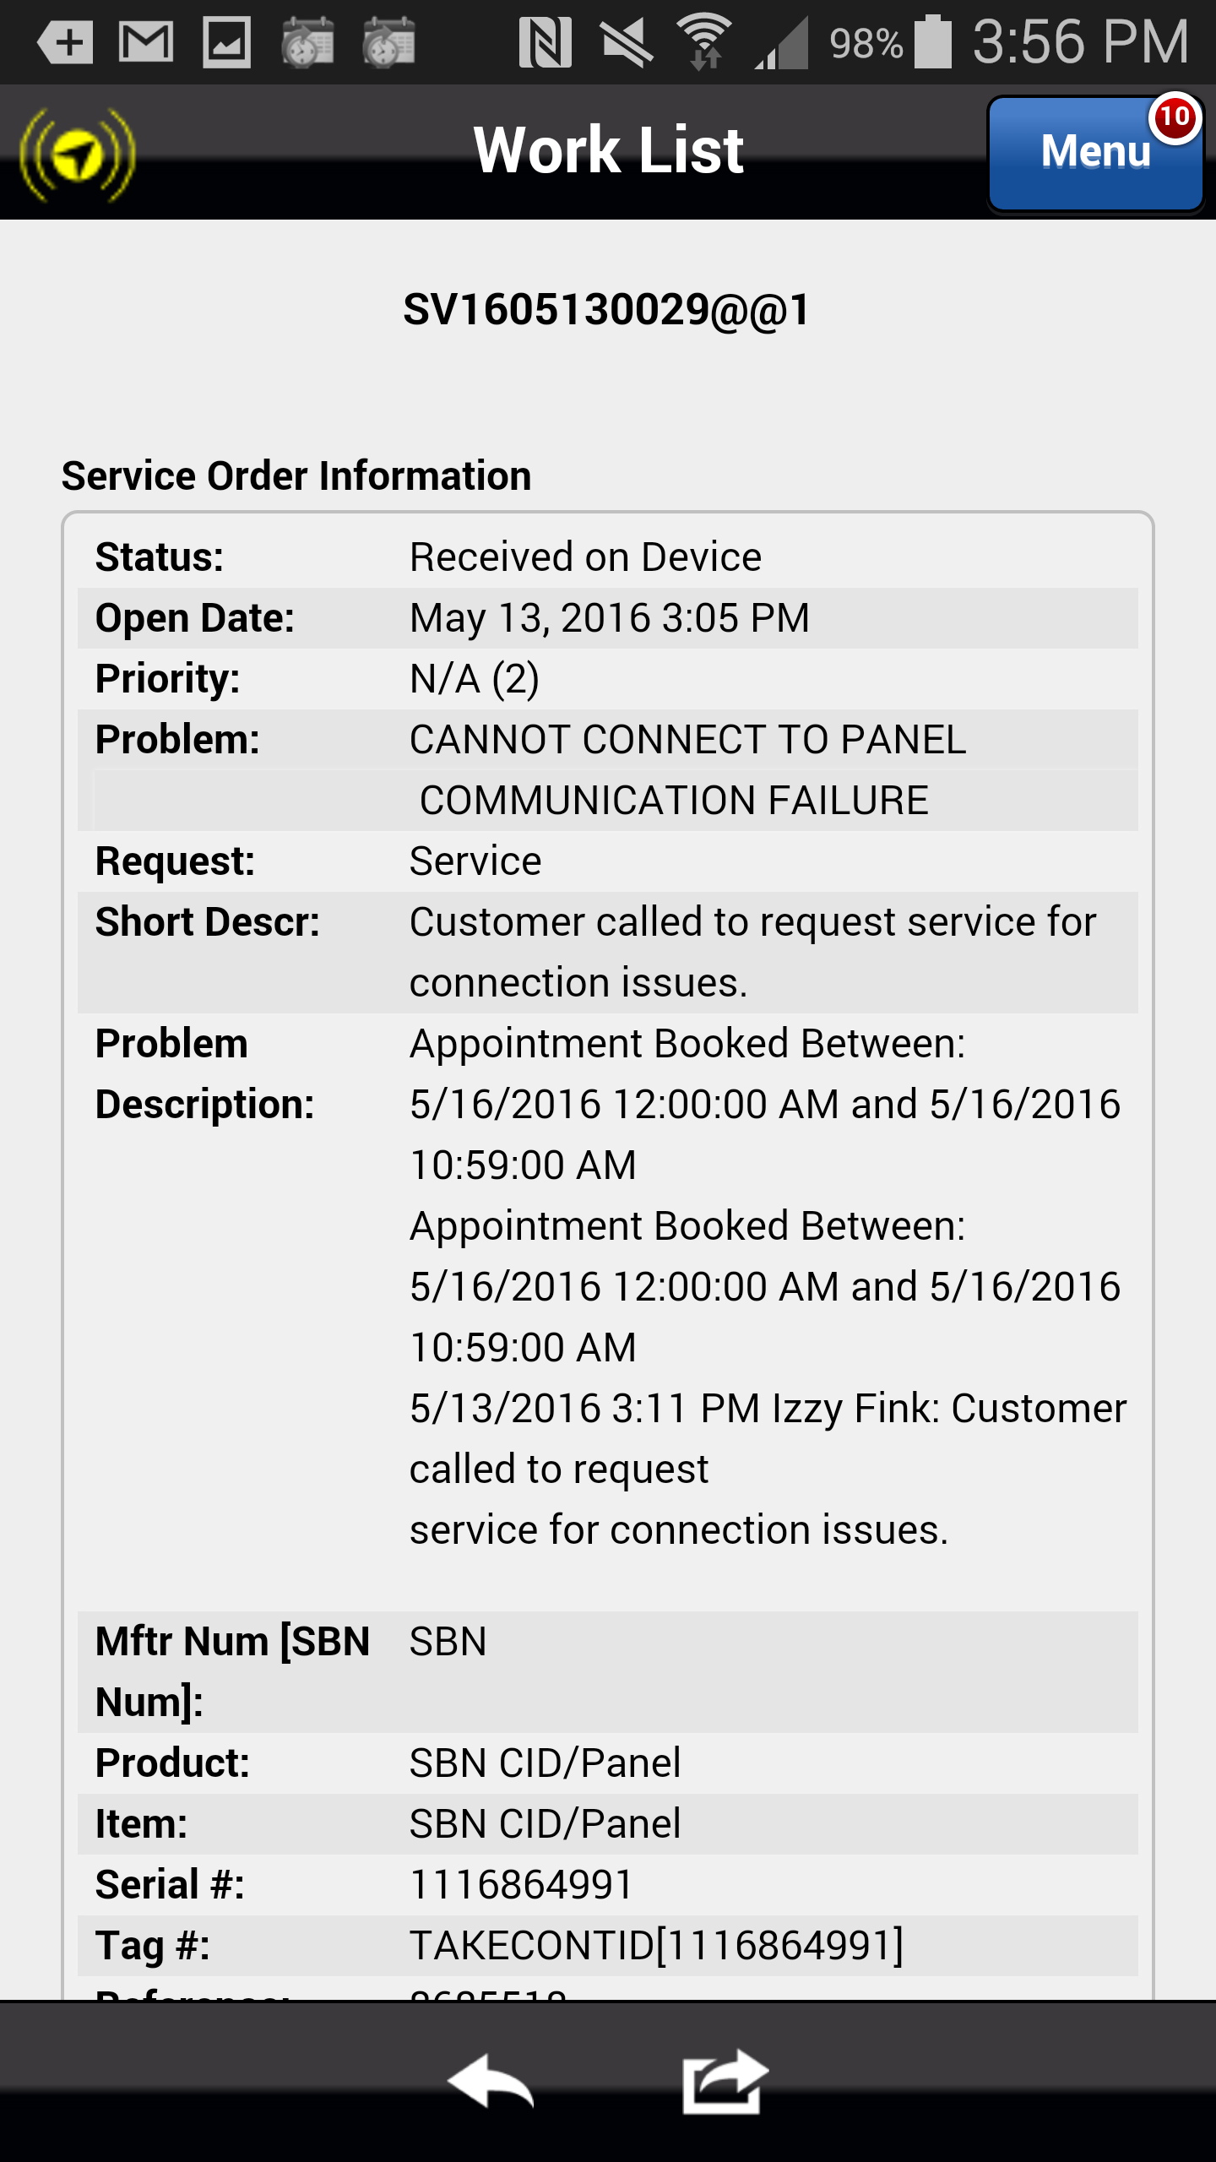
Request Preview
The Preview screen displays additional information about the request including the detailed problem description, monitoring status and the bulletin. Review all of the detailed request information.
Note: the Astea Training Module 1 Introduction to Training module has been updated with these steps.
Click on the Next button below
Previous
Home
End
Next
Icon Legend

Slide 16
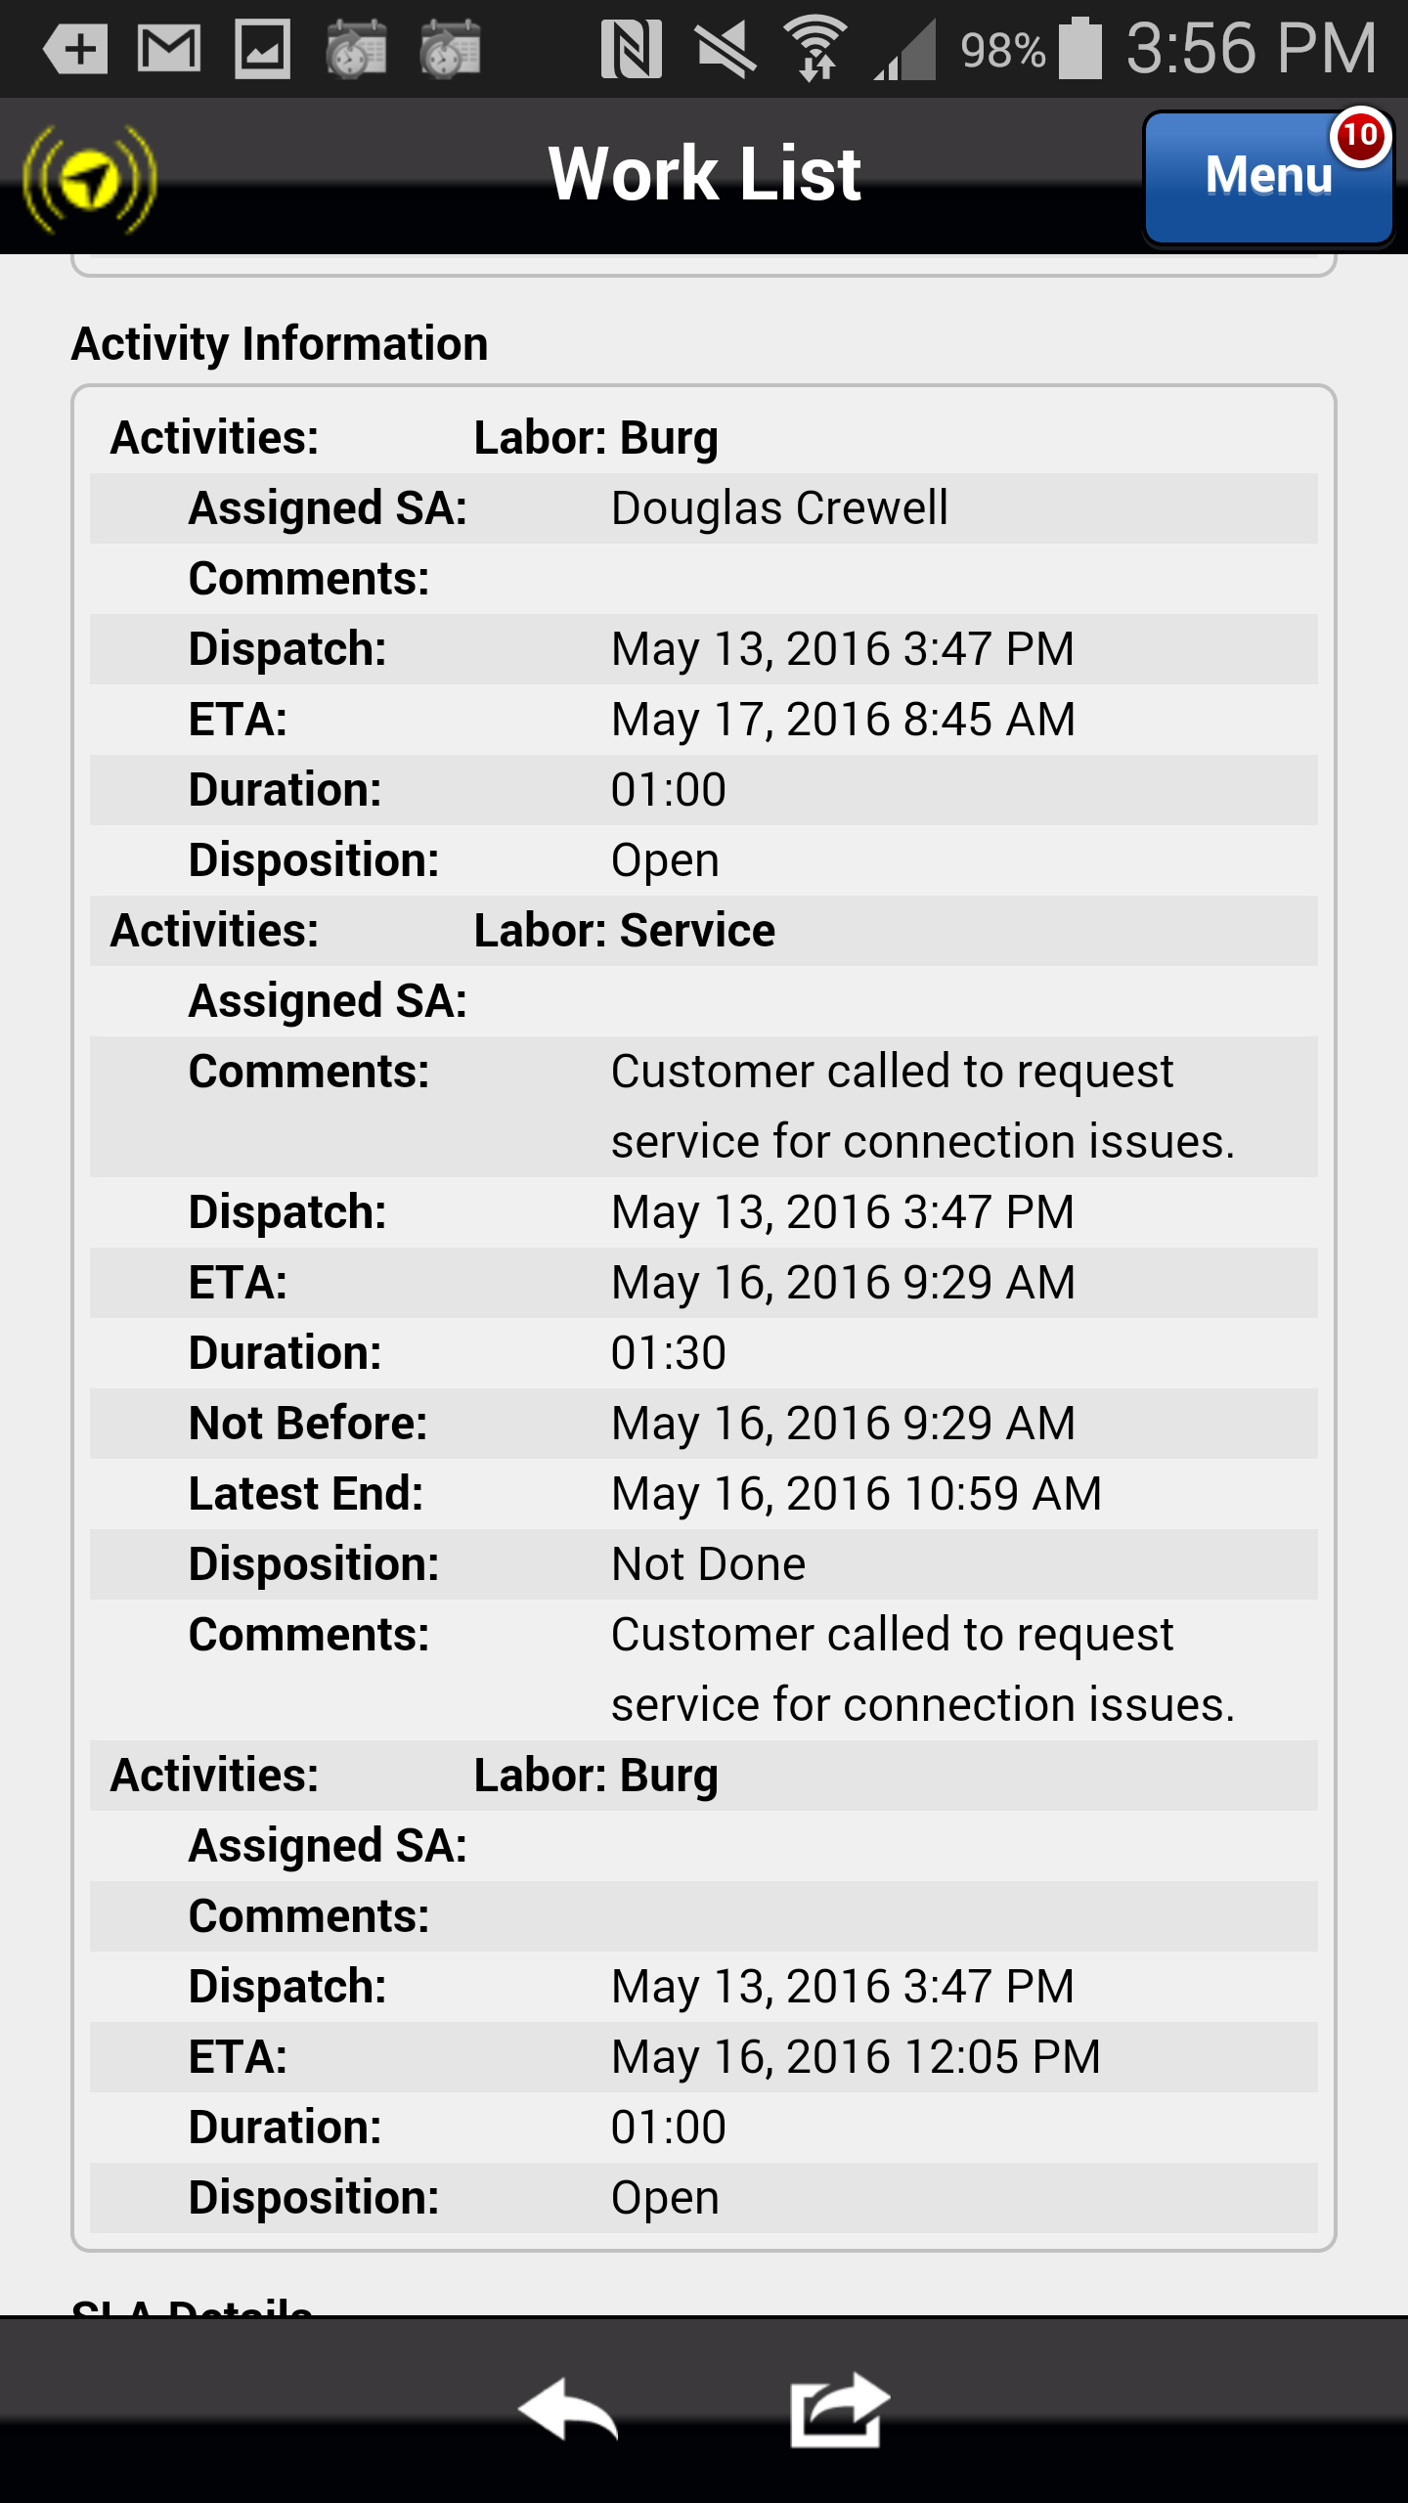
Appointment Bookings
Appointments are assigned or booked for a customer based on their access hours and availability. Appointment times are generally a block of time indicating that a service technician is expected Not Before a specific time but no later (Latest End) than a specific time.
Appointments are available for the service technician to view from the Preview tab.
If you plan to work this request next, you can open the request by clicking the Forward button in the footer.
If you decide not to work this request after reviewing the information, you may click the Back icon in the footer and return to the Work List.
Click on the Forward icon
Previous
Home
End
Icon Legend
16

Slide 17
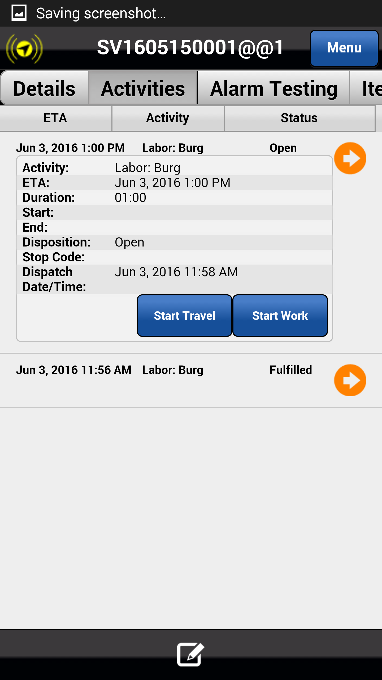
Activities Tab – Multiple Labor Activities
Astea allows service orders to have multiple labor activities in situations where there are multiple problems that need to be repaired. Now each of those problems will have a corresponding system type that identifies the default amount of time it should take to repair the problem.
If you are assigned two or more labor activities, they must all be completed on the mobile device.
Note: the Astea Training Module 1 Introduction to Training module has been updated with these steps.
Click on the Next button below
Previous
Home
End
Next
Icon Legend

Slide 18
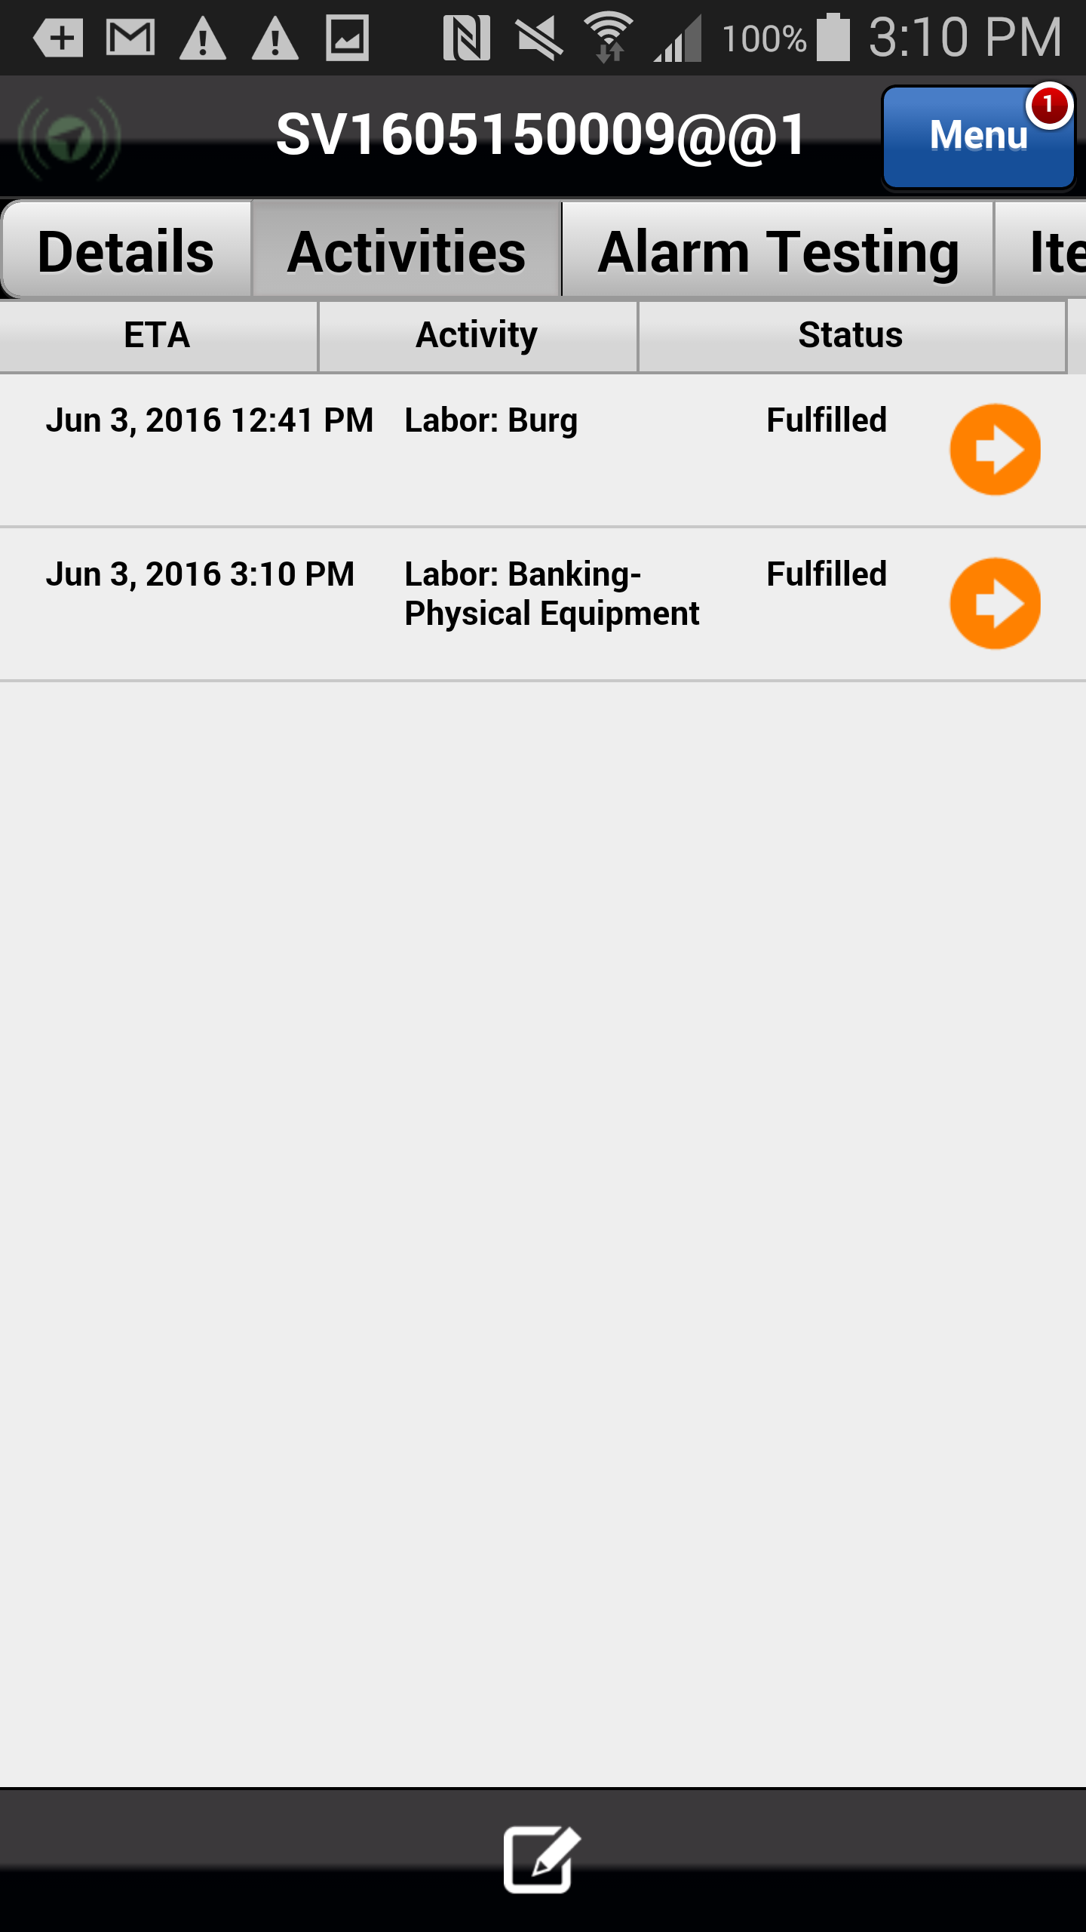
Activities Tab – Multiple Labor Activities
When you are assigned two or more labor activities complete them in the following manner:
Time punch (Start Travel, Start Work, Stop Work) one of the labor activities, select the applicable stop code, and complete it as required.
For any additional labor activities, time punch (Start Work and Stop Work) them in quick succession, selected the applicable stop code, and complete them as required.
Click on the Activities tab
Previous
Home
End
Icon Legend

Slide 19
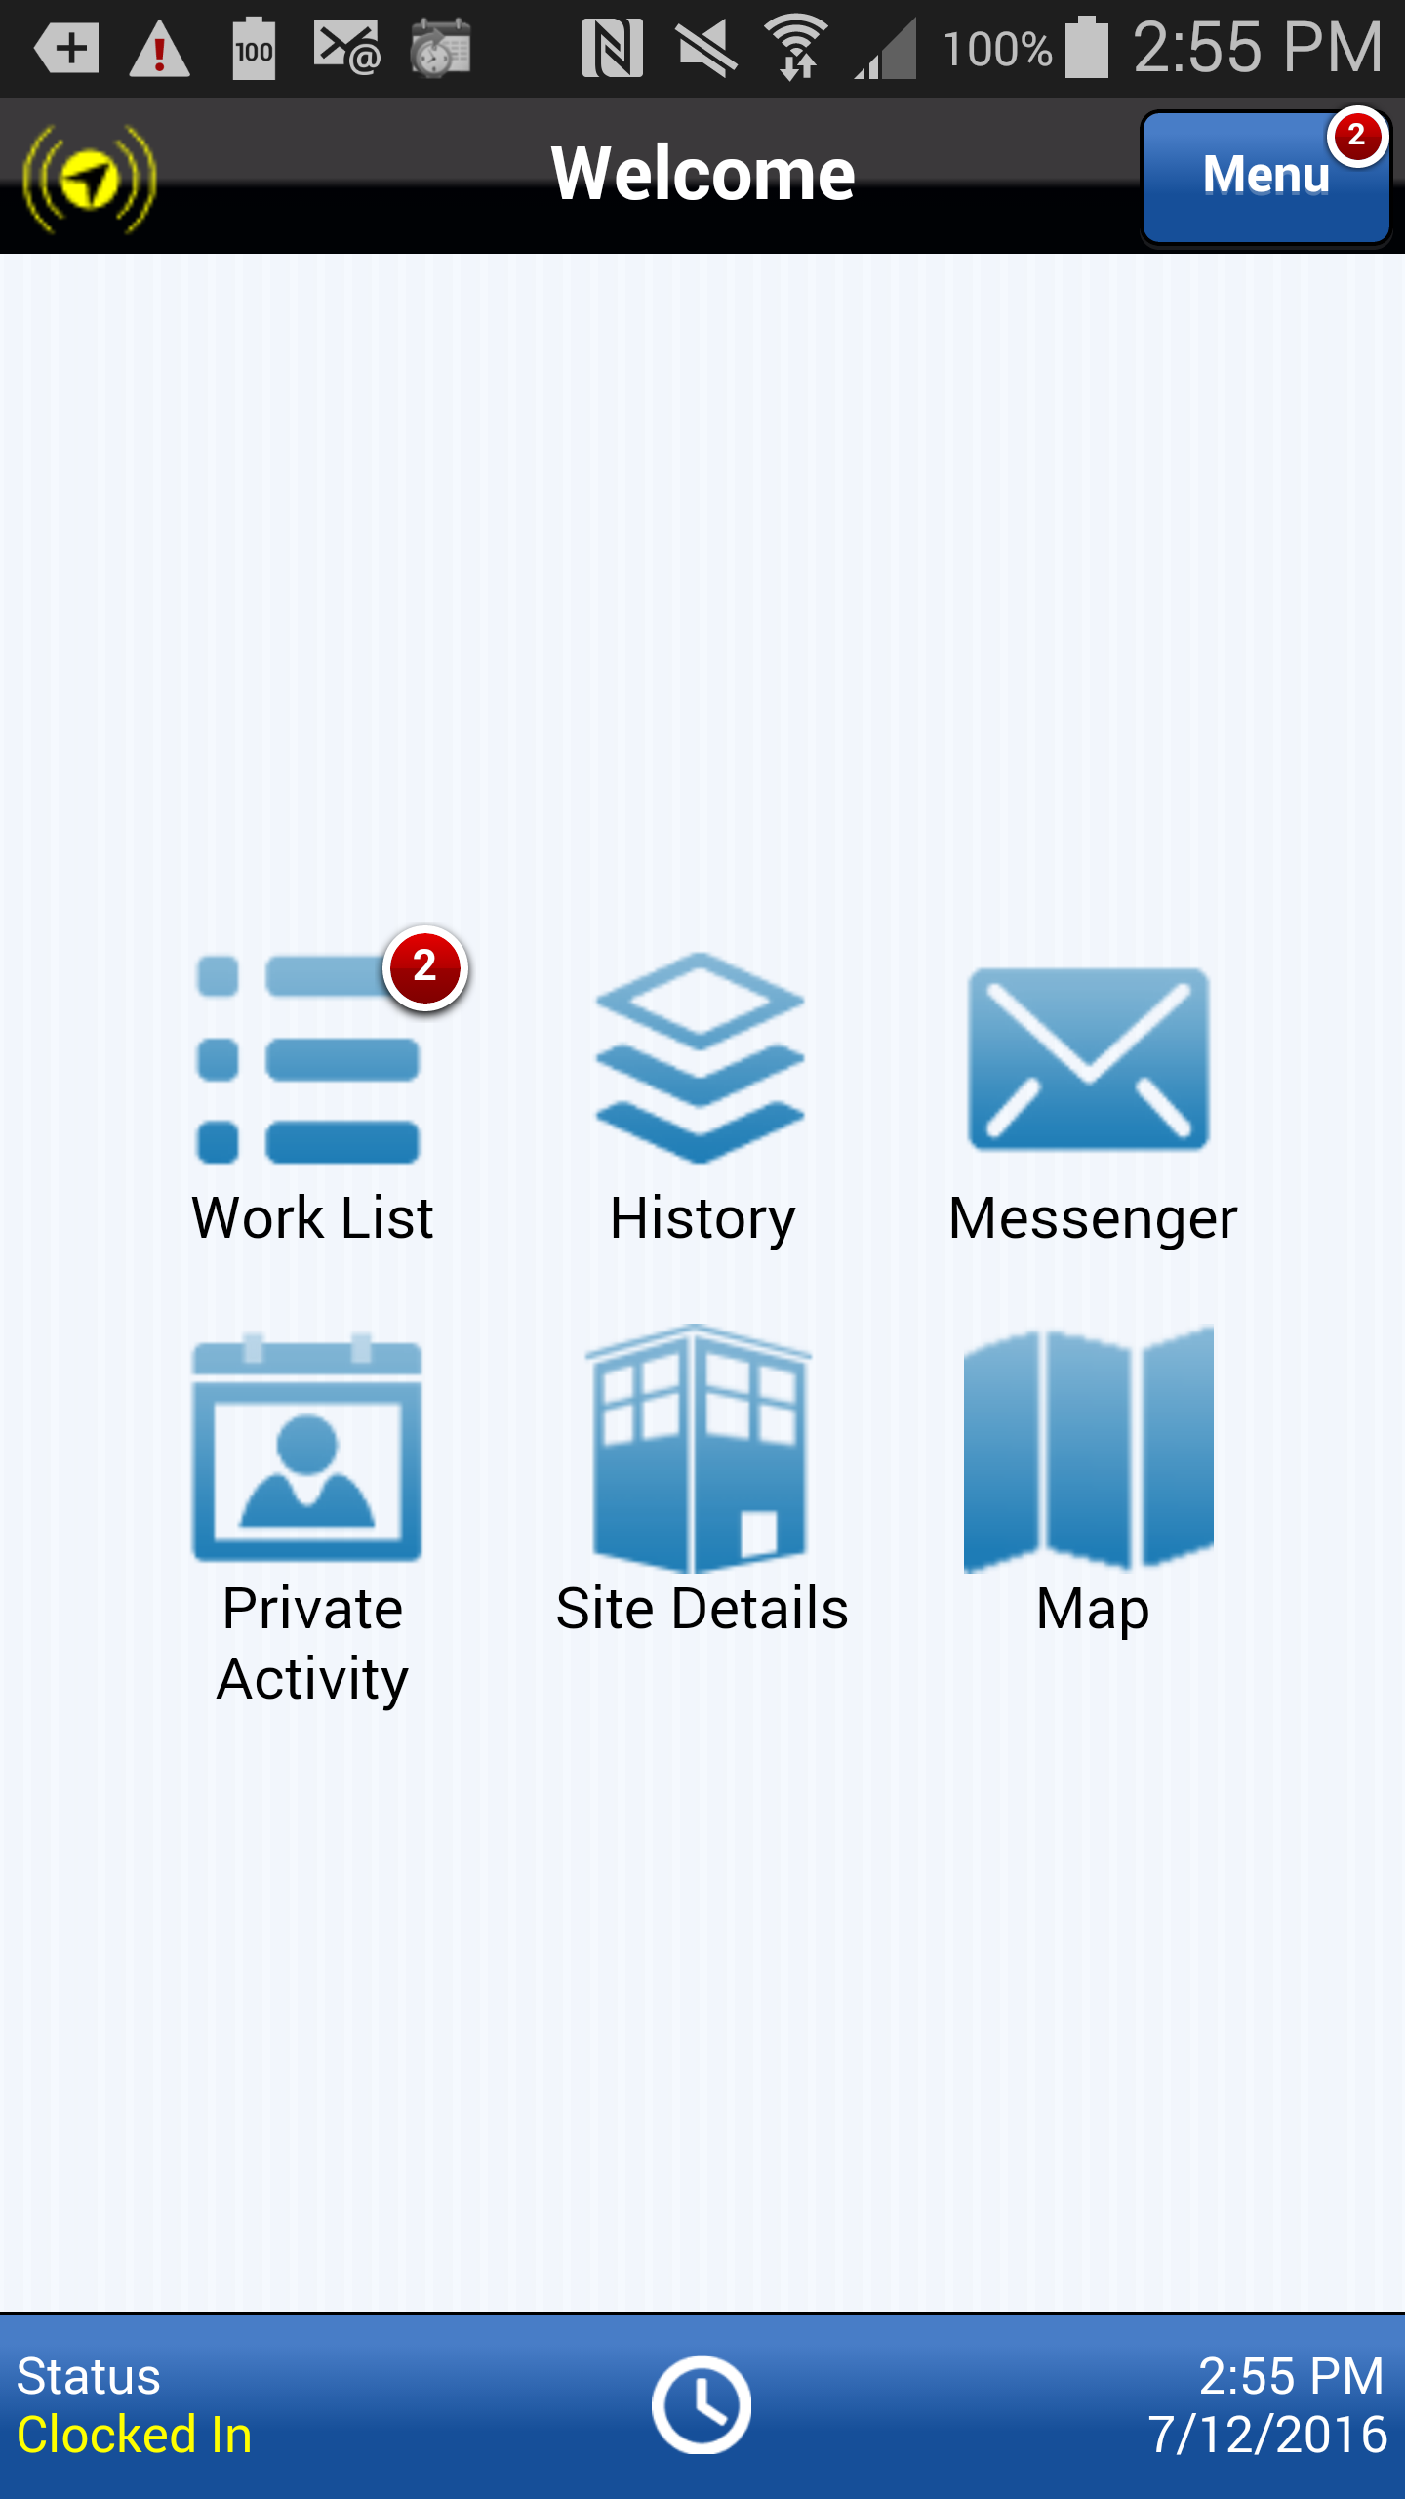
Creating a Lunch Activity
Service technicians are now required to create and complete a Private Activity on their mobile devices for their daily lunch breaks.
A Lunch activity can be added at the beginning of the day anticipating a lunch break or on the fly when you are ready to take your lunch break.
To add a Private Activity for Lunch, select the Private Activity button from the Home page.
Note: this information can be found in the Astea Training Creating and Completing Lunch Breaks presentation.
Action: Click on the Private Activity button
Previous
Home
End
Icon Legend

Slide 20
Creating a Lunch Activity
Add a Private Activity for Lunch by selecting the Add button.
Action: Click on the Add Private Activity Icon in the footer
Previous
Home
End
Icon Legend

Slide 21
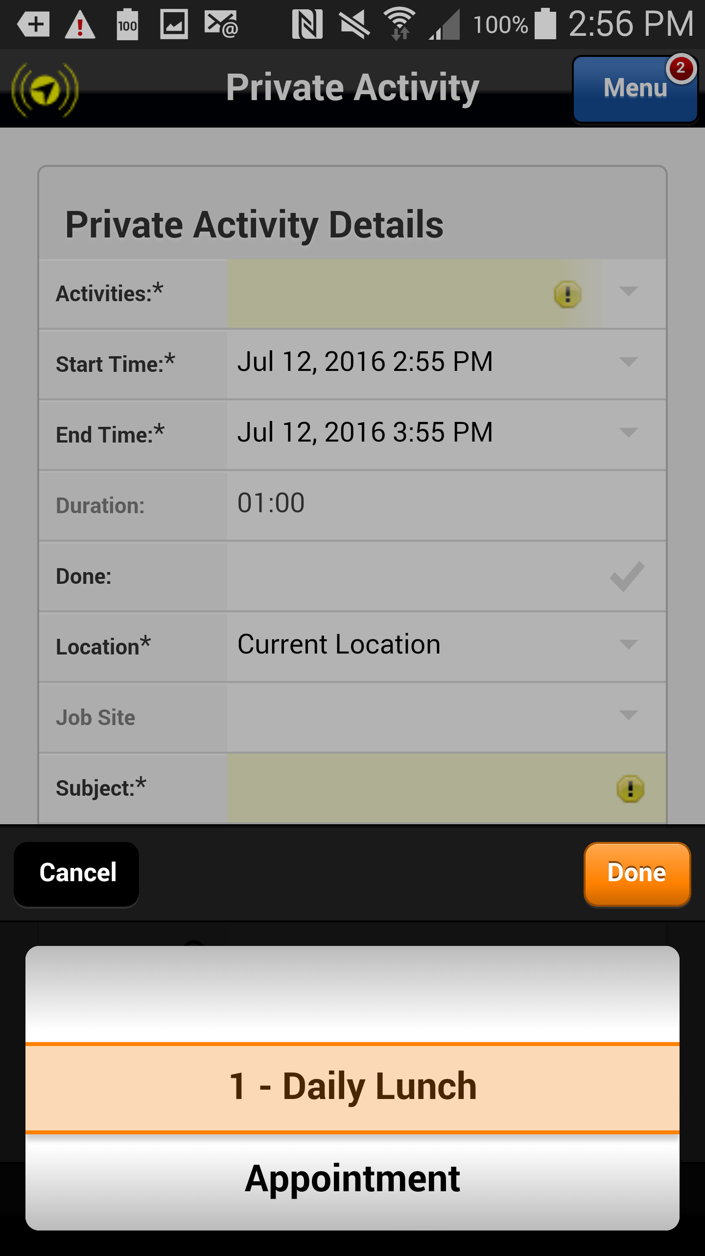
Creating a Lunch Activity
Select 1 – Daily Lunch from the list of options and select Done.
Action: Click on the Done button
Previous
Home
End
Icon Legend

Slide 22
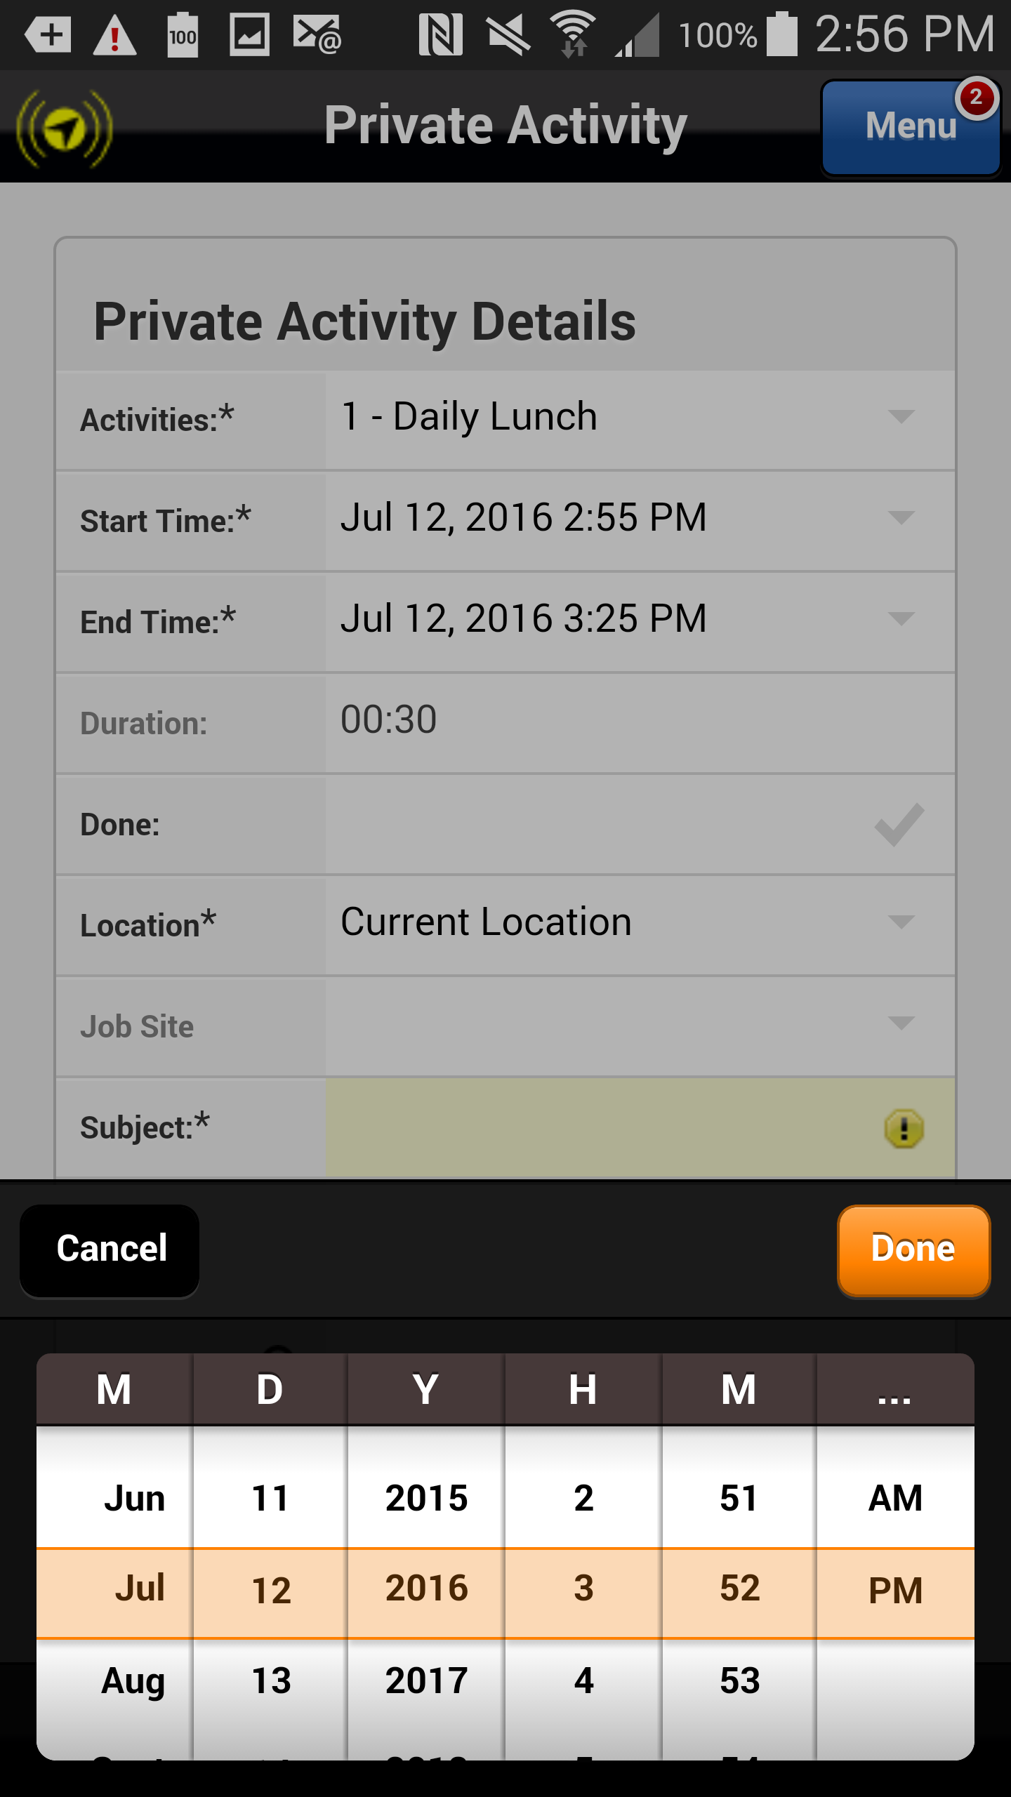
Creating a Lunch Activity
If necessary, adjust the Start and End times as necessary using the calendar dialers. Select Done.
Note: you can adjust the start and end times anticipating your normal lunch break or you can adjust the start and stop time when you actually start and stop your lunch break.
Action: Click on the done button
Previous
Home
End
Icon Legend

Slide 23
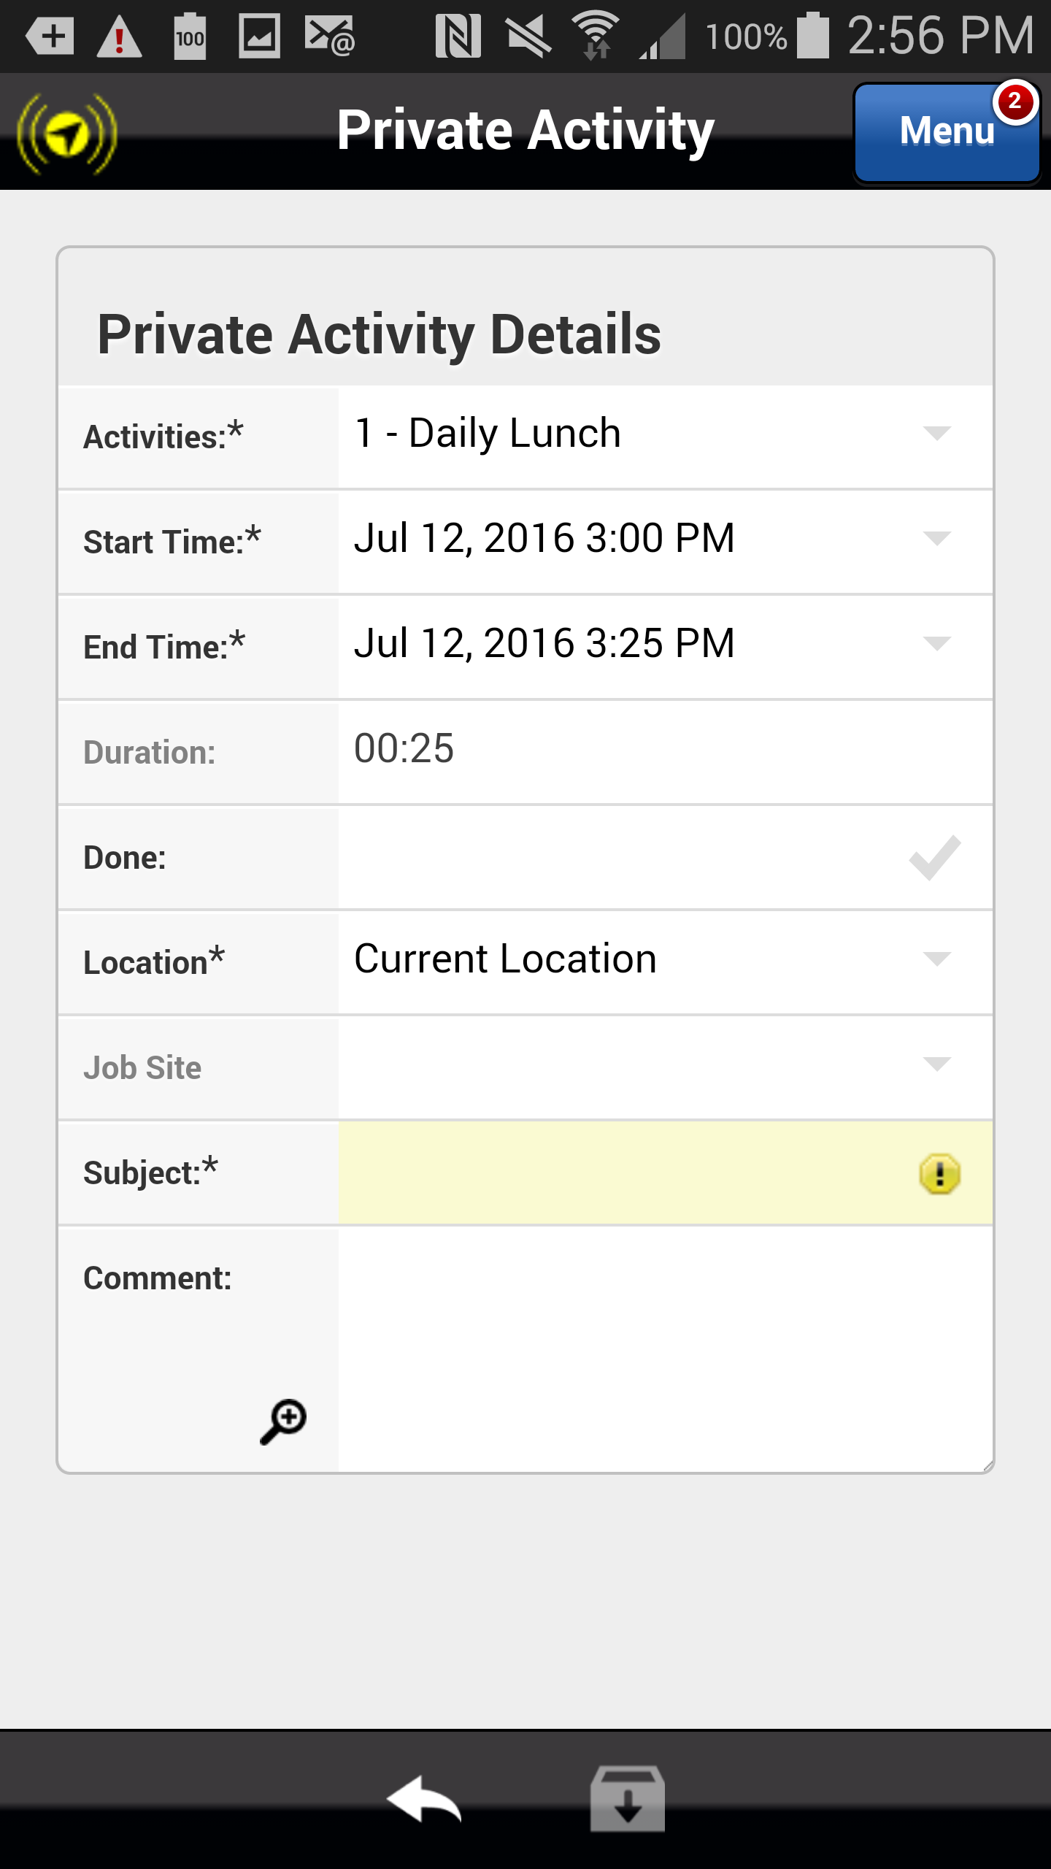
Creating a Lunch Activity
Click in the Subject field to enable to keyboard and enter a subject such as Lunch.
Note: Subject is a required field.
Action: Click in the Subject field
Previous
Home
End
Icon Legend

Slide 24
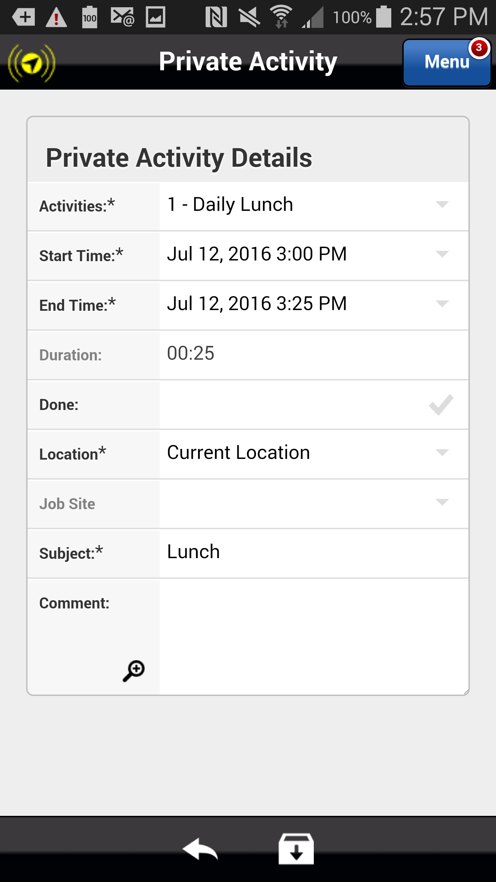
Creating a Lunch Activity
Select Save to save the Private Activity.
Action: Click on the Save Icon in the footer
Previous
Home
End
Icon Legend

Slide 25
Creating a Lunch Activity
The Private Activity for Lunch is added to your mobile device and is ready to be completed.
Select the orange arrow to complete the Lunch activity.
Action: Click on the orange arrow within the activity you want to edit
Previous
Home
End
Icon Legend

Slide 26
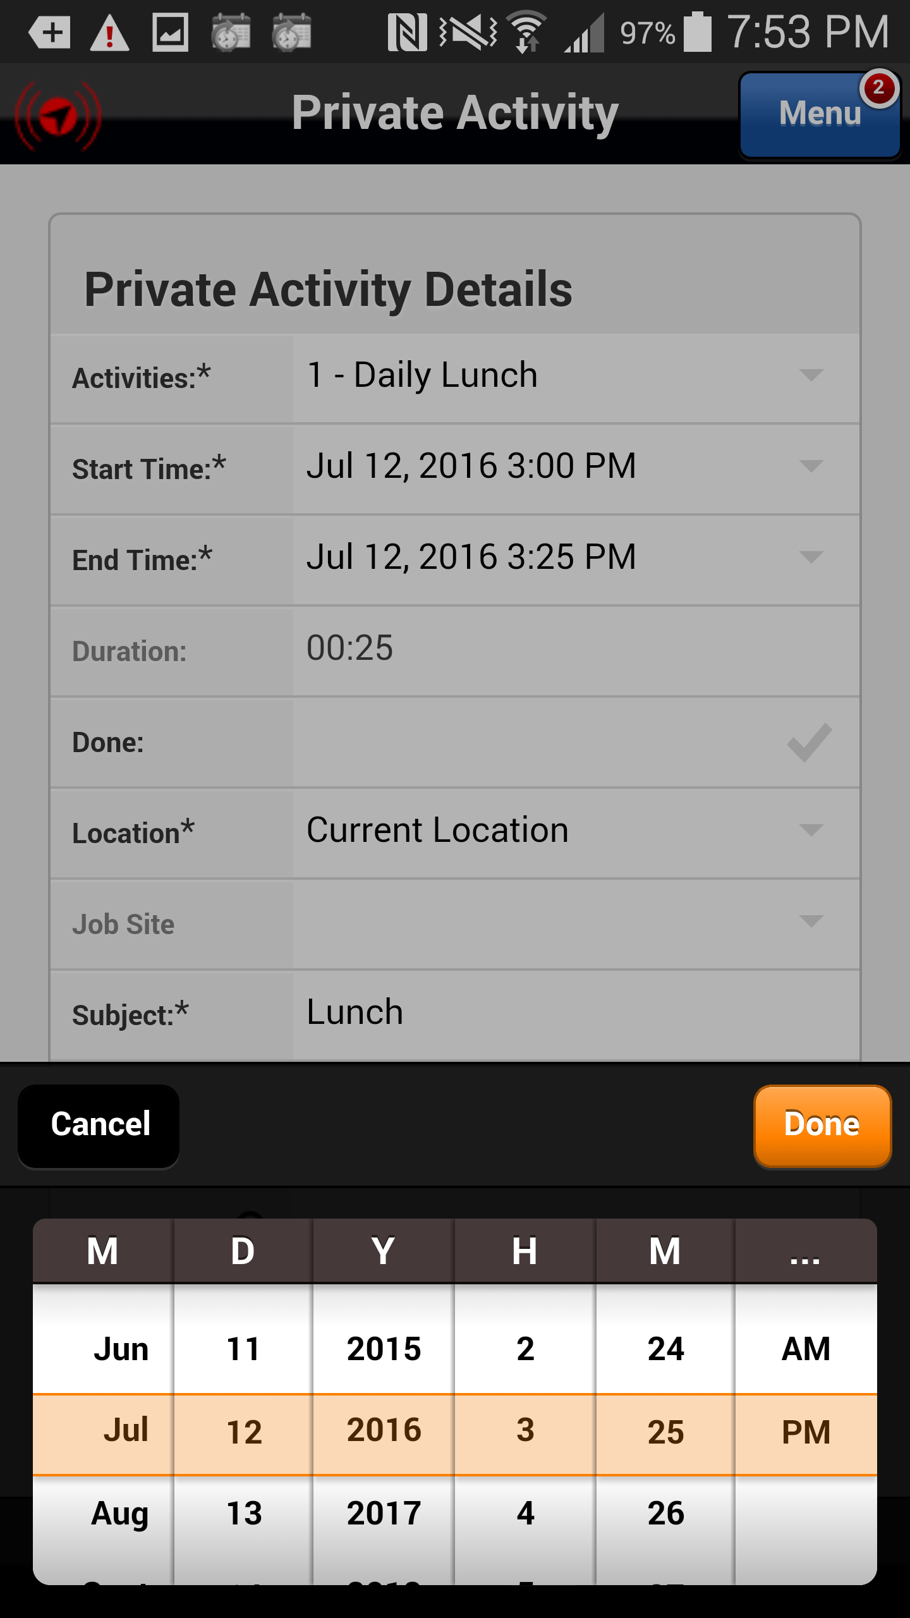
Completing Lunch Activity
If necessary, adjust the Start and End times as necessary using the calendar dialers. Select Done.
Note: when creating the Lunch activity you can adjust the start and end times anticipating your normal lunch break or you can adjust the start and stop time when you actually start and stop your lunch break.
Action: Click on the done button
Previous
Home
End
Icon Legend

Slide 27
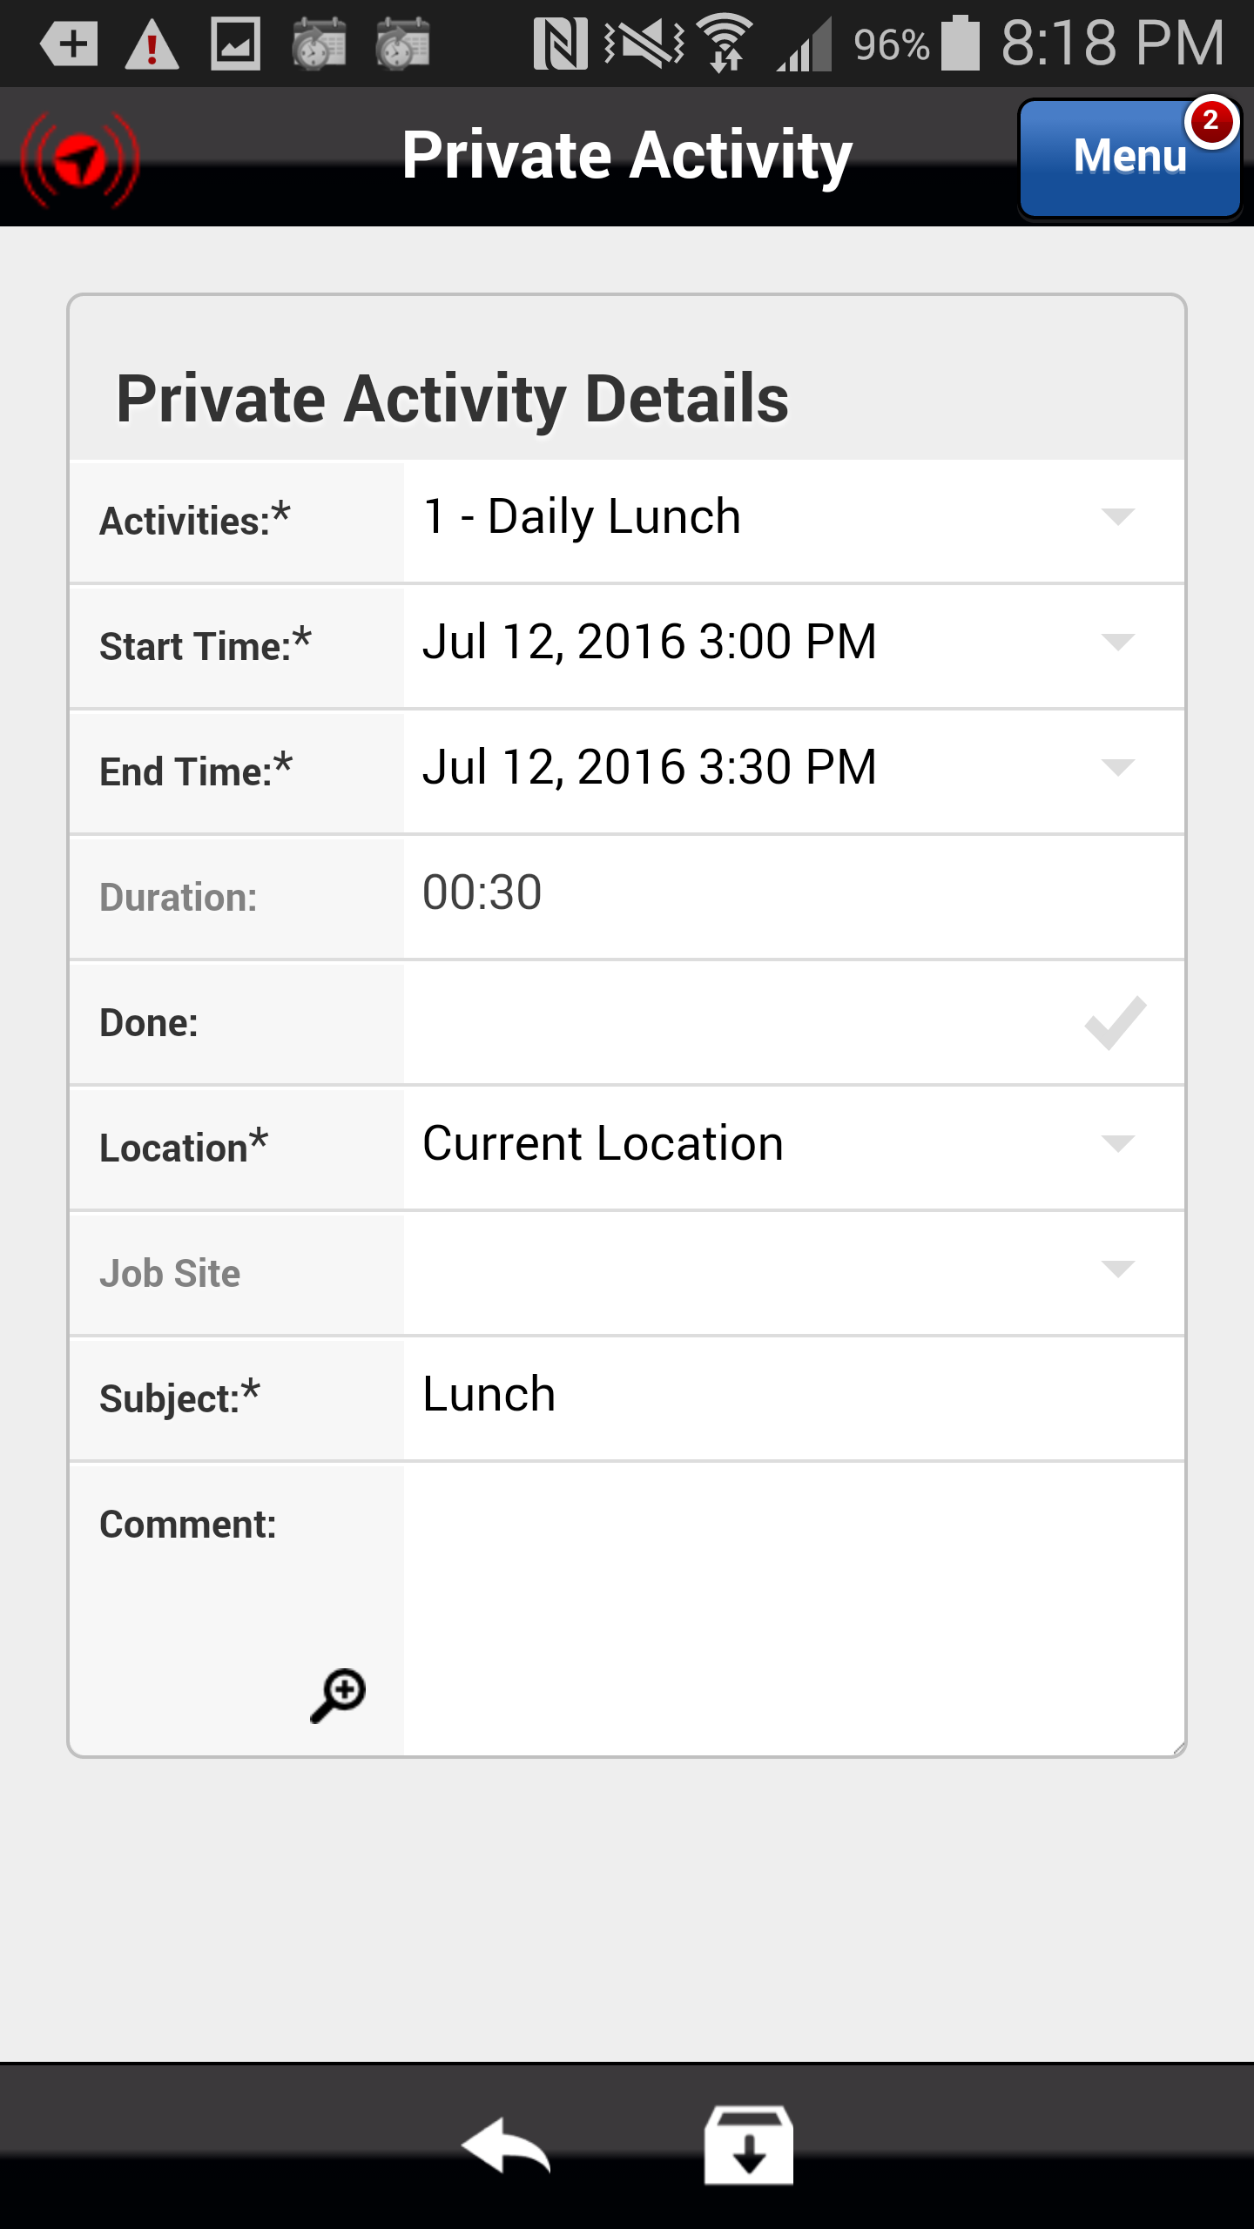
Completing Lunch Activity
Select the Done checkmark to complete the Lunch activity.
Action: Click on the Done checkmark
Previous
Home
End
Icon Legend

Slide 28
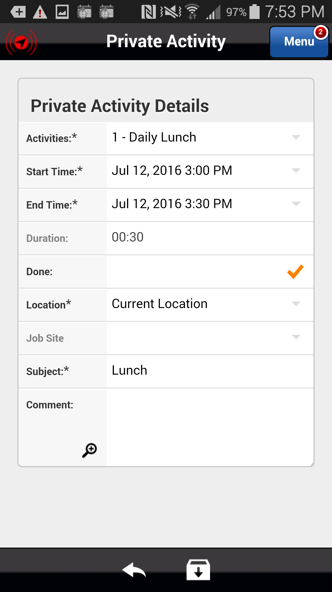
Completing Lunch Activity
Select Save icon to the completed Lunch activity details.
Action: Click on the Save icon in the footer
Previous
Home
End
Icon Legend

Slide 29
Deleting a Lunch Activity Created in Error
From time to time it will be necessary to delete a Lunch activity created in error.
To delete a Lunch activity the activity by clicking on the date or name.
Action: Click on the activity Date or Name
Previous
Home
End
Icon Legend

Slide 30
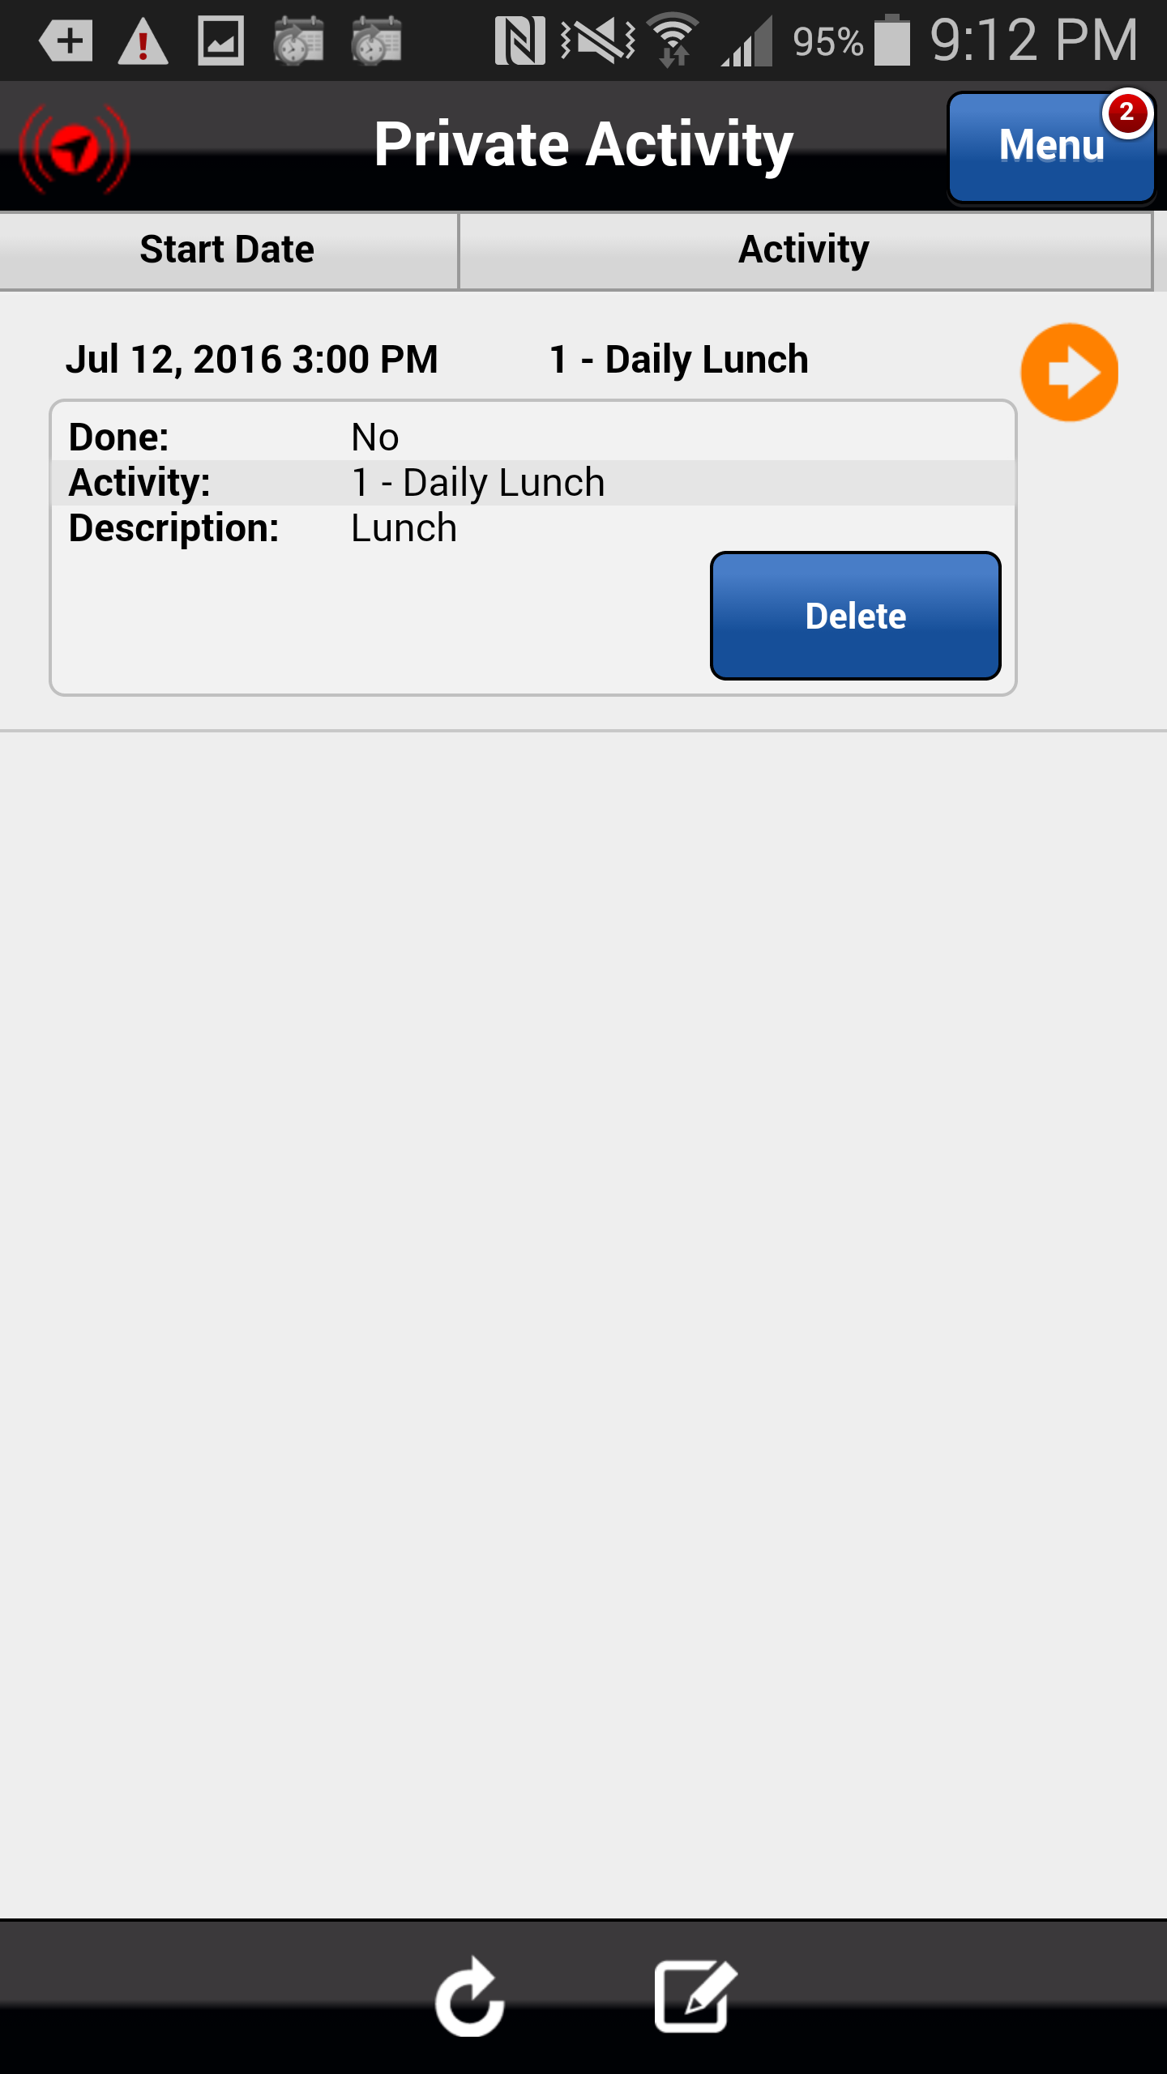
Deleting a Lunch Activity Created in Error
Select the Delete button to delete the Lunch activity.
Action: Click on the Delete button
Previous
Home
End
Icon Legend

Slide 31
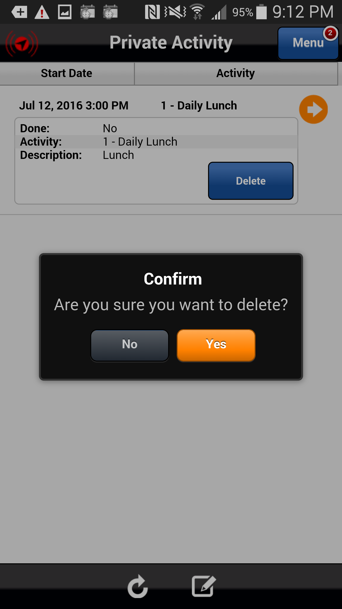
Deleting a Lunch Activity Created in Error
A confirmation message appears ensuring that you want to delete the Lunch Activity. Select Yes.
Action: Click on the Yes button
Previous
Home
End
Icon Legend

Slide 32
Deleting a Lunch Activity Created in Error
The Lunch activity is removed from your Private Activity list.
Action: Click on the Next button
Previous
Home
End
Next
Icon Legend

Slide 33
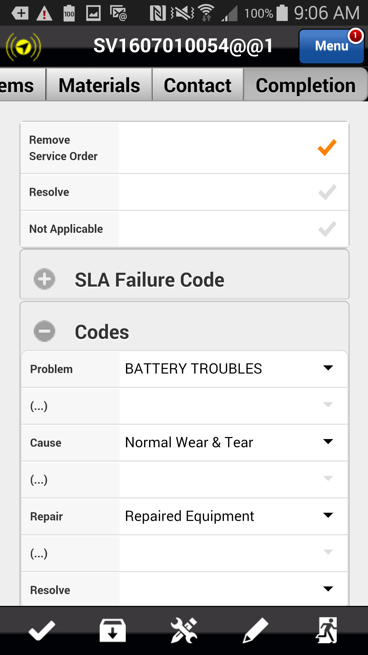
Lunch – Service Order is Complete
If applicable, select the Resolve checkmark (will not appear if you chose an incomplete stop code) and then click the Running Man icon to complete the service order and remove it from you device.
Action: Select the Running Man icon
Previous
Home
End
Icon Legend
33

Slide 34
Lunch – Service Order is Complete
Select the Menu button to return to the list of menu options.
Action: Select the Menu button
Previous
Home
End
Icon Legend
34

Slide 35
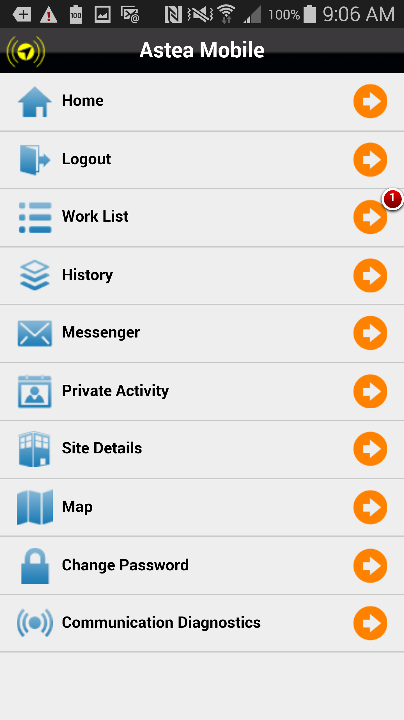
Lunch – Service Order is Complete
To add a Lunch activity, select the Private Activity menu option.
Action: Click on Private Activity
Previous
Home
End
Icon Legend

Slide 36
Lunch – Service Order is Complete
Add a lunch activity with the appropriate Start time. Complete the activity once your lunch break has ended. Work the next service order in your list by hitting the Start Travel button to indicate that you have started traveling to the site.
Note: Lunch activities show on the schedule board in the Dispatch Console so please make sure they are accurate and that you complete any Lunch activity that you add.
Action: Click on the Next button
Previous
Home
End
Next
Icon Legend

Slide 37
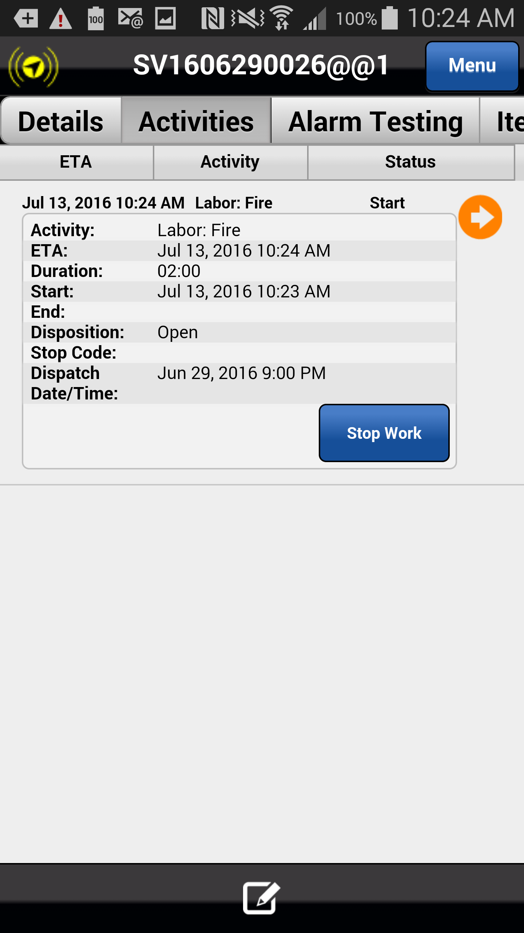
Lunch – Work Not Completed
Another scenario exists in which you are at a customer site and before you have completed the necessary repairs, it is time for your lunch break.
Open the service order and select the Activities tab. Select Stop Work.
Action: Click on the Stop Work button
Previous
Home
End
Icon Legend

Slide 38
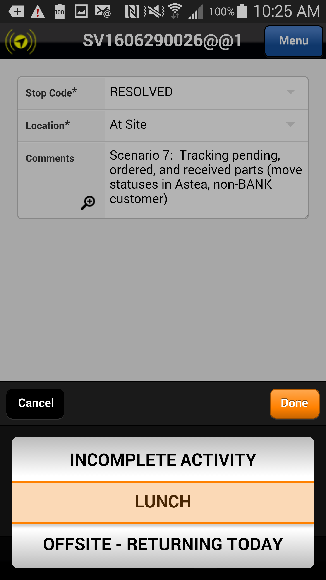
Lunch – Work Not Completed
IMPORTANT: Select the stop code LUNCH and select Done.
Action: Click on the Done button
Previous
Home
End
Icon Legend

Slide 39
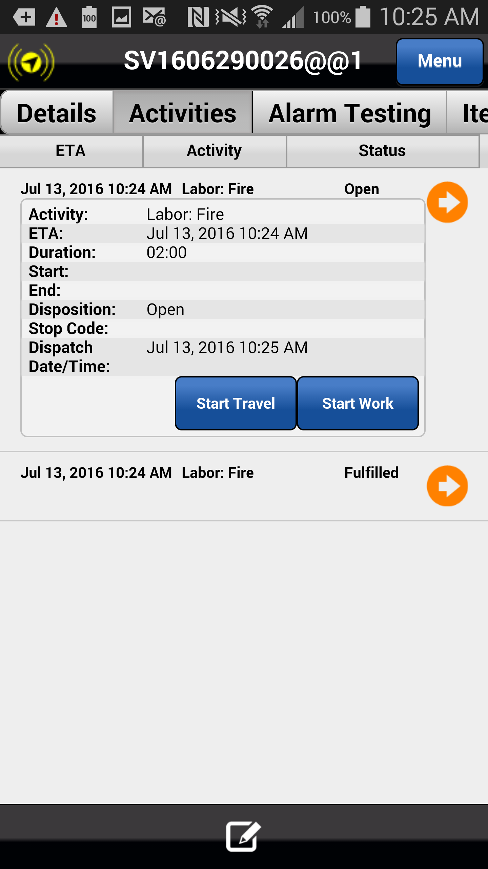
Lunch – Work Not Completed
A second labor activity is created and delivered to your mobile device. Click on the Completion tab and complete the ticket as necessary.
Select the Menu button to access the Private Activity feature. Add a Lunch activity and complete it with the appropriate Start and End times.
When you are ready travel back to the job site, select Start Travel and work the service order to completion.
This concludes this module.
Click on the Next button below
Previous
Home
End
Next
Icon Legend

Slide 40
Previous
Home
End

Slide 41
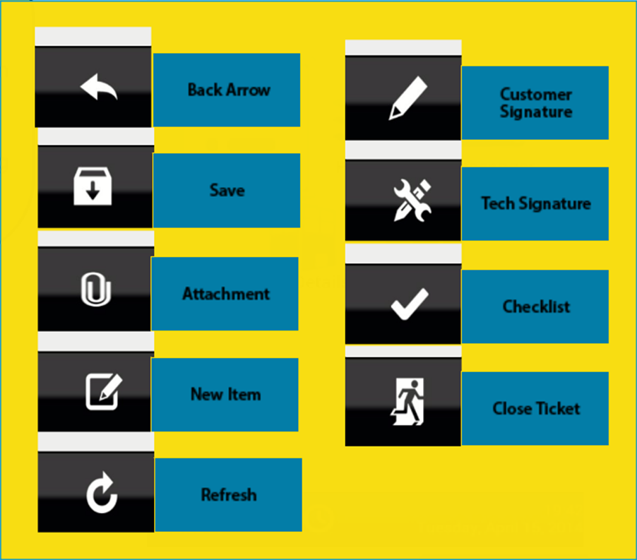
Icon Legend
Common icons used throughout the Astea application
Click on the Return button below to resume presentation
Return

