Slide 1
What’s Changed: Service Dispatch & Ticket Creation Quick Reference Guide

Slide 2
What’s Changed
The implementation of Astea officially transitions the service ticket creation and dispatch processes from SBN to the Astea back office. This implementation also creates the link between the mobile and back end applications. As a result, several changes have been made to the Astea Mobile application providing better functionality for the service technicians (SAs). The following changes to the Astea Mobile application are described in this training presentation:
Viewing Attachments
Viewing AKA, Fire Group Number, Subscriber Type, Monitor Status, and Customer Availability
Viewing Additional Customer Information
Viewing CID and Panel Information
Parts Pending Process Changes
Note: to navigate throughout the training, click in the blue box to proceed to the next slide. If a blue box is not available, use the Next button to advance between slides.
Previous
Home
End
Next
2

Slide 3
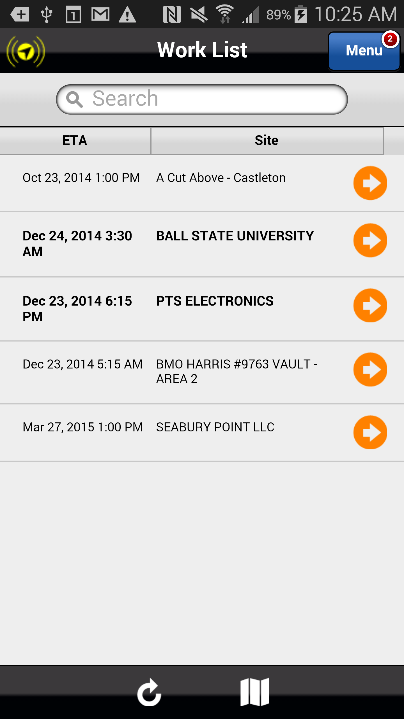
Viewing Attachments
To assist the SA with customer instructions while at the customer site, the Service Bulletin is now available from the Astea Mobile application by accessing Attachments.
To access the Service Bulletin from Attachments, select the orange arrow that corresponds to the following service order from the Work List: Dec 24, 2014 3:30 AM BALL STATE UNIVERSITY.
Previous
Home
End

Slide 4
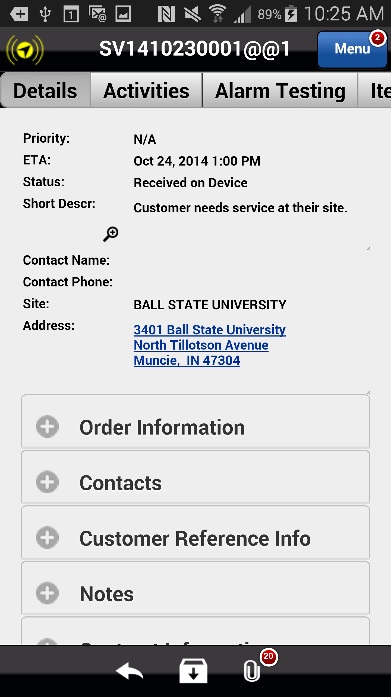
Viewing Attachments
Select the Attachments icon to open and view all available attachments, including the Service Bulletin.
A list of all attachments appears. Attachments that are available from this section include the following:
Service Bulletin
Panel Information
Add’l Customer Information
Contract & R-Codes
Service Instructions/Action Plan
Previous
Home
End

Slide 5
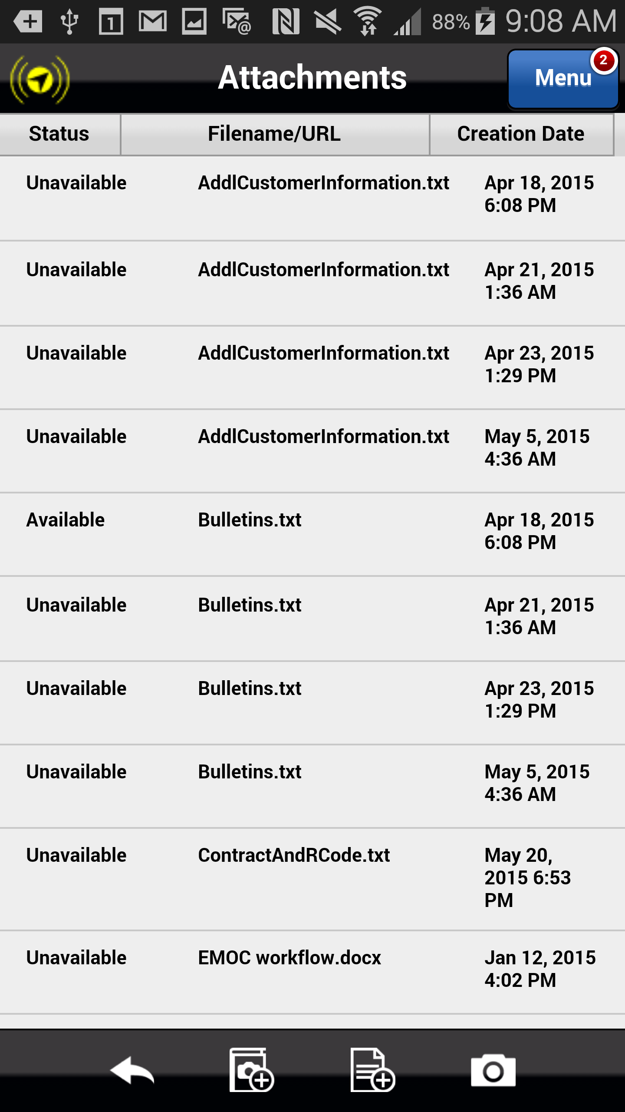
Viewing Attachments
Select the second Attachment titled “Bulletins.txt” to view the Service Bulletin.
The Download button is displayed for this particular file.
Previous
Home
End

Slide 6
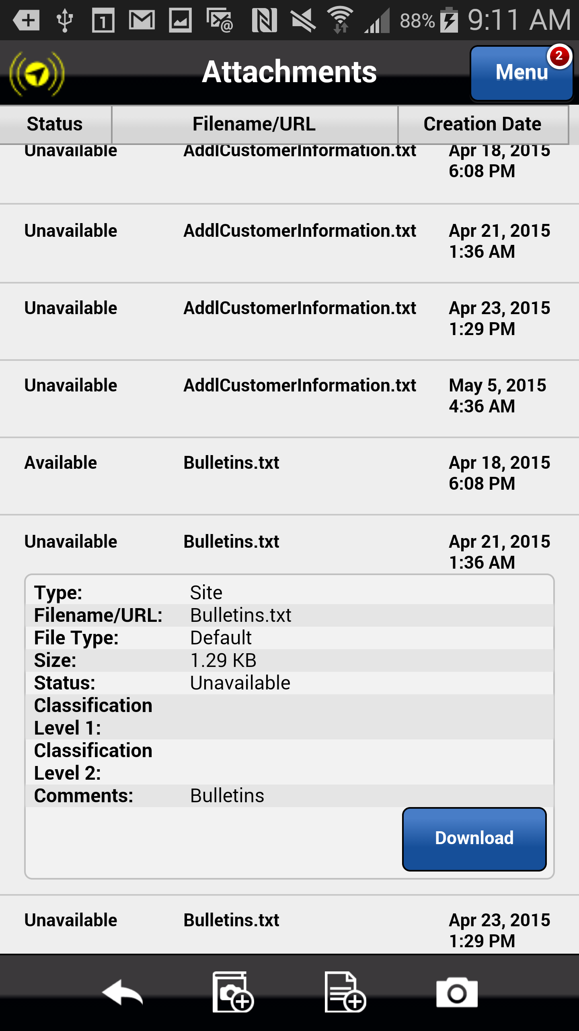
Viewing Attachments
Select the Download button to begin the file download process.
The View and Delete buttons are displayed.
Previous
Home
End

Slide 7
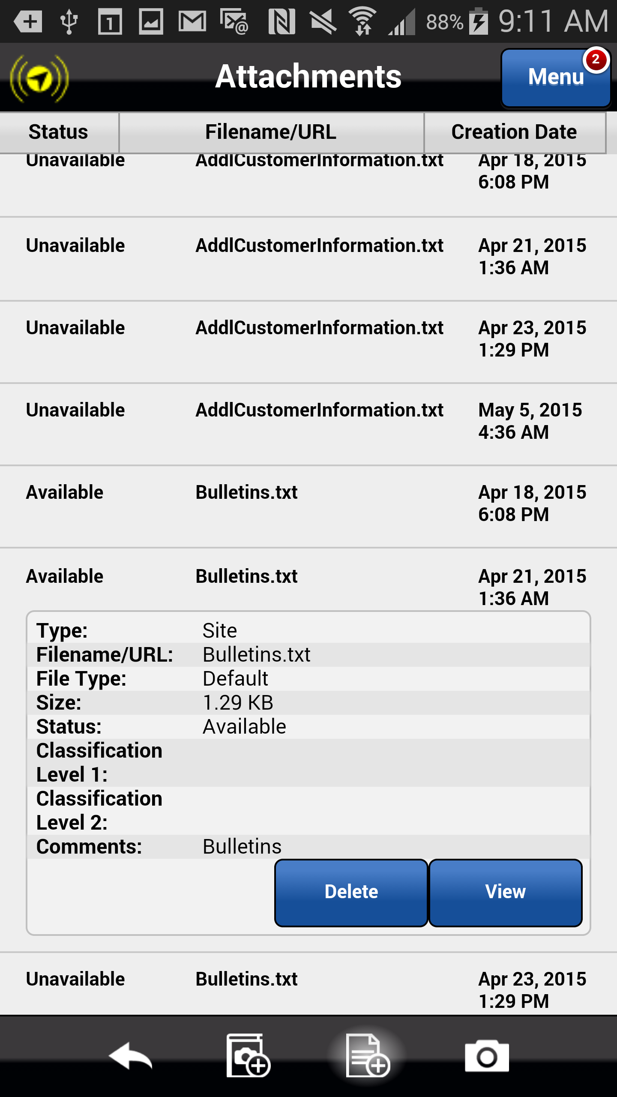
Viewing Attachments
Select View to view the contents of the text file.
The Choose an action dialog appears displaying the apps available from which to display the text file.
Previous
Home
End

Slide 8
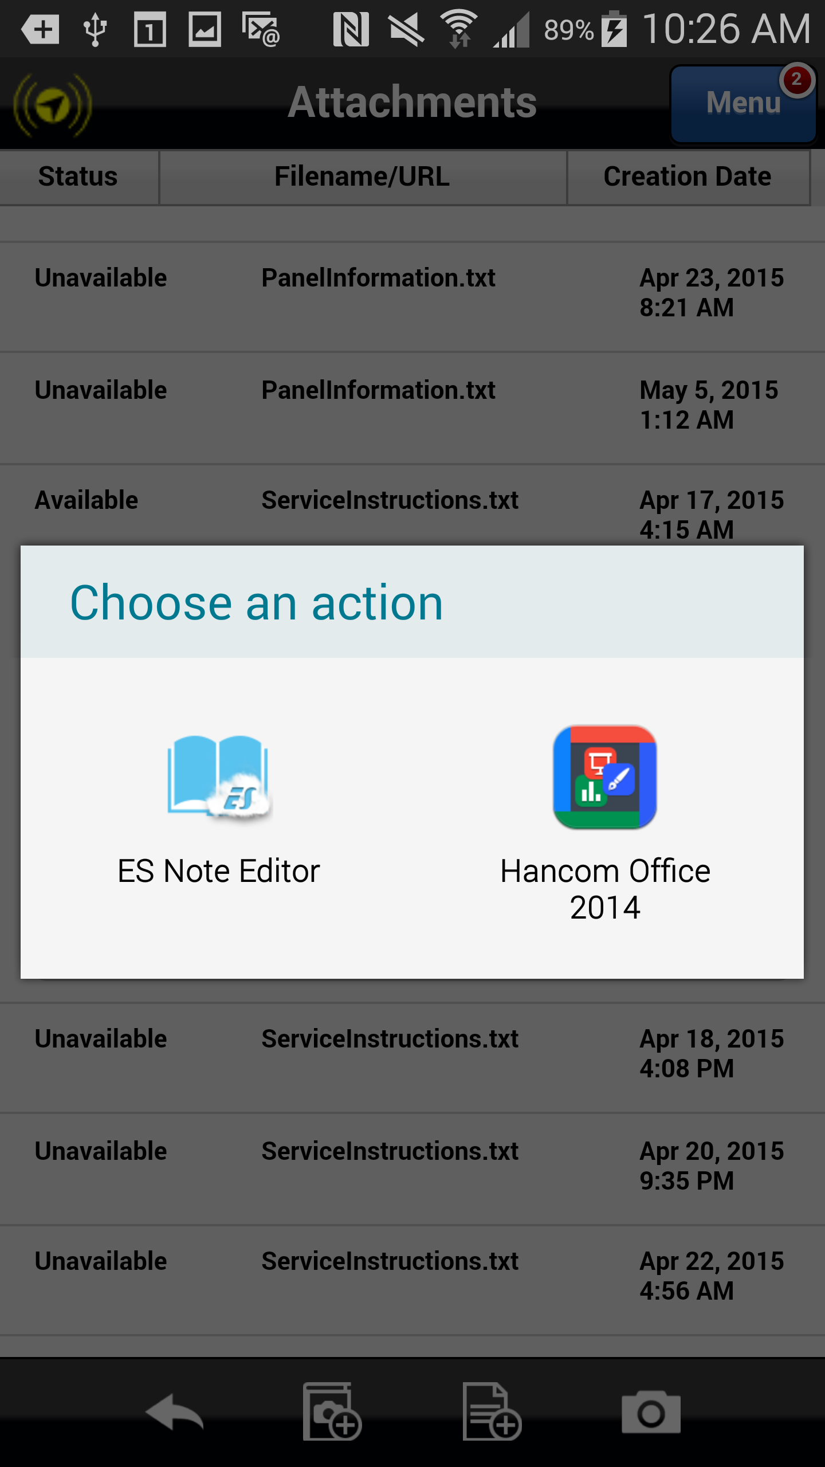
Viewing Attachments
Select the ES Note Editor app to open the attachment.
Previous
Home
End

Slide 9
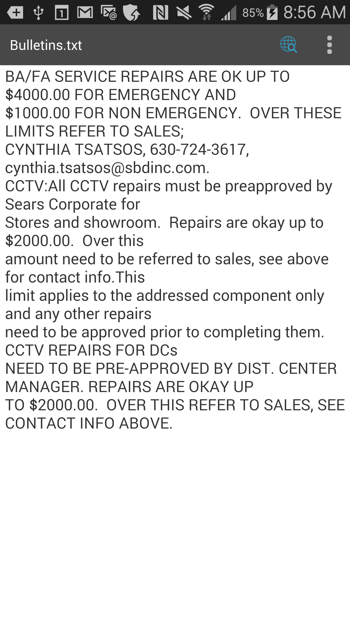
Viewing Attachments
Select the ES Note Editor app to open the service bulletin.
To close the attachment and return to the Astea application, select the phone’s Back button.
Previous
Home
End
Next

Slide 10
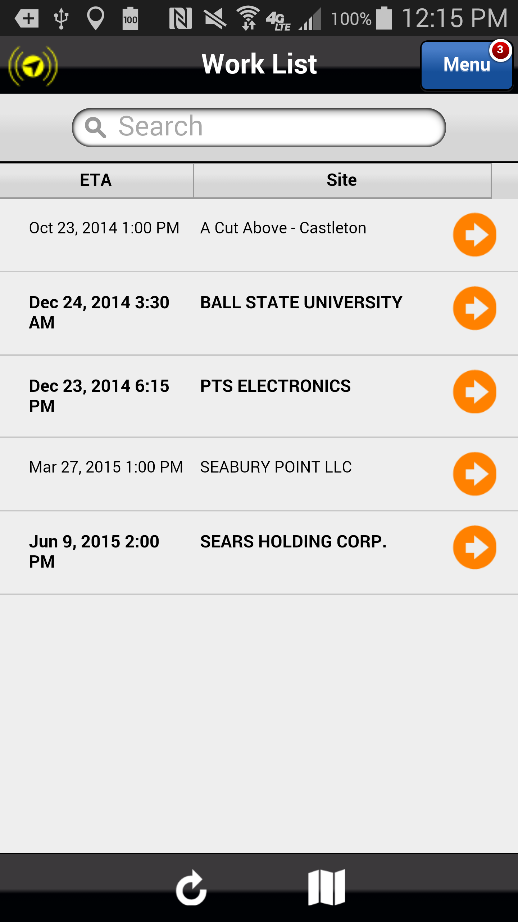
Viewing AKA, Fire Group Number, Subscriber Type, Monitoring Status, and Customer Availability
As a result of this implementation, the AKA, Fire Group Number, Subscriber Type, Monitoring Status, and Customer Availability information is now available to the SA’s from the Astea Mobile application.
To access the information, select the orange arrow that corresponds to the following service order from the Work List: June 9, 2015 2:00 PM SEARS HOLDING CORP.
Previous
Home
End

Slide 11
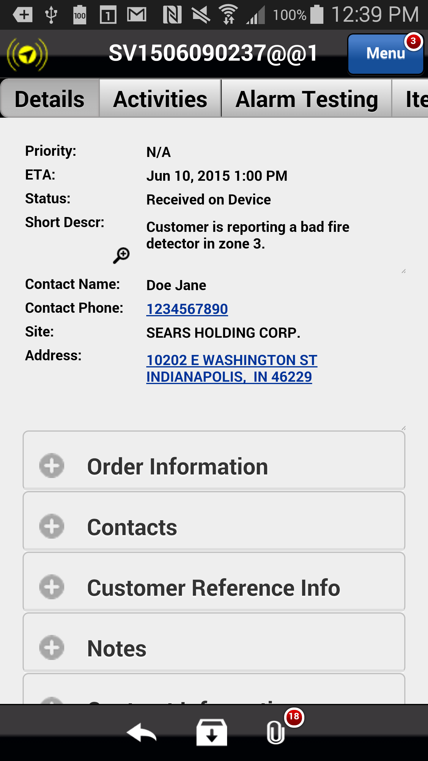
Viewing AKA, Fire Group Number, Subscriber Type, Monitoring Status, and Customer Availability
Select the Notes plus sign to view the information.
The Notes field expands.
Previous
Home
End

Slide 12
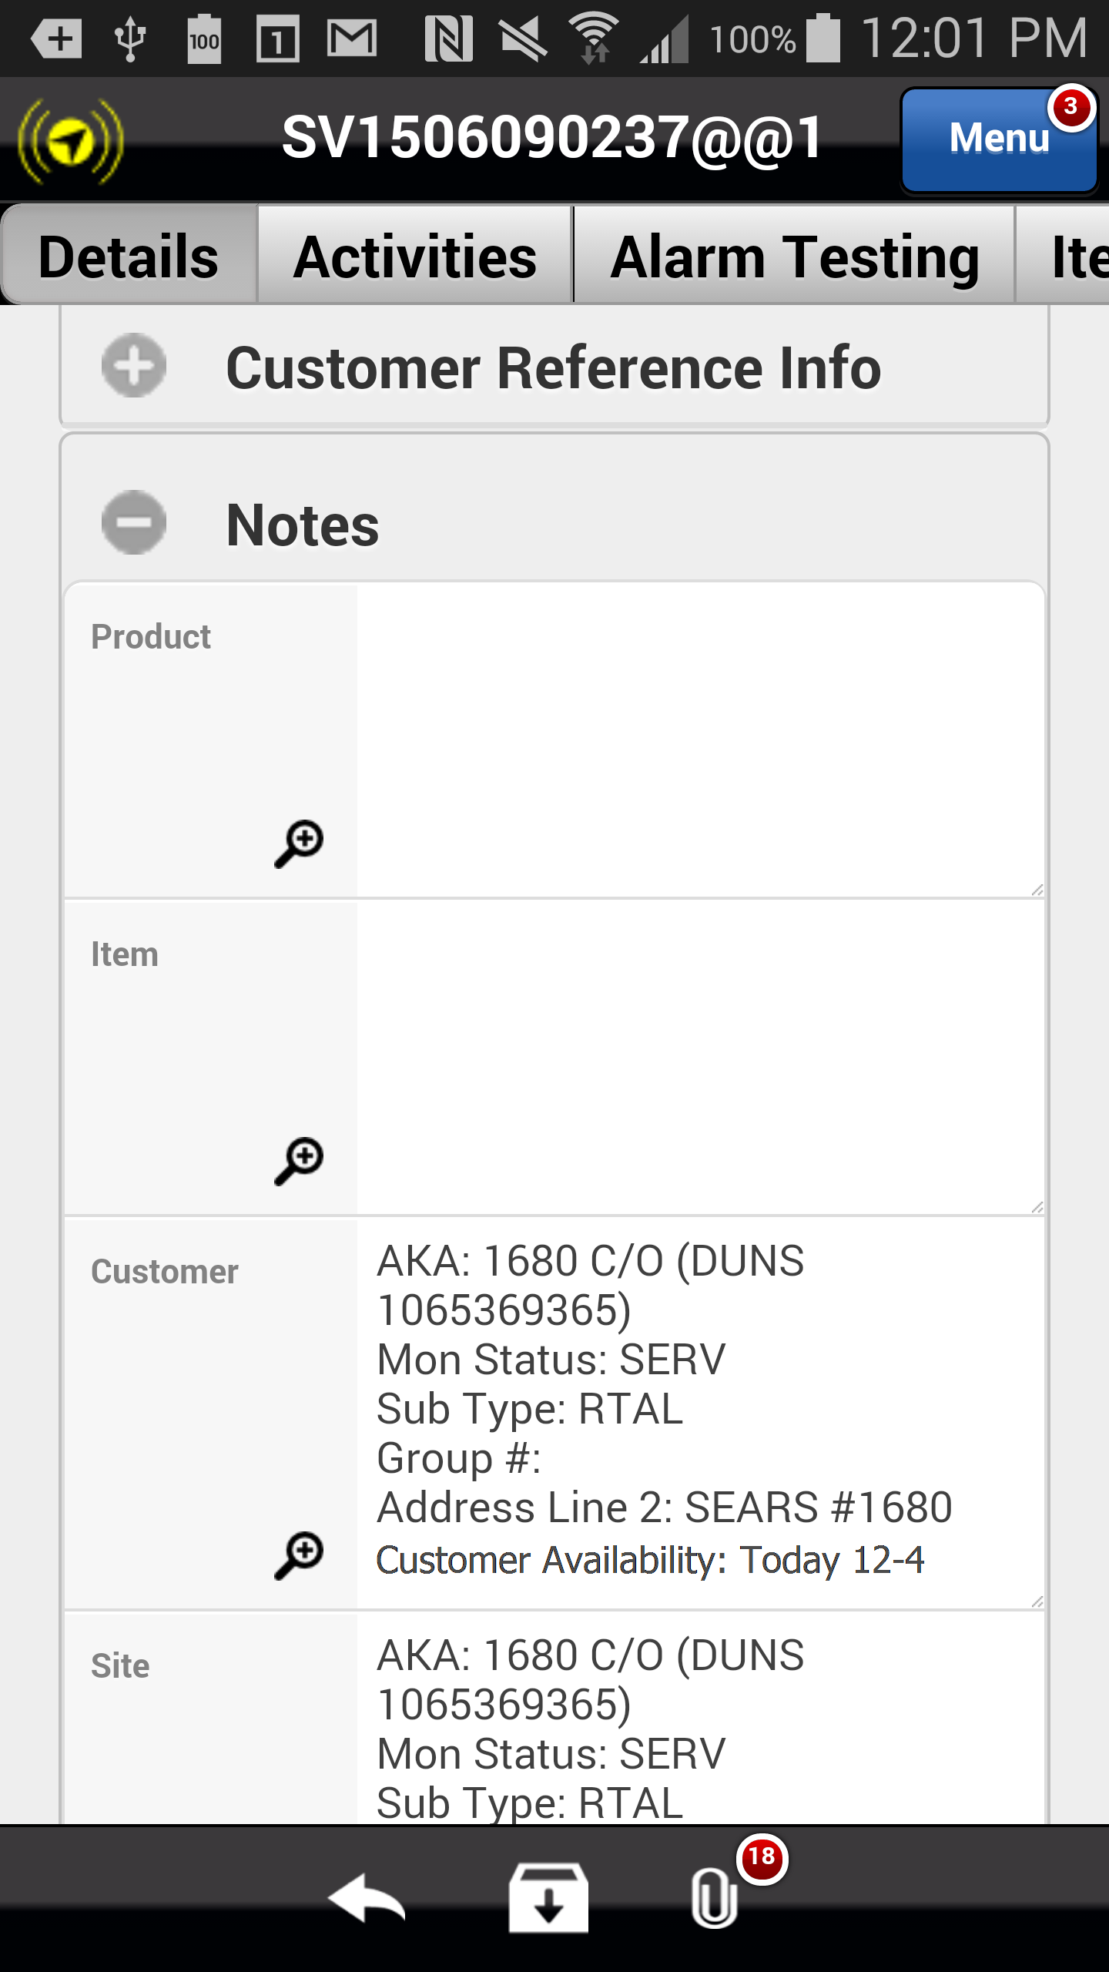
Viewing AKA, Fire Group Number, Subscriber Type, Monitoring Status, and Customer Availability
The customer information is displayed under both the Customer and Site sections.
Previous
Home
End
Next

Slide 13
Viewing Additional Customer Information
Another benefit to the SA as a result of this implementation is the ability to view additional customer information. Additional customer information includes, but is not limited to, the following: description, item, serial #, contact name, contact phone, SLA Details, item information, etc.
To access additional customer information, select ETA or Site (customer name) that corresponds to the following service order from the Work List: June 9, 2015 2:00 PM SEARS HOLDING CORP.:
Previous
Home
End

Slide 14
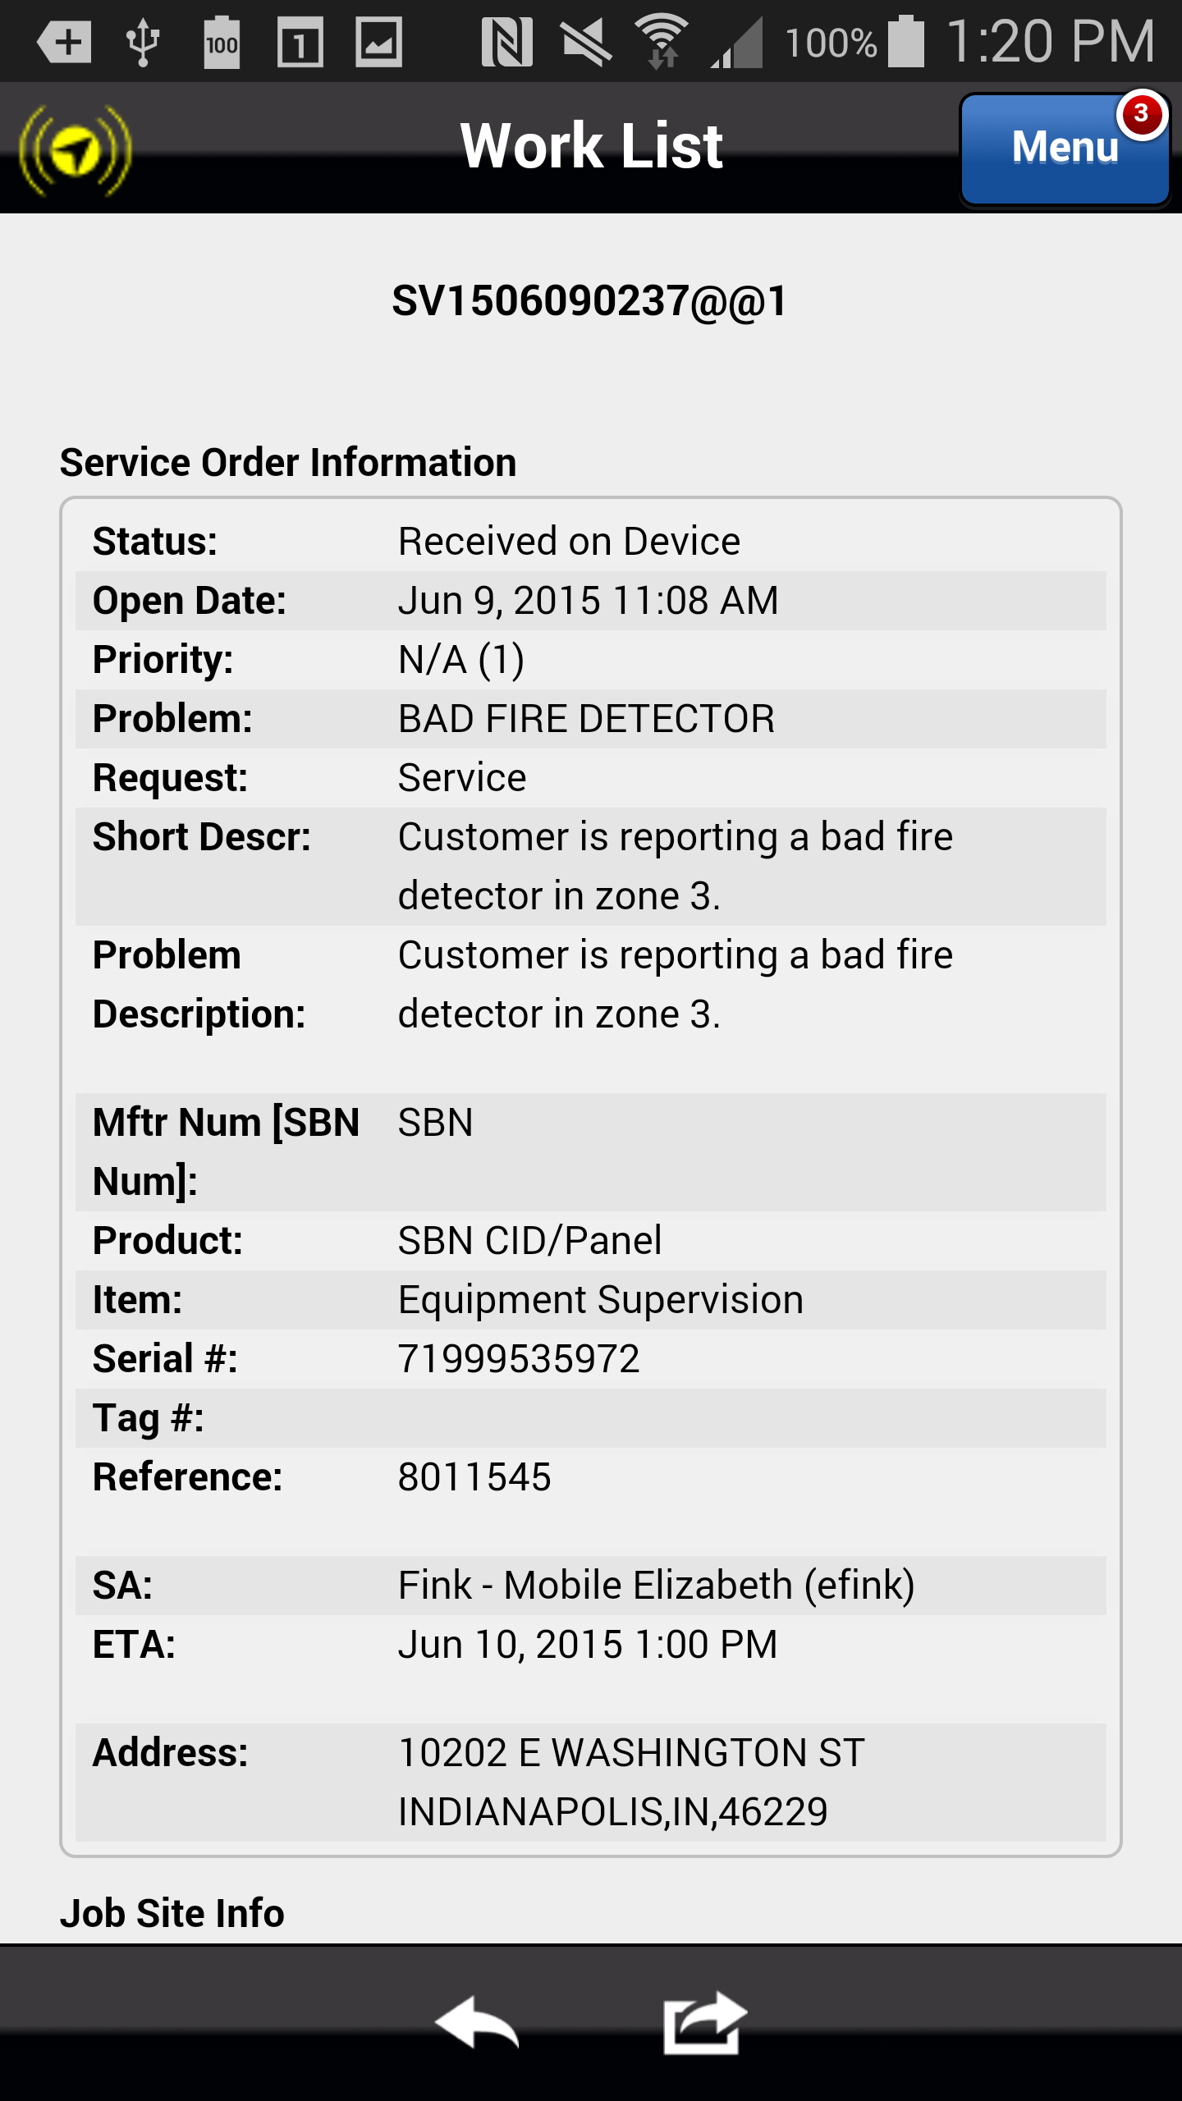
Viewing Additional Customer Information
The additional customer information is displayed. Scroll down to review all available information.
Previous
Home
End
Next

Slide 15
Viewing CID and Panel Information
This implementation also places the CID and Panel information on the Items tab in the Astea Mobile application, making it accessible from each service order.
To access the CID and Panel information, select the orange arrow that corresponds to the following service order from the Work List: June 9, 2015 2:00 PM SEARS HOLDING CORP.:
Previous
Home
End

Slide 16
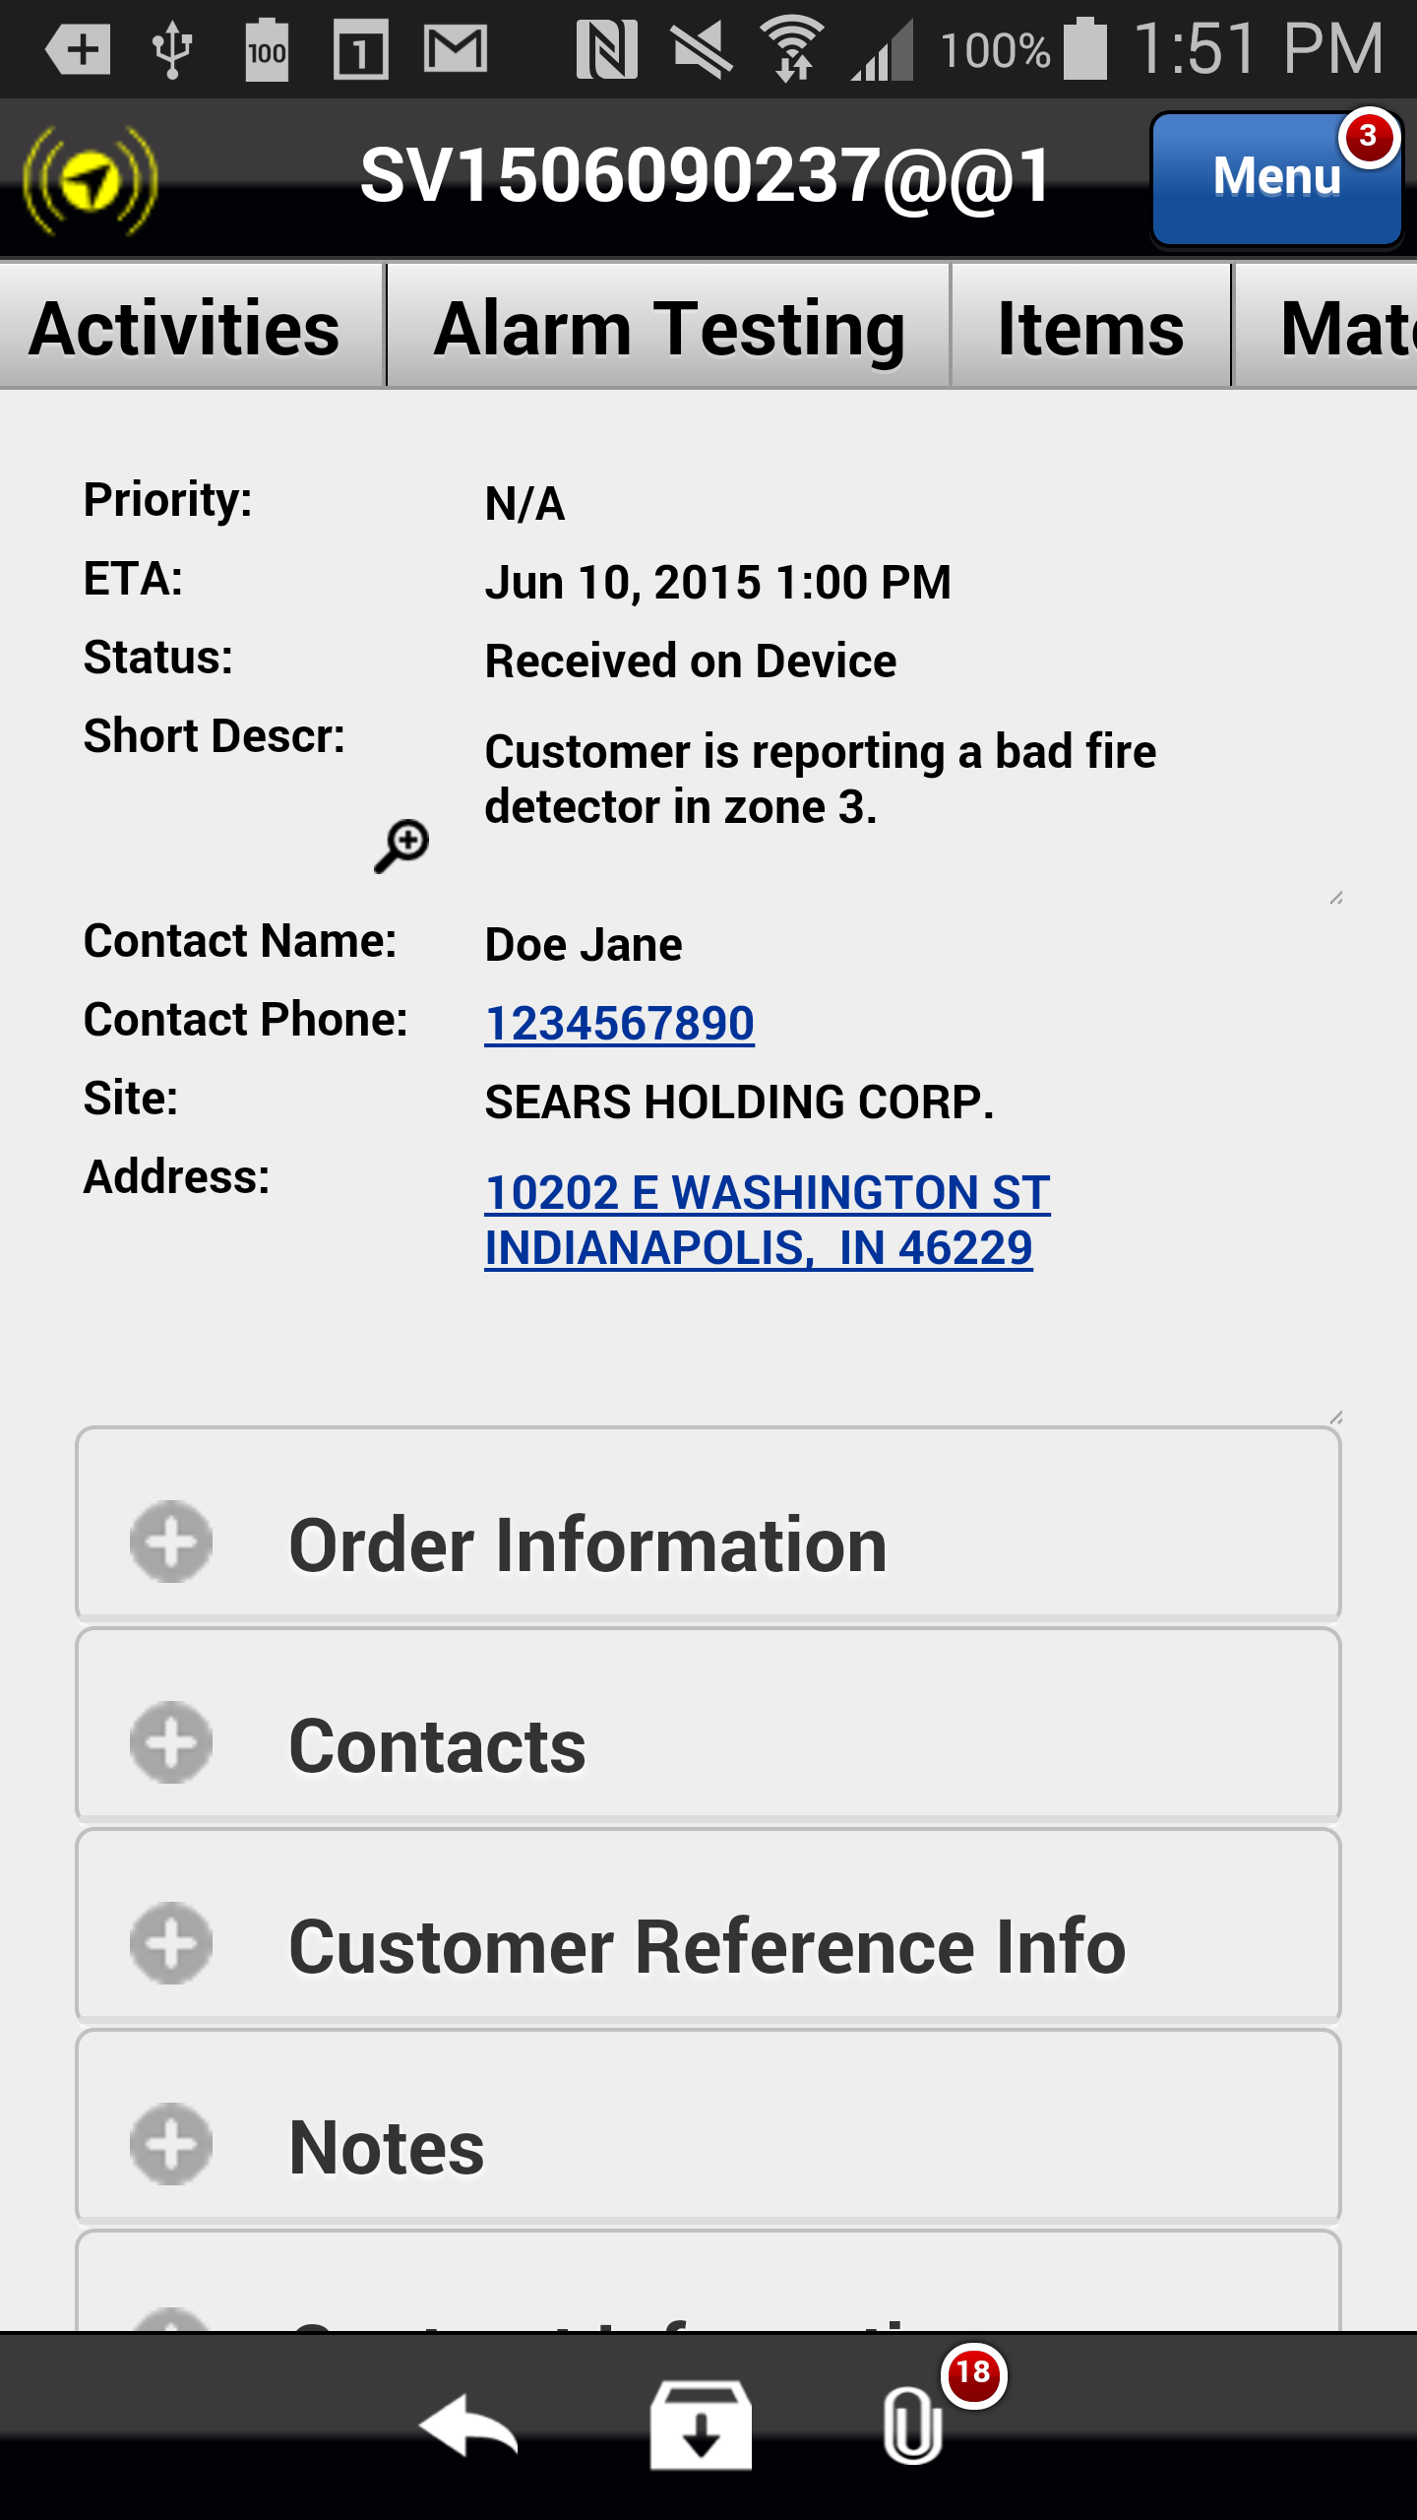
Viewing CID and Panel Information
Scroll to the right to locate the Items tab and select it to view the CID and Panel information.
The Items tab is displayed.
Previous
Home
End

Slide 17
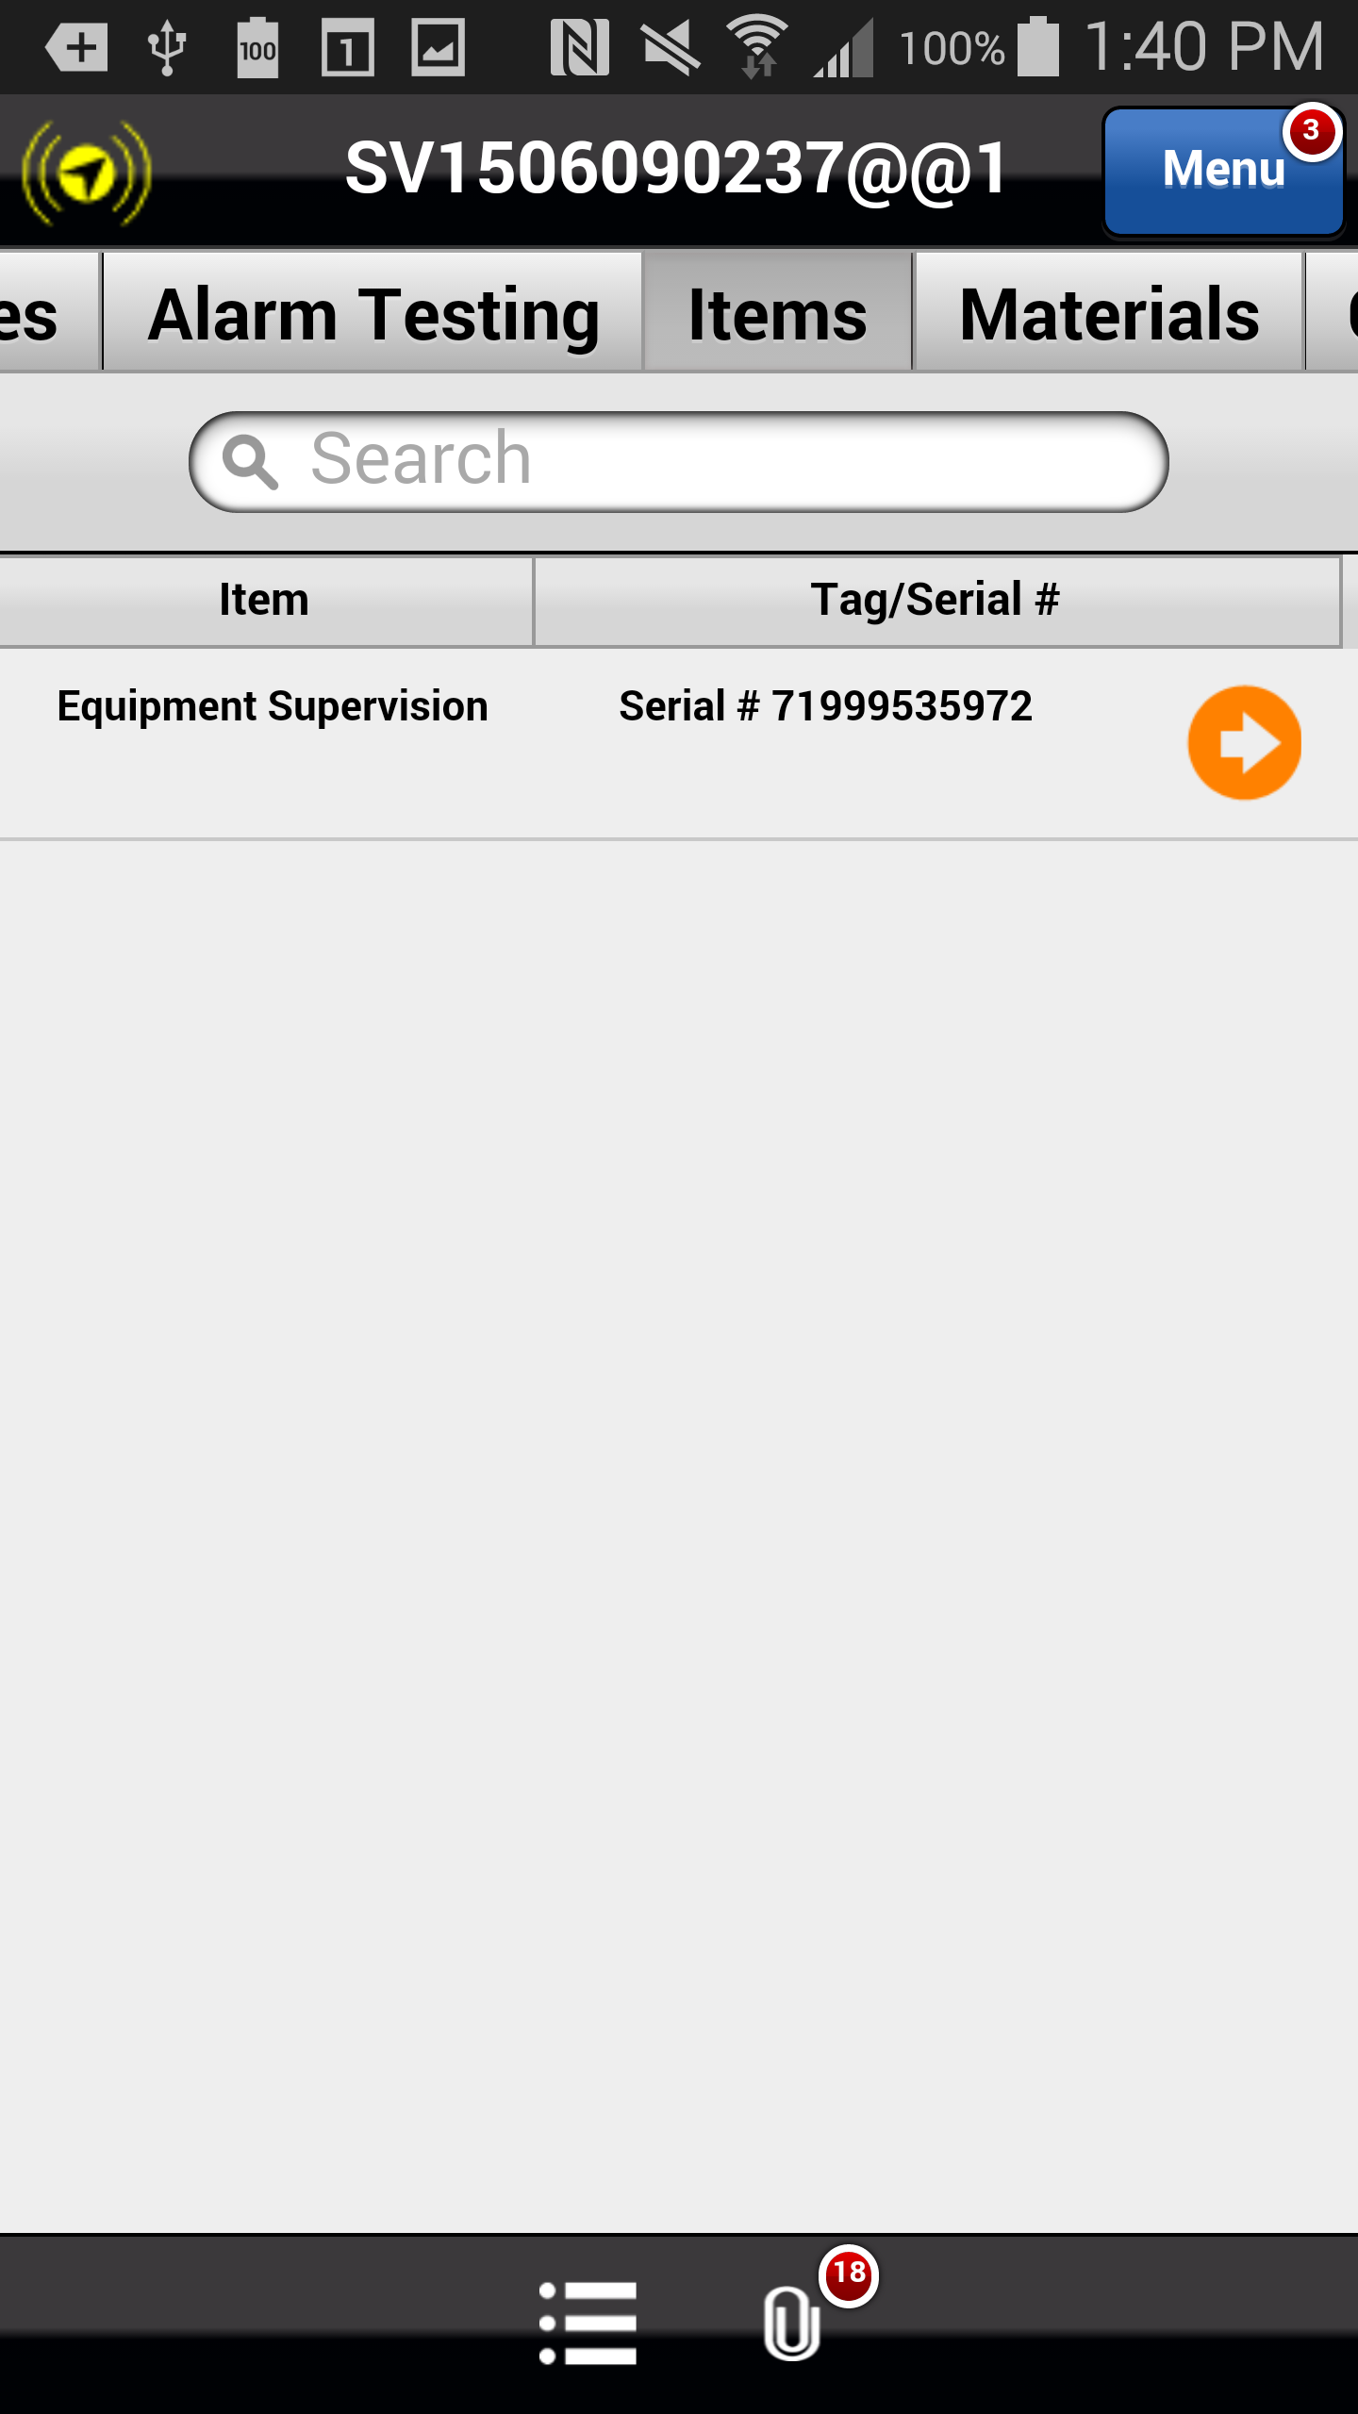
Viewing CID and Panel Information
Select the orange arrow that corresponds to the following Item or Tag/Serial # from the Items List: Equipment Supervision Serial # 71999535972.
Previous
Home
End

Slide 18
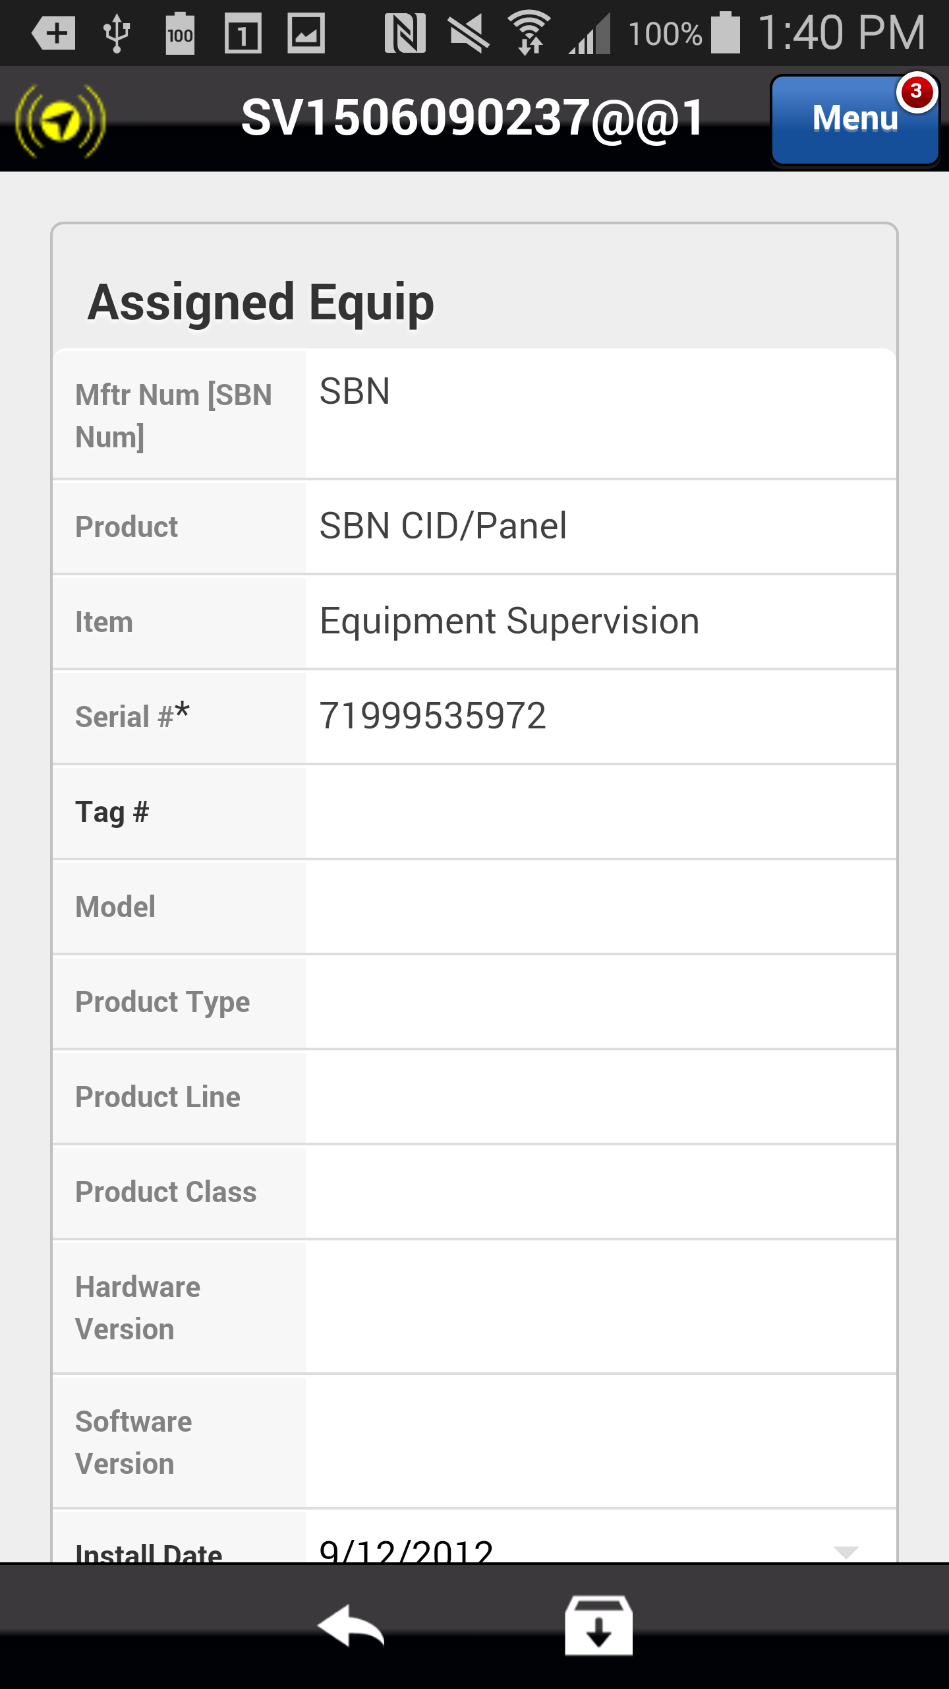
Viewing CID and Panel Information
The CID and Panel Information for the assigned equipment is displayed.
Note: Panel information can also be found by selecting the Attachments icon and selecting the Panel Information attachment.
Previous
Home
End
Next

Slide 19
Changes to the Parts Pending Process
The automated and manual process for tracking, sourcing, and redispatching service orders with parts is now highly dependent on selecting the appropriate stop code.
To complete the parts pending process in the Astea Mobile application, select the orange arrow that corresponds to the following service order from the Work List: June 9, 2015 2:00 PM SEARS HOLDING CORP.:
Previous
Home
End

Slide 20
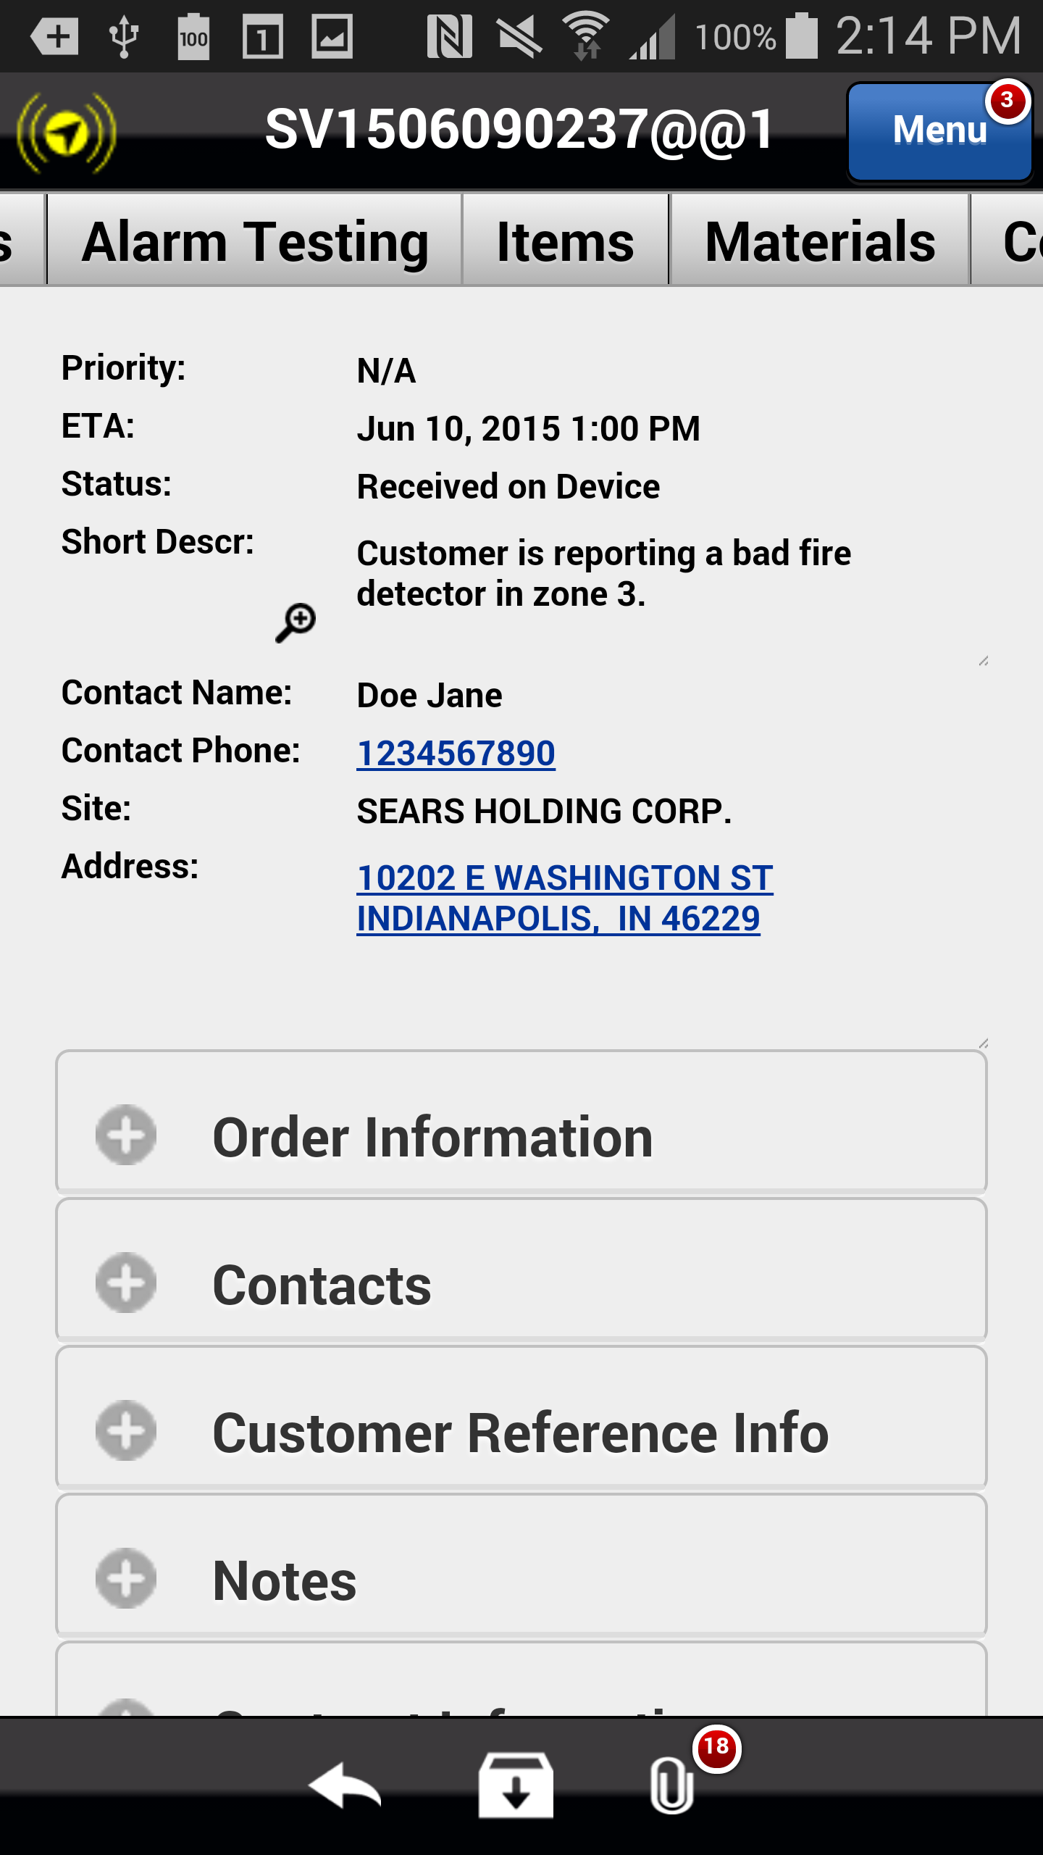
Changes to the Parts Pending Process
In order to complete this exercise, please Start Travel and then Start Work from the Activities tab.
Continue by scrolling right and selecting the Materials tab.
Previous
Home
End

Slide 21
Changes to the Parts Pending Process
Select the Pencil icon at the bottom of the screen to add a new material.
Previous
Home
End

Slide 22
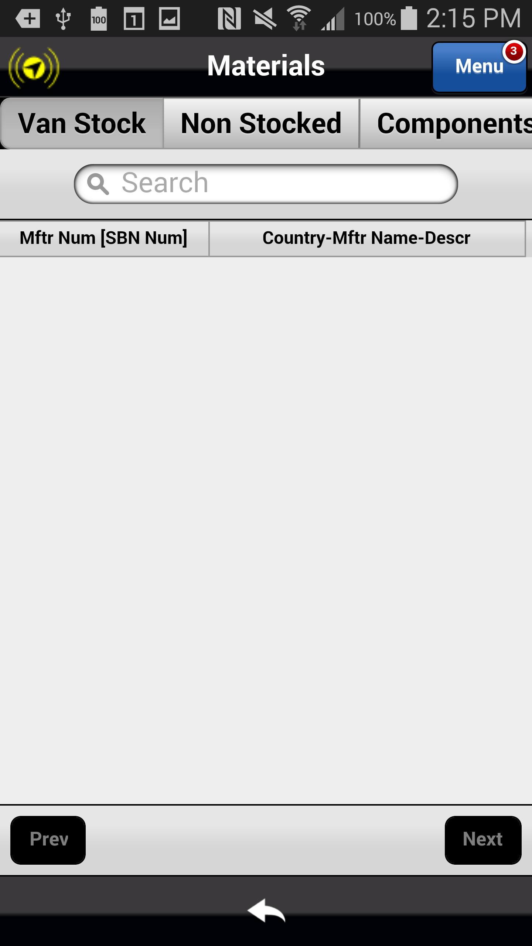
Changes to the Parts Pending Process
Select Non Stocked to view the available materials from which to choose.
Previous
Home
End

Slide 23
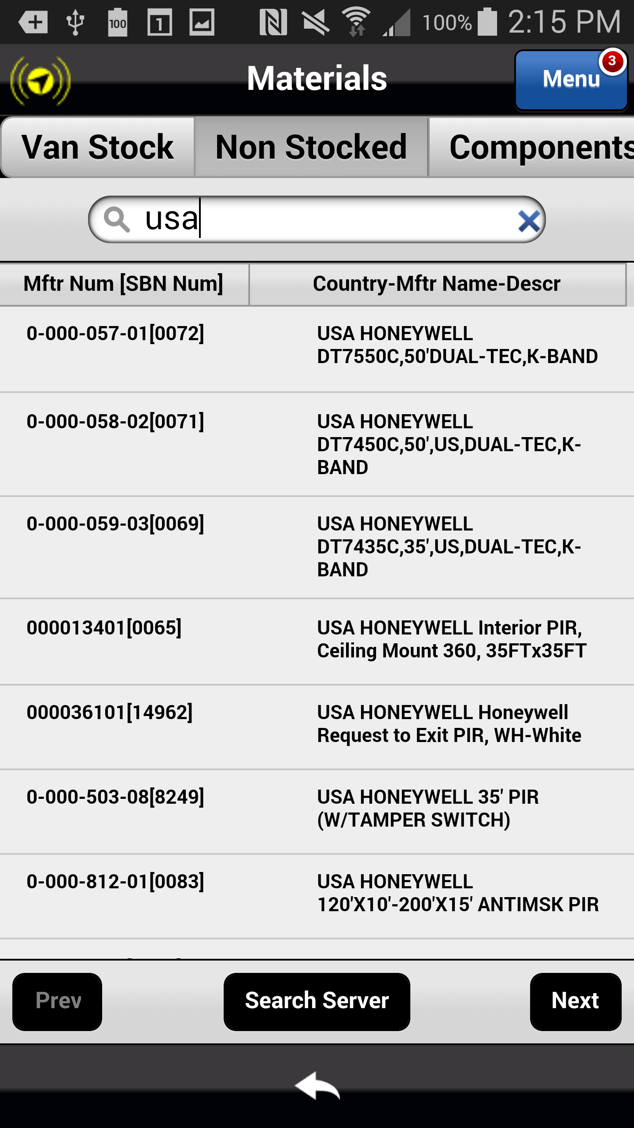
Changes to the Parts Pending Process
Select the following part from the Materials List: 0-000-056-01[0072 USA HONEYWELL DT7FFOC,50DUAL-TEC,K-BAND.
Previous
Home
End

Slide 24
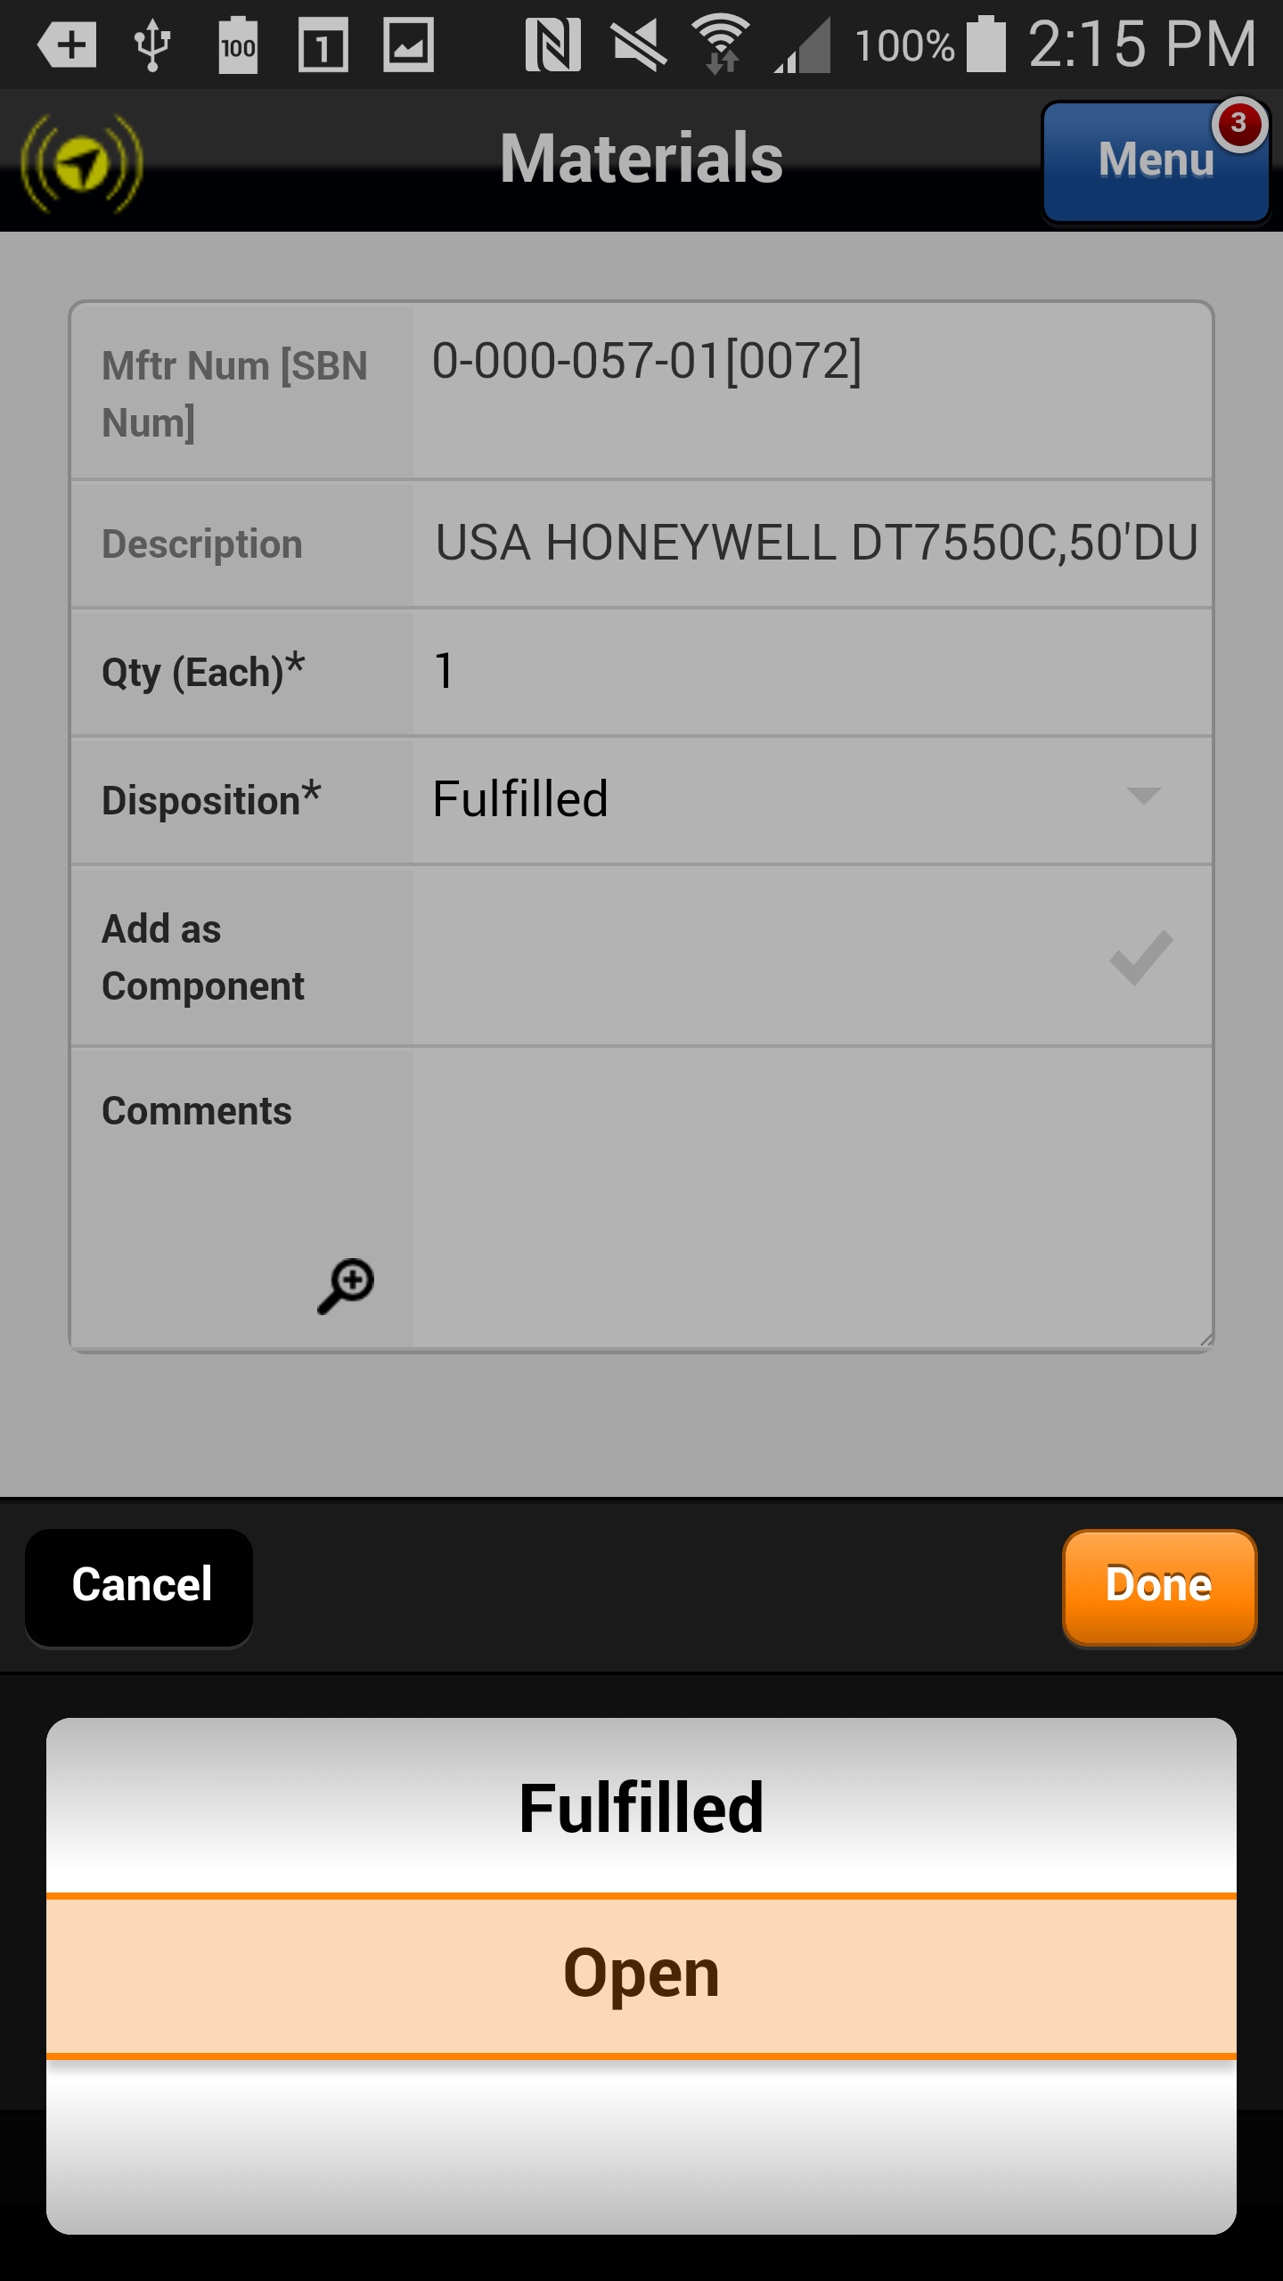
Changes to the Parts Pending Process
Select the Disposition drop down arrow and choose Open from the drop down list.
The part appears in the Materials List and the Status is displayed as Needed.
Previous
Home
End

Slide 25
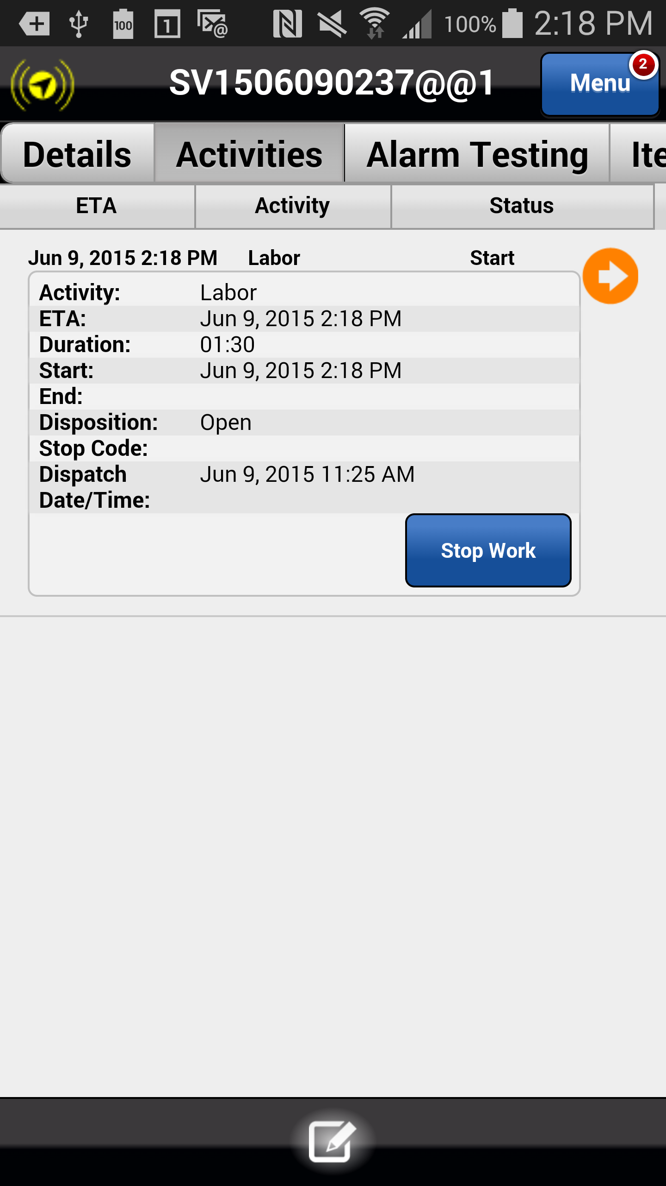
Changes to the Parts Pending Process
Scroll back to and select the Activities tab and select the Stop Work button.
Previous
Home
End

Slide 26
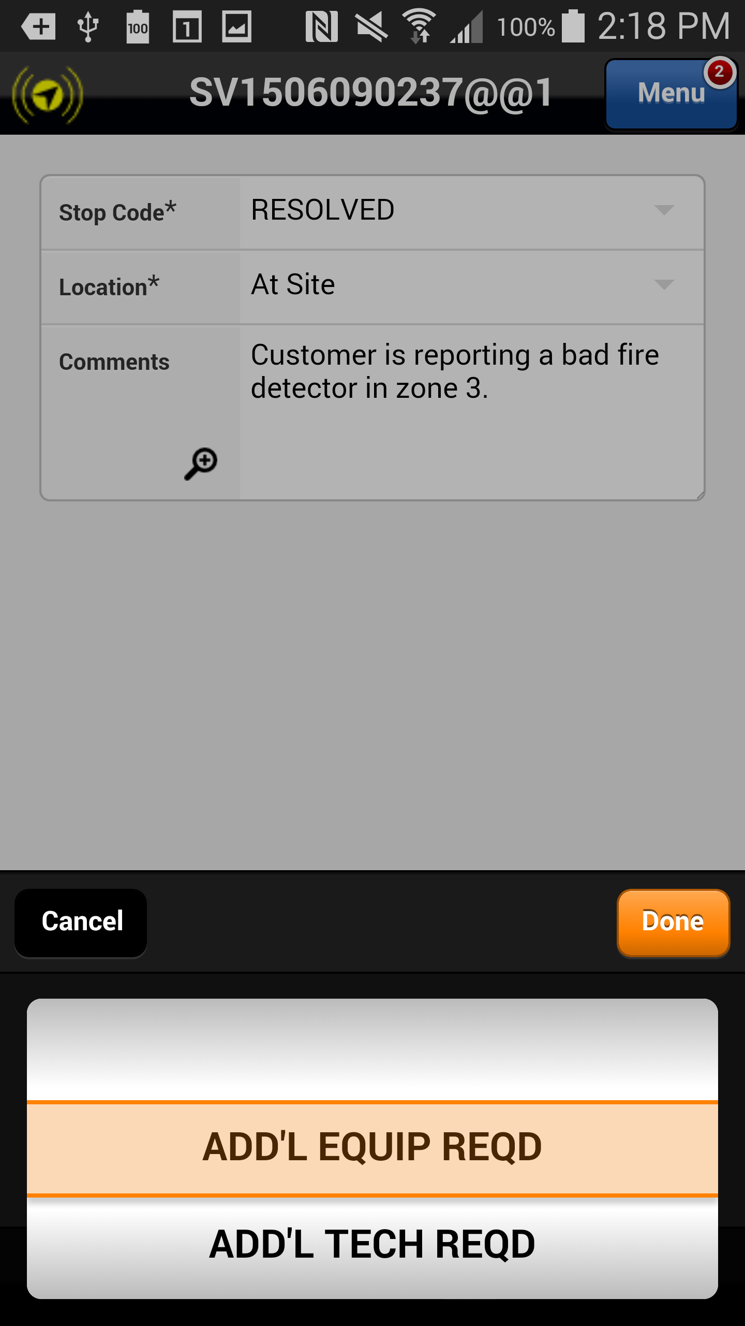
Changes to the Parts Pending Process
Select the Stop Code drop down arrow and choose ADD’L EQUIP REQD from the drop down list. Selecting any other stop code other than ADD’L EQUIP REQD will cause the automated and manual parts pending process to fail.
The part appears in the Materials List and the Status is displayed as Needed
Previous
Home
End

Slide 27
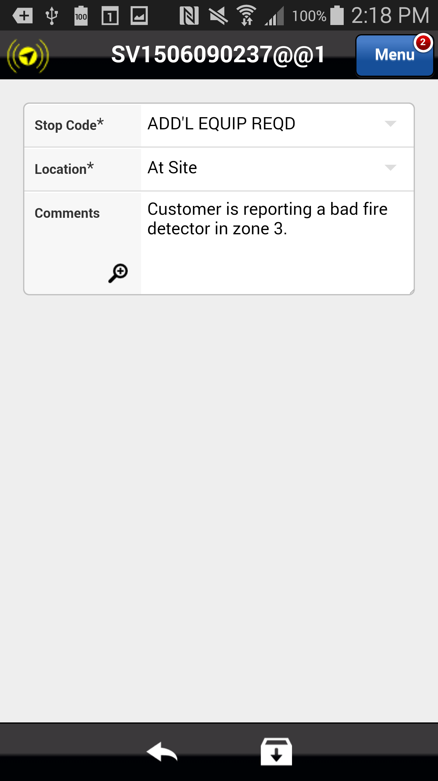
Changes to the Parts Pending Process
The Stop Code appears as ADD’L EQUIP REQD. Select the Save button to save the service order and to initiate the parts pending process in the Astea back office.
Previous
Home
End

Slide 28
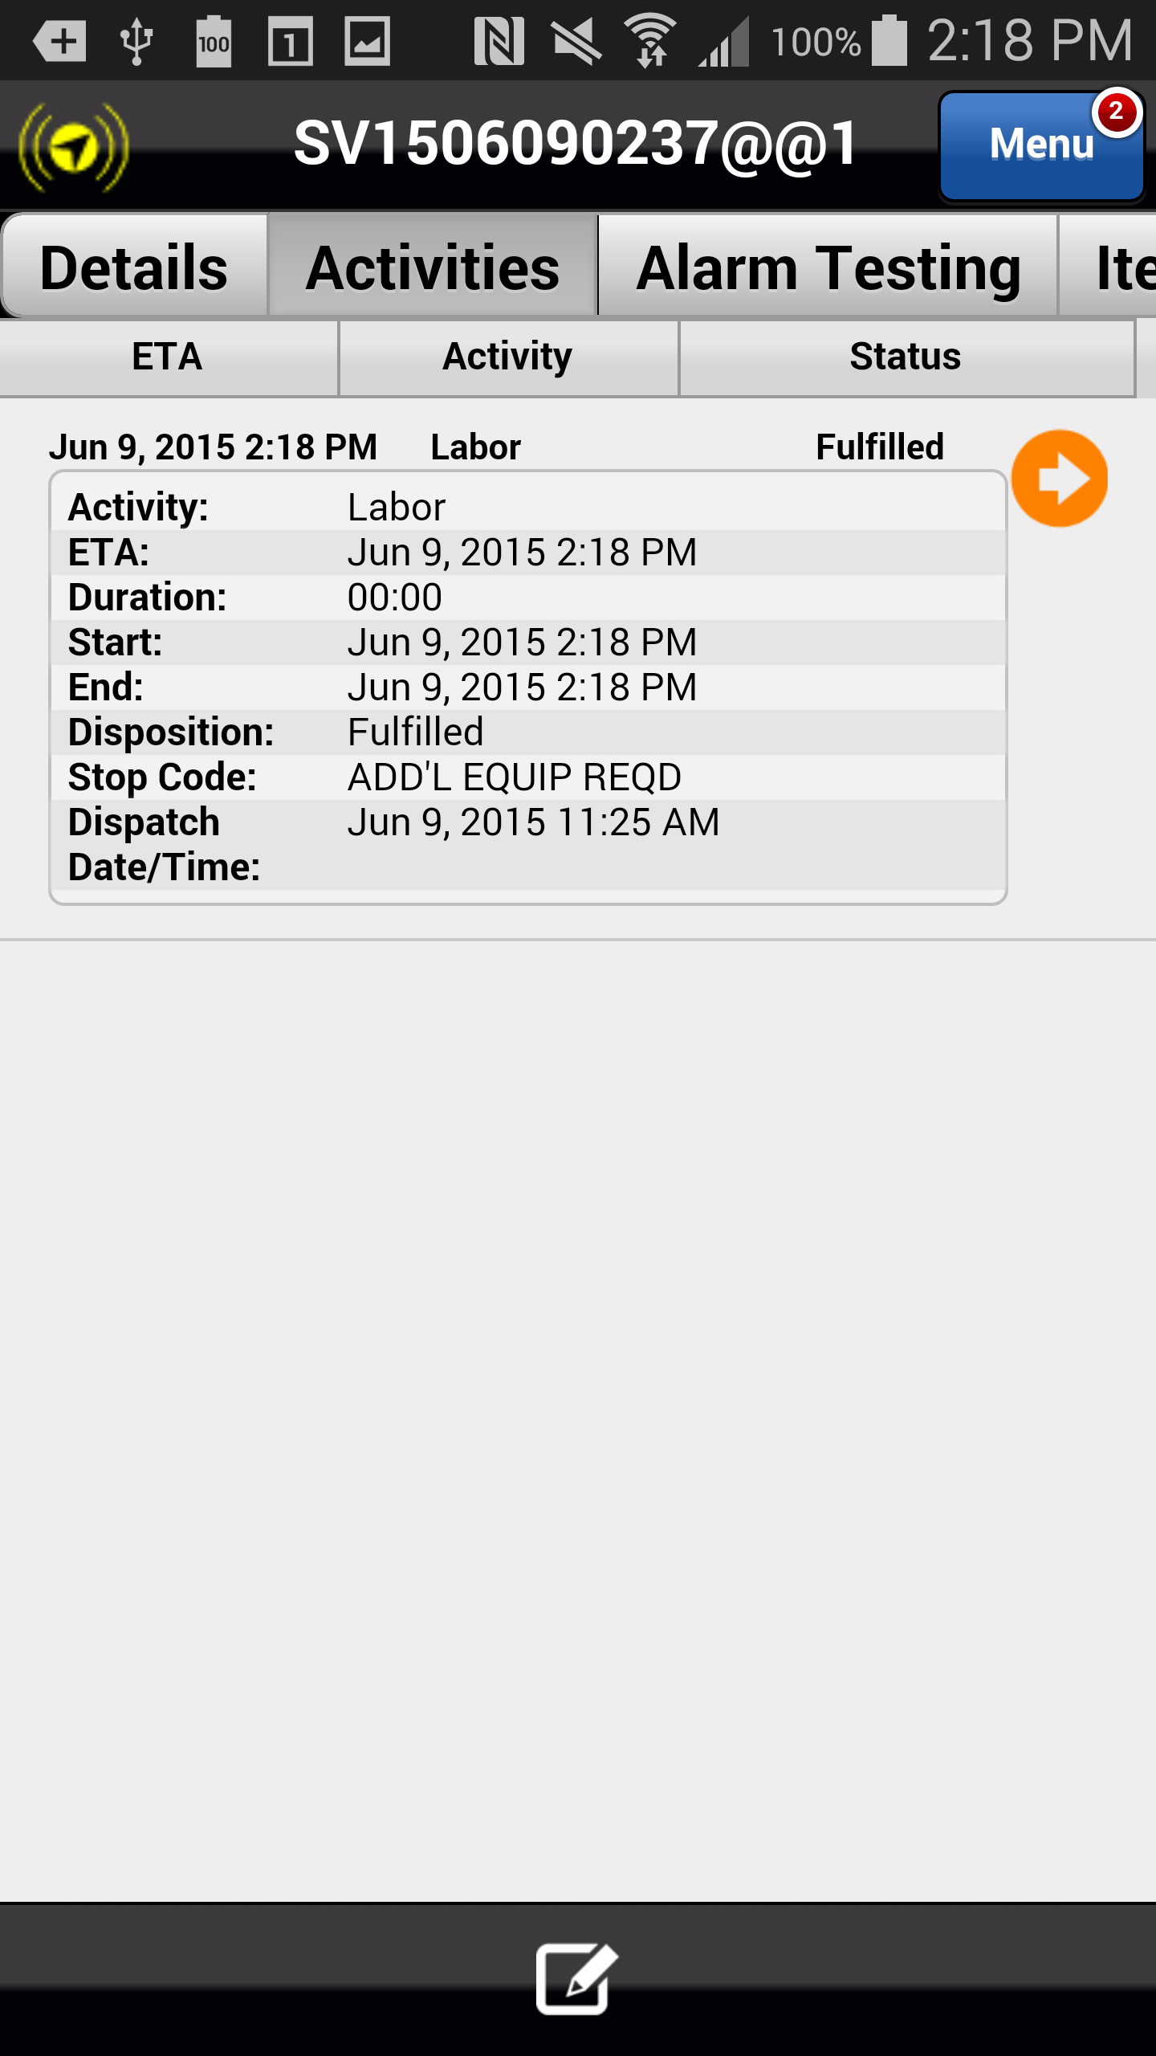
Changes to the Parts Pending Process
The manual and automated parts pending process in the Astea back office is initiated. A second labor activity is added to the service order indicating that an SA is needed to return to the location once the pending parts are received.
When the part is received and the service order is redispatched, the part status is displayed as “NEEDED” on the mobile device. When the part is installed and service is complete, the part status should be manually updated to FULFILLED by the SA.
Previous
Home
End

