Slide 1
Astea Mobile App Training
Using Check Status in closing Service Order
Start

Slide 2
Using Check Status
Module Overview
In this module you will learn how to use the Check Status function to help in closing a Service Order.
Click on the Next button below
Previous
Home
End
Next
Icon Legend

Slide 3
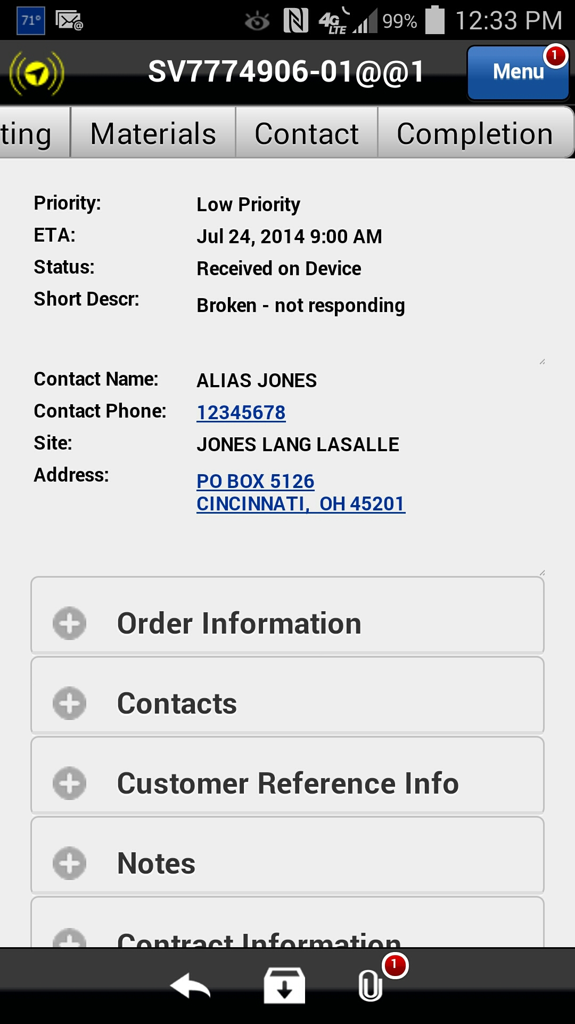
Using Check Status
The Completion tab includes the functions required to complete a Service Order as well as providing status for all required functions necessary in completing the Service Order.
To fulfill functions necessary to complete a Service Order within the Astea Mobile App navigate to the Completion tab.
Action: Click on the Completion tab
Previous
Home
End
Icon Legend

Slide 4
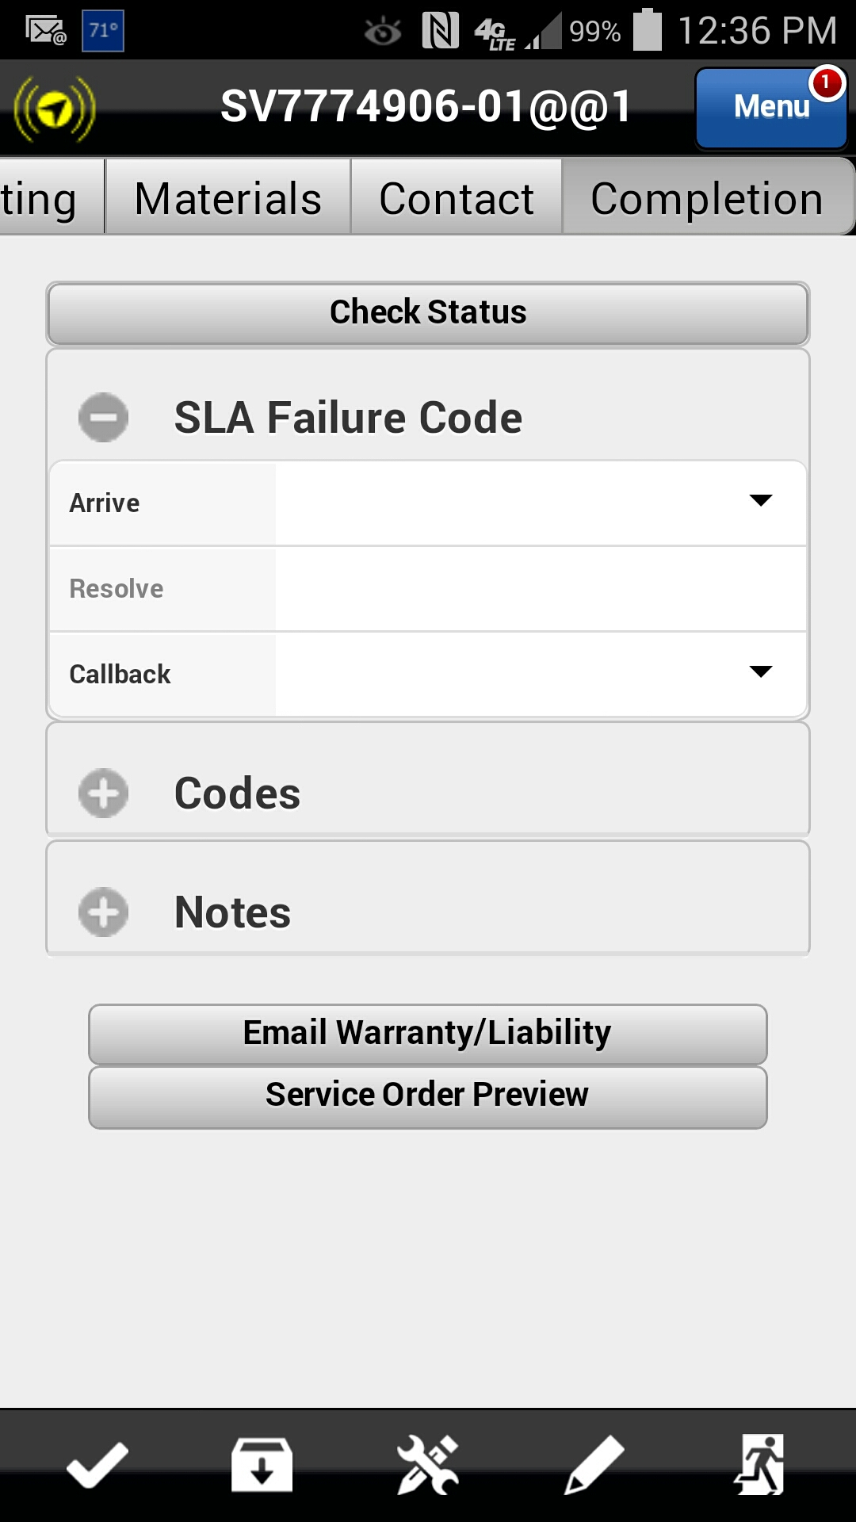
Using Check Status
The Check Status function provides information about the Service Order including which items are still open and need to be addressed before the Service Order can be completed.
Action: Click on the Check Status button
Previous
Home
End
Icon Legend

Slide 5
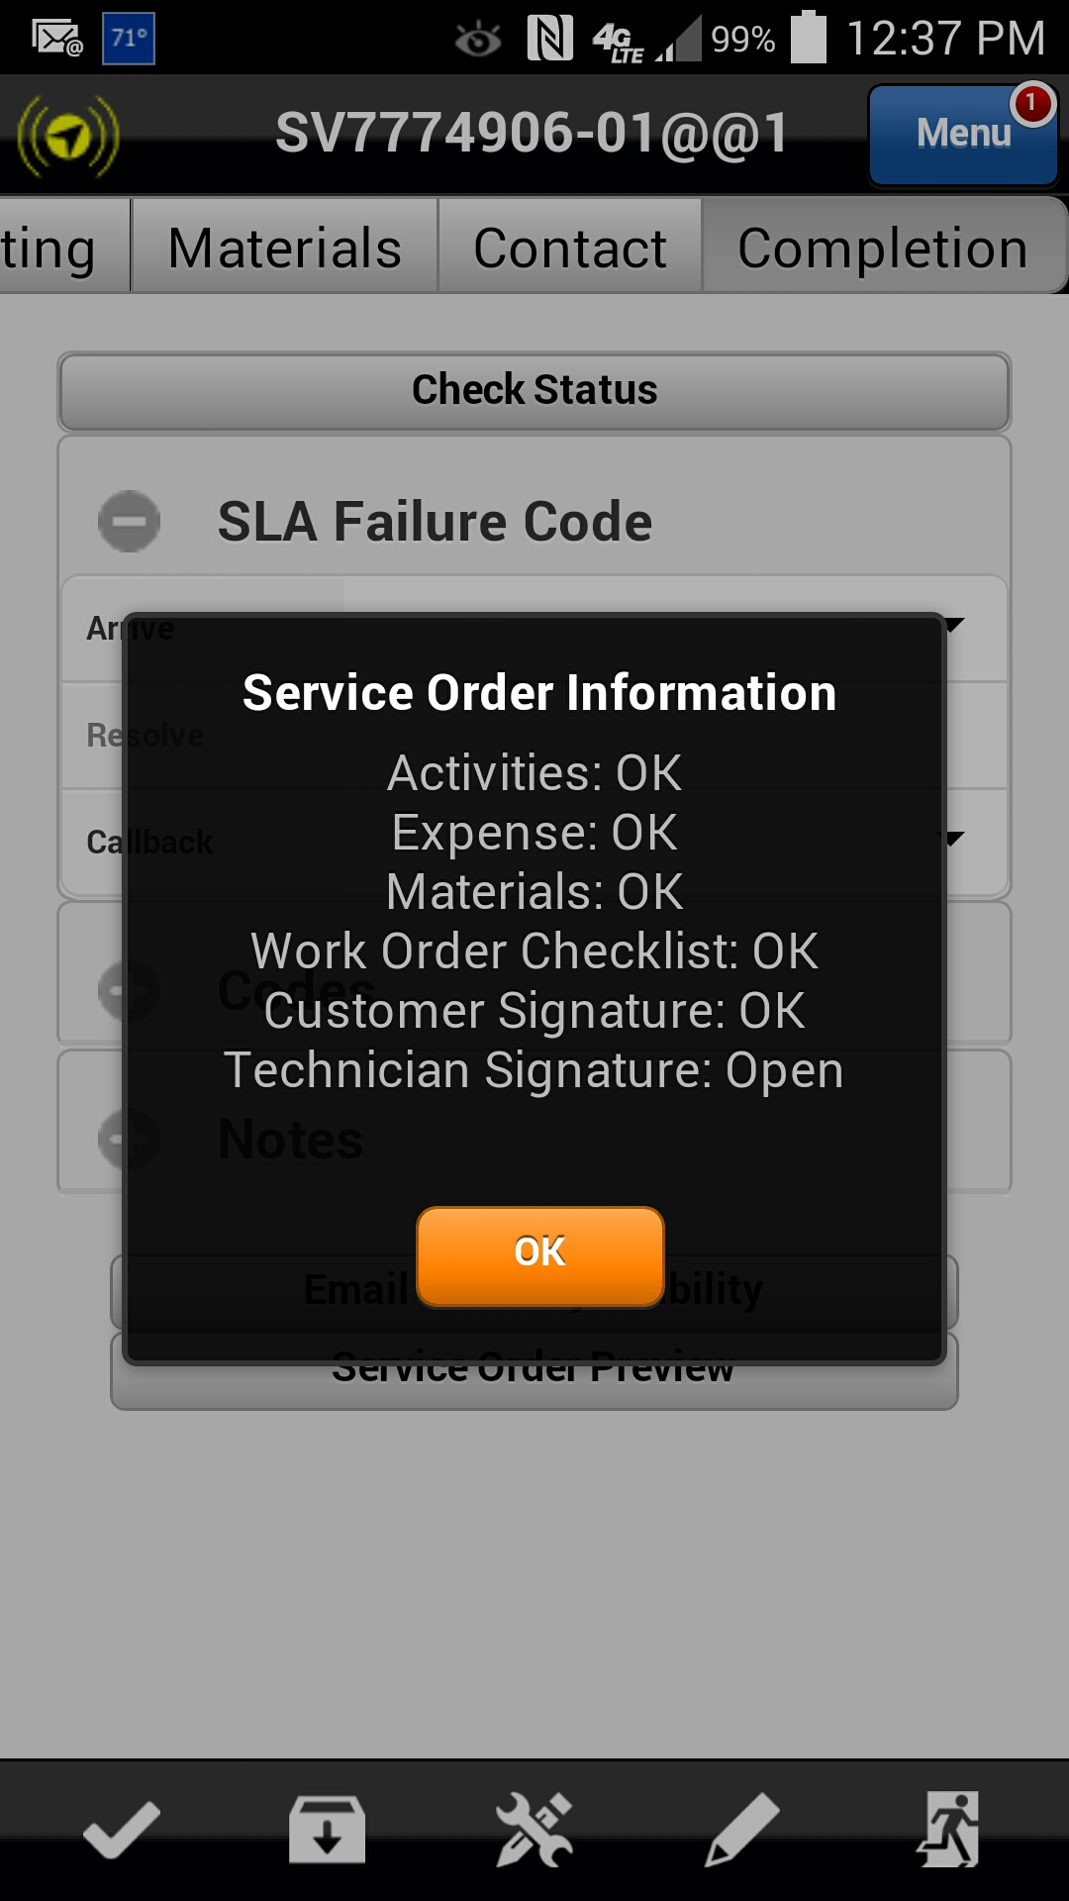
Using Check Status
In this scenario the Check Status shows that all required actions have been completed (i.e. the status is OK) except for the Technician Signature (i.e. the status is Open).
This information informs the user that they need to complete the steps to provide the Technician Signature in order to close the Service Order.
Technician Signature status is Open
Action: Click on the OK button to proceed
Previous
Home
End
Icon Legend

Slide 6
Using Check Status – Technician Signature
The Technician signature is required for all Service Orders.
Click on the pencil/wrench icon in the footer
Previous
Home
End
Icon Legend

Slide 7
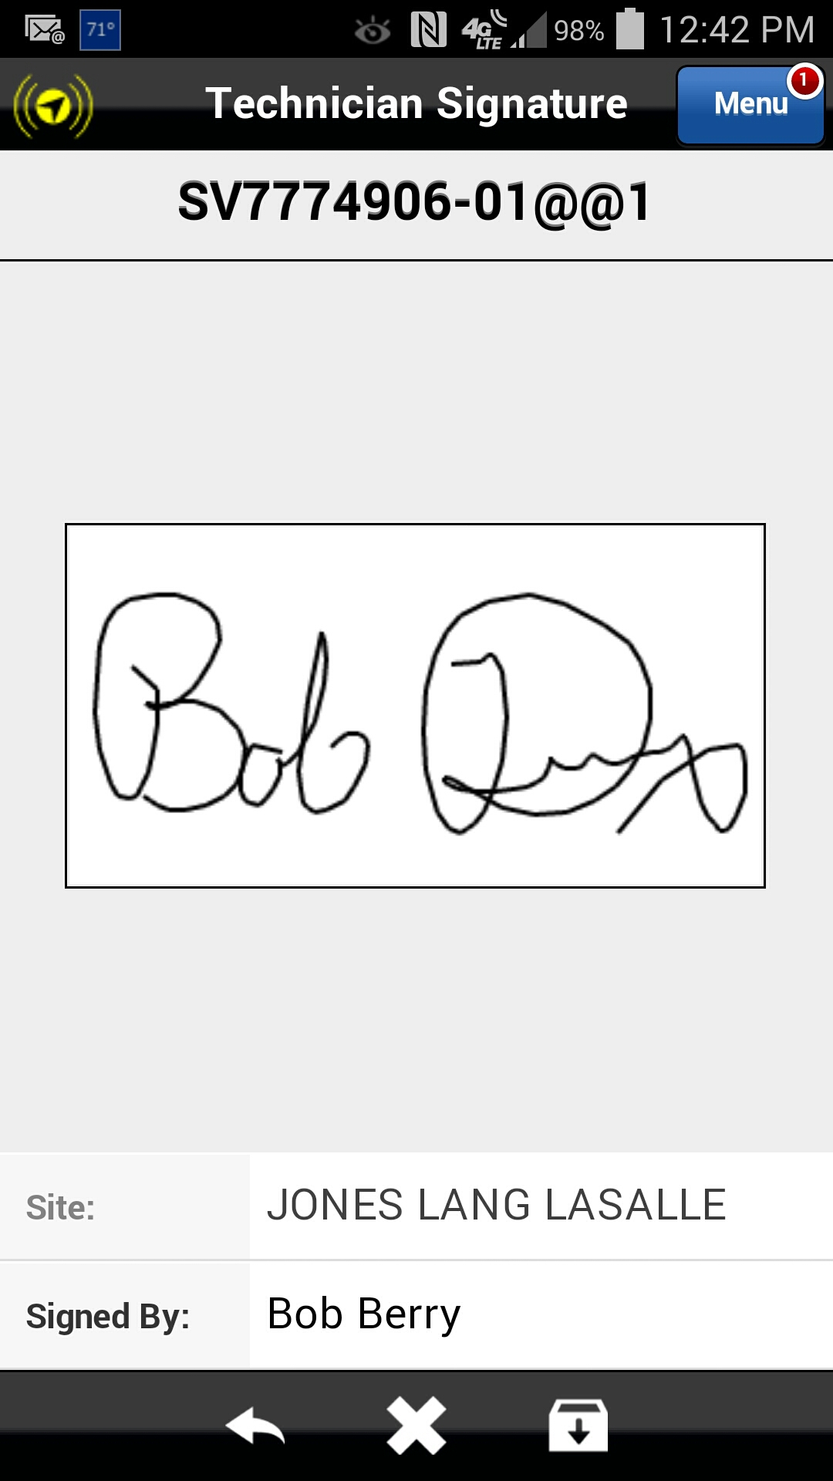
Using Check Status – Technician Signature
You may sign using your finger or the stylus.
Click on the Save icon in the footer
Previous
Home
End
Icon Legend

Slide 8
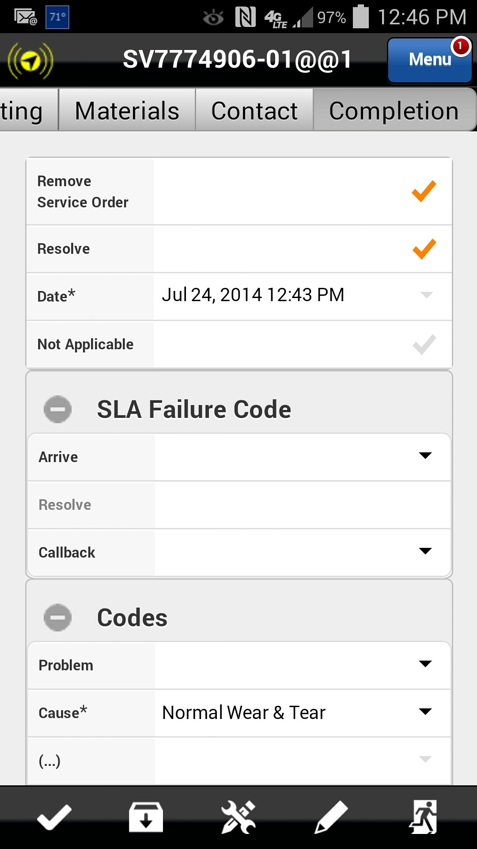
Using Check Status – Resolve Service Order
Check to make sure that the Resolve checkmark is active (i.e. it should be an orange checkmark) and the Codes and Notes have been completed.
The Service Order is now complete. To close the ticket and remove it from your device, click on the Exit button in the footer.
Note: A Service Order cannot be updated or changed in Astea after the ticket has been closed.
Click on the Exit icon in the footer
Previous
Home
End
Icon Legend

Slide 9
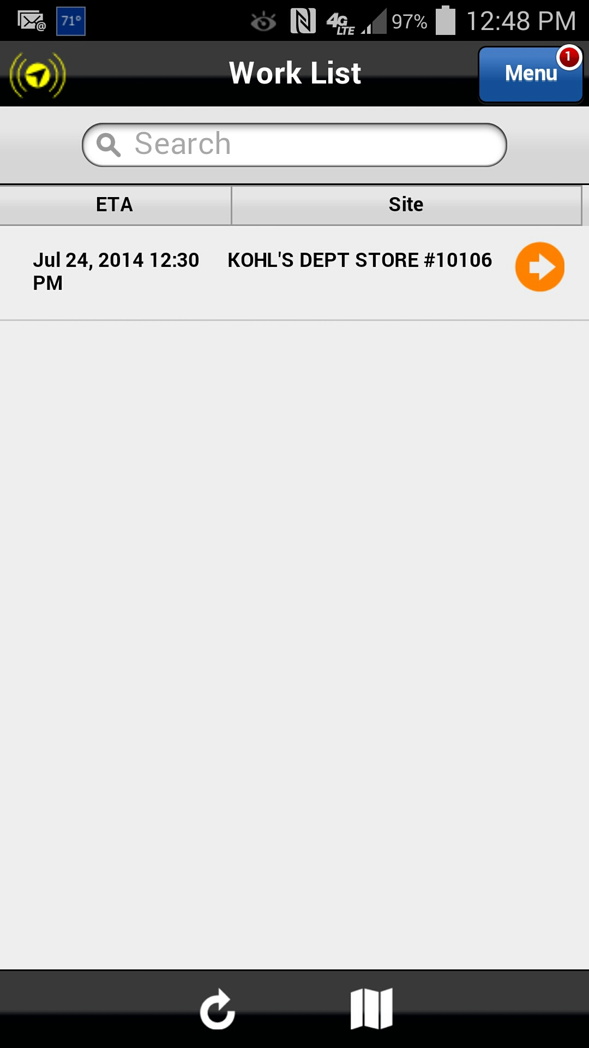
Ticket Resolved
The Service Order has been removed from the Work List. If additional updates to the Service Order are needed after closing, contact your Manager.
Congratulations! You have successfully completed a Service Order in the Astea Mobile App.
This concludes this module.
Click on the Next button below
Previous
Home
End
Next
Icon Legend

Slide 10
Previous
Home
End

Slide 11
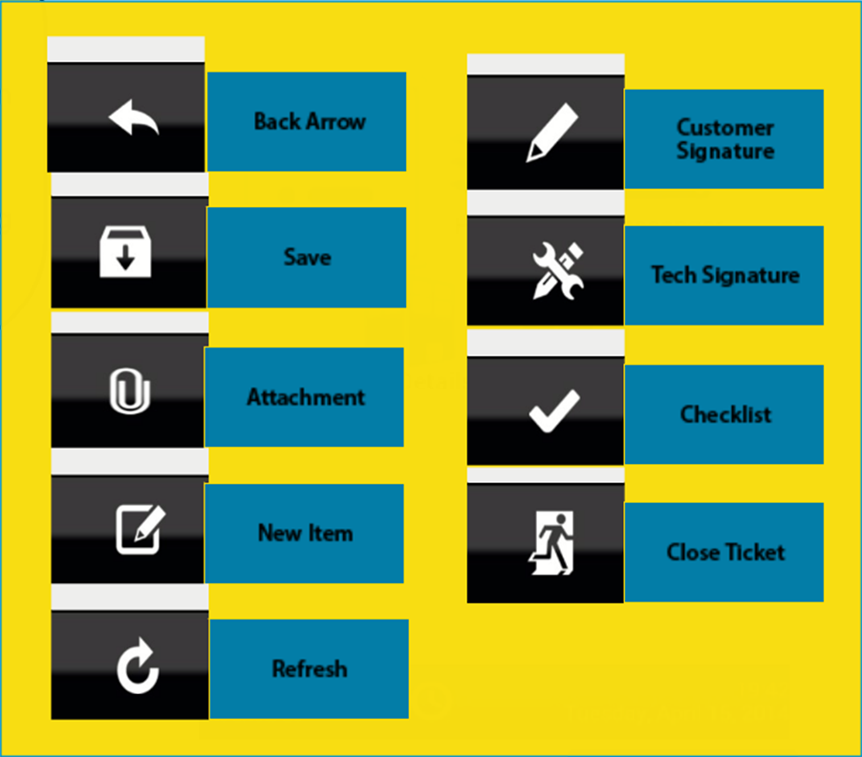
Icon Legend
Common icons used throughout the Astea application
Click on the Return button below to resume presentation
Return

