Slide 1
Astea Mobile App Training
Requesting a Part for a Service Request
Start

Slide 2
Requesting a Part for a Service Request
Module Overview
In this module you will learn how to request a part necessary to complete the service request within the Astea Mobile App. You should only request a part that you do not have on your vehicle or cannot pick up from ADI using your P-Card.
You will request a part in the Astea Mobile App if the part is required from the branch inventory or is required to be ordered with a Purchase Order (PO).
If you request a part in the Astea Mobile App, the App will not allow you to Resolve the service request. When you close the service request, it will return to the SBN queue to be re-dispatched.
Previous
Home
End
Next
Icon Legend

Slide 3
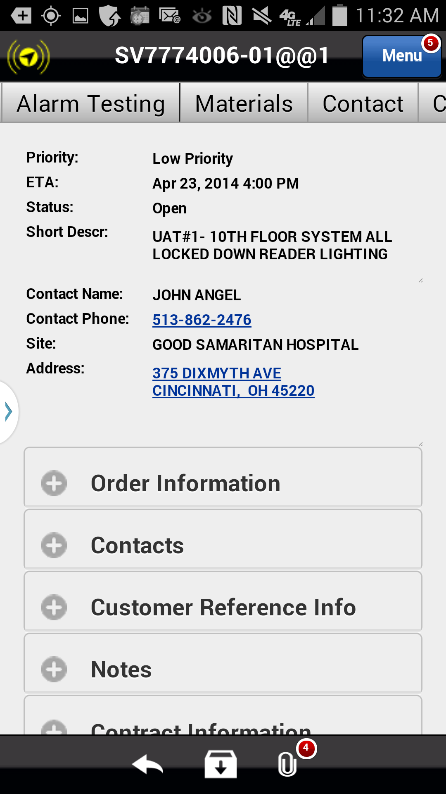
Requesting a Part for a Service Request
The Astea Mobile App’s parts request functionality is in the Materials tab. The part requested must be added to the materials list with a status of ‘Needed’ to trigger the parts ordering process.
To request a part for a service request navigate to the Materials tab.
Action: Click on the Materials tab
Previous
Home
End
Icon Legend

Slide 4
Requesting a Part for a Service Request
A part must be created in the Materials Tab to trigger the Astea Mobile App’s parts ordering functionality.
Action: Click on the Add Item Icon in the footer
Previous
Home
End
Icon Legend

Slide 5
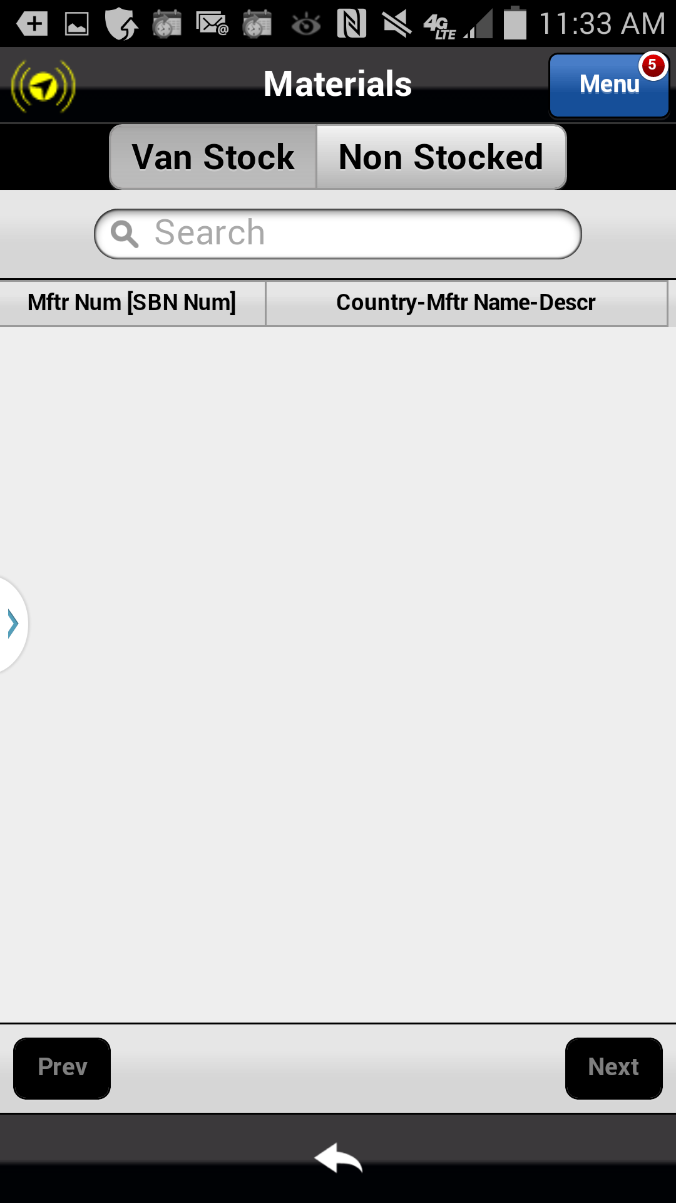
Requesting a Part for a Service Request
A part must be created in the Materials Tab to trigger the Astea Mobile App’s parts ordering functionality.
Action: Click on the Non Stocked tab
Previous
Home
End
Icon Legend

Slide 6
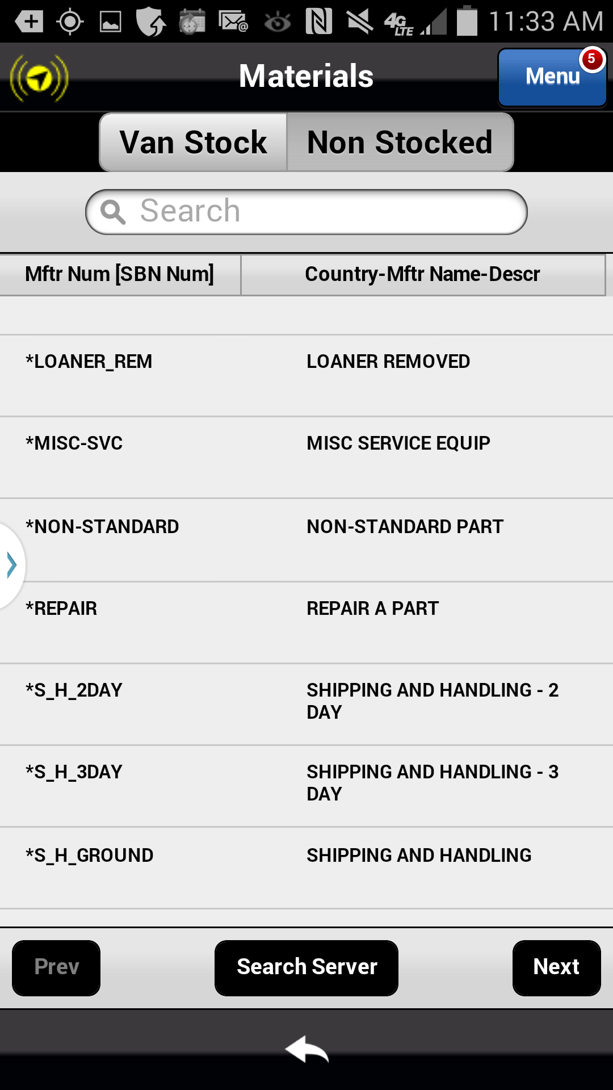
Requesting a Part for a Service Request
A part must be created in the Materials Tab to trigger the Astea Mobile App’s parts ordering functionality.
Action: Click in the Search Bar to search for the part
Previous
Home
End
Icon Legend

Slide 7
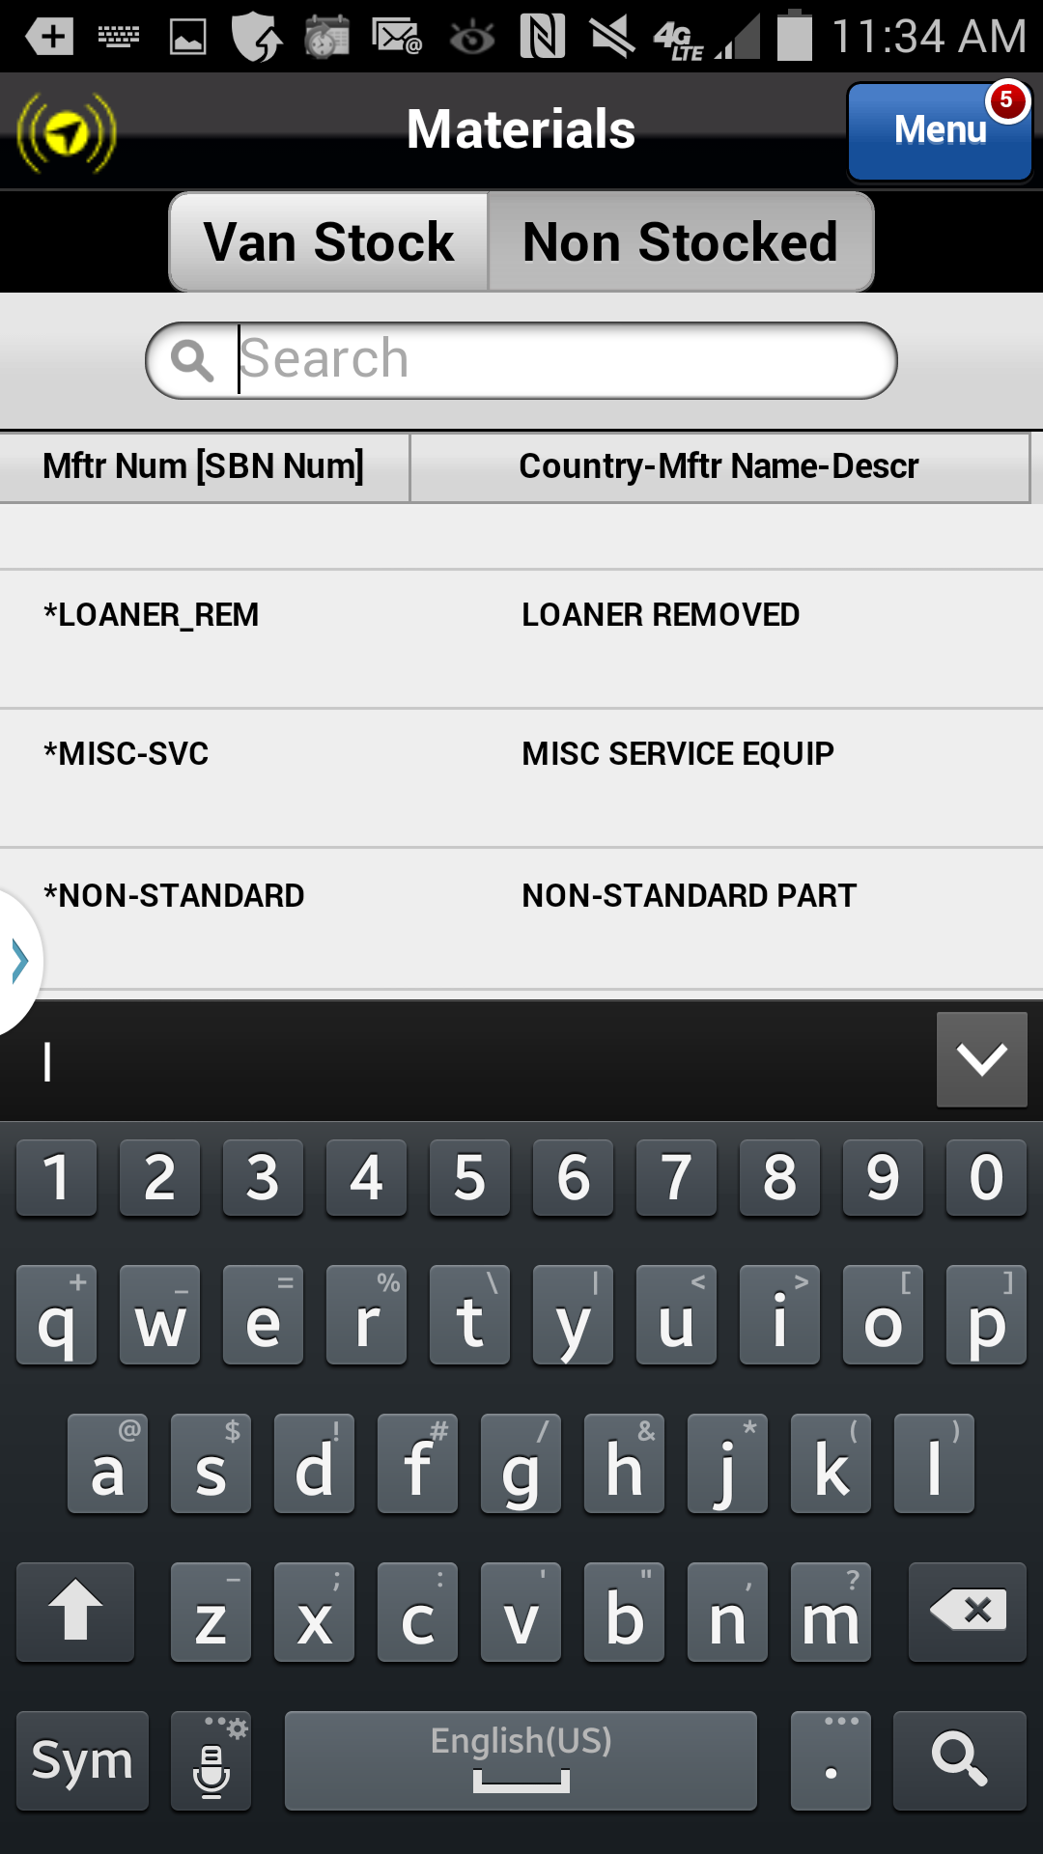
Requesting a Part for a Service Request
A part must be created in the Materials Tab to trigger the Astea Mobile App’s parts ordering functionality.
Search for the part using Manufacturer, Vendor or SBN part # or by keyword search.
Action: Use the keyboard to enter search criteria. Search on keyword ‘reader’
Previous
Home
End
Icon Legend

Slide 8
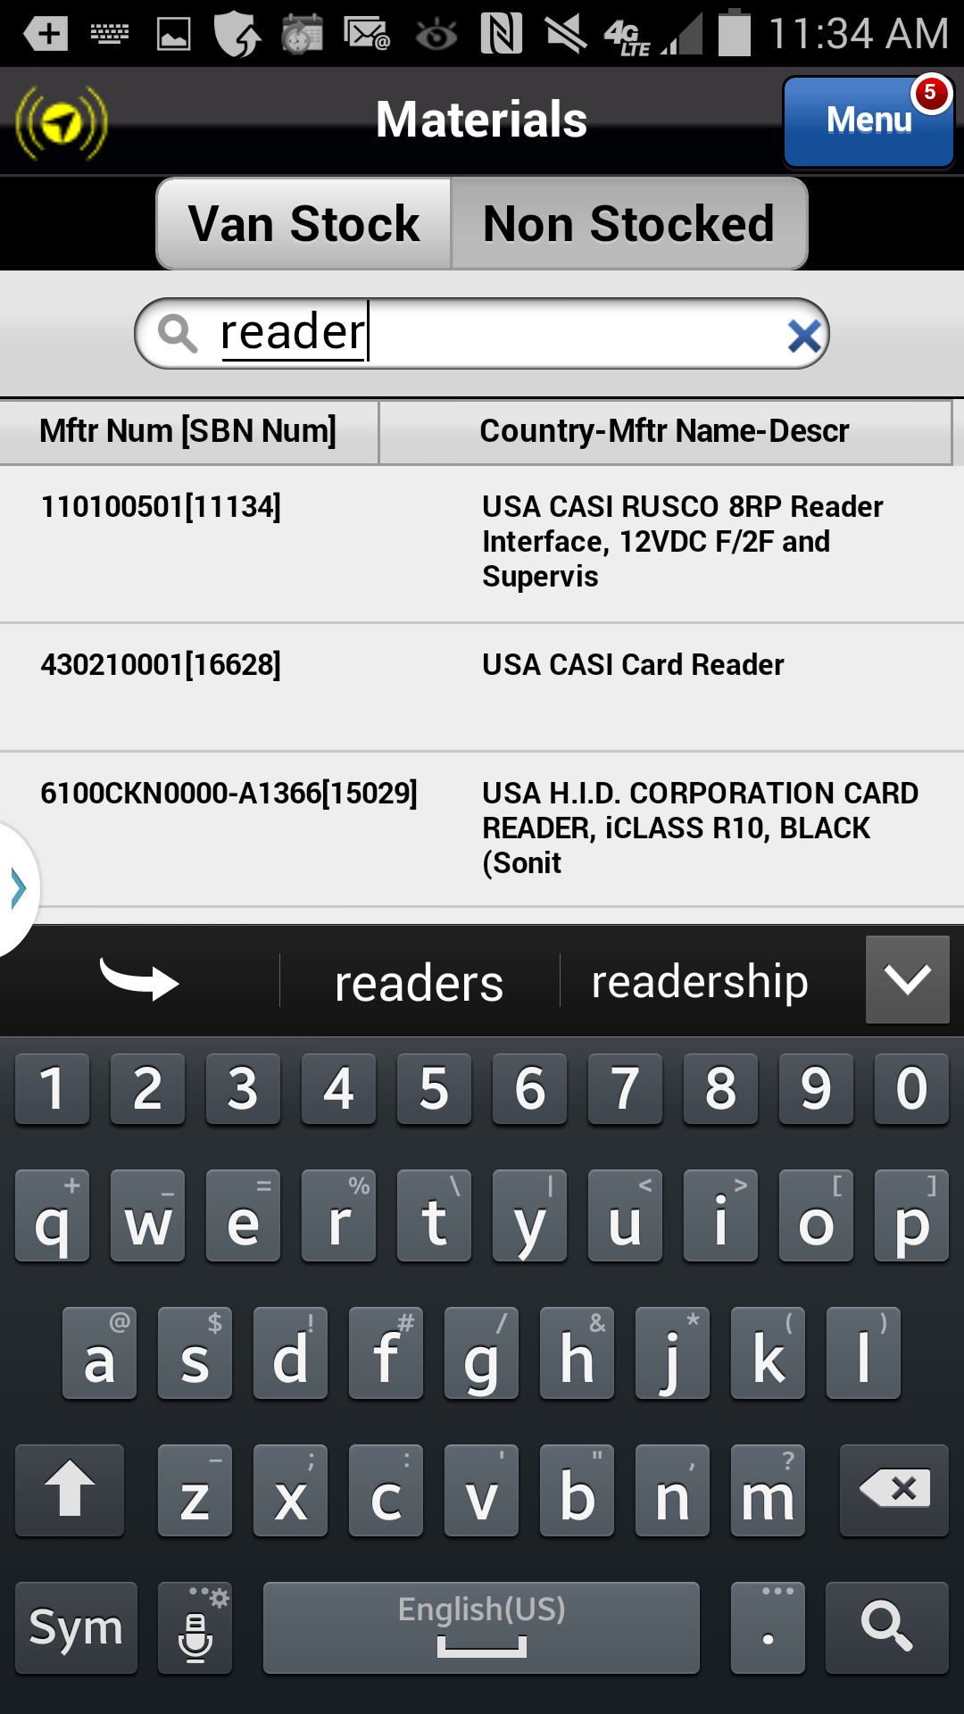
Requesting a Part for a Service Request
A part must be created in the Materials Tab to trigger the Astea Mobile App’s parts ordering functionality.
Action: Click on the search icon on the keyboard
Previous
Home
End
Icon Legend

Slide 9
Requesting a Part for a Service Request
Collapse the keyboard to review all results.
Action: Click on the return arrow on the physical device
Previous
Home
End
Icon Legend

Slide 10
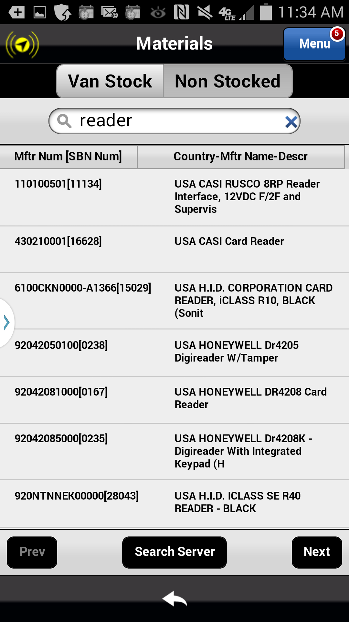
Requesting a Part for a Service Request
If the part needed is not found, use the Search Server button to search the entire Item Master.
If the part is not found in the Item Master, contact your Manager.
Action: Click on part 430210001[16628] to start the request process
Previous
Home
End
Icon Legend

Slide 11
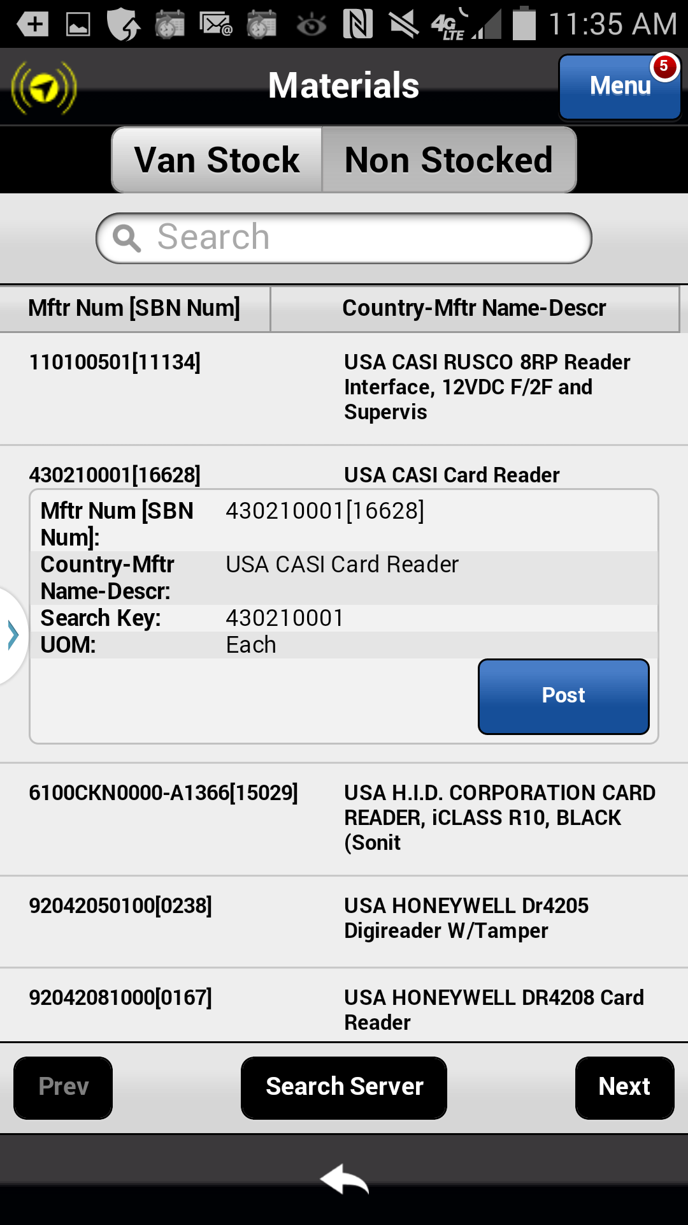
Requesting a Part for a Service Request
Clicking on the part opens the Part Shortcut Menu. You must post the part to the service request to complete the request process.
Action: Click on the Post button
Previous
Home
End
Icon Legend

Slide 12
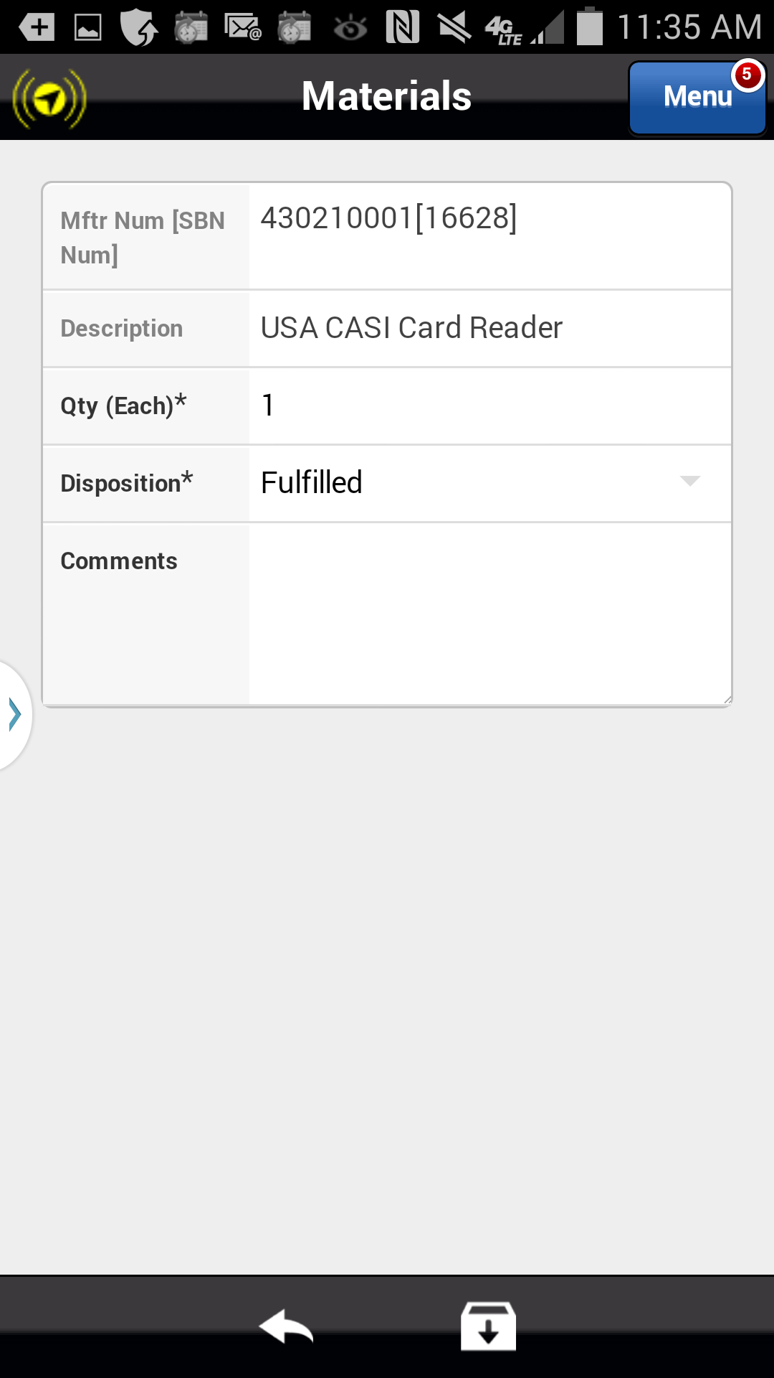
Requesting a Part for a Service Request
To request the part, the Disposition* must be changed from Fulfilled to Open.
Action: Click on the drop down arrow in the Disposition* field
Previous
Home
End
Icon Legend

Slide 13
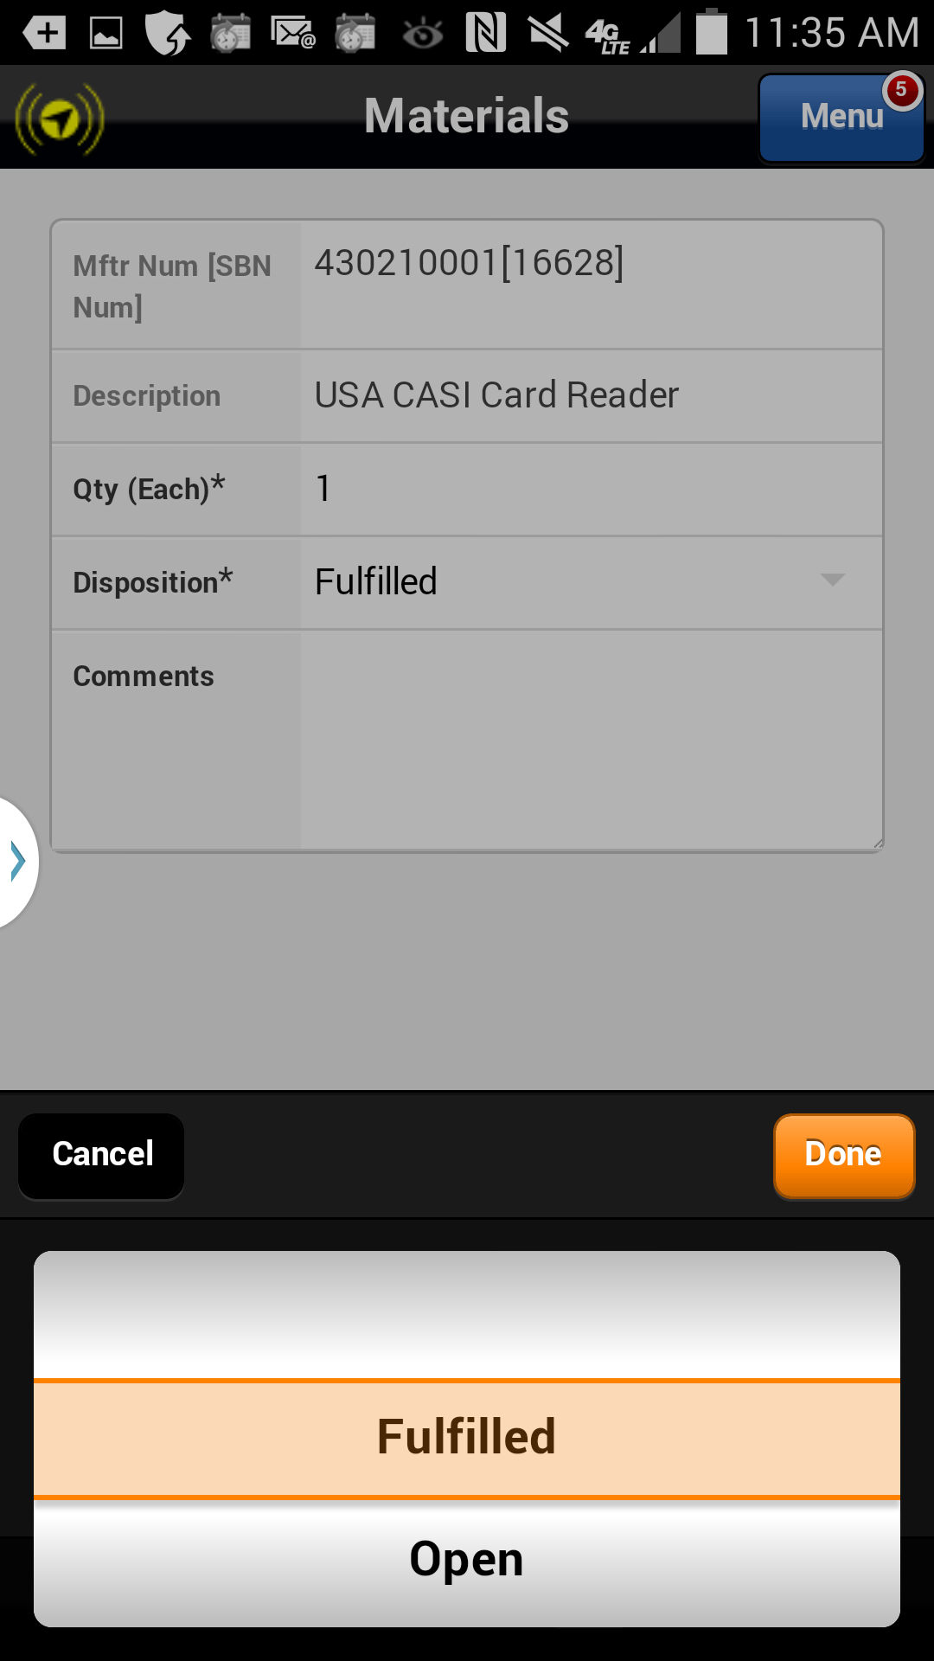
Requesting a Part for a Service Request
To request the part, the Disposition* must be changed from Fulfilled to Open
Action: Click on Open
Previous
Home
End
Icon Legend

Slide 14
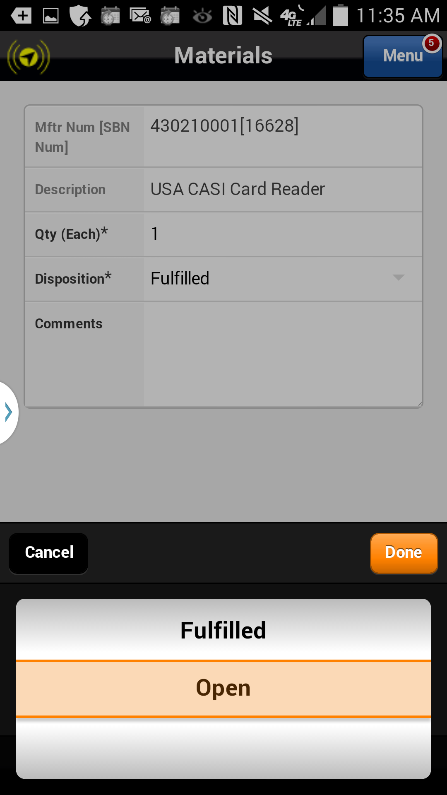
Requesting a Part for a Service Request
To request the part, the Disposition* must be changed from Fulfilled to Open
Action: Click on Done
Previous
Home
End
Icon Legend

Slide 15
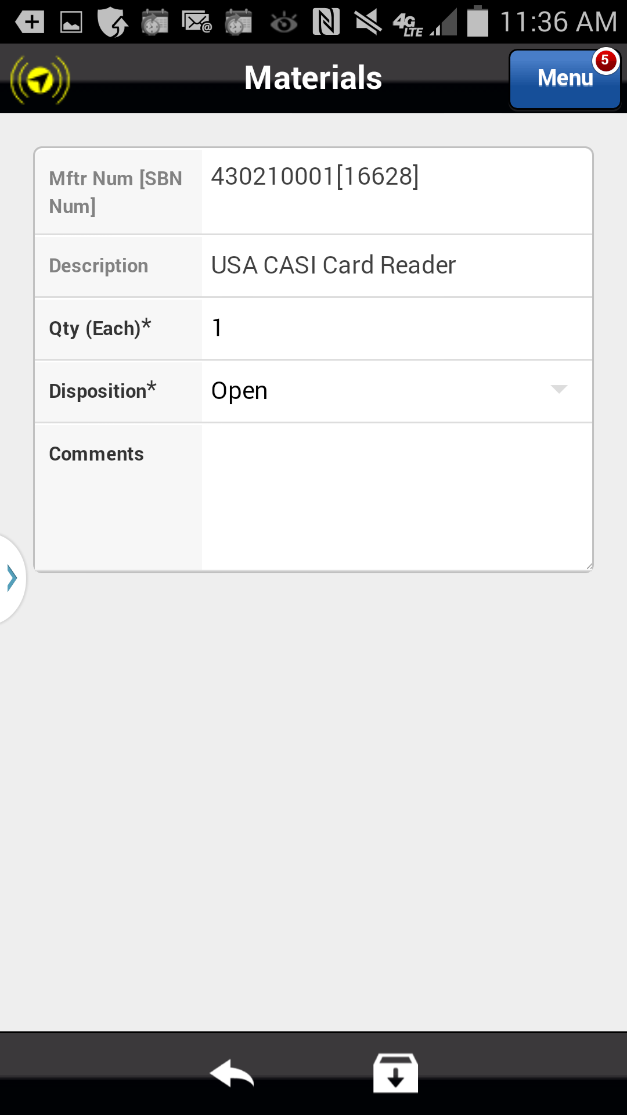
Requesting a Part for a Service Request
To request the part, the Disposition* must be changed from Fulfilled to Open
Disposition of Open indicates part is requested, not used.
Action: Click on the Save icon in the footer
Previous
Home
End
Icon Legend

Slide 16
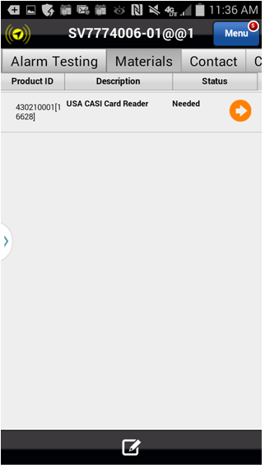
Requesting a Part for a Service Request
The part has been added to the Materials list with a Status of Needed. When the service request is closed on your device a request for this part will be sent to the branch for purchasing.
Repeat this process to add additional parts needed.
Closing a request in the Astea Mobile App with a parts request is slightly different than closing a request with parts used.
The next section of the module will review the appropriate Stop Code and Completion steps that differ from the standard process.
Status of Needed indicates part is requested, not used.
Click on the Next button below
Previous
Home
End
Next
Icon Legend

Slide 17
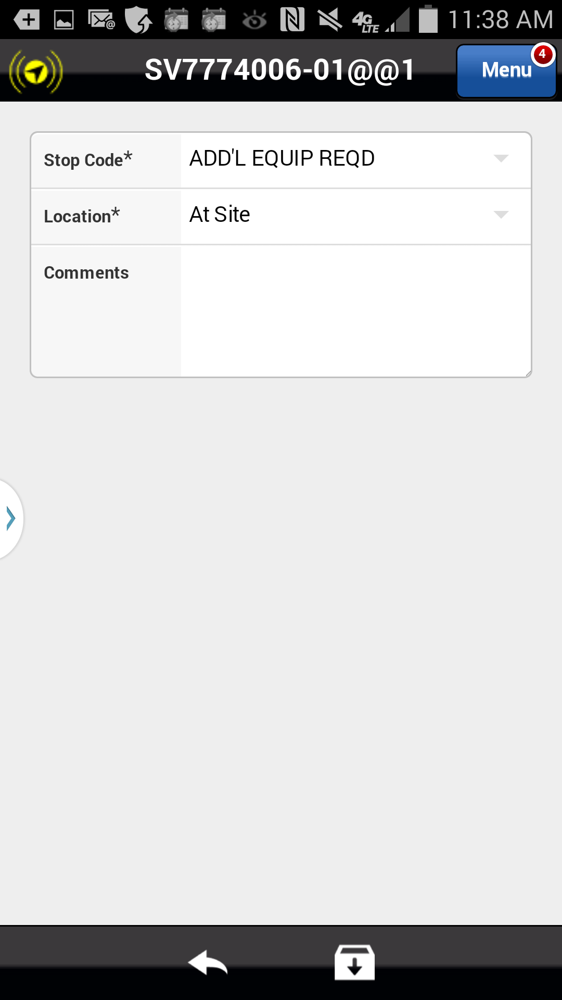
Requesting a Part for a Service Request
When completing your Labor Activity ensure the Stop Code* is changed from RESOLVED to ADD’L EQUIP REQD.
Update Stop Code
Click on the Next button below
Previous
Home
End
Next
Icon Legend

Slide 18
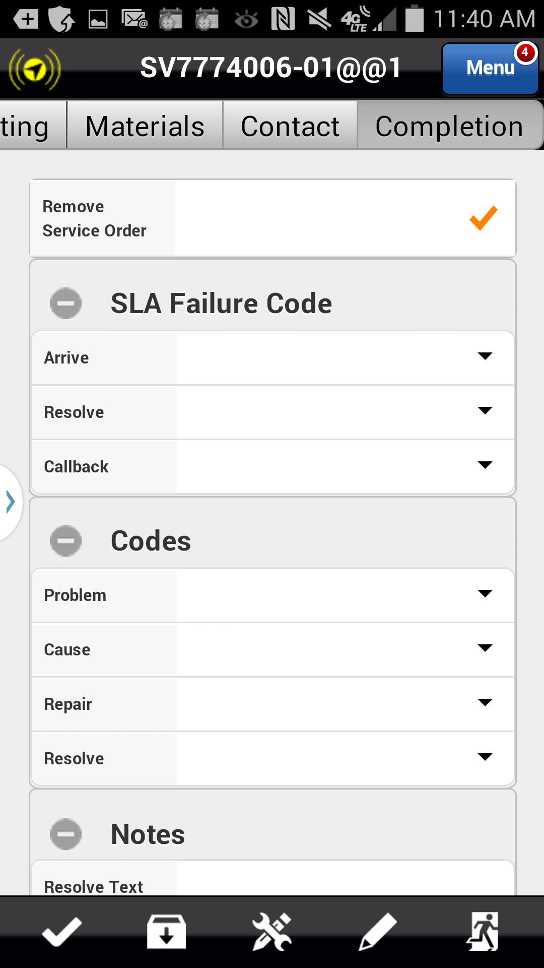
Requesting a Part for a Service Request
When completing the request in the Completion tab notice the check box to Resolve the request is not available.
Since the Labor Activity was stopped with a Stop Code of ADD’L EQUIP REQ the request cannot be resolved.
When your onsite work is complete, remove the request from your device and exit. The request will return to the SBN queue for re-dispatch when the part requested is obtained.
Resolved Checkbox disabled
Action: Click on the Exit icon in the footer
Previous
Home
End
Icon Legend

Slide 19
Previous
Home
End

Slide 20
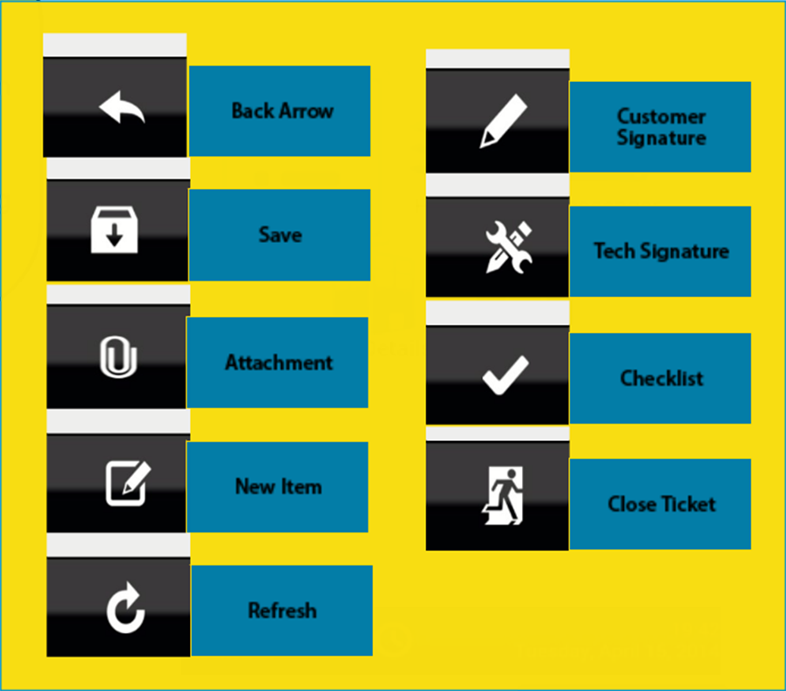
Icon Legend
Common icons used throughout the Astea application
Click on the Return button below to resume presentation
Return

