Slide 1
Astea Mobile App Training
Using a Preventative Maintenance/Inspection Checklist
Start

Slide 2
Preventative Maintenance/Inspection Checklist
Module Overview
In this module you will learn how to add a preventative maintenance/inspection checklist to a service request in the Astea Mobile App.
The Astea Mobile App allows you to electronically complete 5 different preventative maintenance/inspection checklists.
The checklists include:
Sonitrol Audio Intrusion
STANLEY Access Control
STANLEY Traditional Intrusion
STANLEY UL Inspection
STANLEY Video
Checklists completed within the Astea Mobile App will be attached to the PDF Service Ticket e-mailed to the customer. All other checklists must be completed manually (Paper) outside of the Astea Mobile App.
Previous
Home
End
Next
Icon Legend

Slide 3
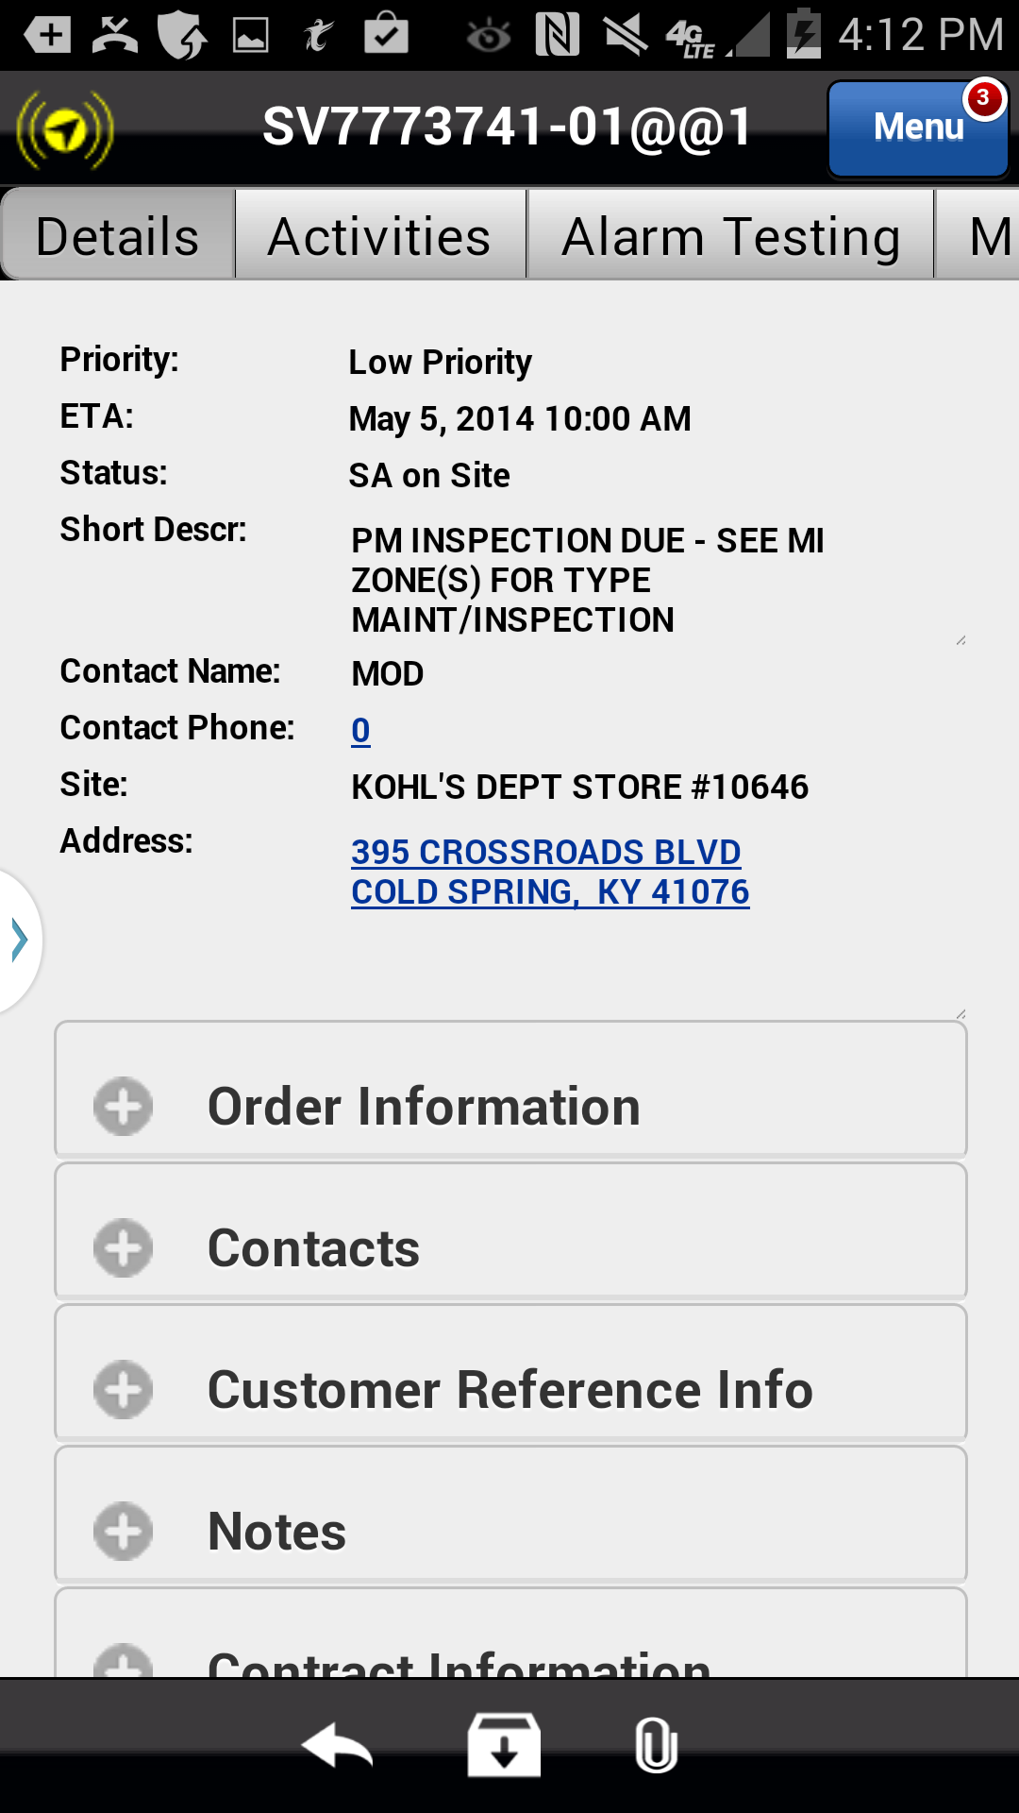
Preventative Maintenance/Inspection Checklist
The Astea Mobile App utilizes checklists within the Activities tab. A checklist activity must be added to use the electronic checklist functionality within the Astea Mobile App.
To use a checklist within the Astea Mobile App navigate to the Activities tab.
Action: Click on the Activities tab
Previous
Home
End
Icon Legend

Slide 4
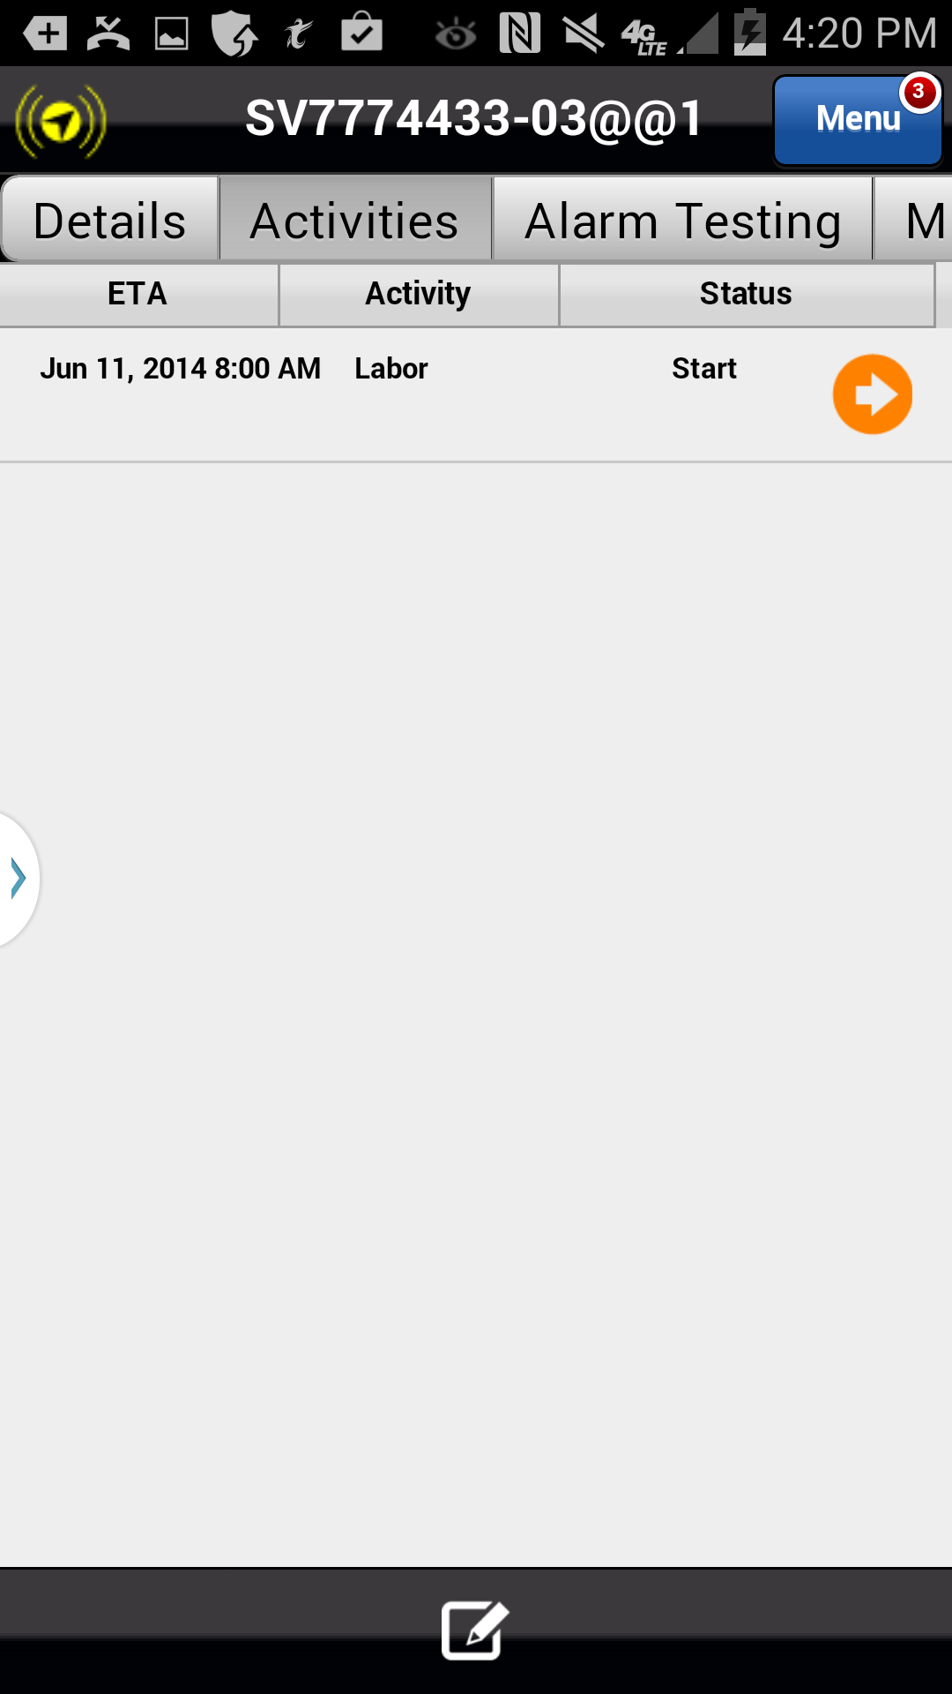
Preventative Maintenance/Inspection Checklist
A new activity must be created to add a checklist.
Action: Click on the Add Item Icon in the footer
Previous
Home
End
Icon Legend

Slide 5
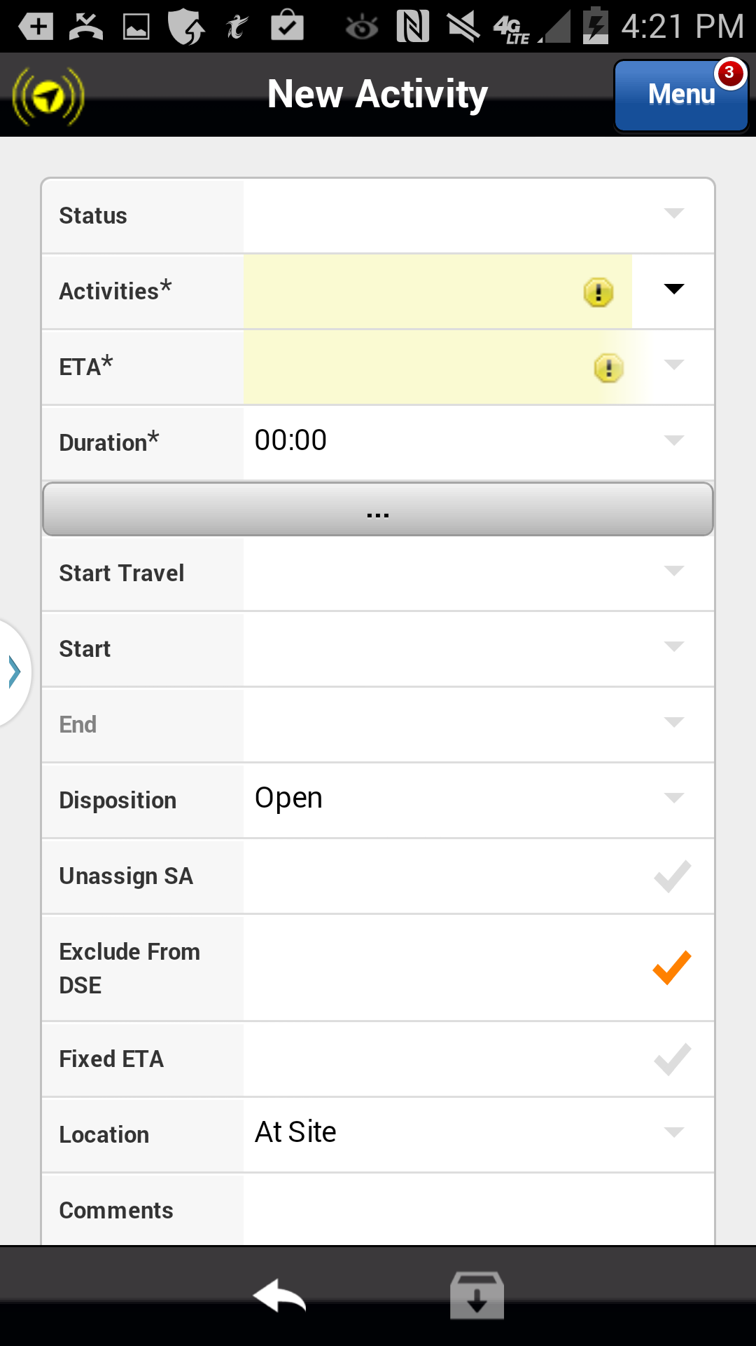
Preventative Maintenance/Inspection Checklist
To add a checklist, select the checklist type in the Activities* section.
Action: Click drop down arrow in the Activities* field
Previous
Home
End
Icon Legend

Slide 6
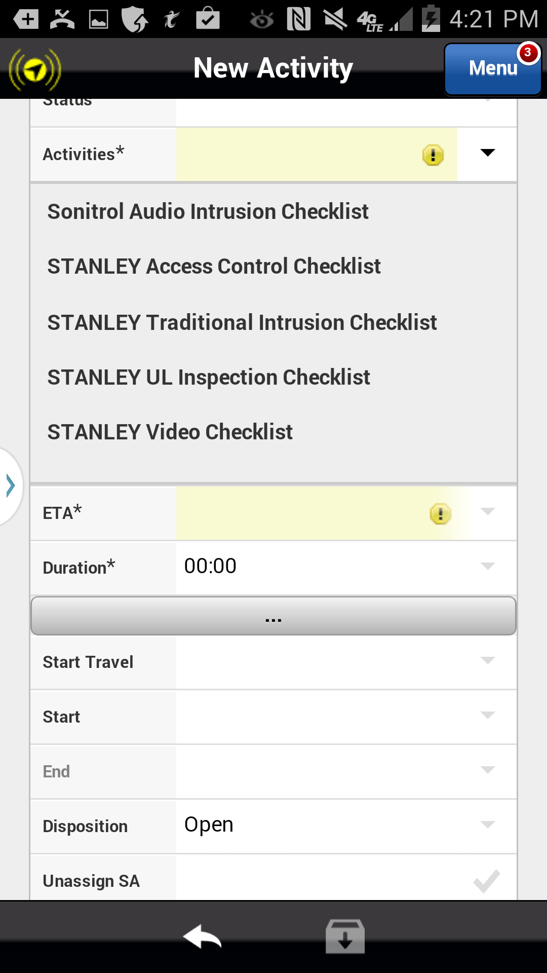
Preventative Maintenance/Inspection Checklist
To add a checklist, select the checklist type in the Activities* section.
Action: Select the STANLEY Traditional Intrusion Checklist
Previous
Home
End
Icon Legend

Slide 7
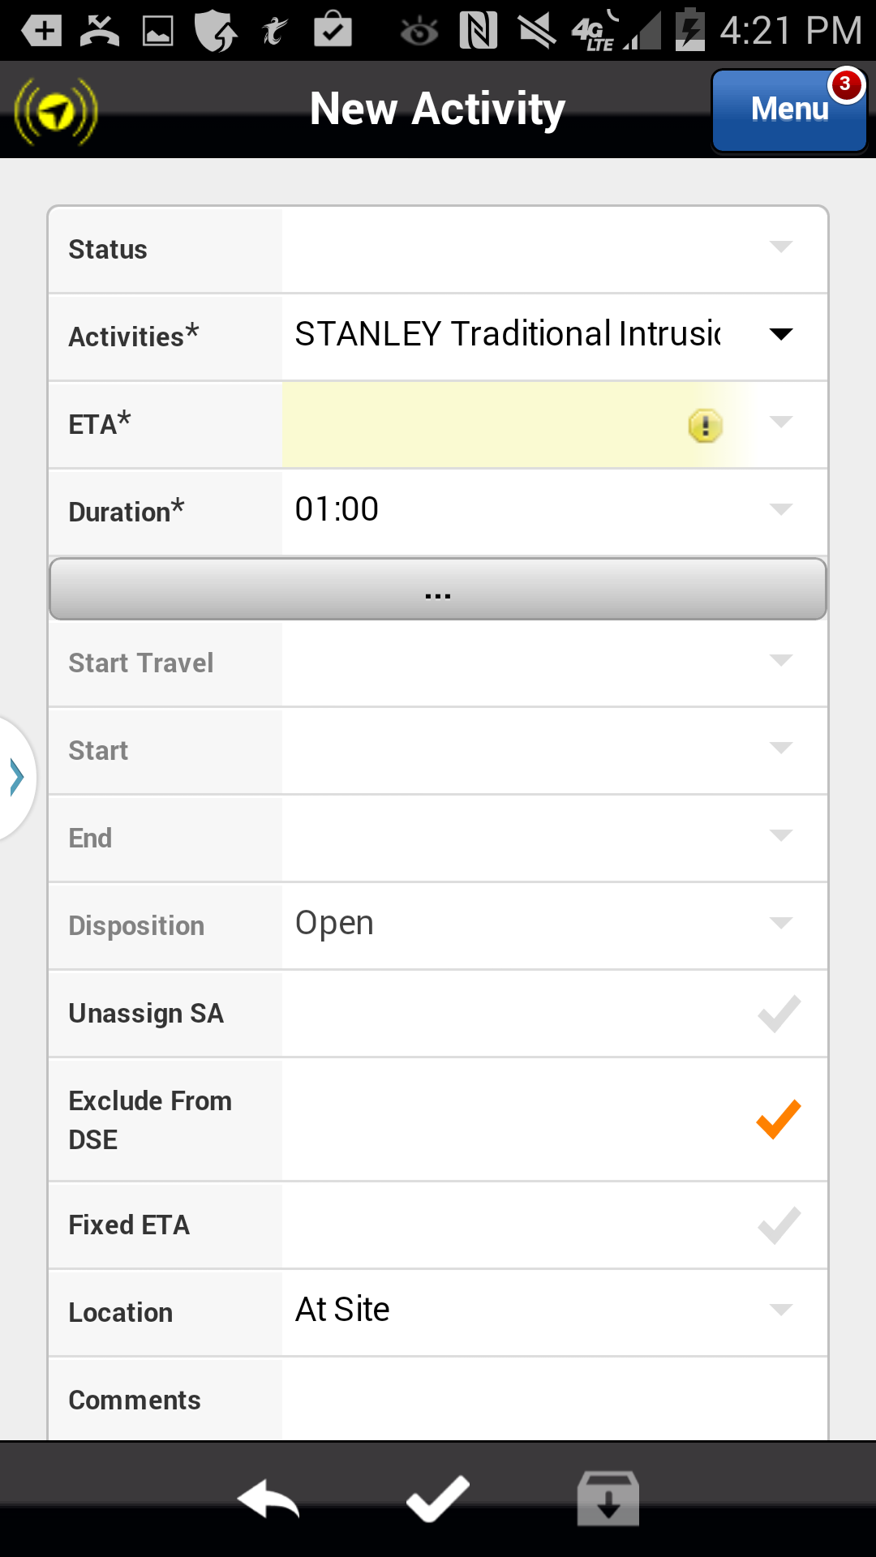
Preventative Maintenance/Inspection Checklist
Any new Activity must have an ETA set. The ETA is a required field in the Astea Mobile App but is not used by Stanley CSS. Always enter the current date and time.
Action: Click drop down arrow in the ETA* field
Previous
Home
End
Icon Legend

Slide 8
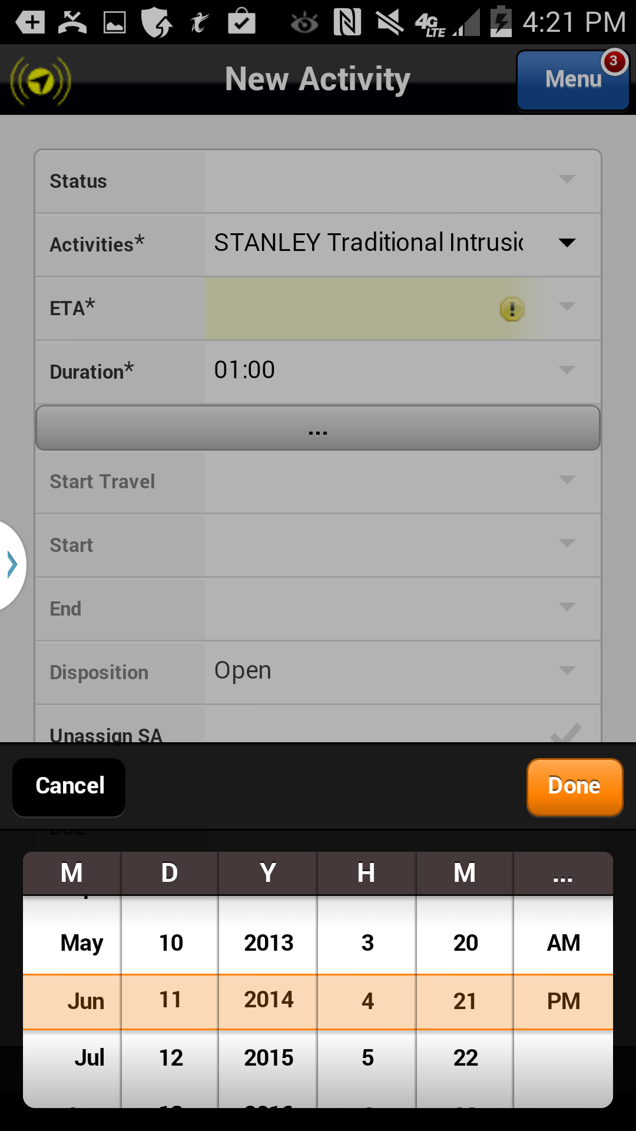
Preventative Maintenance/Inspection Checklist
The Astea Mobile App defaults the ETA to the current date and time (highlighted). Always use the default date and time.
Action: Click the Done button
Previous
Home
End
Icon Legend

Slide 9
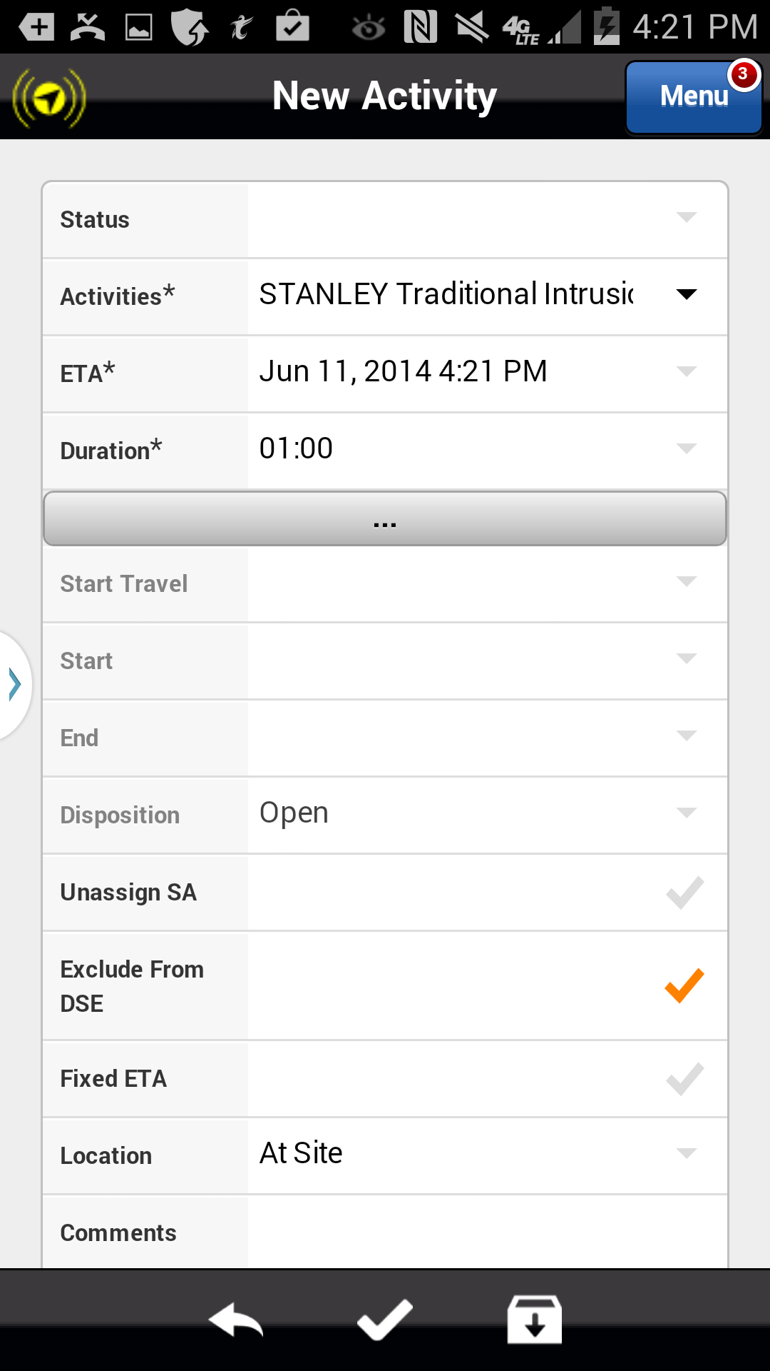
Preventative Maintenance/Inspection Checklist
To apply the checklist to the service request you must save the new activity.
Action: Click the Save icon in the footer
Previous
Home
End
Icon Legend

Slide 10
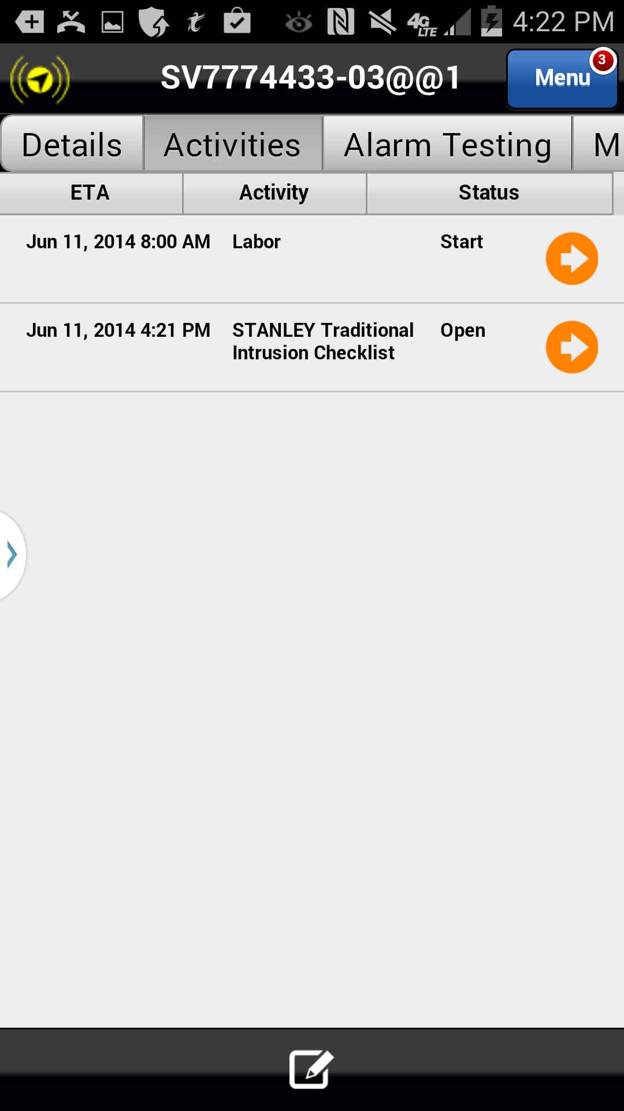
Preventative Maintenance/Inspection Checklist
A new checklist activity of ‘STANLEY Traditional Intrusion Checklist’ has been created with a status of Open. This status indicates the checklist is not complete. When completed, the checklist will have a status of Fulfilled.
The next section of this training will cover how to complete (Fulfill) the checklist.
Action: Click on the Activity ETA, Name or Status
Do Not Click the Orange Arrow
Previous
Home
End
Icon Legend

Slide 11
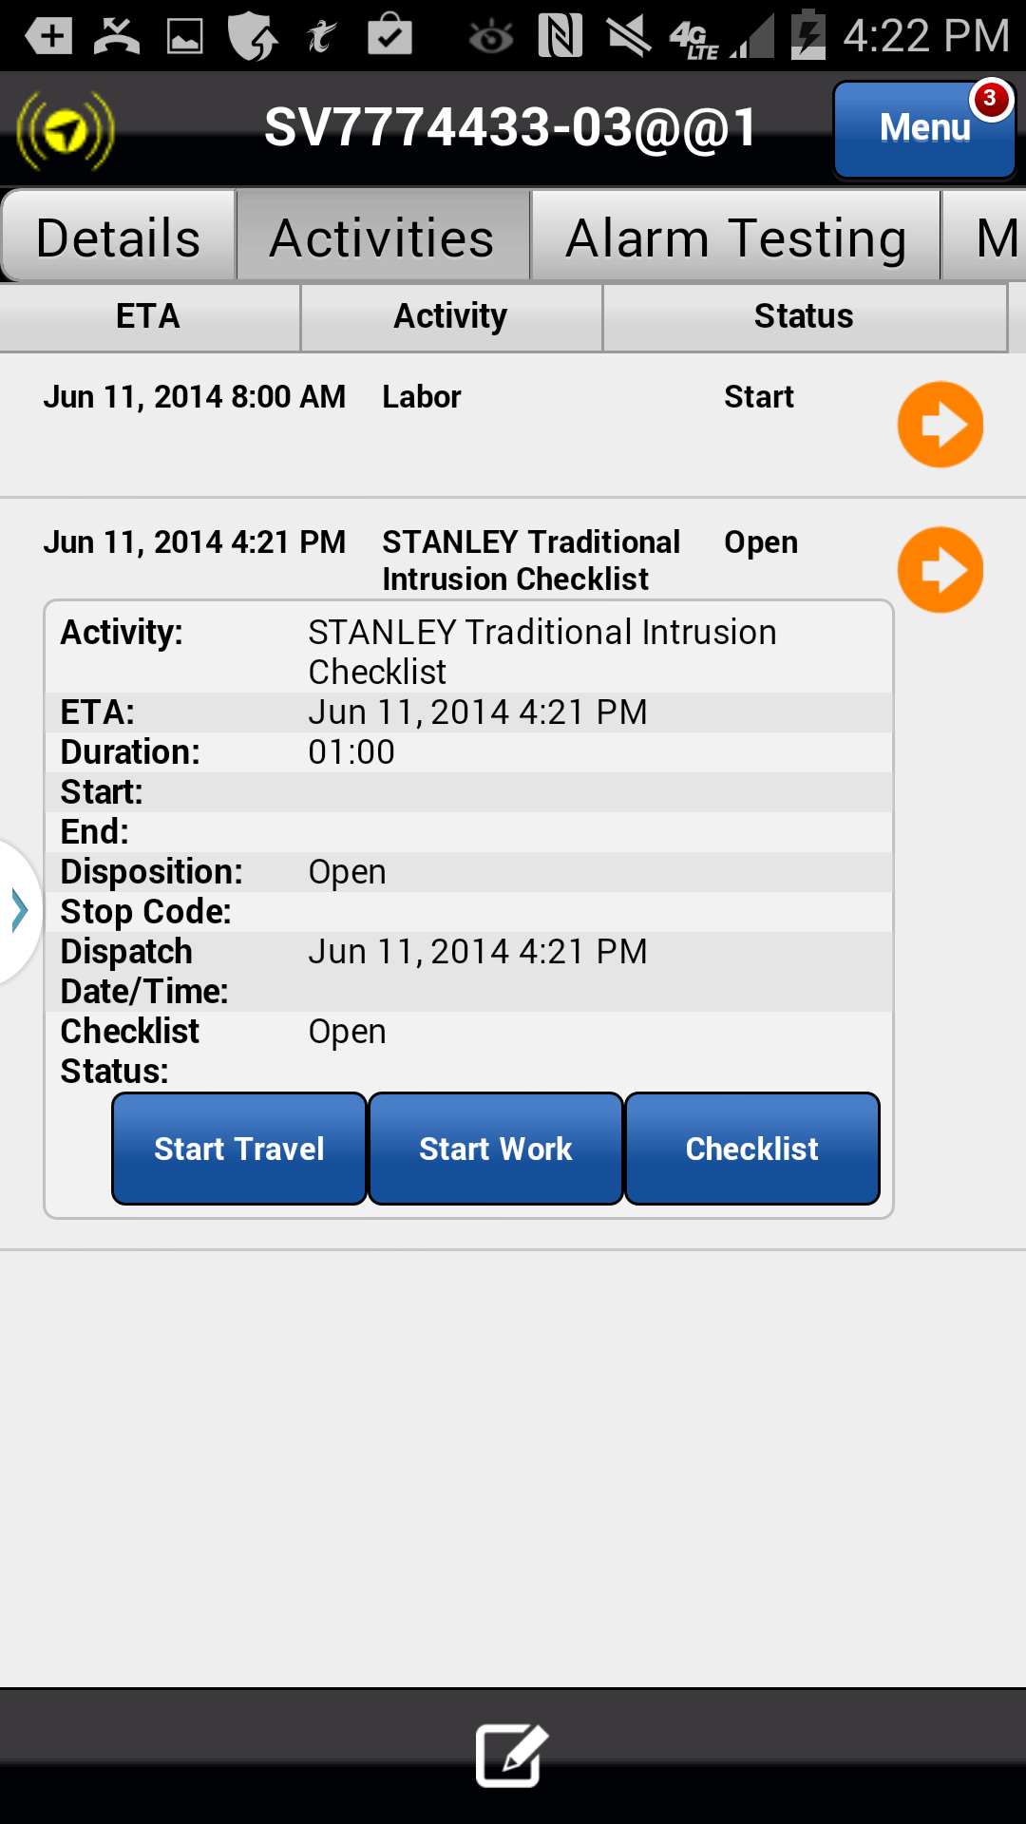
Preventative Maintenance/Inspection Checklist
Clicking on the Activity ETA, Name or Status opens the Activity Shortcut Menu. You must start work on the checklist to complete it.
Action: Click on the Start Work button
Previous
Home
End
Icon Legend

Slide 12
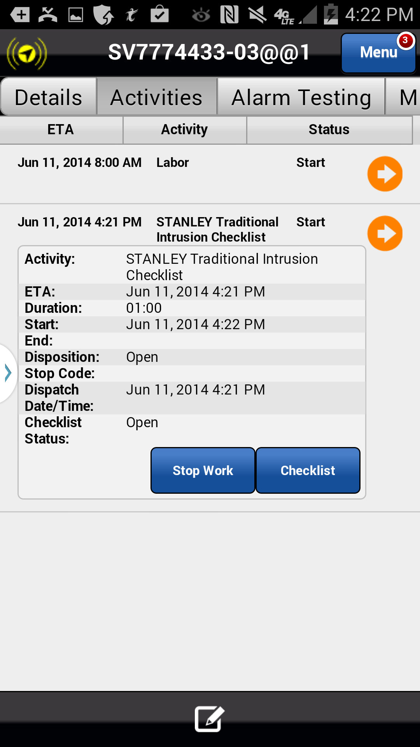
Preventative Maintenance/Inspection Checklist
Once you have started the checklist activity the activity status has updated to ‘Start’. Once the activity is started, you may complete the checklist within the Astea Mobile App.
Status Update
Action: Click on the Checklist button
Previous
Home
End
Icon Legend

Slide 13
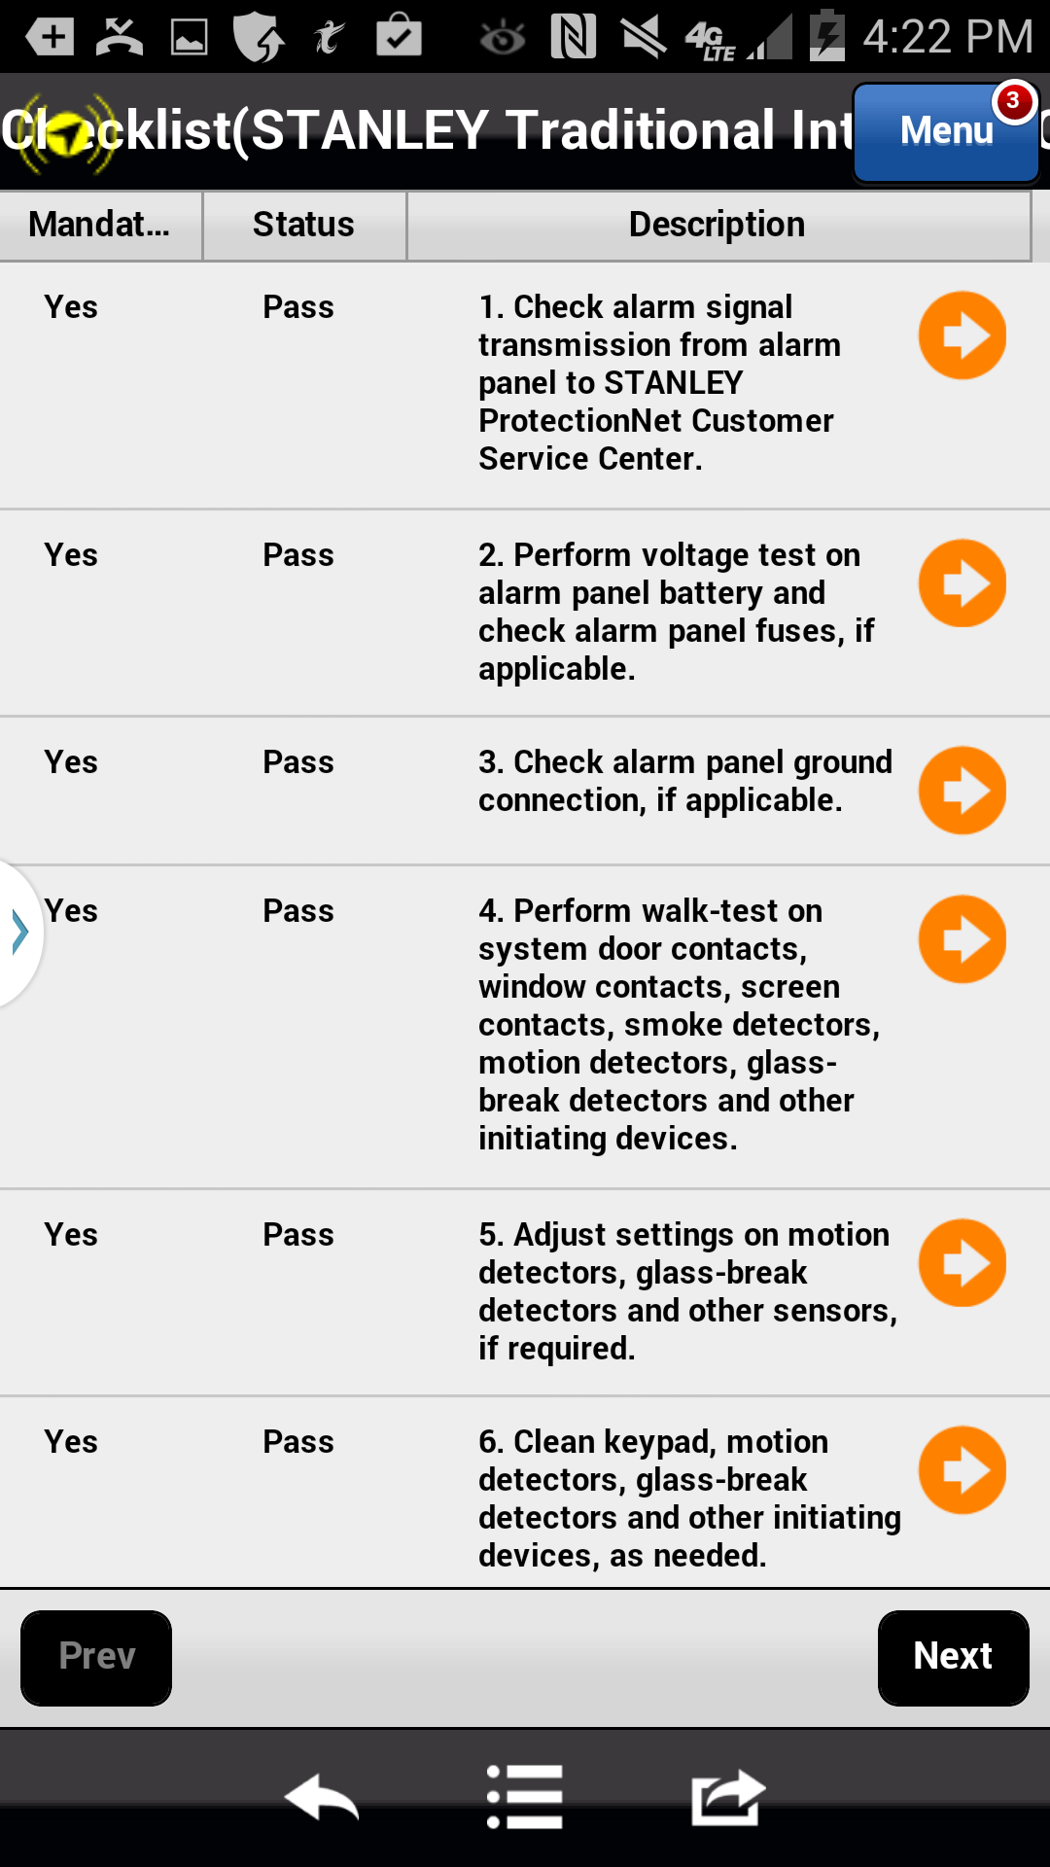
Preventative Maintenance/Inspection Checklist
Once you have clicked the checklist button, a summary of all questions on the checklist is displayed.
The Astea Mobile App defaults the answers to all questions as Pass. However, if any section failed during your inspection you will need to update the Status to Fail.
Each question must be reviewed. To review the question and validate the correct answer click on the Orange Arrow next to the first question.
Action: Click on the Orange Arrow
Previous
Home
End
Icon Legend

Slide 14
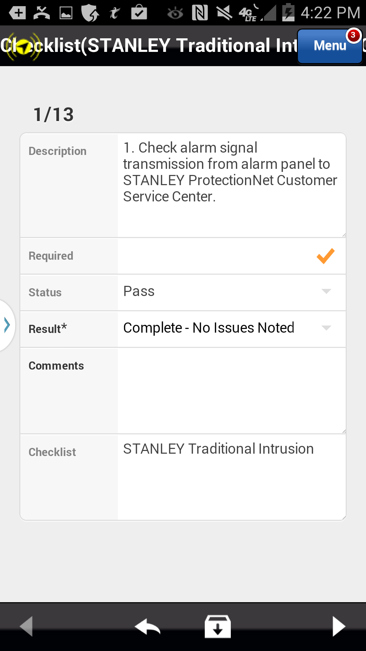
Preventative Maintenance/Inspection Checklist
The details of the question are displayed along with the option to change the answer from pass to fail.
To change the answer from pass to fail you must update the Result* field. Click on the drop down arrow in the Result* field to change the question status. Results can be:
Complete-No Issues Noted (Pass)
Complete-Issues Noted (Fail)
Not Applicable (Fail)
For this training we will assume all inspections pass and updates are not necessary.
Click here to change the result
Action: Click on the right facing arrow in the footer to advance to the next question
Previous
Home
End
Icon Legend

Slide 15
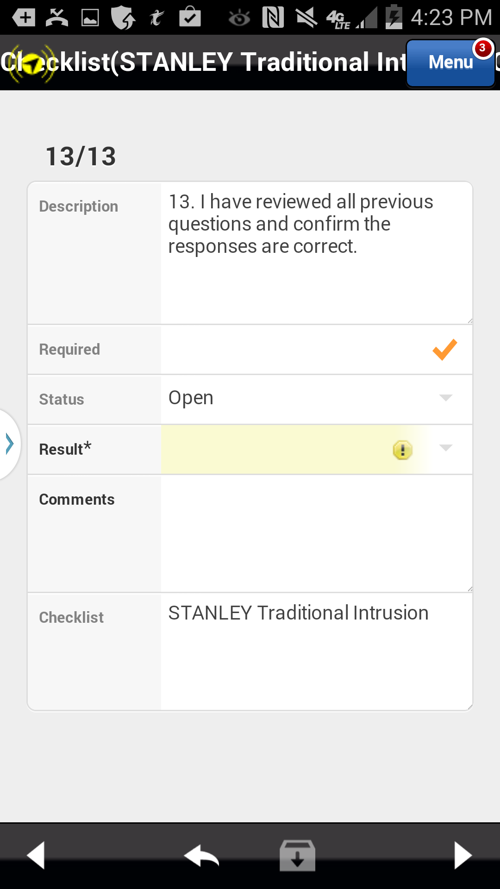
Preventative Maintenance/Inspection Checklist
Review all questions in the checklist and confirm the default results or update as necessary. The last question on each checklist is not defaulted and you must enter an answer.
The last question confirms you have reviewed each question and confirmed all results are accurate.
Update the Result* field to complete this question
Last question
Action: Click on the drop down arrow in the Result* field
Previous
Home
End
Icon Legend

Slide 16
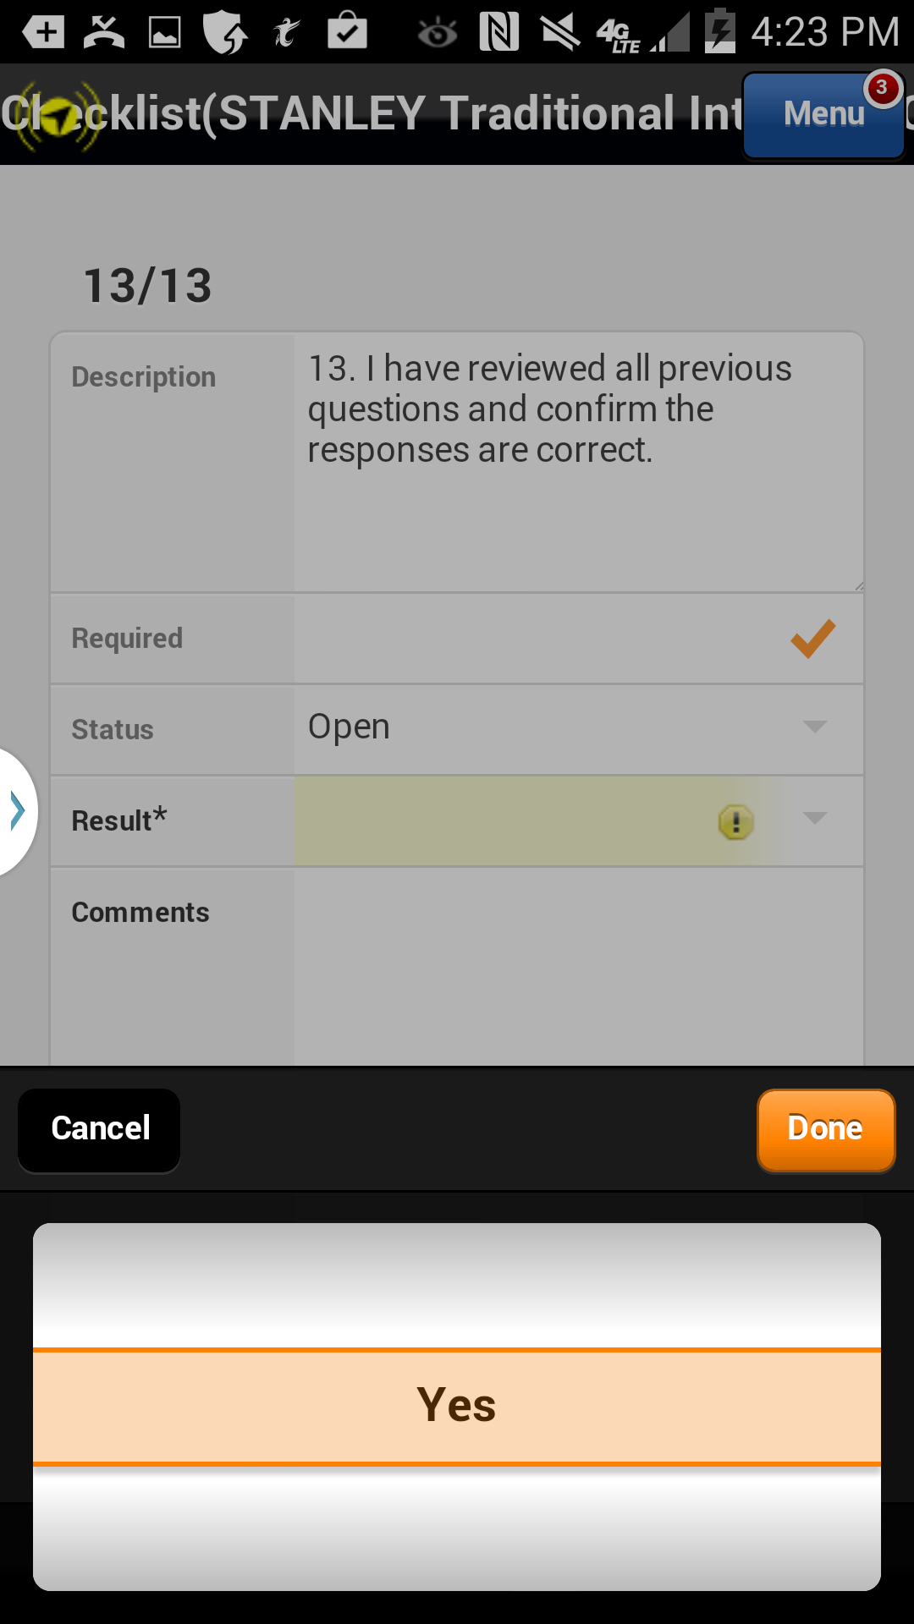
Preventative Maintenance/Inspection Checklist
Yes is the only option for the question and is the default selection.
Action: Click on the Done button
Previous
Home
End
Icon Legend

Slide 17
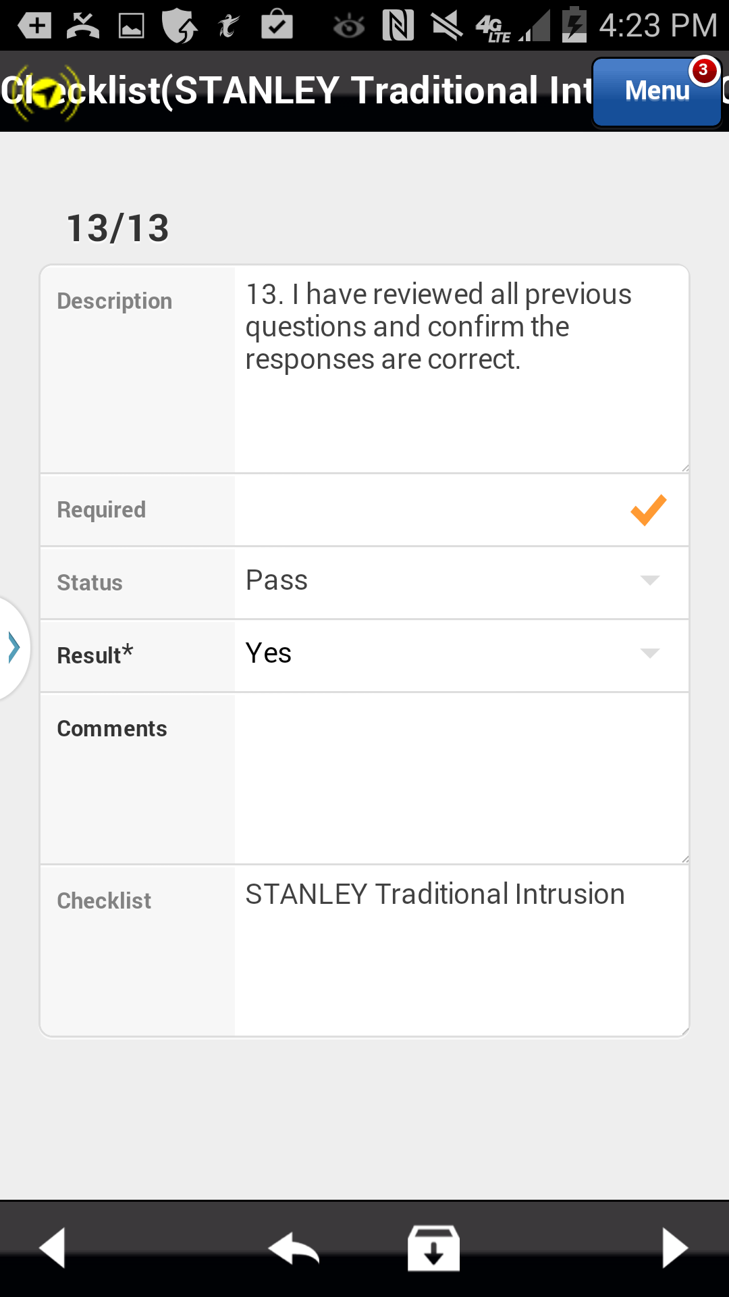
Preventative Maintenance/Inspection Checklist
Click on the right arrow in the footer to complete the checklist questions.
Action: Click on the right arrow in the footer
Previous
Home
End
Icon Legend

Slide 18
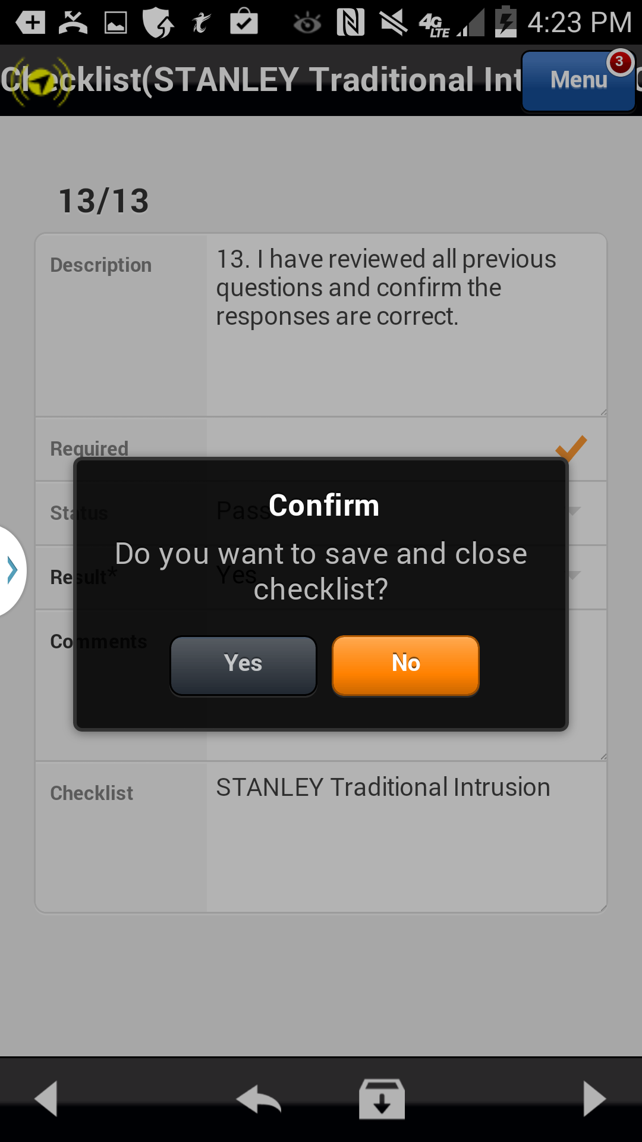
Preventative Maintenance/Inspection Checklist
Confirm your results
Action: Click on the Yes button
Previous
Home
End
Icon Legend

Slide 19
Preventative Maintenance/Inspection Checklist
Once completed, stop work on the checklist activity.
Action: Click the Stop Work button
Previous
Home
End
Icon Legend

Slide 20
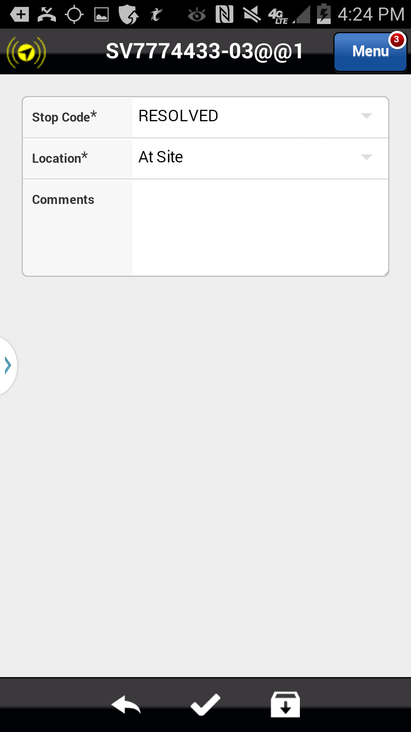
Preventative Maintenance/Inspection Checklist
Resolve the activity.
Action: Click the Save icon in the footer
Previous
Home
End
Icon Legend

Slide 21
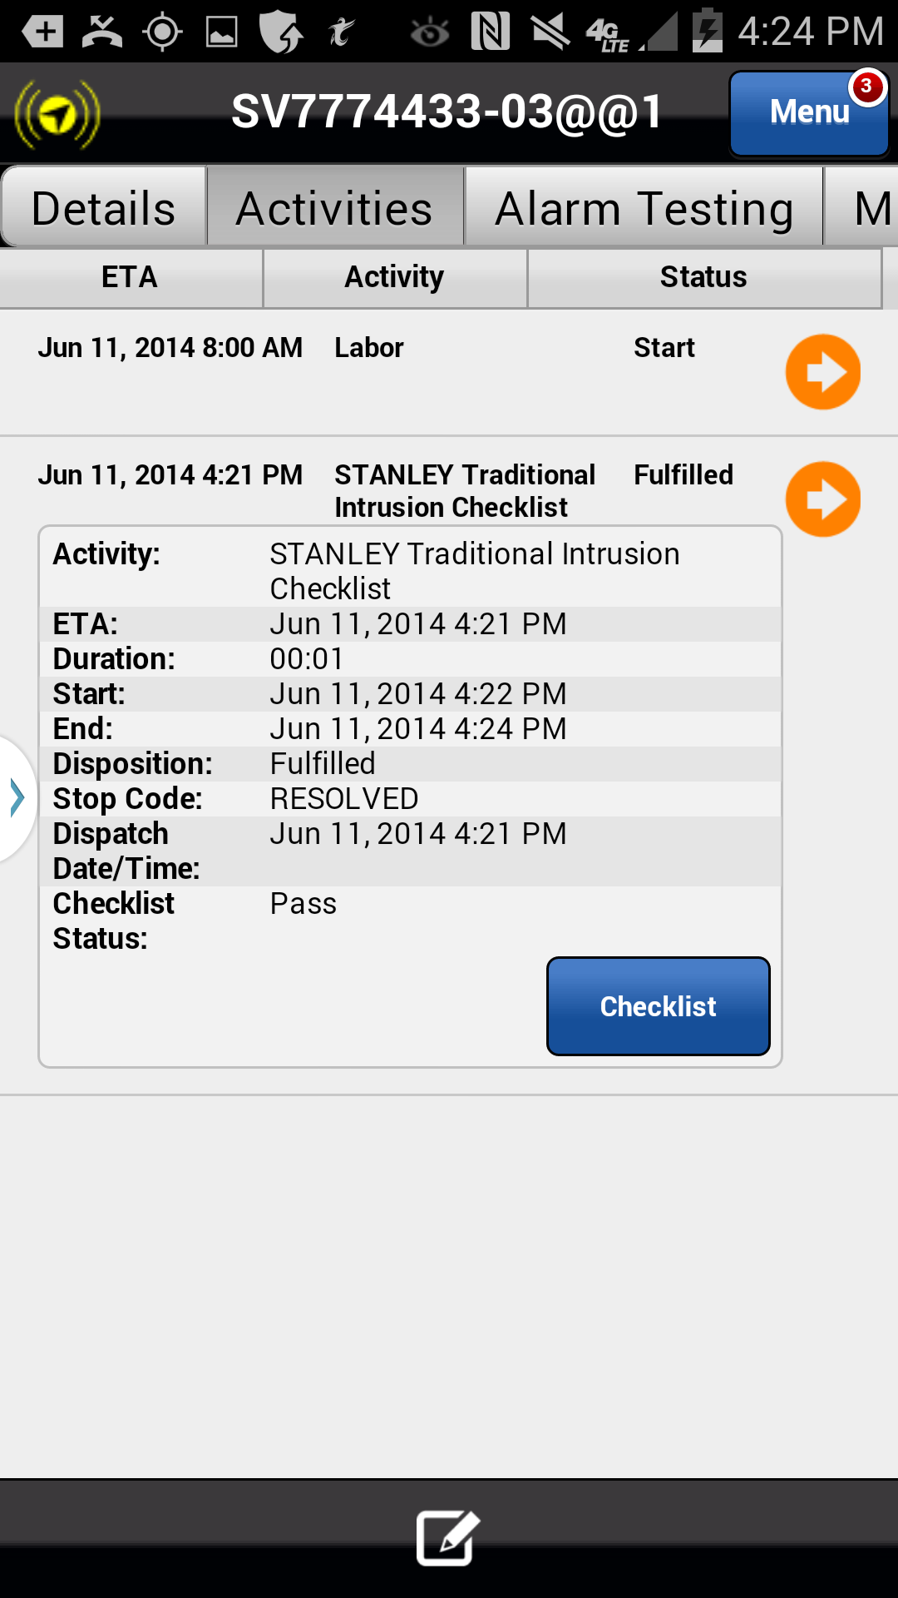
Preventative Maintenance/Inspection Checklist
The checklist is complete. Note the status of the checklist activity has changed from Open to Fulfilled. The checklist, with your results will be attached to the PDF service ticket e-mailed to the customer.
This concludes this module.
Status Update
Click on the Next button below
Previous
Home
End
Next
Icon Legend

Slide 22
Previous
Home
End

Slide 23
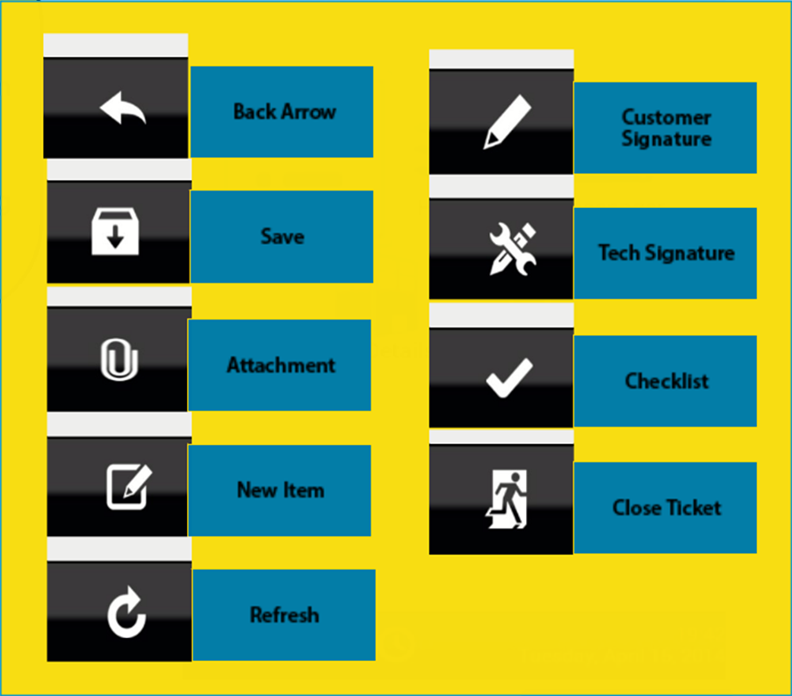
Icon Legend
Common icons used throughout the Astea application
Click on the Return button below to resume presentation
Return

