Slide 1
Astea Mobile App Training
Materials Shipping and Handling
Start

Slide 2
Adding Shipping and Handling Charges
Module Overview
In this module you will learn how to apply Shipping and Handling charges to a service request.
In some instances expedited shipping is necessary to meet a customers needs. If parts were expedited you must add an expedited shipping and handling part to the service request.
Click on the Next button below
Previous
Home
End
Next
Icon Legend

Slide 3
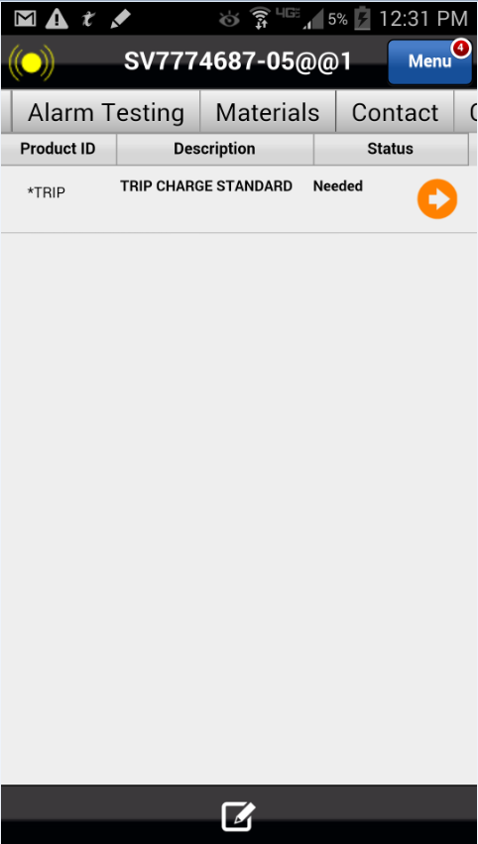
Adding Shipping and Handling Charges
The Astea Mobile App’s Shipping and Handling parts are found in the Materials tab. The Shipping and Handling part must be added to the Materials list with a status of Fulfilled.
To add Shipping and Handling charges to a service request navigate to the Materials tab.
Action: Click on the Materials tab
Previous
Home
End
Icon Legend

Slide 4
Adding Shipping and Handling Charges
A part must be created in the Tab to add Shipping and Handling charges.
Action: Click on the Add Item Icon in the footer
Previous
Home
End
Icon Legend

Slide 5
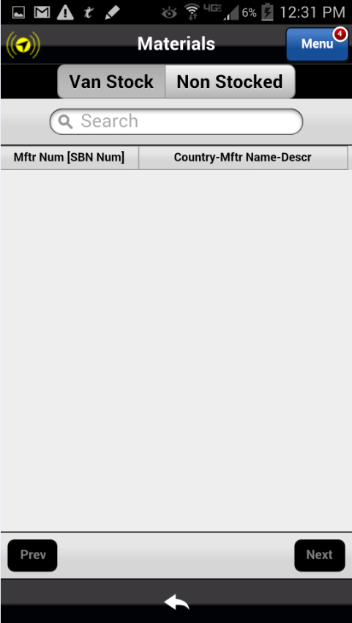
Adding Shipping and Handling Charges
A part must be created in the Tab to add Shipping and Handling charges
Tip: Make sure to use the Non Stocked tab when searching for parts.
Action: Select the Non Stocked tab
Previous
Home
End
Icon Legend

Slide 6
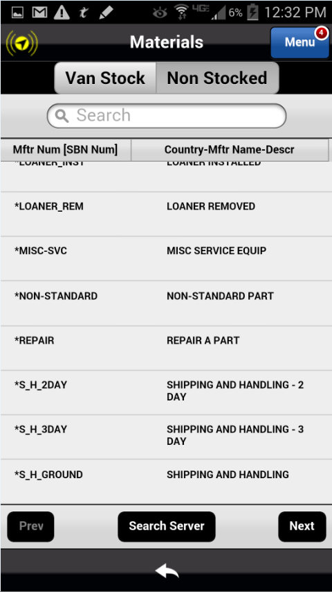
Adding Shipping and Handling Charges
A list of the most commonly used parts is displayed in the Search feature including miscellaneous parts and Shipping and Handling charge options. The Options include:
Shipping and Handling – Ground
Shipping Handling – 3 Day
Shipping and Handling – 2 Day
Shipping and Handling – Next Day
Action: Select the Ground Shipping and Handling part
Previous
Home
End
Icon Legend

Slide 7
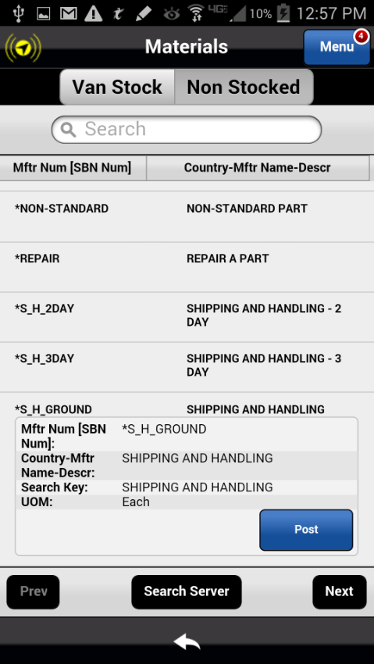
Adding Shipping and Handling Charges
A text box opens up and information about the charge is displayed. Post this charge to the ticket.
Action: Click on the Post button to add the charge to the ticket
Previous
Home
End
Icon Legend

Slide 8
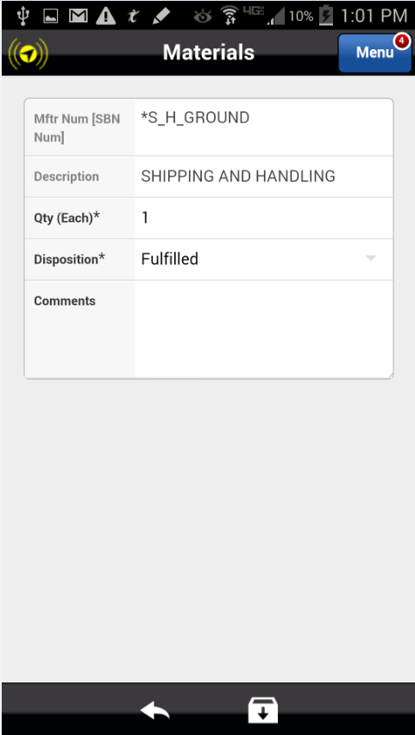
Adding Shipping and Handling Charges
The charge displays on the application as being Fulfilled. This must be saved to add this charge to the ticket.
Action: Click on the Save Item Icon in the footer
Previous
Home
End
Icon Legend

Slide 9
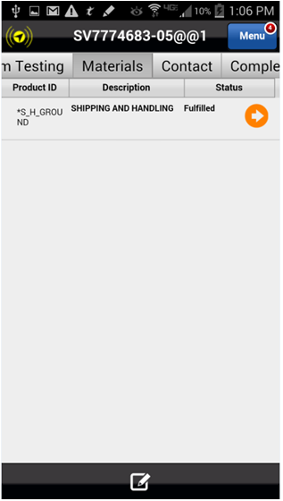
Adding Shipping and Handling Charges
The charge is applied to the ticket showing as fulfilled.
This concludes this module
Click on the Next button below
Previous
Home
End
Next
Icon Legend

Slide 10
Previous
Home
End

Slide 11
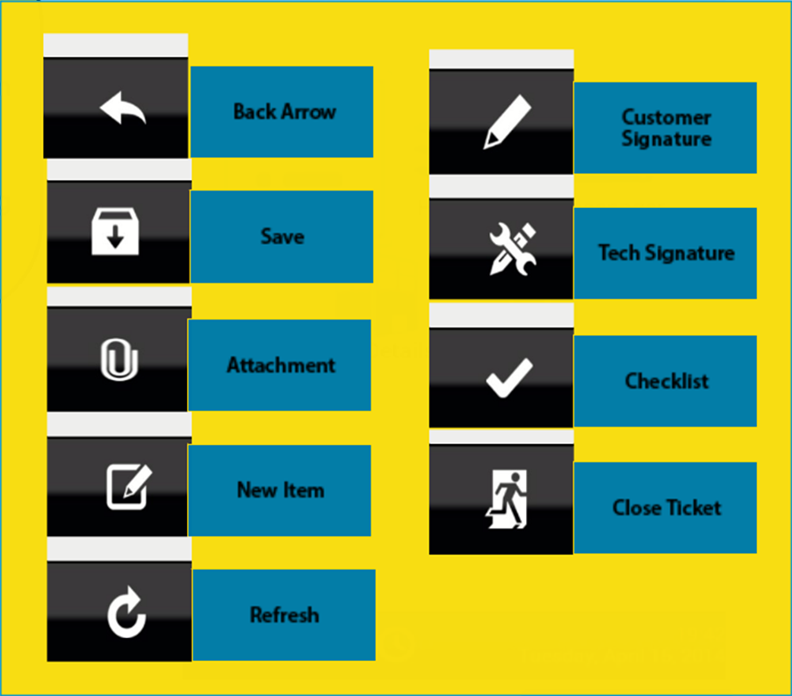
Icon Legend
Common icons used throughout the Astea application
Click on the Return button below to resume presentation
Return

