Slide 1
Astea Mobile App Training
Materials – Repair a Part
Start

Slide 2
Repair a Part – Leave Loaner
Module Overview
In this module you will learn how to transact sending a part out for repair and install a loaner part within the Astea Mobile App. You will also learn how to transact removing the loaner part and installing the repaired part.
Click on the Next button below
Previous
Home
End
Next
Icon Legend

Slide 3
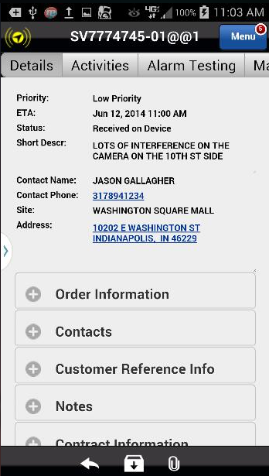
Repair a Part – Leave Loaner
The Astea Mobile App’s part repair and loaner install/removal functionality is in the Materials tab. All transitions:
Part sent for repair
Loaner installed
Loaner removed
Repaired part installed
Must be entered into the Astea Mobile App.
Let’s start by sending a part out for repair.
Action: Click on the Materials tab
Previous
Home
End
Icon Legend

Slide 4
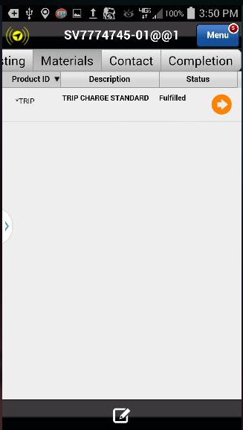
Repair a Part – Leave Loaner
To send a part out for repair a ‘Repair’ part must be added to the Materials list. The ‘Repair’ part in the Materials list will send a notification to the branch that a part is coming back for repair.
You will still need to physically deliver the part for repair back to the Branch.
Search for and apply the repair part to the Materials list.
Action: Click on the Add Item Icon in the footer
Previous
Home
End
Icon Legend

Slide 5
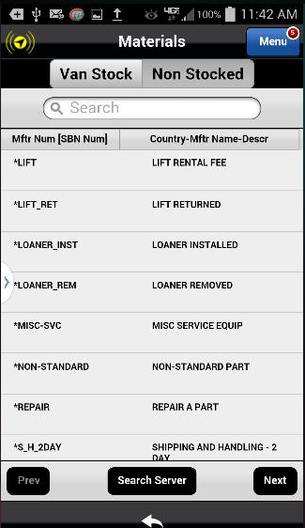
Repair a Part – Leave Loaner
To send a part out for repair a ‘Repair’ part must be added to the Materials list. The ‘Repair’ part in the Materials list will send a notification to the branch that a part is coming back for repair.
You will still need to physically deliver the part for repair back to the Branch.
Search for and apply the repair part to the Materials list.
Action: Click on the Non-Stocked tab
Previous
Home
End
Icon Legend

Slide 6
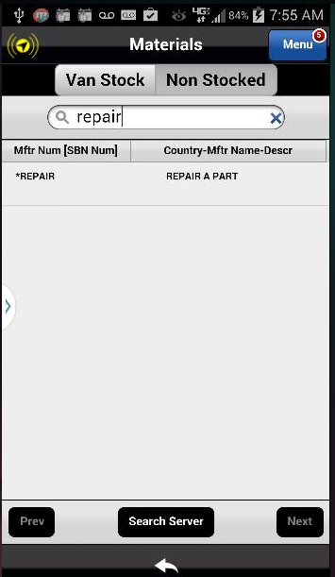
Repair a Part – Leave Loaner
To search for the Repair part type ‘repair’ in the Search box.
Tip: Notice as you type, the parts list minimizes to included only terms that match the search criteria.
Action: Click on the *REPAIR part to add it
Previous
Home
End
Icon Legend

Slide 7
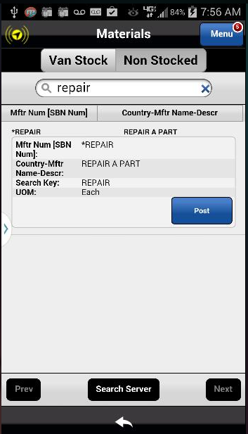
Repair a Part – Leave Loaner
Clicking on the part opens the Part Shortcut Menu. You must post the part to the service request to complete the repair process.
Action: Click on the Post button
Previous
Home
End
Icon Legend

Slide 8
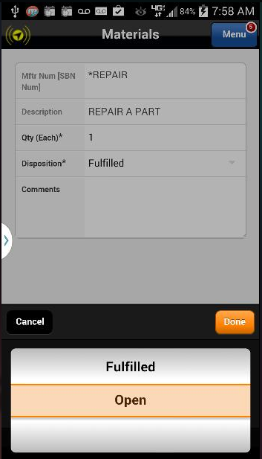
Repair a Part – Leave Loaner
To notify the Branch a part is coming back for repair, the Disposition* of the *REPAIR part must be changed from Fulfilled to Open.
An Open Disposition* indicates action is needed by the Branch for the part.
Action: Select Open and click Done
Previous
Home
End
Icon Legend

Slide 9
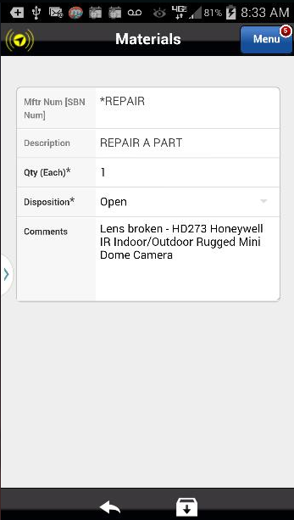
Repair a Part – Leave Loaner
In Comments, enter the Product ID and Description of the part to be repaired.
Include other pertinent details as well since these comments are included in the communication to the branch.
Enter detailed comments about the repair part including details on the needed repair
Action: Click on the Save Icon in the footer
Previous
Home
End
Icon Legend

Slide 10
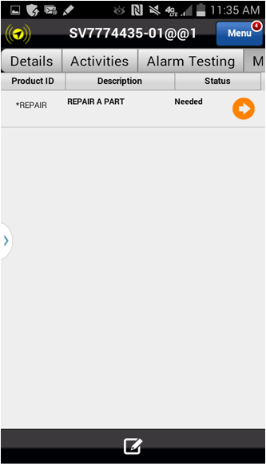
Repair a Part – Leave Loaner
The repair part has been added to the Service Order.
The next step is to add the installed loaner part. All installed loaners parts must be added to the Materials list in the Astea Moblie App for asset/inventory tracking purposes.
Search for and apply the loaner part to the Materials list. If no loaner part is installed, the next steps can be skipped.
Notice the Status shows the part is Needed
Action: Click on the Add Item Icon in the footer
Previous
Home
End
Icon Legend

Slide 11
Repair a Part – Leave Loaner
All installed loaners parts must be added to the Materials list in the Astea Moblie App for asset/inventory tracking purposes.
Search for and apply the loaner part to the Materials list
Action: Click on the Non-Stocked tab
Previous
Home
End
Icon Legend

Slide 12
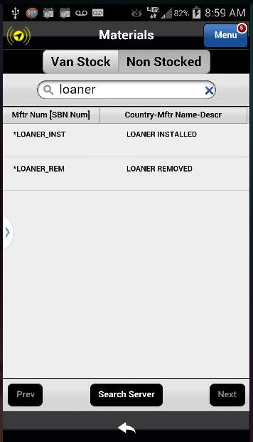
Repair a Part – Leave Loaner
Type Loaner in the Search box.
There are two parts that cover the loaner scenario:
Loaner Installed
Loaner Removed.
Select the Loaner Installed part.
Tip: Notice as you type, the parts list minimizes to included only terms that match the search criteria.
Action: Click on the Loaner Installed Part

Slide 13
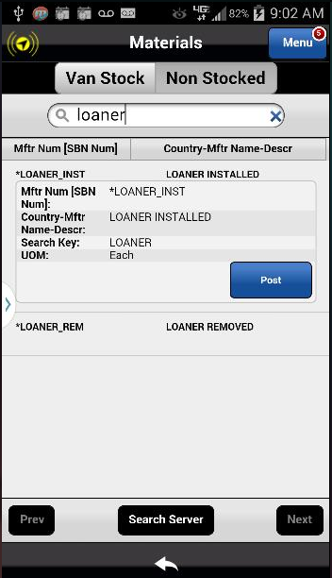
Repair a Part – Leave Loaner
Clicking on the part opens the Part Shortcut Menu. You must post the part to the service request to complete the loaner install process.
Action: Click on the Post button
Previous
Home
End
Icon Legend

Slide 14
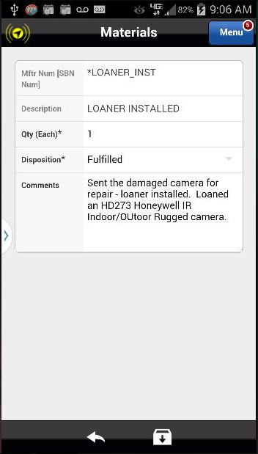
Repair a Part – Leave Loaner
In Comments, enter the Product ID and Description of the loaner part.
Action: Click on the Save Icon in the footer
Previous
Home
End
Icon Legend

Slide 15
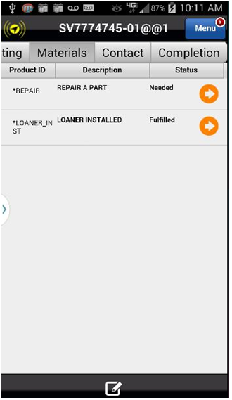
Repair a Part – Leave Loaner
The installed loaner part has been added to the Materials list with a status of Fulfilled. The Fulfilled status indicates the loaner part was used/installed.
Once complete, close the service request in the defined closing process. Make sure you use the Stop Code of ADD’L EQUIP NEEDED. The service request will go back into the SBN for re-dispatch with the repaired part returns.
Next, you will learn what to do when the service request is re-dispatched to you when the repaired part returns.
Action: Click on the Add Item Icon in the footer
Previous
Home
End
Icon Legend

Slide 16
Reinstall a Repaired Part – Remove Loaner
Once re-dispatched you will need to remove the loaner part and install the repaired part. Both of those transaction must be entered into the Astea Mobile App.
These transactions are entered in the Materials tab.
Start by logging the repaired part.
Action: Click on the Materials tab (far right)
Previous
Home
End
Icon Legend

Slide 17
Reinstall a Repaired Part – Remove Loaner
The installed repaired part must be added to the Materials list.
Search for and apply the repair part to the Materials list.
Action: Click on the Add Item Icon in the footer
Previous
Home
End
Icon Legend

Slide 18
Reinstall a Repaired Part – Remove Loaner
The installed repaired part must be added to the Materials list.
Search for and apply the repair part to the Materials list.
Action: Click on the Non-Stocked tab
Previous
Home
End
Icon Legend

Slide 19
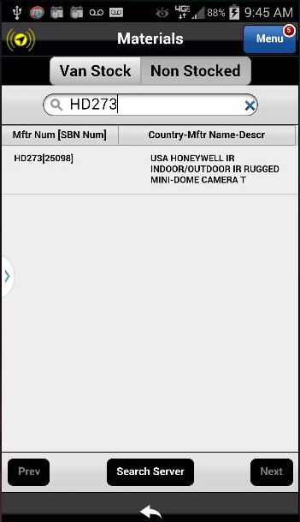
Reinstall a Repaired Part – Remove Loaner
Type the repaired part # or keywords in the Search box: HD273 Honeywell IR Indoor/Outdoor Rugged Mini Dome Camera
Tip: Notice as you type, the parts list minimizes to included only terms that match the search criteria.
Action: Click on the Part to select it
Previous
Home
End
Icon Legend

Slide 20
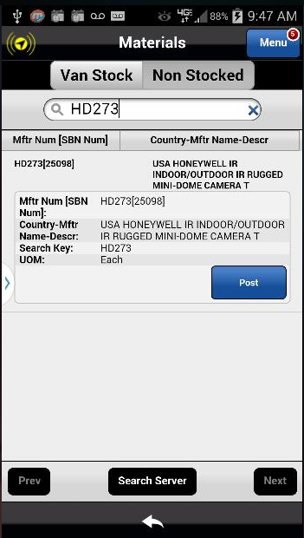
Reinstall a Repaired Part – Remove Loaner
Clicking on the part opens the Part Shortcut Menu. You must post the part to the service request to complete the part install process.
Action: Click Post
Previous
Home
End
Icon Legend

Slide 21
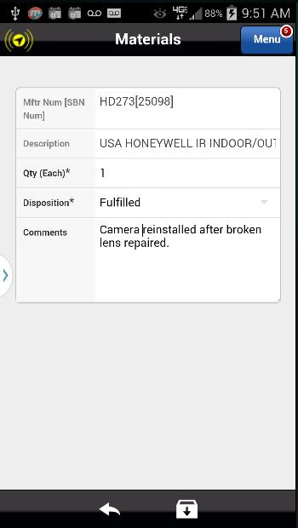
Reinstall a Repaired Part – Remove Loaner
In Comments, indicate the part was repaired and reinstalled.
Action: Click on the Save Icon in the footer
Previous
Home
End
Icon Legend

Slide 22
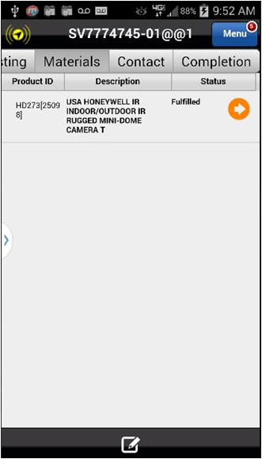
Reinstall a Repaired Part – Remove Loaner
The repaired part has been added to the Materials list.
The next step is to add the removed loaner part. All removed loaner parts must be added to the Materials list in the Astea Mobile App for asset/inventory tracking purposes.
Search for and apply the loaner removed part to the Materials list. If no loaner part is onsite, the next steps can be skipped.
Action: Click on the Add Item Icon in the footer
Previous
Home
End
Icon Legend

Slide 23
Reinstall a Repaired Part – Remove Loaner
All removed loaner parts must be added to the Materials list in the Astea Mobile App for asset/inventory tracking purposes.
Search for and apply the loaner removed part to the Materials list.
Action: Click on the Non-Stocked tab
Previous
Home
End
Icon Legend

Slide 24
Reinstall a Repaired Part – Remove Loaner
Type loaner in the Search box.
There are two parts that cover the loaner scenario:
Loaner Installed
Loaner Removed.
Select the Loaner Removed part.
Action: Click on the the Loaner Removed Part to select it
Previous
Home
End
Icon Legend

Slide 25
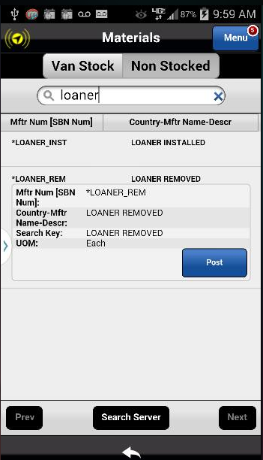
Reinstall a Repaired Part – Remove Loaner
Clicking on the part opens the Part Shortcut Menu. You must post the part to the service request to complete the loaner removal process.
Action: Click on the Post button
Previous
Home
End
Icon Legend

Slide 26
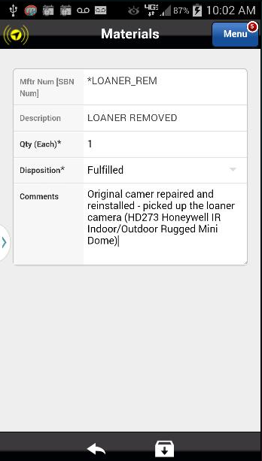
Reinstall a Repaired Part – Remove Loaner
In Comments, enter the Product ID and Description of the returned loaner part.
Action: Click on the Save Icon in the footer
Previous
Home
End
Icon Legend

Slide 27
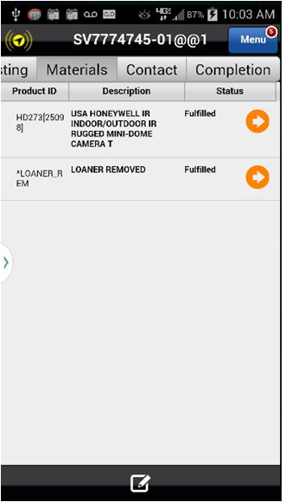
Repair a Part – Leave Loaner
The Loaner Returned Part is added to the Materials list which completes the repair/loaner process.
This concludes this module.
Click on the Next button below
Previous
Home
End
Next
Icon Legend

Slide 28
Previous
Home
End

Slide 29
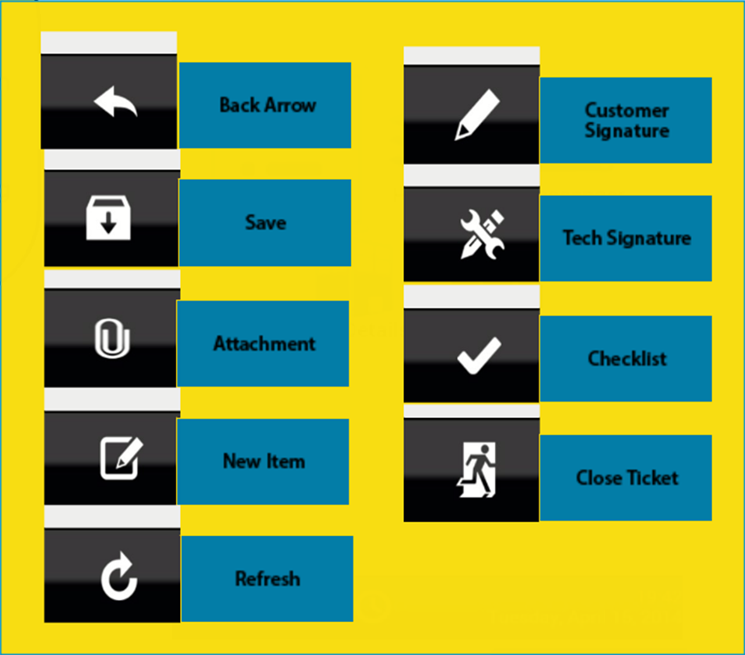
Icon Legend
Common icons used throughout the Astea application
Click on the Return button below to resume presentation
Return

