Slide 1
Astea Mobile App Training
Materials – Add and Delete Miscellaneous Service
Start

Slide 2
Materials – Add Misc. and Delete
Module Overview
There are times you need to use parts that are not in the standard parts list (bolts, screws, nuts, etc). In this module you will learn how to add a miscellaneous part to a Service Order.
Also, since you may occasionally add the wrong part to a Service Order, this module also covers how to delete a part.
Click on the Next button below
Previous
Home
End
Next
Icon Legend

Slide 3
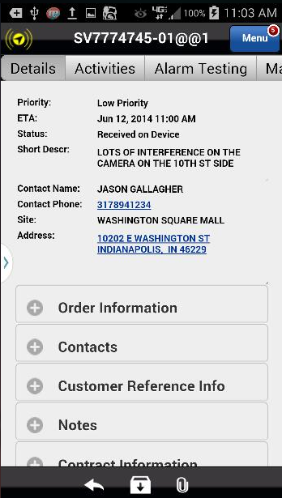
Materials – Add Misc. and Delete
Adding a part that is not in the standard parts list begins like adding any part. Start on the Materials tab of the Service Order.
Action: Click on the Materials tab on the far right
Previous
Home
End
Icon Legend

Slide 4
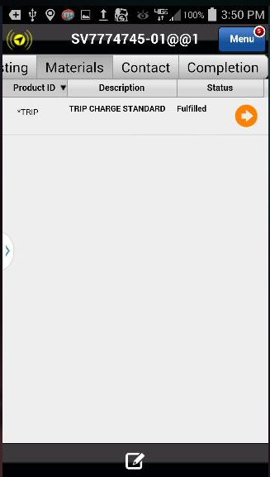
Materials – Add Misc. and Delete
Add the miscellaneous service part to the Service Order.
Note: For purposes of this module, we assume you have already fulfilled the Trip Charge.
Action: Click on the Add Item Icon in the footer
Previous
Home
End
Icon Legend

Slide 5
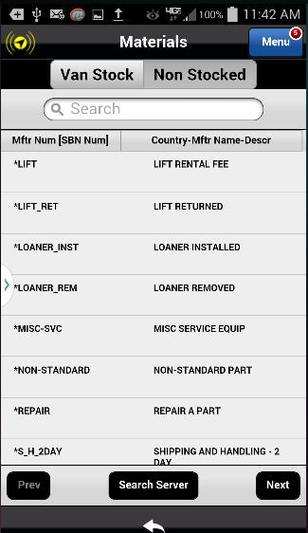
Materials – Add Misc. and Delete
Parts lookup uses the Non-Stocked tab.
Action: Click on the Non-Stocked tab.
Previous
Home
End
Icon Legend

Slide 6
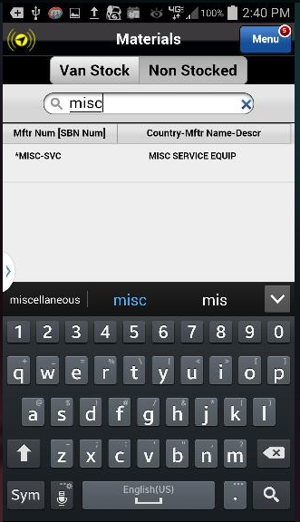
Materials – Add Misc. and Delete
Type misc in the Search box.
Tip: Notice as you type, the parts list minimizes to included only terms that match the search criteria.
Action: Click on the Misc Service Equipment to select the part
Previous
Home
End
Icon Legend

Slide 7
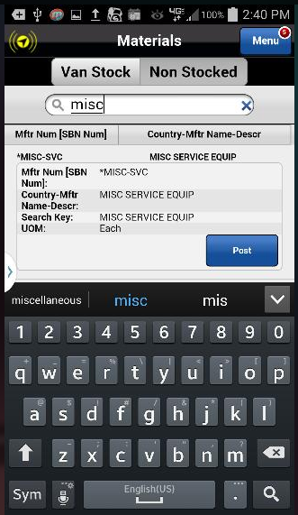
Materials – Add Misc. and Delete
Post the Miscellaneous Service part to the Service Order.
Action: Click on the Post button
Previous
Home
End
Icon Legend

Slide 8
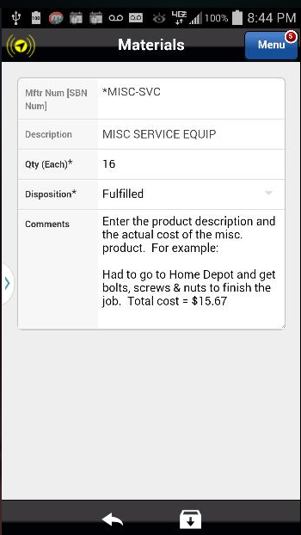
Materials – Add Misc. and Delete
Quantity: Log the miscellaneous part cost (rounded up to the nearest dollar) as the quantity.
Disposition: Since the part was installed, the Disposition is Fulfilled.
Comments: Enter the miscellaneous product description and the actual cost as comments. This information is saved back to SBN.
Action: Click on the Save Icon in the footer
Previous
Home
End
Icon Legend

Slide 9
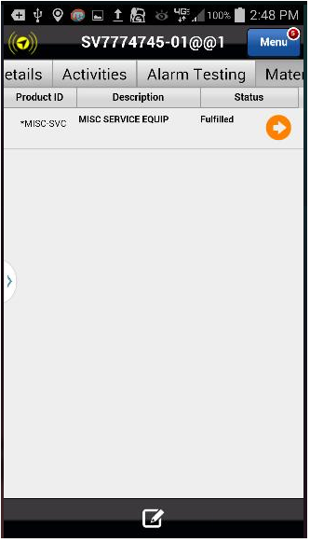
Materials – Add Misc. and Delete
The Miscellaneous Service part has been added to the Service Order.
The next section of this training covers removing a posted part from the Service Order.
Action: Click on the Add Item Icon in the footer
Previous
Home
End
Icon Legend

Slide 10
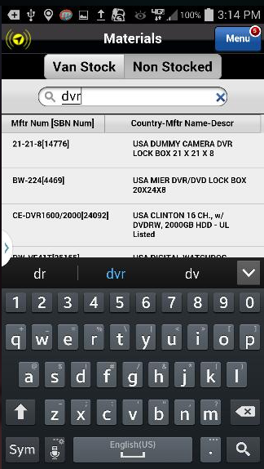
Materials – Add Misc. and Delete
Once again, with the Non-Stocked tab highlighted, type dvr to begin the search.
Action: Click on the USA Dummy Camera DVR to select
Previous
Home
End
Icon Legend

Slide 11
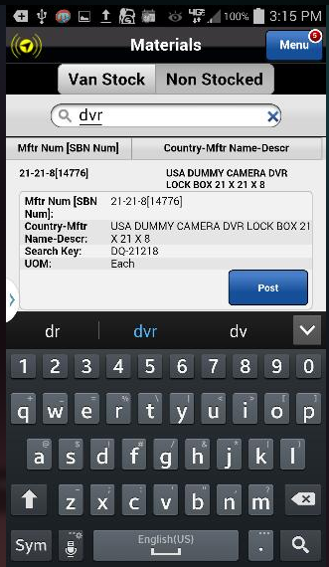
Materials – Add Misc. and Delete
Post the USA Dummy Camera DVR to the Service Order.
Action: Click on the Post button
Previous
Home
End
Icon Legend

Slide 12
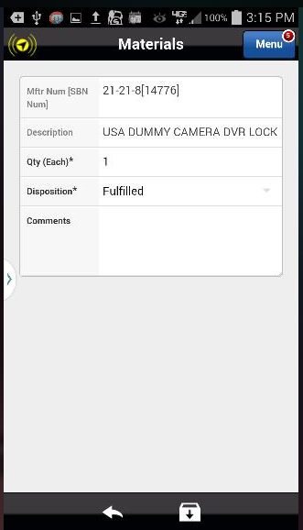
Materials – Add Misc. and Delete
Save the part to the Service Order.
Action: Click on the Save icon in the footer
Previous
Home
End
Icon Legend

Slide 13
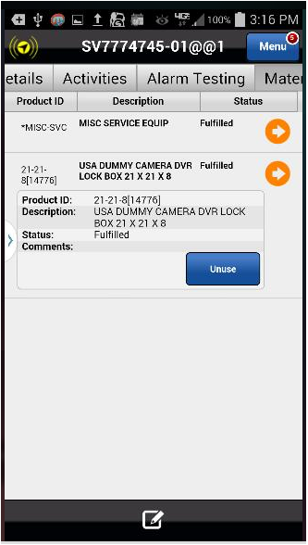
Materials – Add Misc. and Delete
On the Materials tab, click on the Product ID to display the information about the part.
Since the part status is Fulfilled, meaning it was installed, first you have to indicate the part was not used.
Action: Click on the Unuse button
Previous
Home
End
Icon Legend

Slide 14
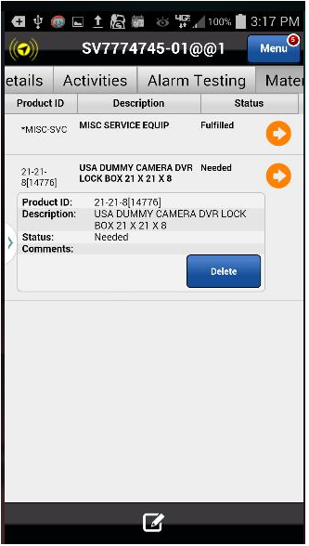
Materials – Add Misc. and Delete
Now that the part Status is no longer Fulfilled, delete the part.
Status changed to Needed
Action: Click on the Delete button
Previous
Home
End
Icon Legend

Slide 15
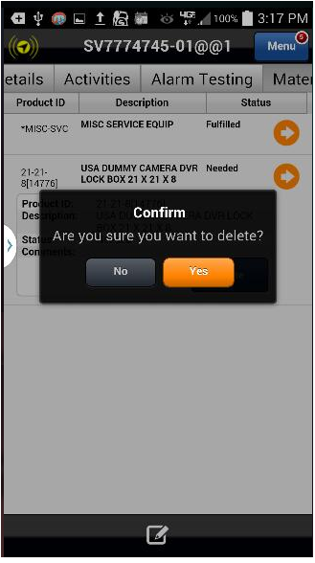
Materials – Add Misc. and Delete
Confirm the deletion.
Action: Click on the Yes button to confirm
Previous
Home
End
Icon Legend

Slide 16
Materials – Add Misc. and Delete
The unneeded part has been removed from the Service Ticket.
This concludes this module.
Click on the Next button below
Previous
Home
End
Next
Icon Legend

Slide 17
Previous
Home
End

Slide 18
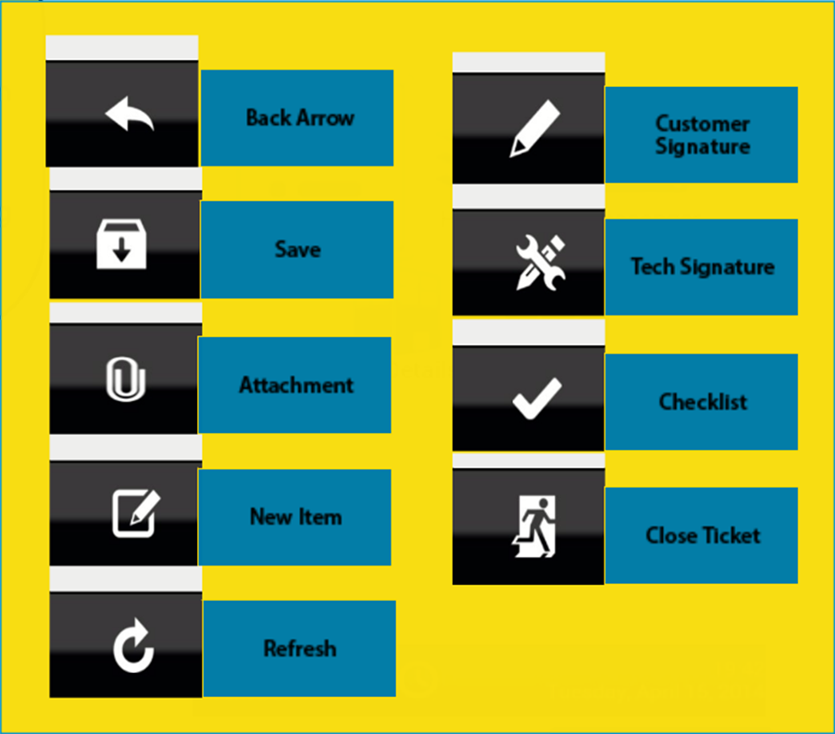
Icon Legend
Common icons used throughout the Astea application
Click on the Return button below to resume presentation
Return

