Slide 1
Astea Mobile App Training
Materials – Add a Non-Standard Part
Start

Slide 2
Using a Non-Standard Part
Module Overview
There are times when you will need to purchase and install new or unusual parts that are not typically stocked. In this module you will learn how to:
Order a Non-Standard Part
Log a Non-Standard Part purchased and installed onsite.
Click on the Next button below
Previous
Home
End
Next
Icon Legend

Slide 3
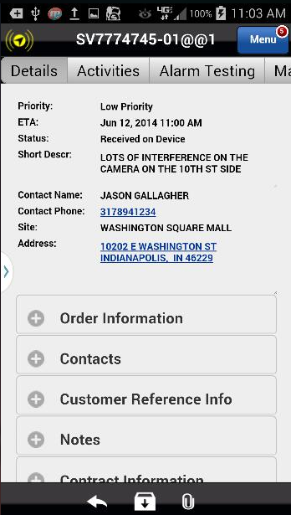
Using a Non-Standard Part
Ordering a part that is not in the standard parts list begins like adding any part. Start on the Materials tab of the Service Order.
Action: Click on the Materials tab on the far right
Previous
Home
End
Icon Legend

Slide 4
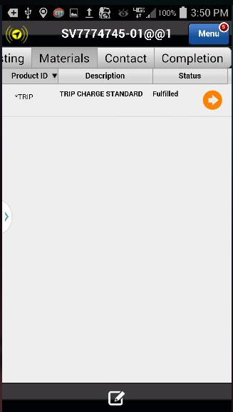
Using a Non-Standard Part
Add a part to the Service Order.
Action: Click on the Add Item Icon in the footer
Previous
Home
End
Icon Legend

Slide 5
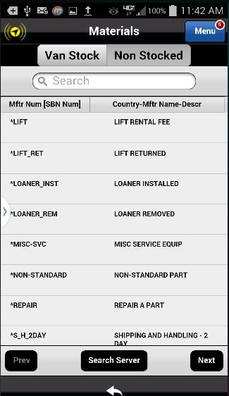
Using a Non-Standard Part
Parts lookup uses the Non-Stocked tab.
Action: Click on the Non-Stocked tab
Previous
Home
End
Icon Legend

Slide 6
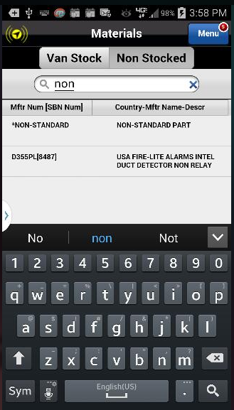
Using a Non-Standard Part
Start to type Non-Standard in the Search box.
Tip: Notice as you type, the parts list minimizes to included only terms that match the search criteria.
Action: Click on the the Non-Standard Part to select it
Previous
Home
End
Icon Legend

Slide 7
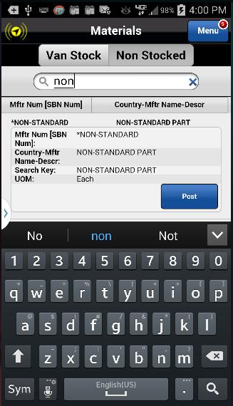
Using a Non-Standard Part
Post the Non-Standard Part to the Service Order.
Action: Click on the Post button
Previous
Home
End
Icon Legend

Slide 8
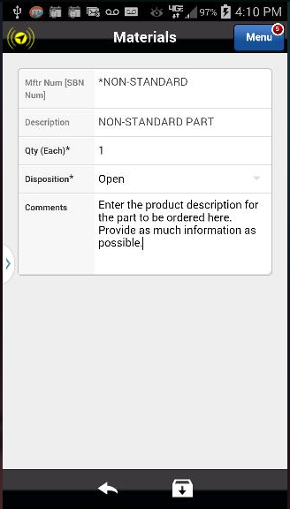
Using a Non-Standard Part
Quantity: Enter the number of Non-Standard Parts needed.
Disposition: To order the part, Click on the selection arrow and change the Disposition from Fulfilled to Open.
Comments: Enter the Non-Standard Part description and include as much detail as possible. This information is emailed to the branch to initiate the order.
Action: Click on the Save Icon in the footer
Previous
Home
End
Icon Legend

Slide 9
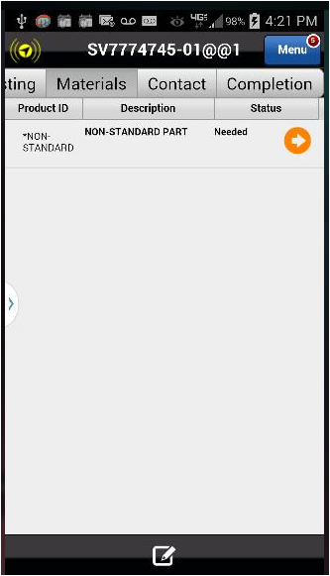
Using a Non-Standard Part
The Non-Standard Part has been added to the Service Order.
The next section of this training covers a Non-Standard Part you purchased and installed.
Notice the Status shows the part is Needed
Action: Click on the Add Item Icon in the footer
Previous
Home
End
Icon Legend

Slide 10
Using a Non-Standard Part
Once again, with the Non-Stocked tab highlighted, type non- to begin the search.
Action: Click on the Non-Standard Part to add it to the Service Order.
Previous
Home
End
Icon Legend

Slide 11
Using a Non-Standard Part
Post the Non-Standard Part to the Service Order.
Action: Click Post
Previous
Home
End
Icon Legend

Slide 12
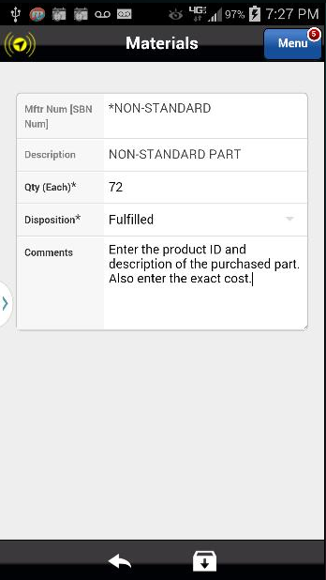
Using a Non-Standard Part
Quantity: Enter the cost of the part, rounded up to the nearest dollar.
Disposition: Since you purchased and installed the part, leave the Disposition as Fulfilled.
Comments: Enter the Non-Standard Part ID and description. Be sure to include the exact cost as well. This information is uploaded to SBN.
Action: Click on the Save icon in the footer
Previous
Home
End
Icon Legend

Slide 13
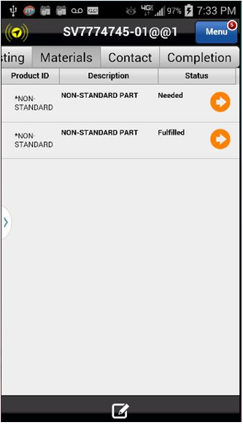
Using a Non-Standard Part
The Non-Standard Part is saved to the Service Order and the Fulfilled status indicates the part was purchased and installed.
This concludes this module.
Click on the Next button below
Previous
Home
End
Next
Icon Legend

Slide 14
Previous
Home
End

Slide 15
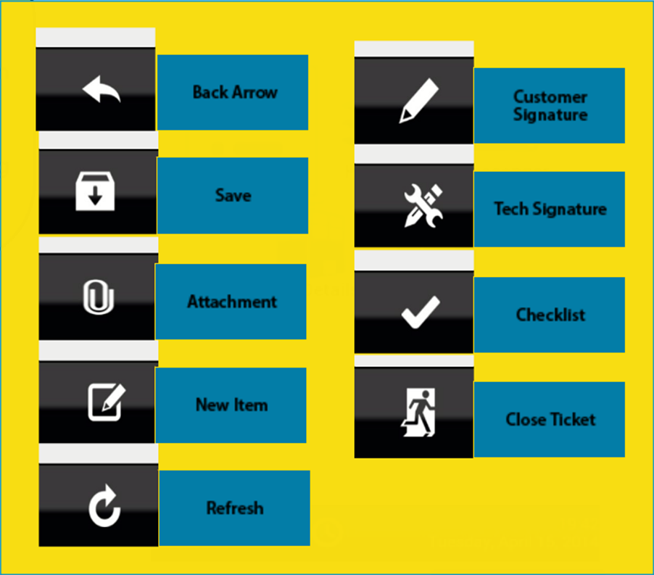
Icon Legend
Common icons used throughout the Astea application
Click on the Return button below to resume presentation
Return

