Slide 1
Astea Mobile App Training
Labor Activity Stop Codes
Start

Slide 2
Stop Codes
Module Overview
In this module you will learn about the different Stop Codes that can be used to classify why a labor activity (punch in & punch out) was stopped (punch out).
The Activity Stop Code is a critical factor in determining if a service request will be closed for billing or remain open for an additional trip.
Previous
Home
End
Next
Icon Legend

Slide 3
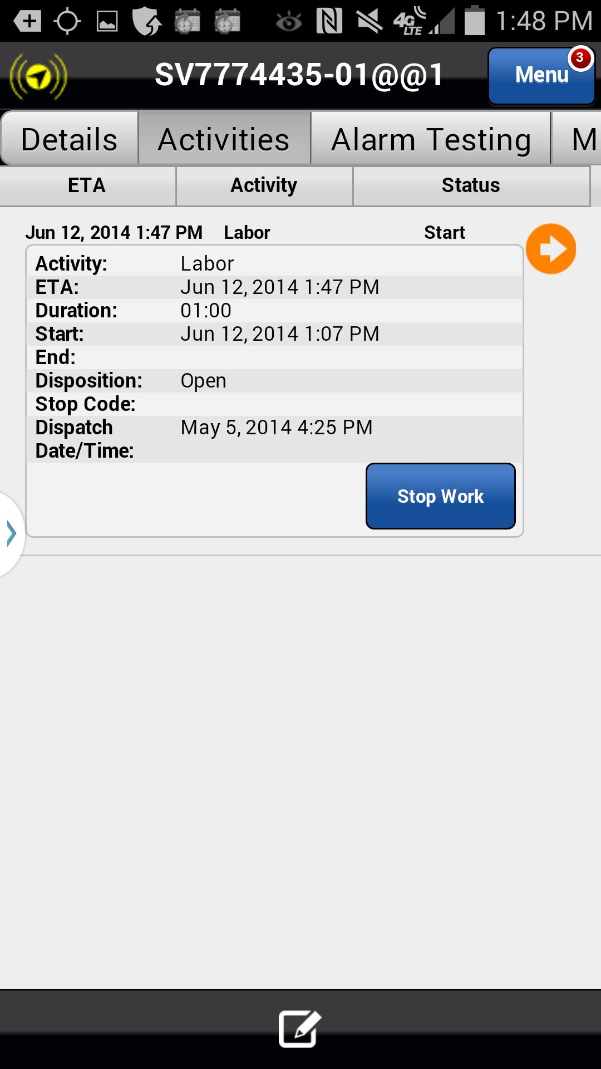
Stop Codes
Stop Codes are required for all Labor Activities when the Stop Work button is clicked (punch out).
Action: Click on the Stop Work Button
Previous
Home
End
Icon Legend

Slide 4
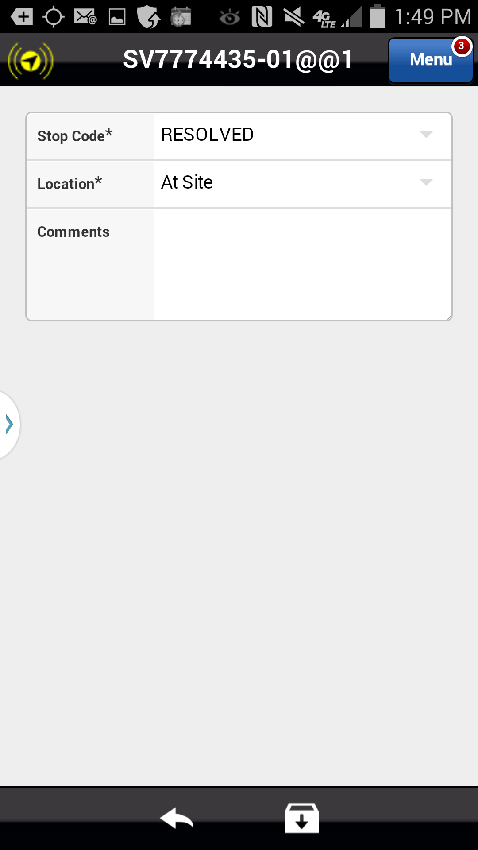
Stop Codes
When you stop work on a Labor Activity, the Astea Mobile App automatically takes you to a screen to define the Stop Code for that Activity. The Stop Code will help determine if the Service Request will be completed and closed for billing, or is incomplete and requires an additional trip. The default Stop Code is RESOLVED.
Complete Stop Codes | Incomplete Stop Codes
RESOLVED PNC: CUSTOMER CANCELLED | ADD’L EQUIP REQ ADD’L TECH REQ ADDT’L TIME REQ CUST NOT AVAIL CUST NOT READY CUST/OTH RESCHED INCOMPLETE ACTIVITY LUNCH OFFSITE RETURNING TODAY REFER TO INSTALL REFER TO SALES RE-ROUTED TO ANOTHER SITE
Click on the Next button below
Previous
Home
End
Next
Icon Legend

Slide 5
Stop Codes
Stop Code definitions and when to use each Stop Code
Complete Stop Codes enable the Resolve checkbox in the Completion tab, used to close the ticket complete (no additional trips/work required). Incomplete Stop Codes disable the Resolve checkbox in the Completion tab. The service request can be removed from your device but it will not be completed in SBN.
Complete Stop Codes | Incomplete Stop Codes
RESOLVED – Service request is complete, no additional trips are necessary. Service request is ready for billing. PNC: CUSTOMER CANCELLED – Customer cancelled request for service. | ADD’L EQUIP REQ – Additional equipment is needed to complete the service request. ADD’L TECH REQ – Additional Tech is needed to complete the service request. ADDT’L TIME REQ – Additional time is needed to complete the service request. CUST NOT AVAIL – Customer was not available, work was not completed. CUST NOT READY – Customer/Site was not ready, work was not completed. CUST/OTH RESCHED – Customer/Dispatch re-scheduled. INCOMPLETE ACTIVITY – Work was not completed. LUNCH – Leaving for lunch but will return today. OFFSITE-RETURNING TODAY – Leaving for other reasons (ADI trip, EMOC) but will return today. REFER TO INSTALL – Install issue, work not completed. REFER TO SALES – Potential new sale, work not completed. RE-ROUTED TO ANOTHER SITE – Re-routed before arrival, work not completed.
Previous
Home
End
Next
Icon Legend

Slide 6
Stop Codes
If the Labor Activity was stopped for any incomplete reason the Stop Code must be updated.
Action: Click in the down arrow in the Stop Code* field
Previous
Home
End
Icon Legend

Slide 7
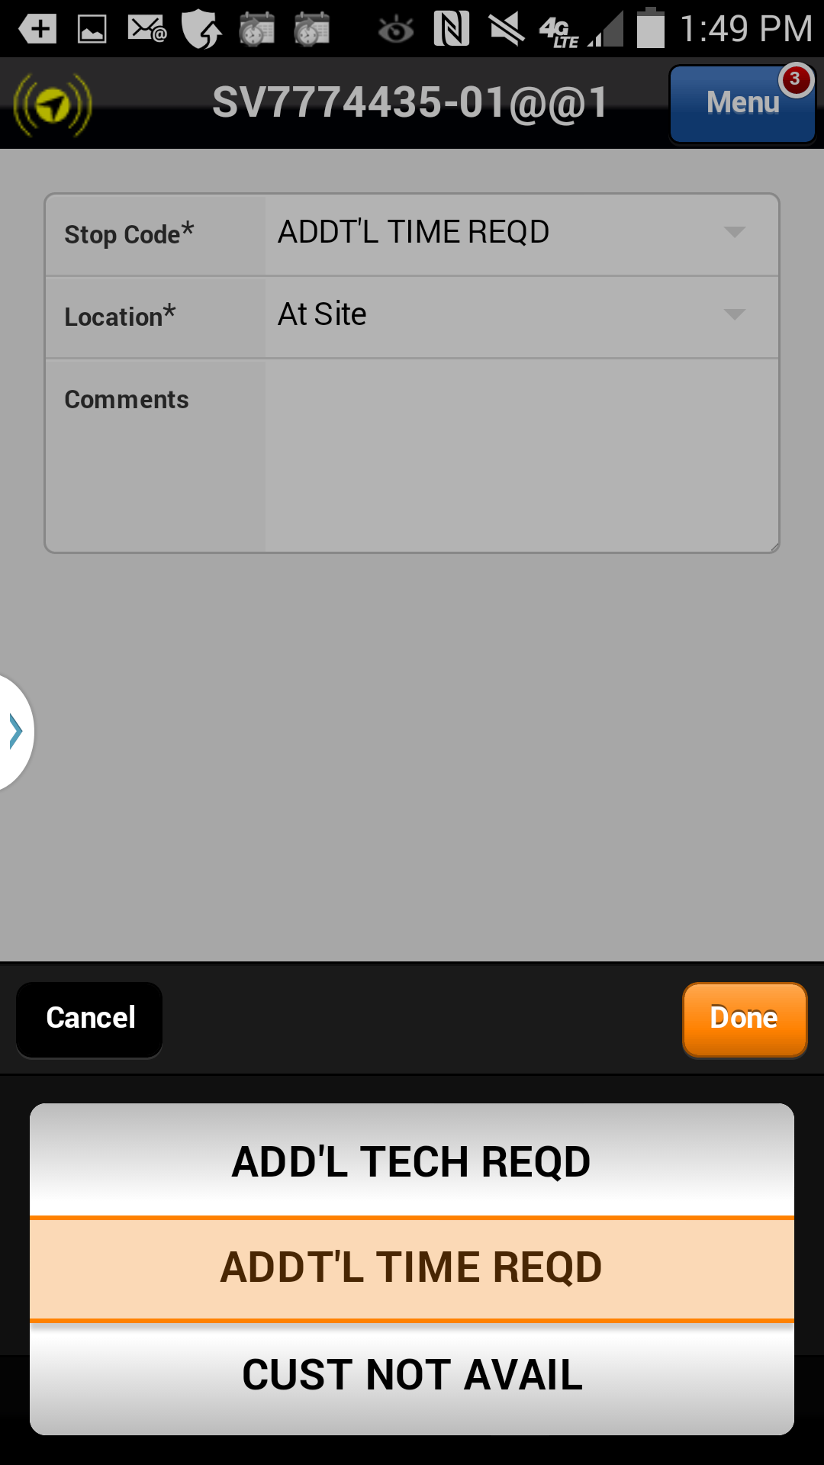
Stop Codes
Scroll through all Stop Codes to find the relevant Stop Code for your Labor Activity.
Action: Click on ADDT’L TIME REQD
Previous
Home
End
Icon Legend

Slide 8
Stop Codes
Scroll through all Stop Codes to find the relevant Stop Code for your Labor Activity.
Action: Click Done
Previous
Home
End
Icon Legend

Slide 9
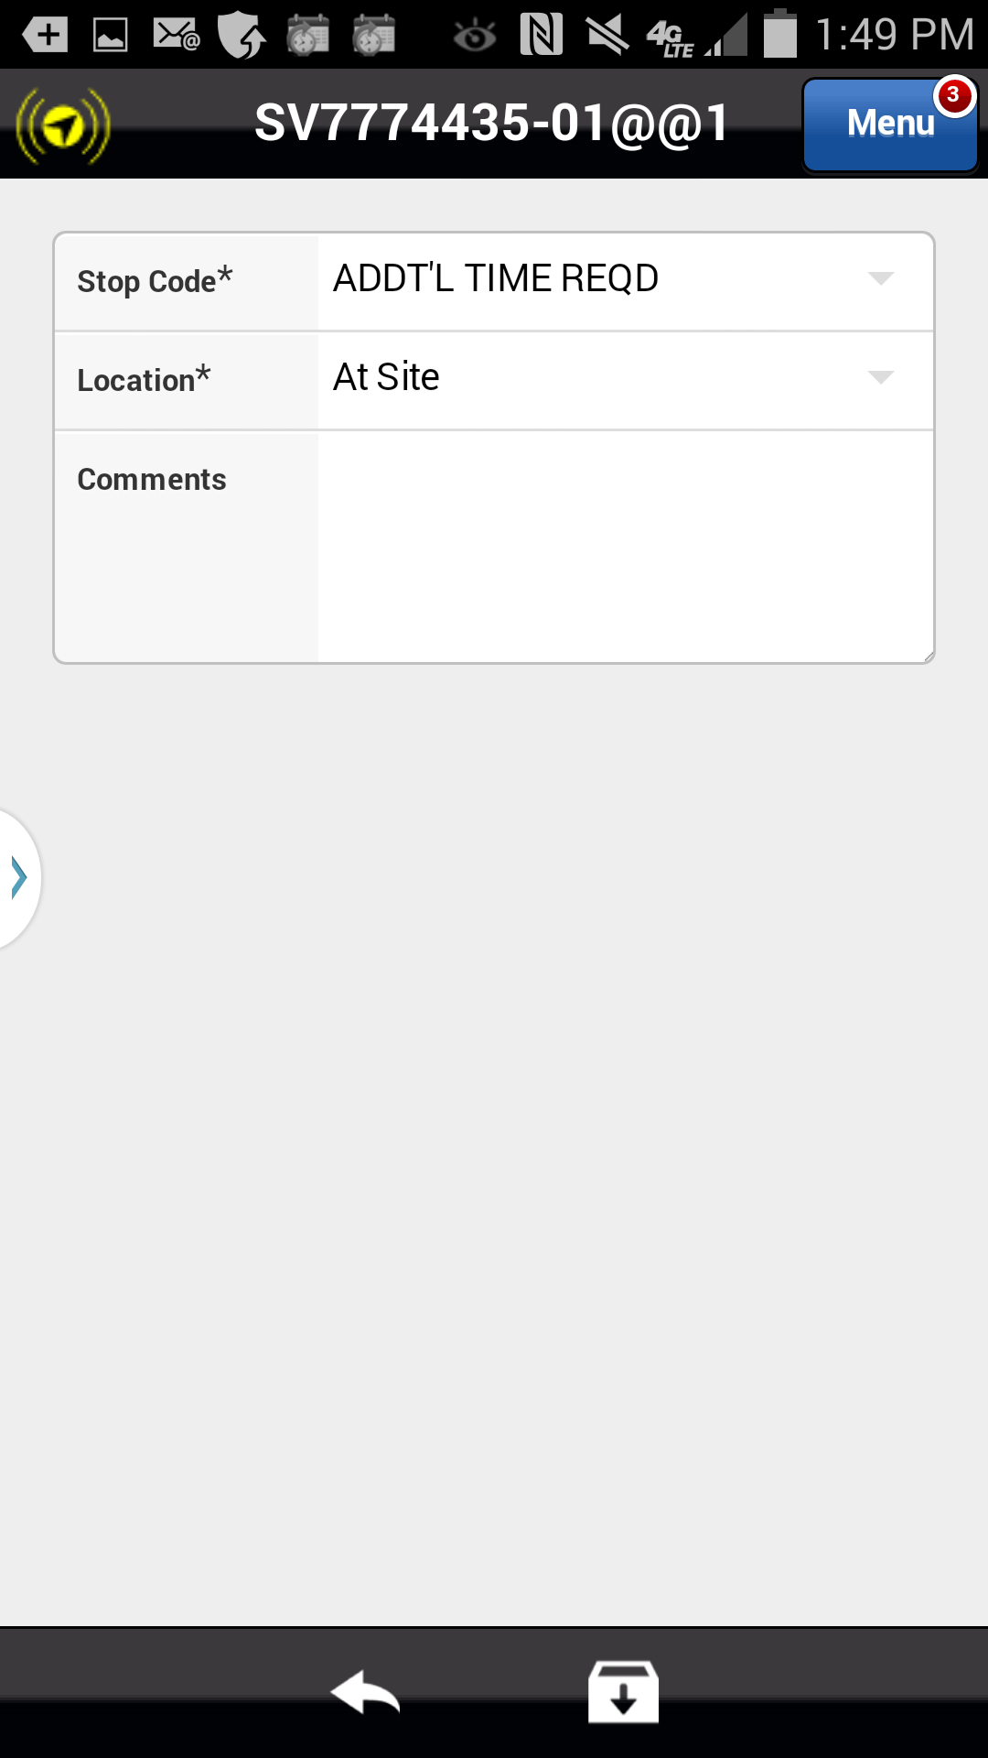
Stop Codes
Stop Code changes must be saved to apply.
Stop Code is updated.
Action: Click on Save icon in the footer
Previous
Home
End
Icon Legend

Slide 10
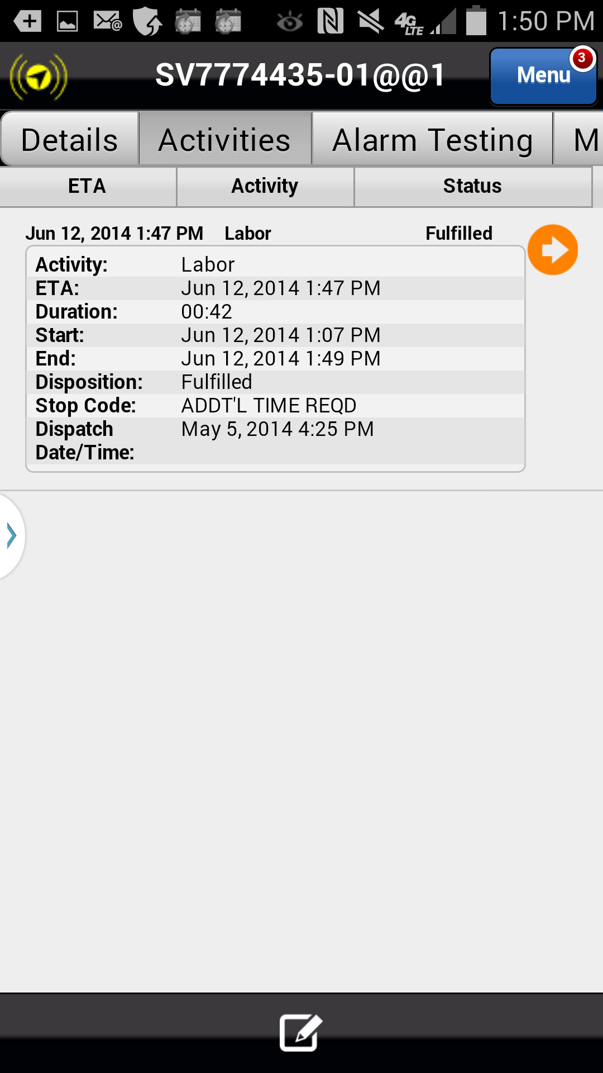
Stop Codes
Once saved, the Astea Mobile App will return to the Activities Tab. Review the Activity, the Status is Fulfilled and the Stop Code is ADDT’L TIME REQD.
This means the activity is complete (fulfilled) and no additional time will be applied on this trip; however, the Service Request is not complete. To complete the Service Request additional time is required on an later trip.
Labor Activity Status is Fulfilled
Stop Code indicates the Service Request is incomplete.
Click on the Next button below
Previous
Home
End
Next
Icon Legend

Slide 11
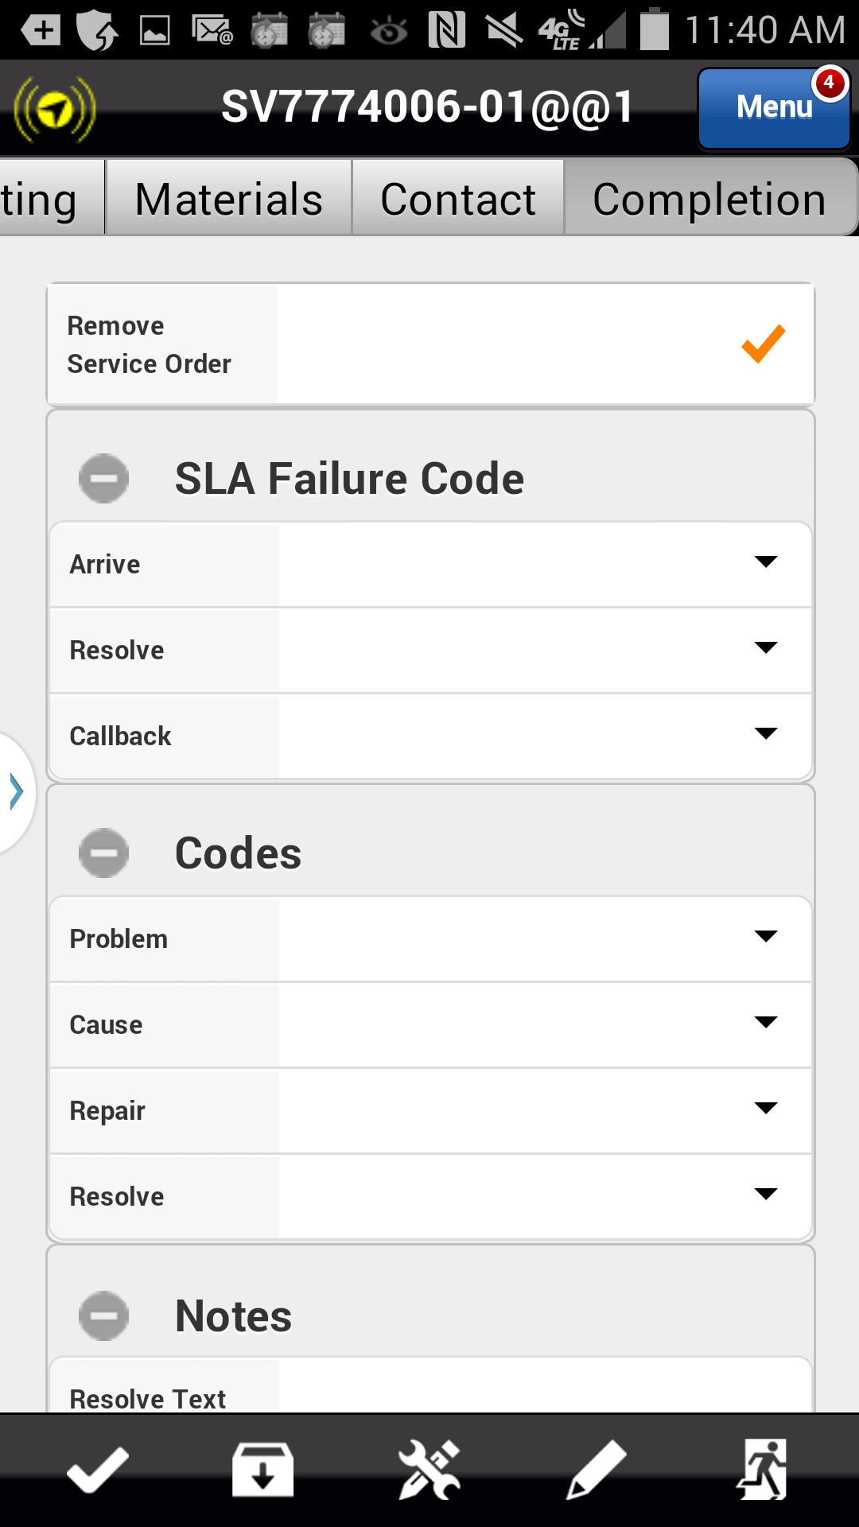
Stop Codes
When completing the request with an incomplete Stop Code the Resolve checkbox in Completion tab is disabled.
When your onsite work is complete, remove the request from your device and exit. The request will return to the SBN queue for re-dispatch when additional time is available.
Resolved Checkbox disabled
Action: Click the Exit icon in the footer
Previous
Home
End
Next
Icon Legend

Slide 12
Previous
Home
End

Slide 13
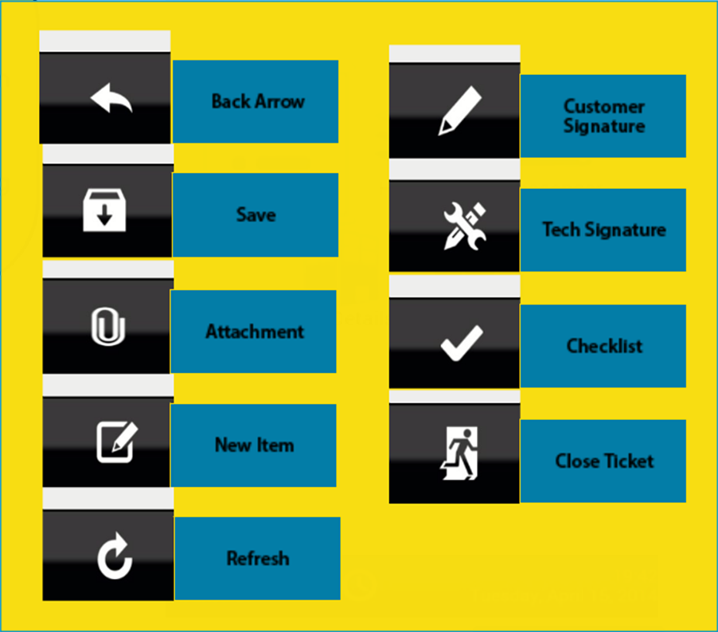
Icon Legend
Common icons used throughout the Astea application
Click on the Return button below to resume presentation
Return

