Slide 1
Astea Mobile App Training
Customer Unavailable Module (Technician contacts customer before beginning travel)
Start

Slide 2
Customer Unavailable (Call Before Starting Travel)
Module Overview
In this module you will learn how to complete a service request in the Astea Mobile App in the event that you have called ahead before traveling to customer site and customer is unavailable.
Click on the Next button below
Previous
Home
End
Next
Icon Legend

Slide 3
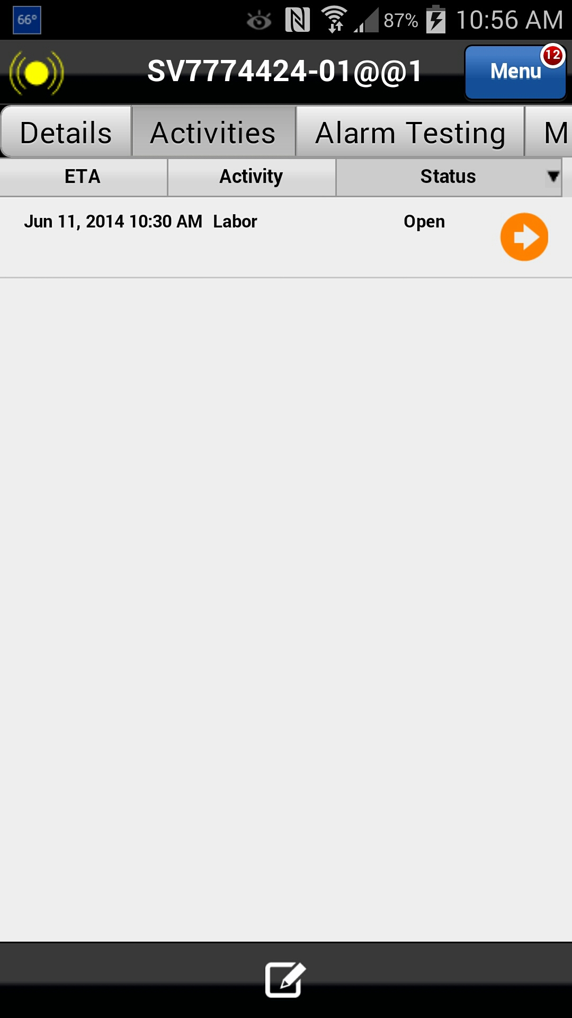
Customer Unavailable (Call Before Starting Travel)
In this scenario, you contacted (or attempted to contact) the customer to confirm the appointment before starting travel; however, the customer is not available.
When a customer is unavailable you will need to clear the service request from your device using the following steps.
To begin to close ticket and note that the customer is unavailable, navigate to the Activities tab.
Action: Click on the Activities tab
Previous
Home
End
Icon Legend

Slide 4
Customer Unavailable (Call Before Starting Travel)
To clear the service request from your device you must fulfill the ‘Open’ Labor activity.
Action: Click on the Activity’s ETA, Name or Status.
Previous
Home
End
Icon Legend

Slide 5
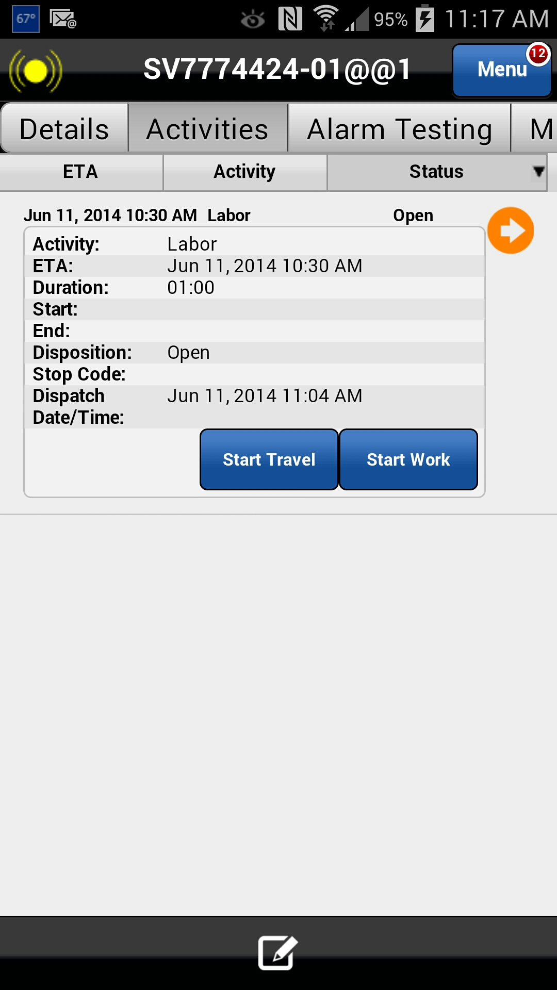
Customer Unavailable (Call Before Starting Travel)
Start Travel and Start Work within the Astea Mobile App.
Action: In immediate succession, click on the Start Travel button, then Start Work
Previous
Home
End
Icon Legend

Slide 6
Customer Unavailable (Call Before Starting Travel)
Start Travel and Start Work within the Astea Mobile App.
Action: In immediate succession, click on the Start Travel button then Start Work
Previous
Home
End
Icon Legend

Slide 7
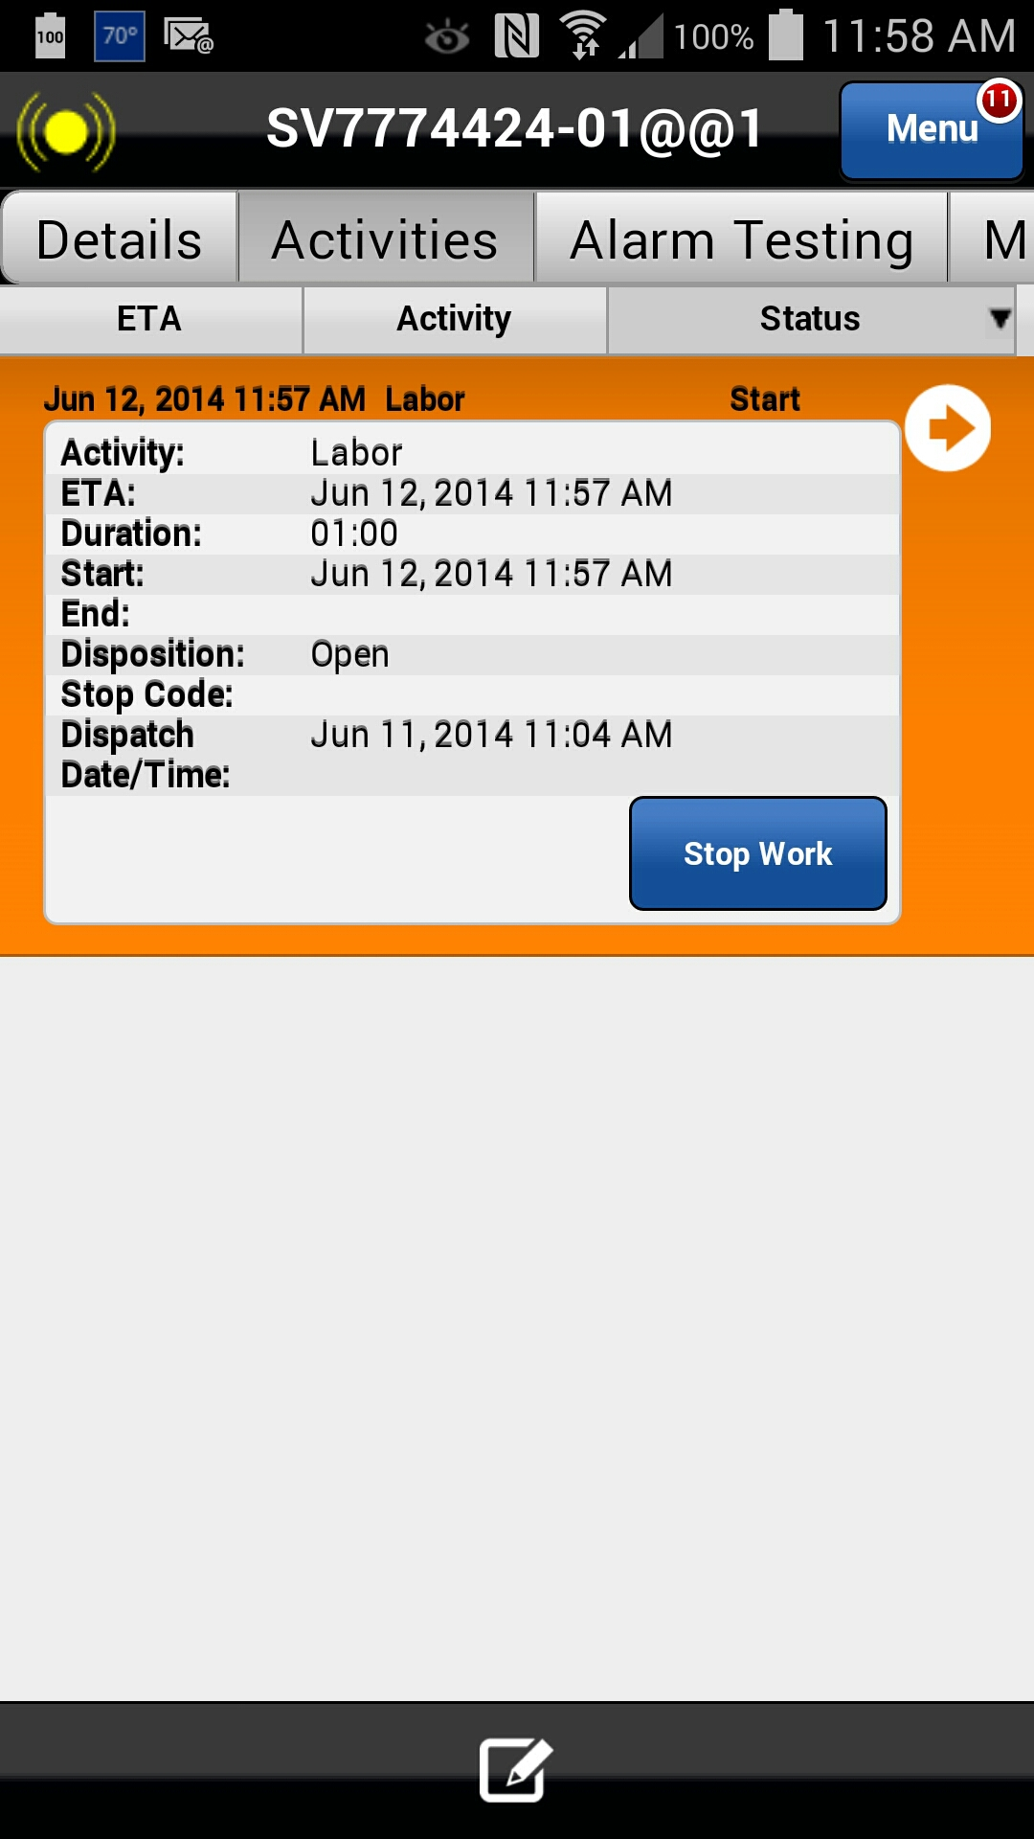
Customer Unavailable (Call Before Starting Travel)
Immediately Stop Work within the Astea Mobile App.
Action: Click on the Stop Work button
Previous
Home
End
Icon Legend

Slide 8
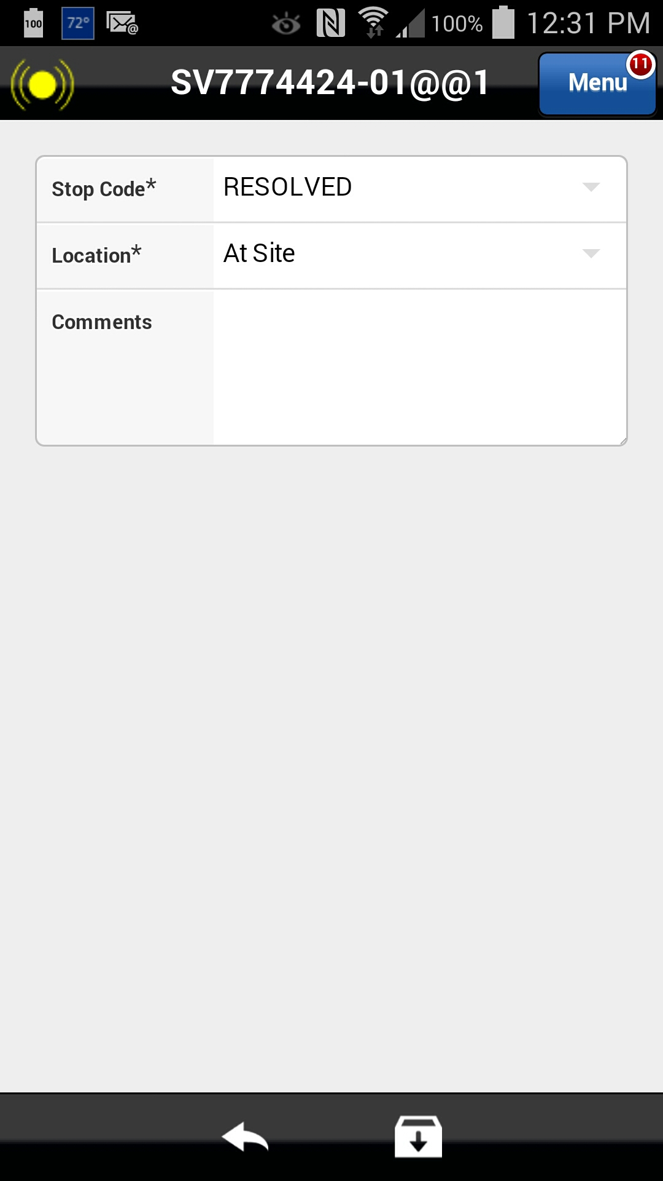
Customer Unavailable (Call Before Starting Travel)
Because the work could not be performed due to customer unavailability, the Stop Code will need to updated accordingly.
Action: Select the Stop code field
Previous
Home
End
Icon Legend

Slide 9
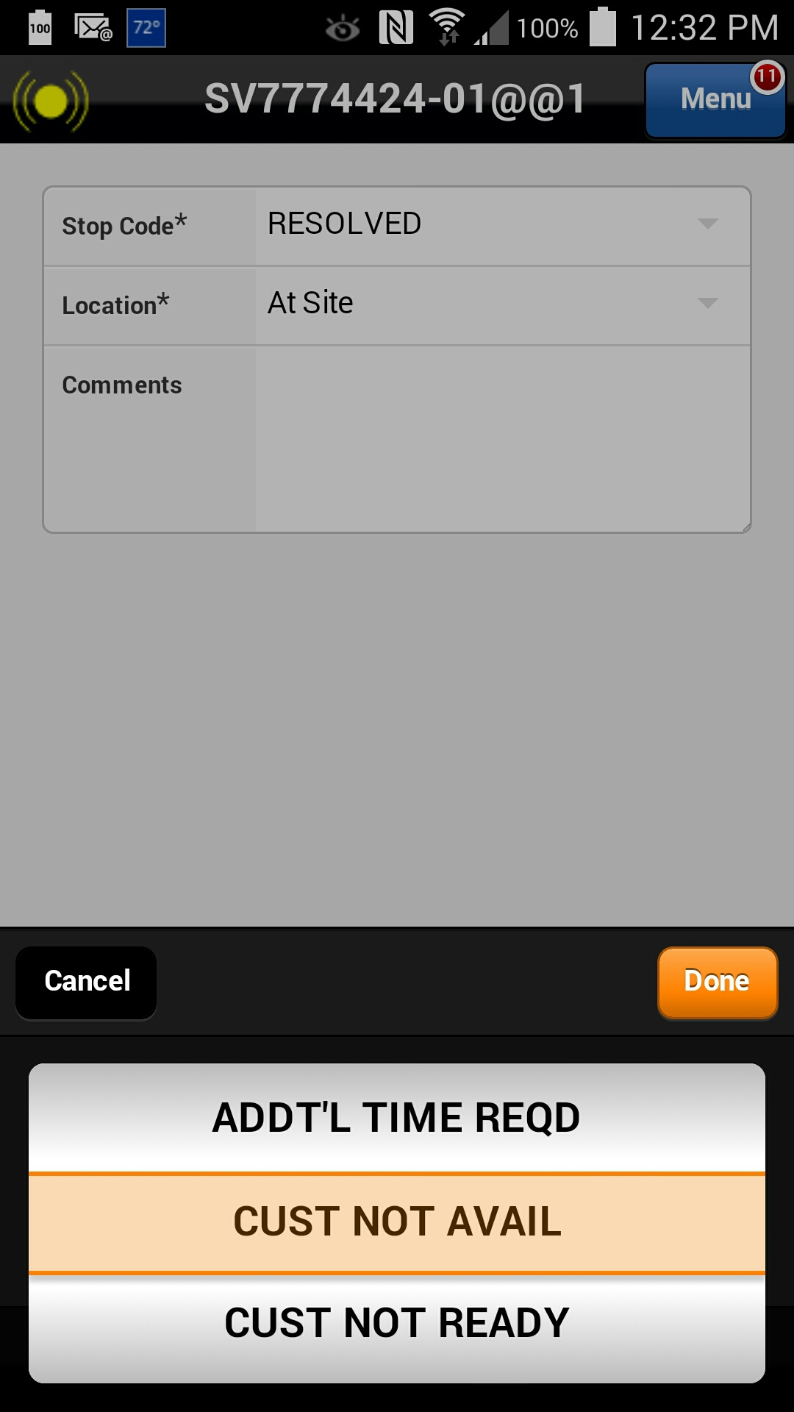
Customer Unavailable (Call Before Starting Travel)
Because the work could not be performed due to customer unavailability, the Stop Code will need to updated accordingly.
Action: Select “CUST NOT AVAIL” and Click on the Done button
Previous
Home
End
Icon Legend

Slide 10
Customer Unavailable (Call Before Starting Travel)
Save the Stop Work activity by clicking the down arrow box icon at the bottom of the screen.
Action: Click on the Save icon in the footer
Previous
Home
End
Icon Legend

Slide 11
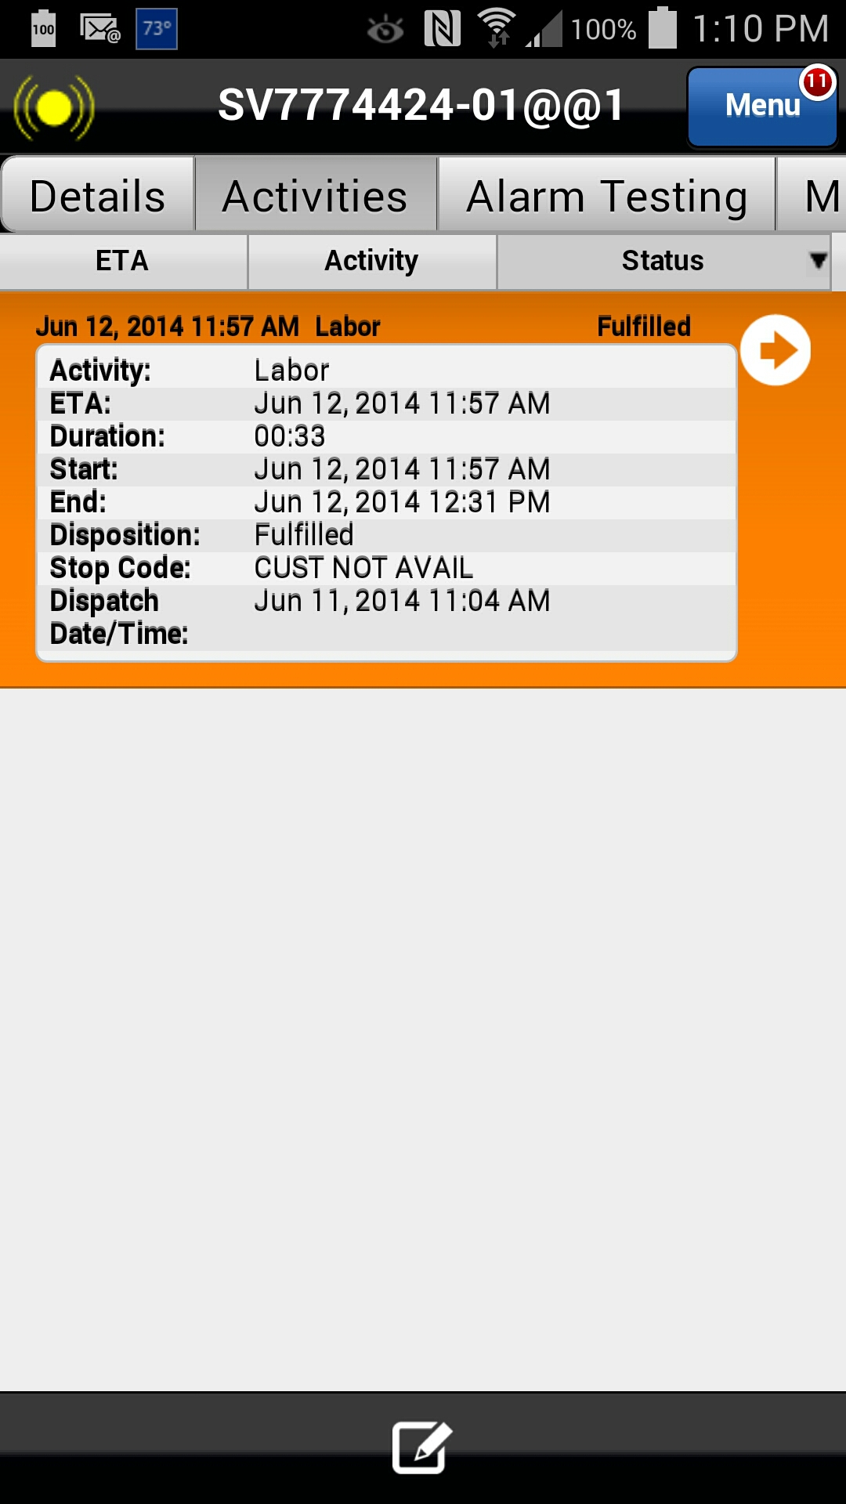
Customer Unavailable (Call Before Starting Travel)
By clicking on the Stop Work button , the clock stops tracking your on-site time (i.e., time which will be billed to the customer). Note that after Stop Work is selected, the Status changes to "Fulfilled" and a timestamp is now listed in the "End" field in the activity details.
“Customer Unavailable” should be entered into Customer Signature and normal close process should be followed
This concludes this module.
Activity status
Click on the Next button below
Previous
Home
End
Next
Icon Legend

Slide 12
Previous
Home
End

Slide 13
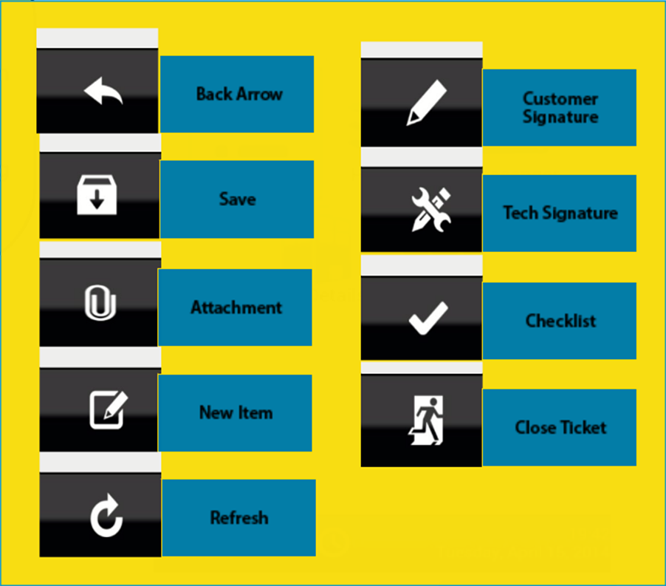
Icon Legend
Common icons used throughout the Astea application
Click on the Return button below to resume presentation
Return

