Slide 1
Astea Mobile App Training
Customer Unavailable Module (Technician arrives onsite)
Start

Slide 2
Customer Unavailable (Arrived at Customer Site)
Module Overview
In this module you will learn the process of working a Service Ticket in Astea in the event that you arrive at the customer site to find that the customer is unavailable.
Click on the Next button below
Previous
Home
End
Next
Icon Legend

Slide 3
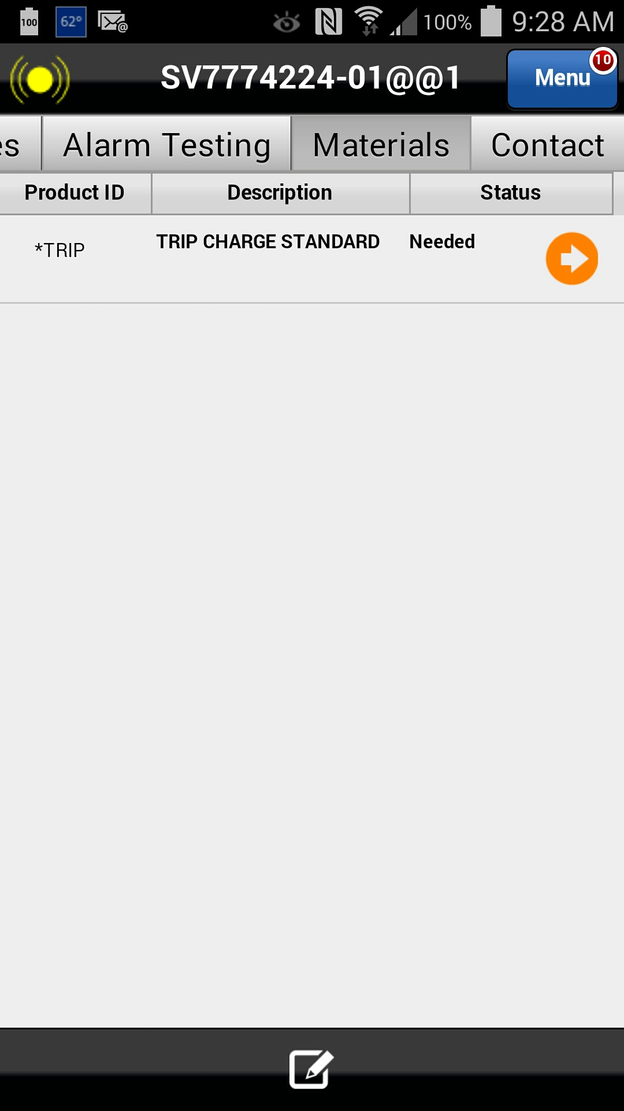
Customer Unavailable (Arrived at Customer Site)
In this scenario, you have arrived at the customer site to find that the customer is not available.
As you have started work and traveled to the site, the next step is to complete the ticket with the appropriate stop code.
Note: Branch management will determine actual charge to customer.
Action: Select the Materials tab
Previous
Home
End
Icon Legend
3

Slide 4
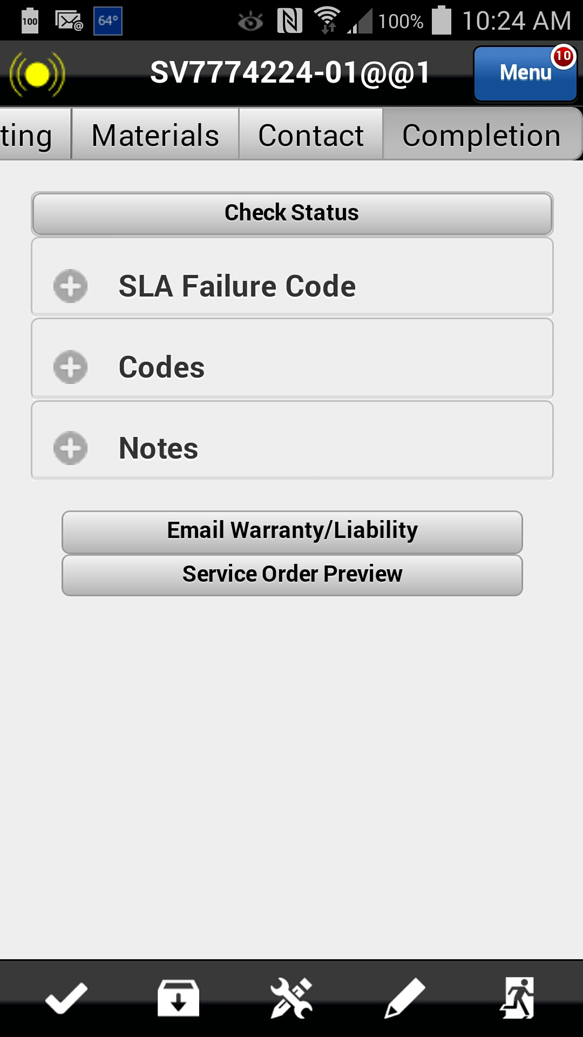
Customer Unavailable (Arrived at Customer Site)
Select the Completion tab and complete the codes, checklist, etc., noting that the customer was unavailable. Note: This process is the same as other tickets.
Action: Select Completion tab
Previous
Home
End
Icon Legend
4

Slide 5
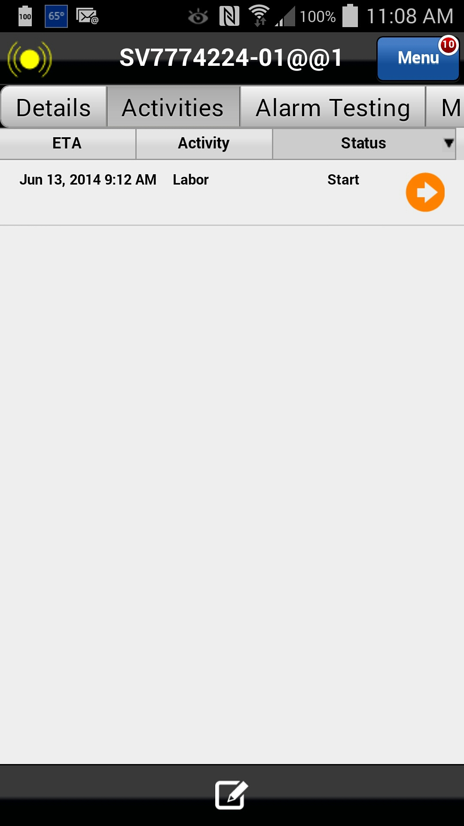
Customer Unavailable (Arrived at Customer Site)
After completing completion entries, including Completion Checklist, proceed to the Activities tab to Stop Work and resolve the service order.
Action: Select Activities tab
Previous
Home
End
Icon Legend
5

Slide 6
Customer Unavailable (Arrived at Customer Site)
Select the Activity by clicking the date.
By clicking on the date, the activity details will expand on the screen. Since this Service Order was recently opened on the device, note that the Status is "Open".
Action: Click on the Date
Previous
Home
End
Icon Legend

Slide 7
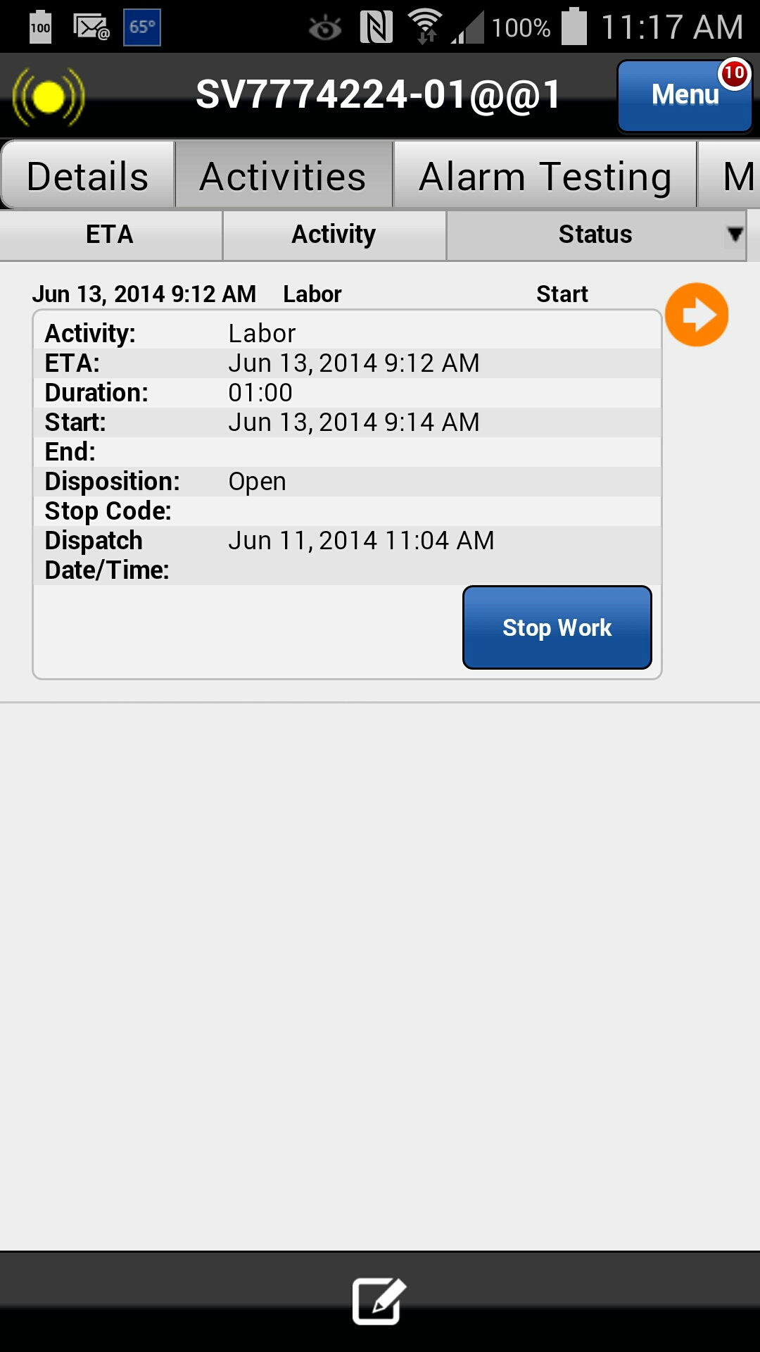
Customer Unavailable (Arrived at Customer Site)
After all labor has been completed for this Service Order, Click on the Stop Work button.
Action: Click on the Stop Work button
Previous
Home
End
Icon Legend

Slide 8
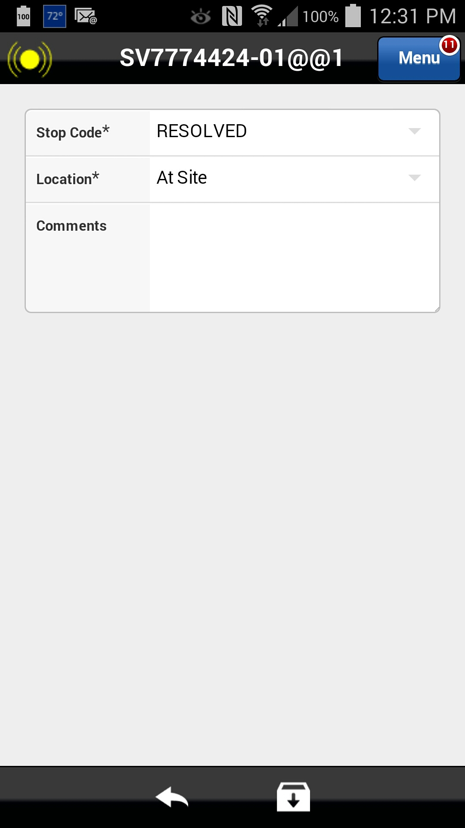
Customer Unavailable (Arrived at Customer Site)
Because the work could not be performed due to customer unavailability, the Stop Code will need to updated accordingly.
Action: Select the Stop code field
Previous
Home
End
Icon Legend

Slide 9
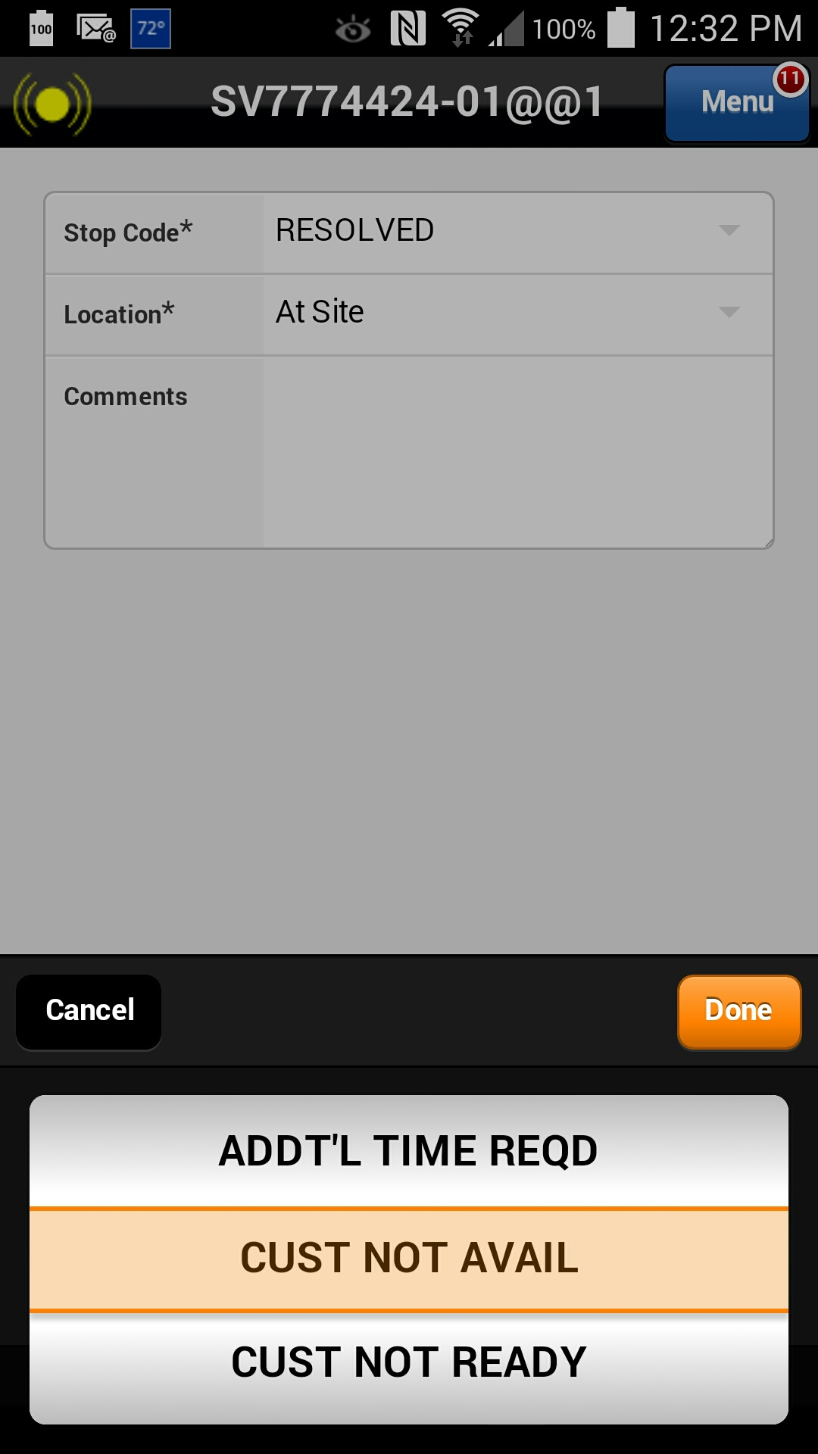
Customer Unavailable (Arrived at Customer Site)
Because the work could not be performed due to customer unavailability, the Stop Code will need to updated accordingly.
Action: Select “CUST NOT AVAIL” and Click on the Done button
Previous
Home
End
Icon Legend

Slide 10
Customer Unavailable (Arrived at Customer Site)
Save the Stop Work activity by clicking the down arrow box icon at the bottom of the screen.
Action: Click on the Save icon in the footer
Previous
Home
End
Icon Legend

Slide 11
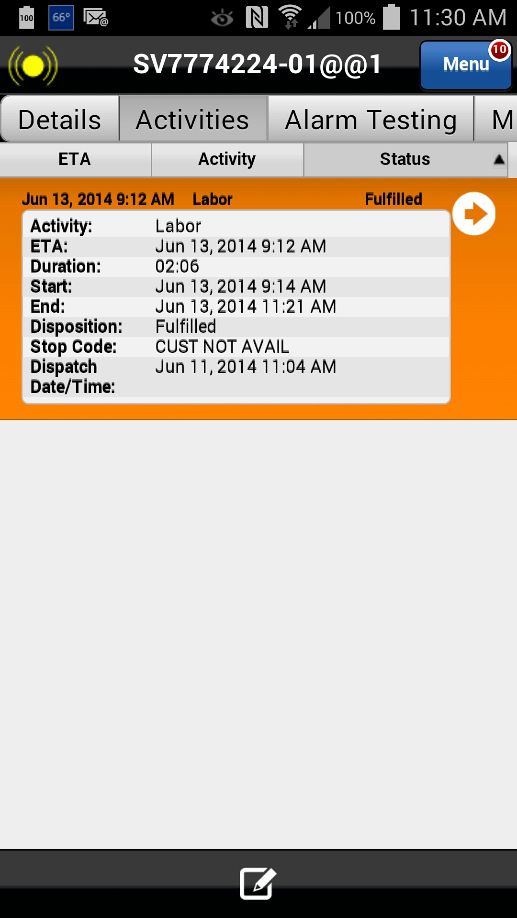
Customer Unavailable (Arrived at Customer Site)
By clicking on Stop Work, the clock stops tracking your on-site time (i.e., time which will be billed to the customer). Note that after Stop Work is selected, the Status changes to "Fulfilled" and a timestamp is now listed in the "End" field in the activity details.
“Customer Unavailable” should be entered into Customer Signature and normal close process should be followed
This concludes this module.
Activity status
Click on the Next button below
Previous
Home
End
Next
Icon Legend

Slide 12
Previous
Home
End

Slide 13
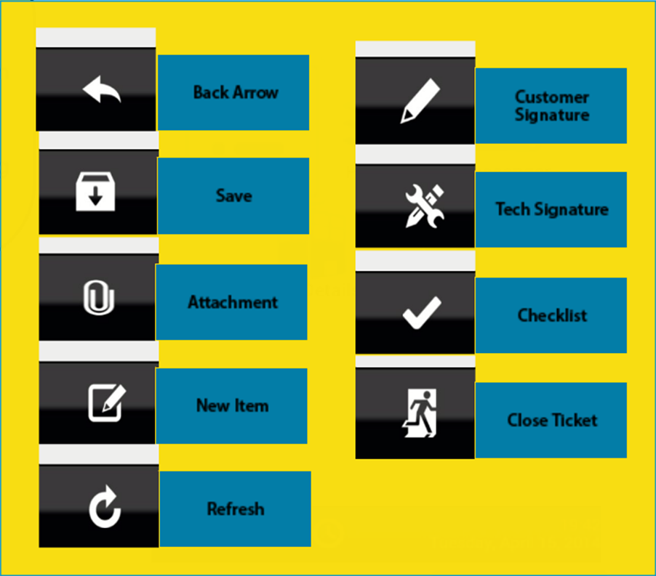
Icon Legend
Common icons used throughout the Astea application
Click on the Return button below to resume presentation
Return

