Slide 1
Astea Mobile App Training
Creating and Completing Lunch Activities
Start

Slide 2
Lunch Activities
Module Overview
In this module you will learn how to create and complete a daily lunch break from the Astea Mobile application.
In order to effectively account for a service technician’s daily work time, including travel, onsite time, and lunches, the ability to add a Private Activity for a daily lunch is now available.
Previous
Home
End
Next
Icon Legend

Slide 3
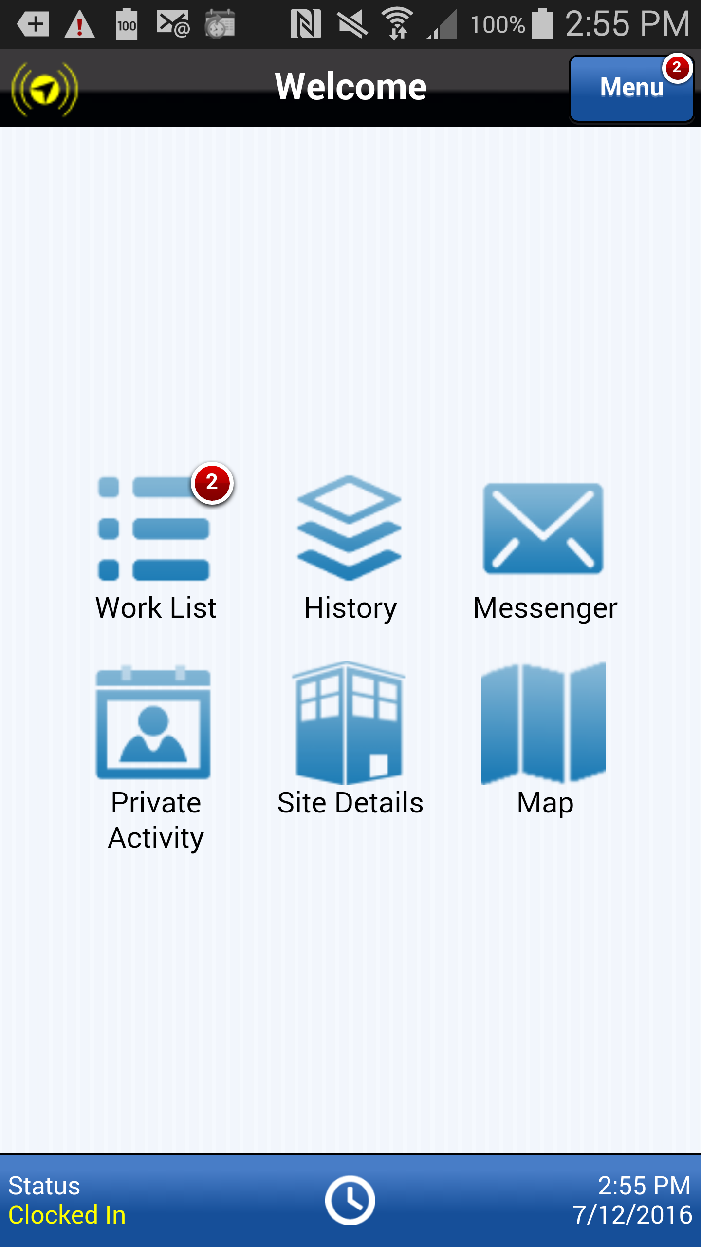
Creating a Lunch Activity
Service technicians are now required to create and complete a Private Activity on their mobile devices for their daily lunch breaks.
A Lunch activity can be added at the beginning of the day anticipating a lunch break or on the fly when you are ready to take your lunch break.
To add a Private Activity for Lunch, select the Private Activity button from the Home page.
Action: Click on the Private Activity button
Previous
Home
End
Icon Legend

Slide 4
Creating a Lunch Activity
Add a Private Activity for Lunch by selecting the Add button.
Action: Click on the Add Private Activity Icon in the footer
Previous
Home
End
Icon Legend

Slide 5
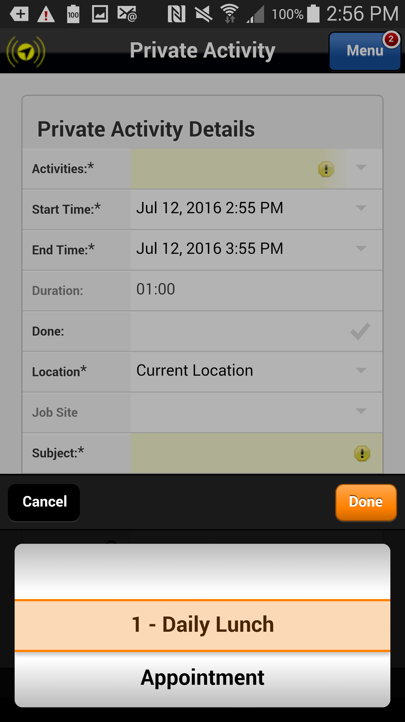
Creating a Lunch Activity
Select 1 – Daily Lunch from the list of options and select Done.
Action: Click on the Done button
Previous
Home
End
Icon Legend

Slide 6
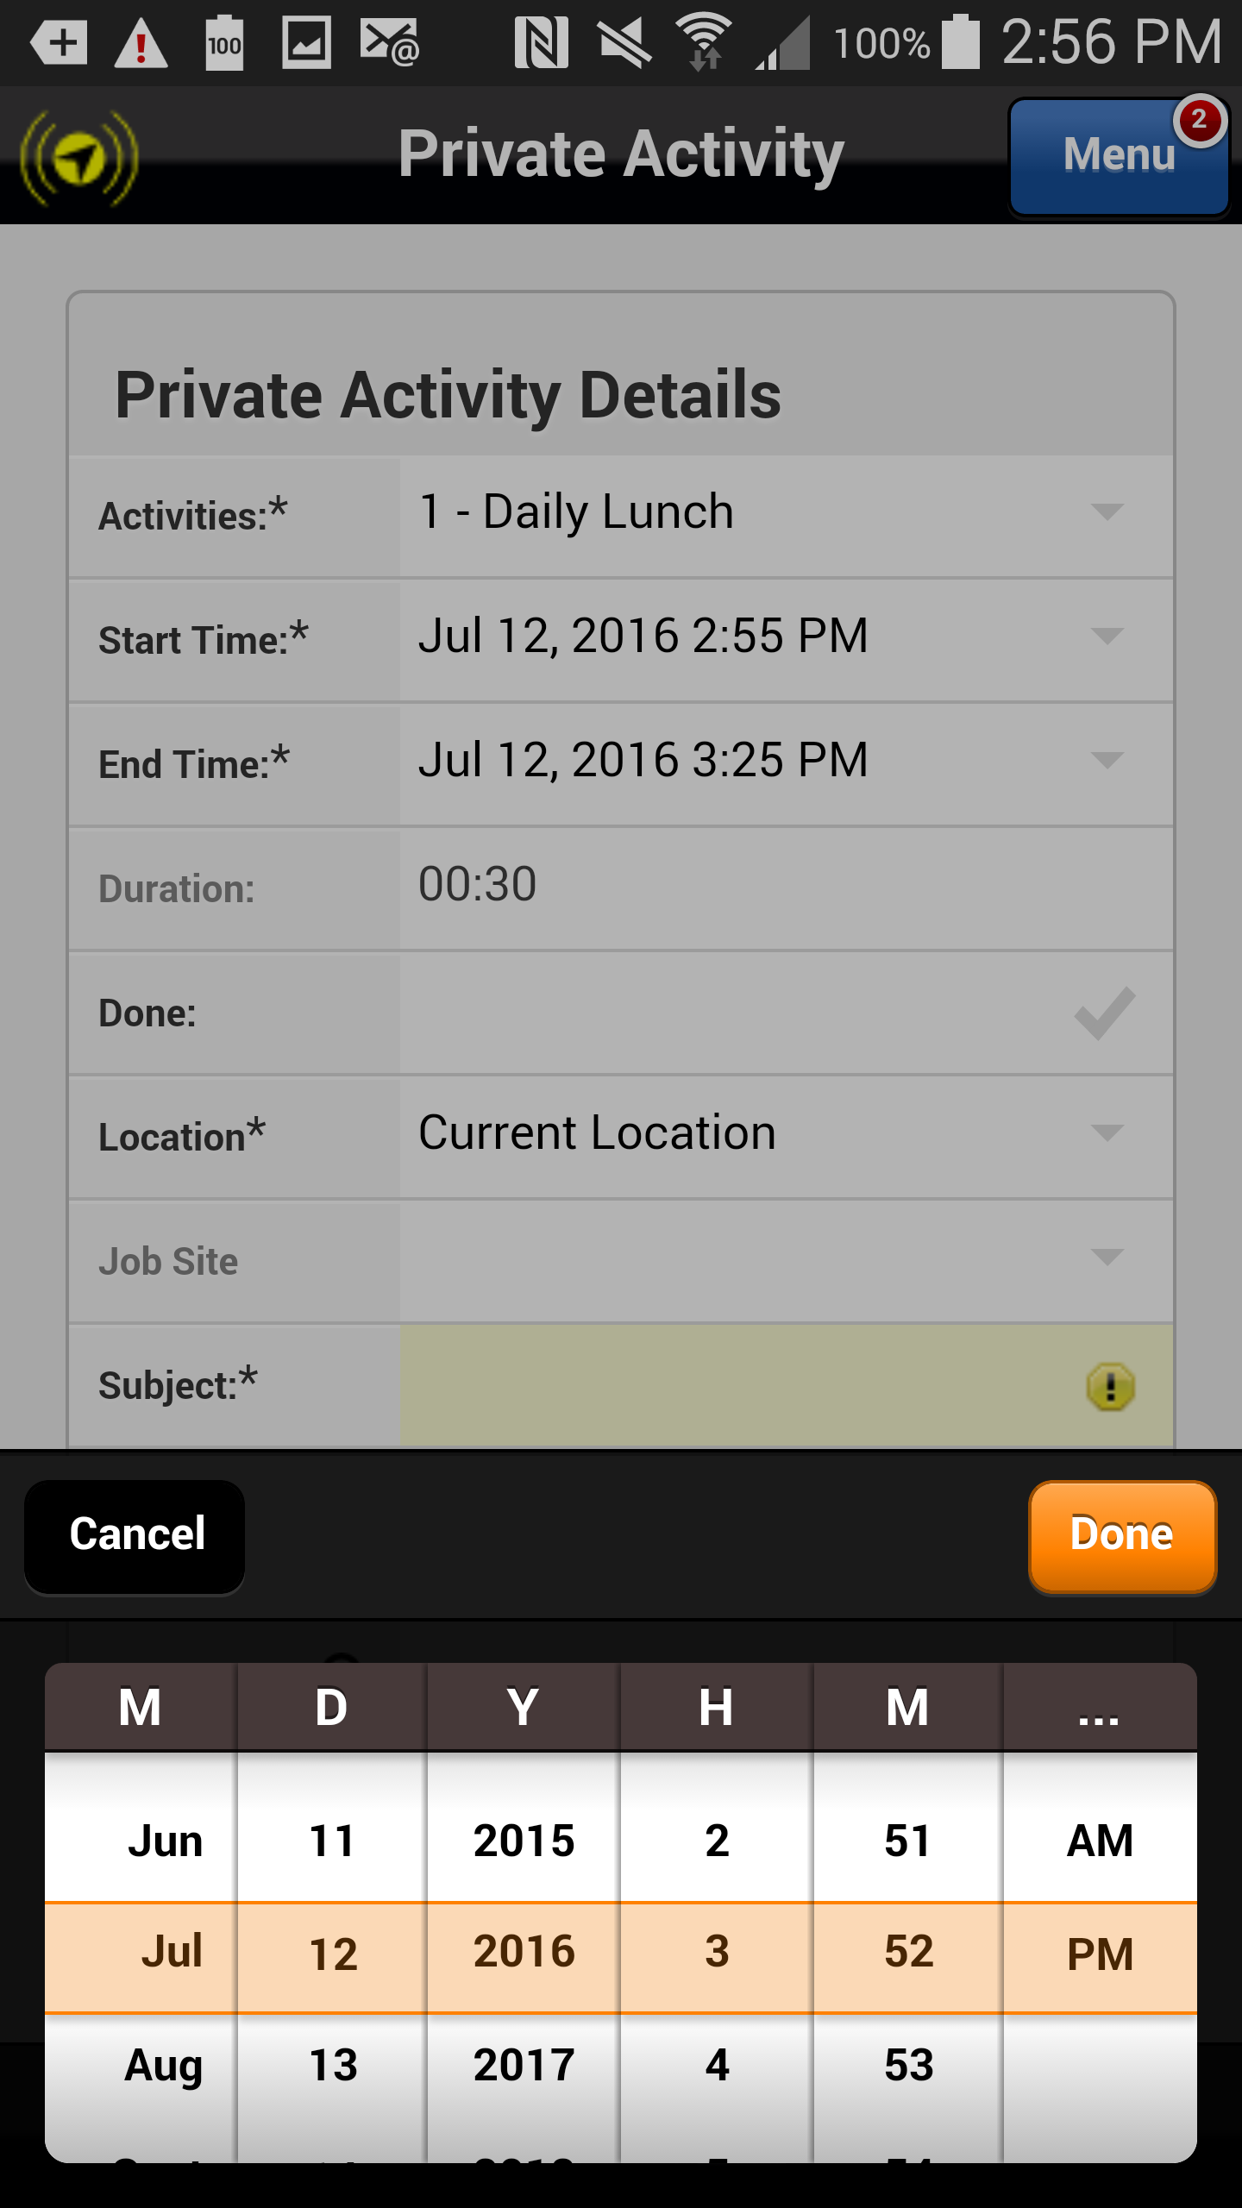
Creating a Lunch Activity
If necessary, adjust the Start and End times as necessary using the calendar dialers. Select Done.
Note: you can adjust the start and end times anticipating your normal lunch break or you can adjust the start and stop time when you actually start and stop your lunch break.
Action: Click on the done button
Previous
Home
End
Icon Legend

Slide 7
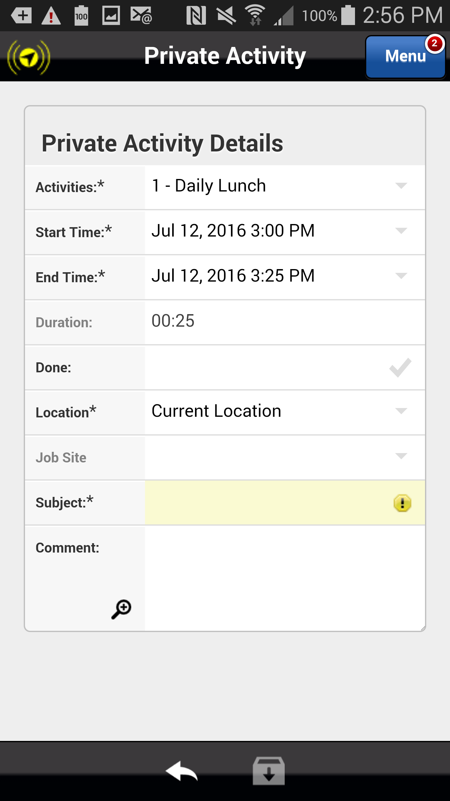
Creating a Lunch Activity
Click in the Subject field to enable to keyboard and enter a subject such as Lunch.
Note: Subject is a required field.
Action: Click in the Subject field
Previous
Home
End
Icon Legend

Slide 8
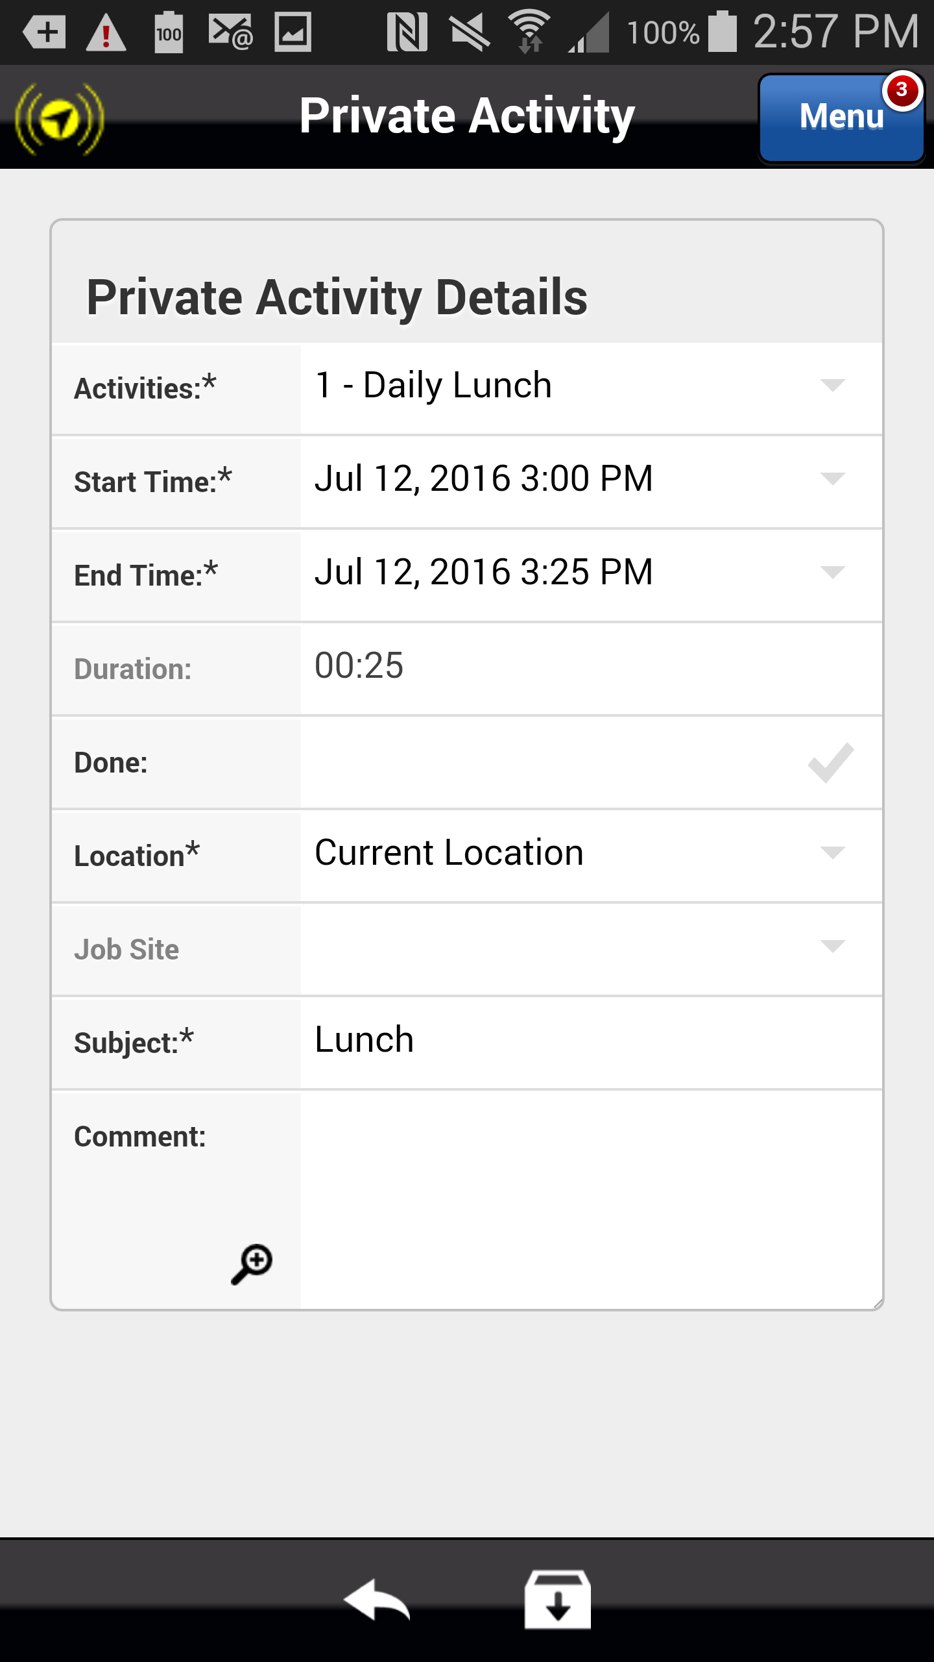
Creating a Lunch Activity
Select Save to save the Private Activity.
Action: Click on the Save Icon in the footer
Previous
Home
End
Icon Legend

Slide 9
Creating a Lunch Activity
The Private Activity for Lunch is added to your mobile device and is ready to be completed.
Select the orange arrow to complete the Lunch activity.
Action: Click on the orange arrow within the activity you want to edit
Previous
Home
End
Icon Legend

Slide 10
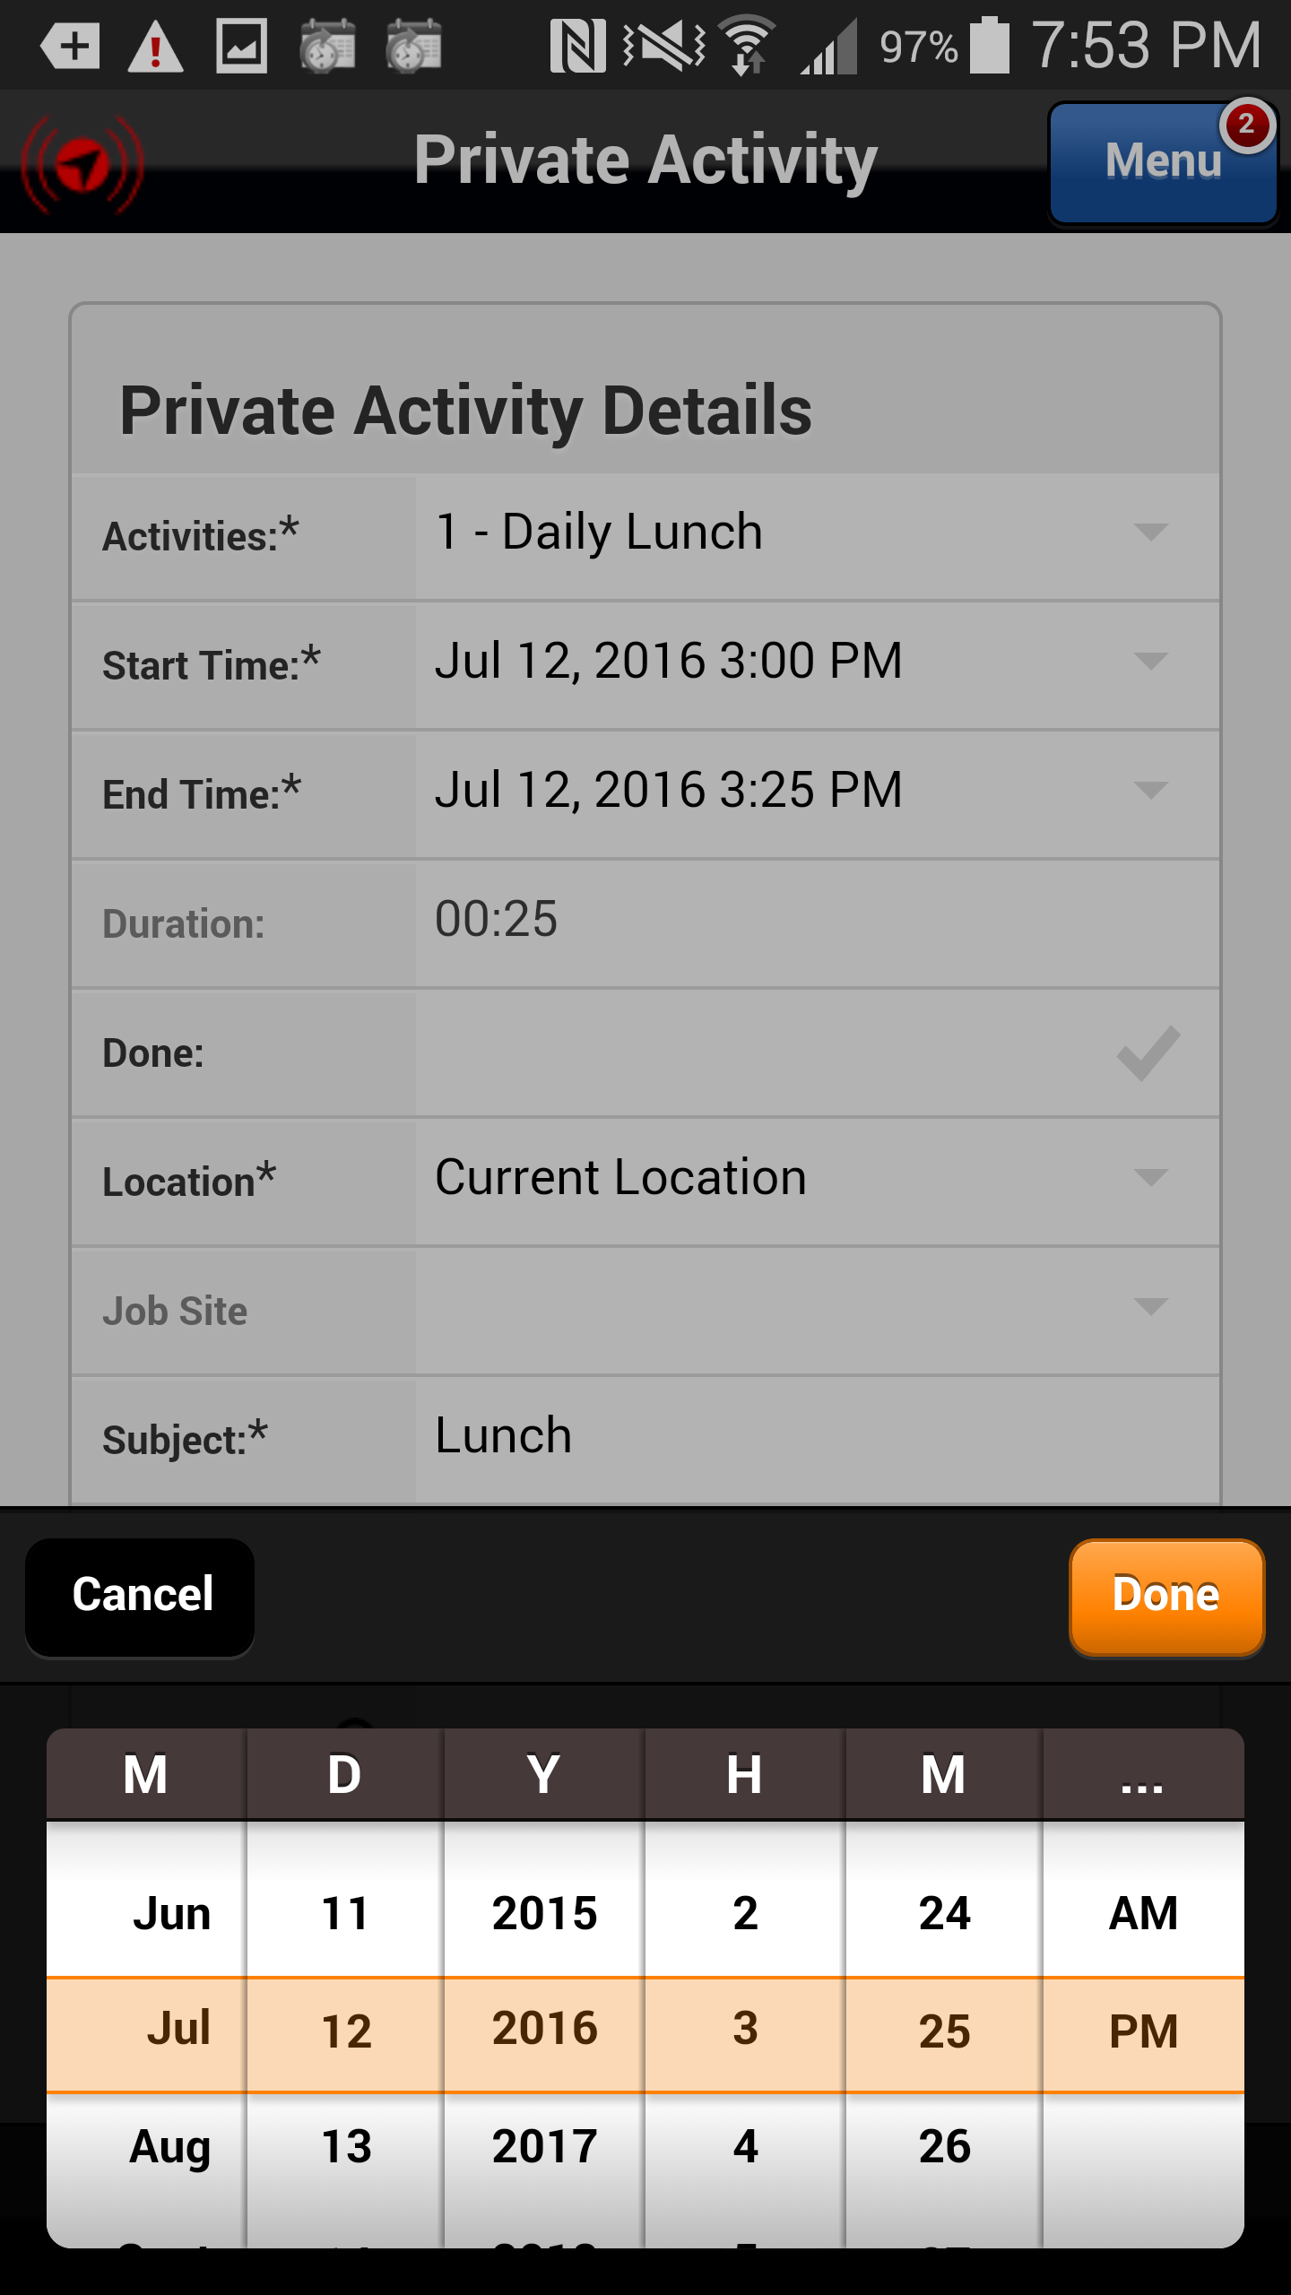
Completing Lunch Activity
If necessary, adjust the Start and End times as necessary using the calendar dialers. Select Done.
Note: when creating the Lunch activity you can adjust the start and end times anticipating your normal lunch break or you can adjust the start and stop time when you actually start and stop your lunch break.
Action: Click on the done button
Previous
Home
End
Icon Legend

Slide 11
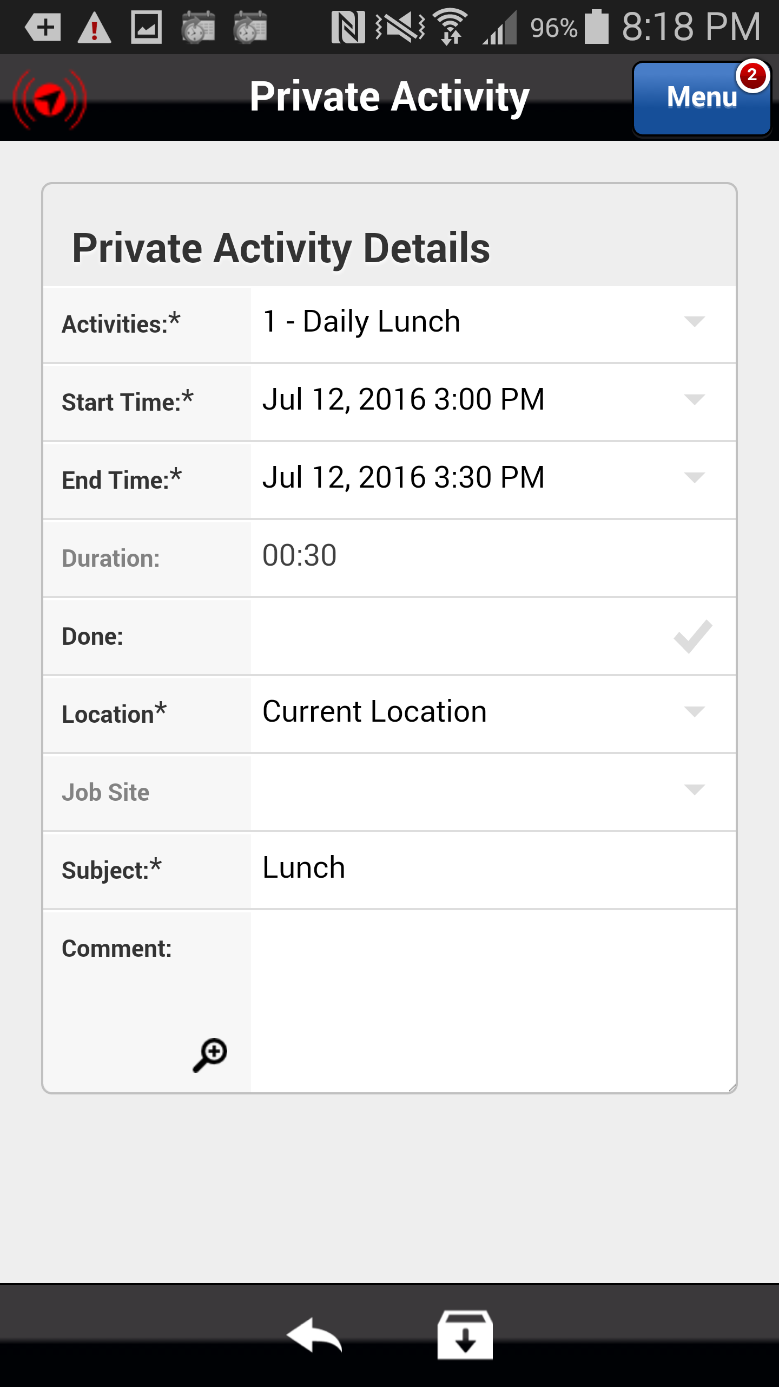
Completing Lunch Activity
Select the Done checkmark to complete the Lunch activity.
Action: Click on the Done checkmark
Previous
Home
End
Icon Legend

Slide 12
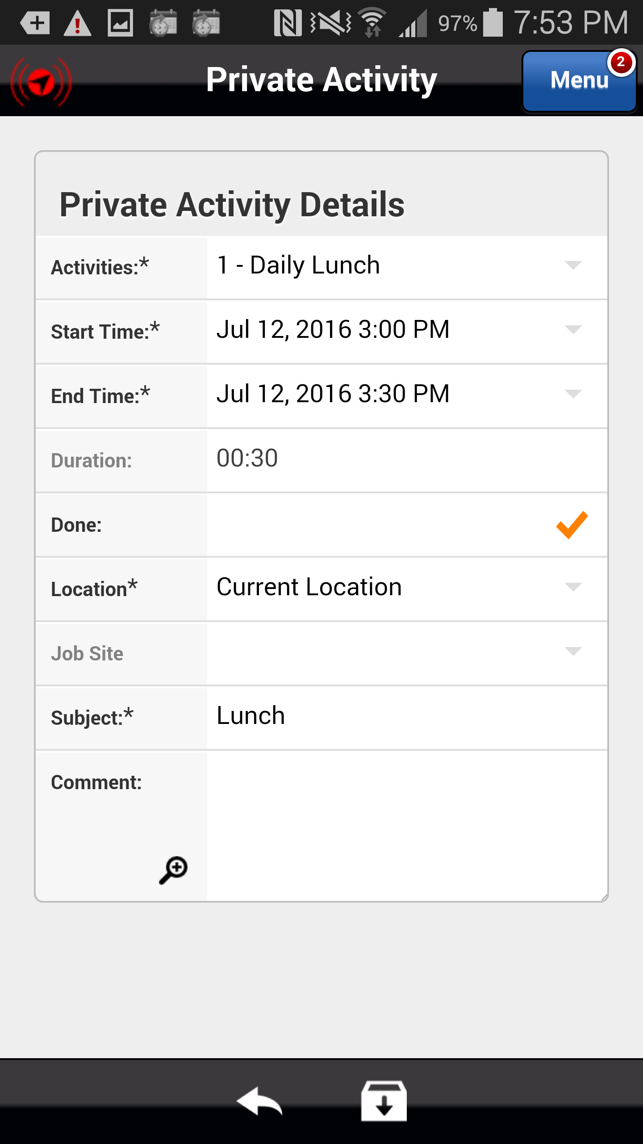
Completing Lunch Activity
Select Save icon to the completed Lunch activity details.
Action: Click on the Save icon in the footer
Previous
Home
End
Icon Legend

Slide 13
Deleting a Lunch Activity Created in Error
From time to time it will be necessary to delete a Lunch activity created in error.
To delete a Lunch activity the activity by clicking on the date or name.
Action: Click on the activity Date or Name
Previous
Home
End
Icon Legend

Slide 14
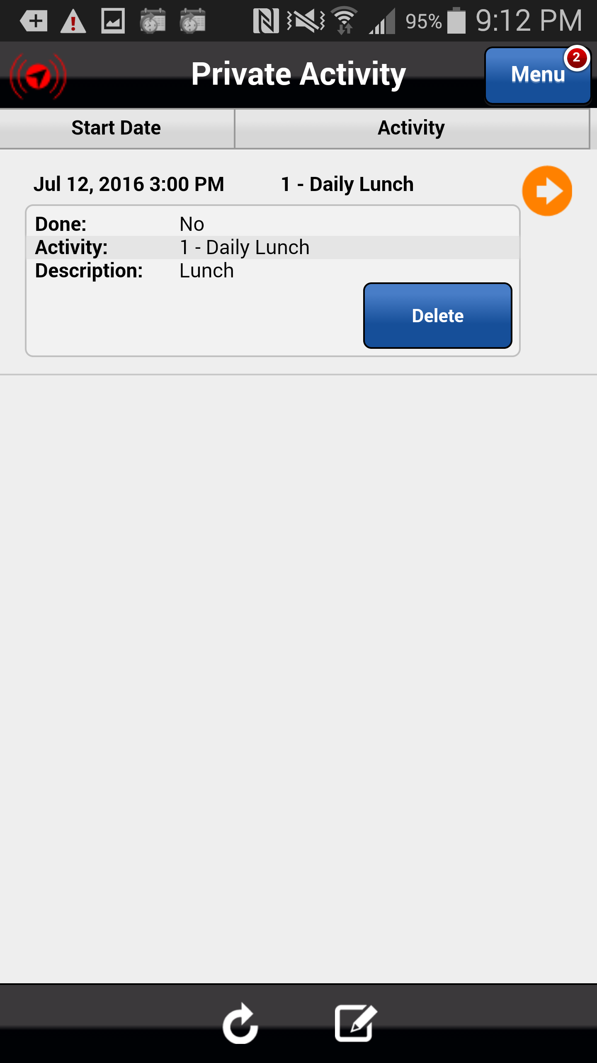
Deleting a Lunch Activity Created in Error
Select the Delete button to delete the Lunch activity.
Action: Click on the Delete button
Previous
Home
End
Icon Legend

Slide 15
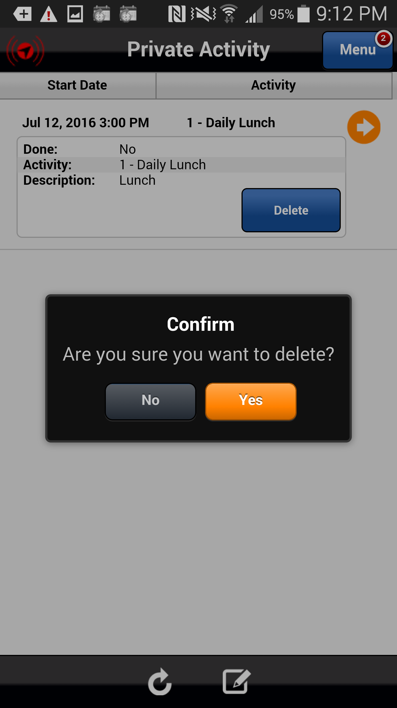
Deleting a Lunch Activity Created in Error
A confirmation message appears ensuring that you want to delete the Lunch Activity. Select Yes.
Action: Click on the Yes button
Previous
Home
End
Icon Legend

Slide 16
Deleting a Lunch Activity Created in Error
The Lunch activity is removed from your Private Activity list.
Action: Click on the Next button
Previous
Home
End
Next
Icon Legend

Slide 17
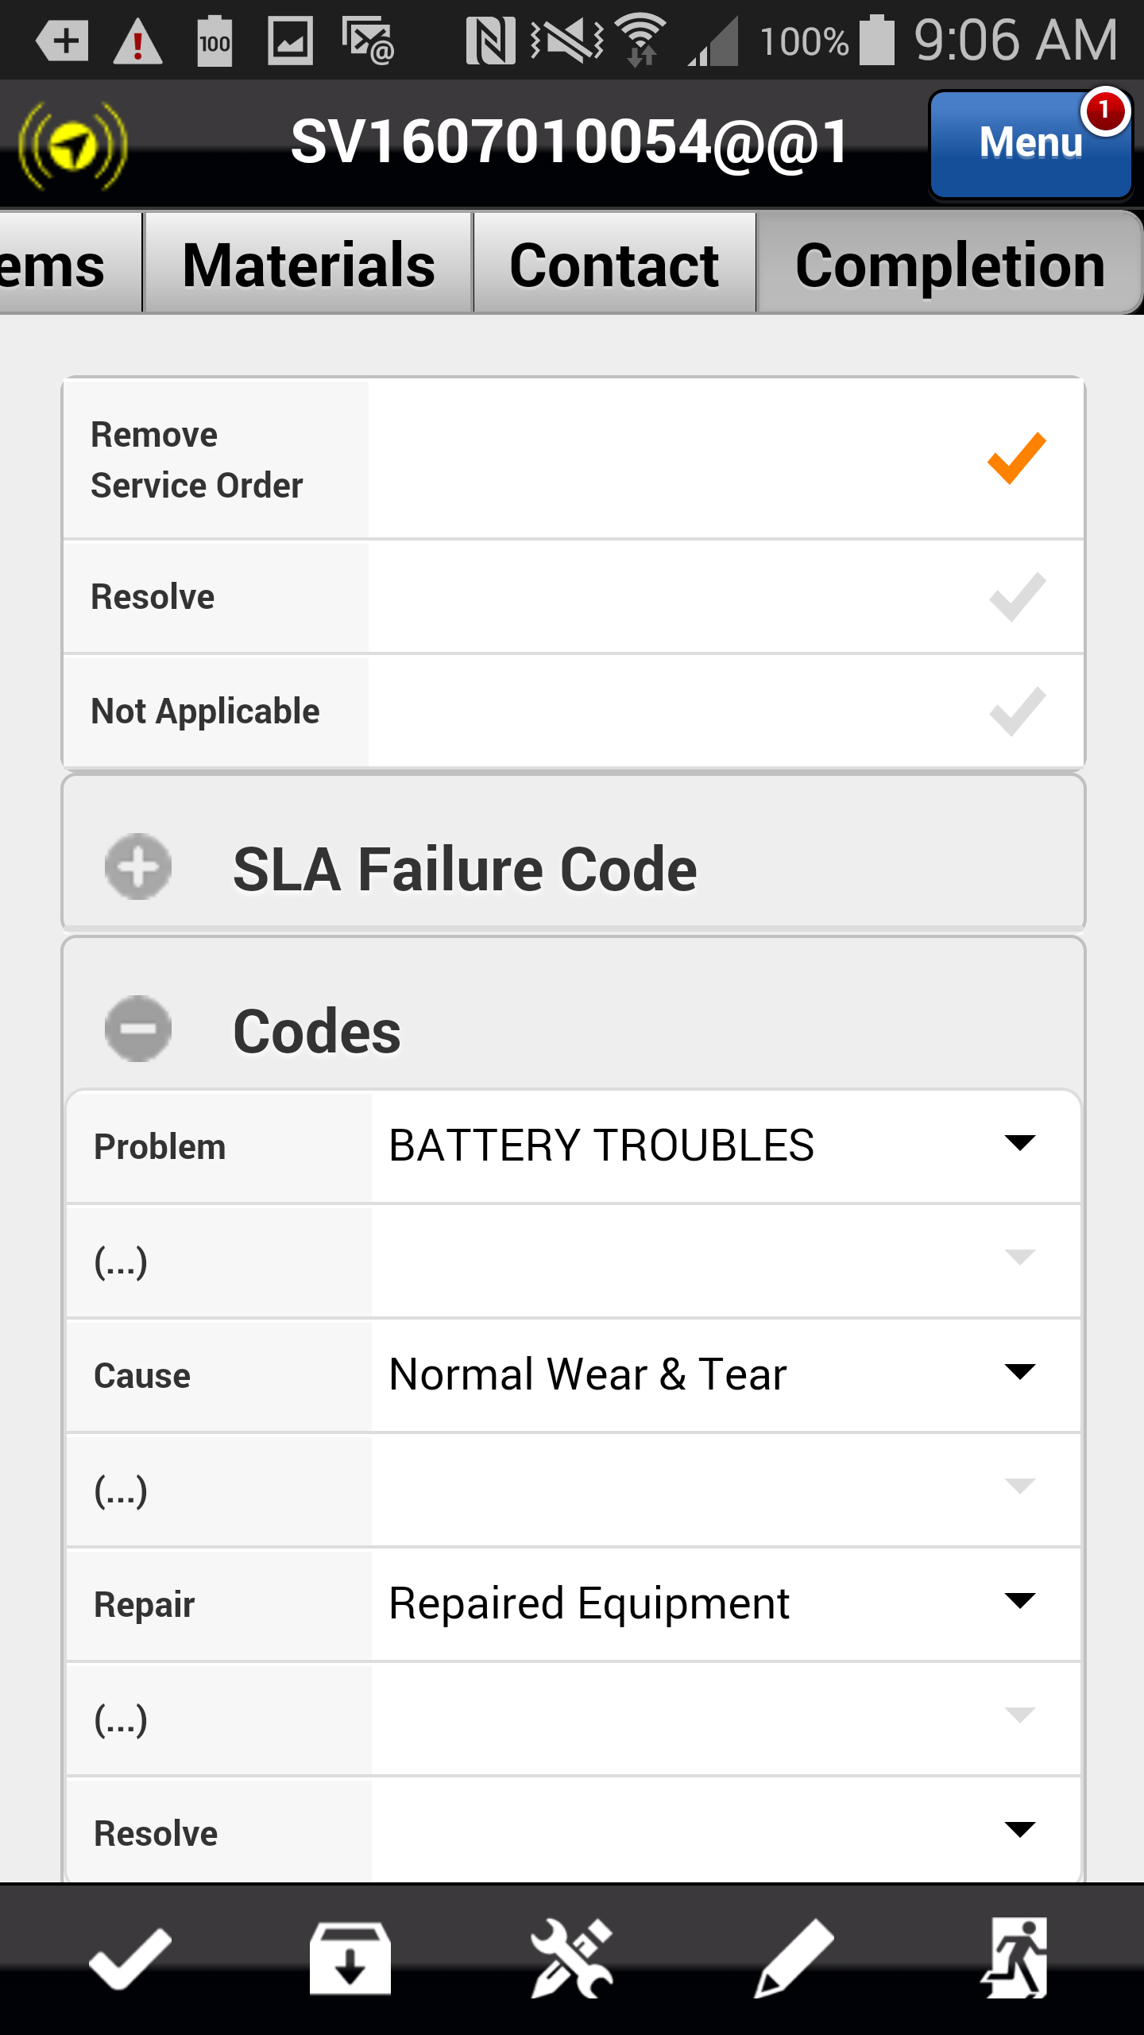
Lunch – Service Order is Complete
If applicable, select the Resolve checkmark (will not appear if you chose an incomplete stop code) and then click the Running Man icon to complete the service order and remove it from you device.
Action: Select the Running Man icon
Previous
Home
End
Icon Legend
17

Slide 18
Lunch – Service Order is Complete
Select the Menu button to return to the list of menu options.
Action: Select the Menu button
Previous
Home
End
Icon Legend
18

Slide 19
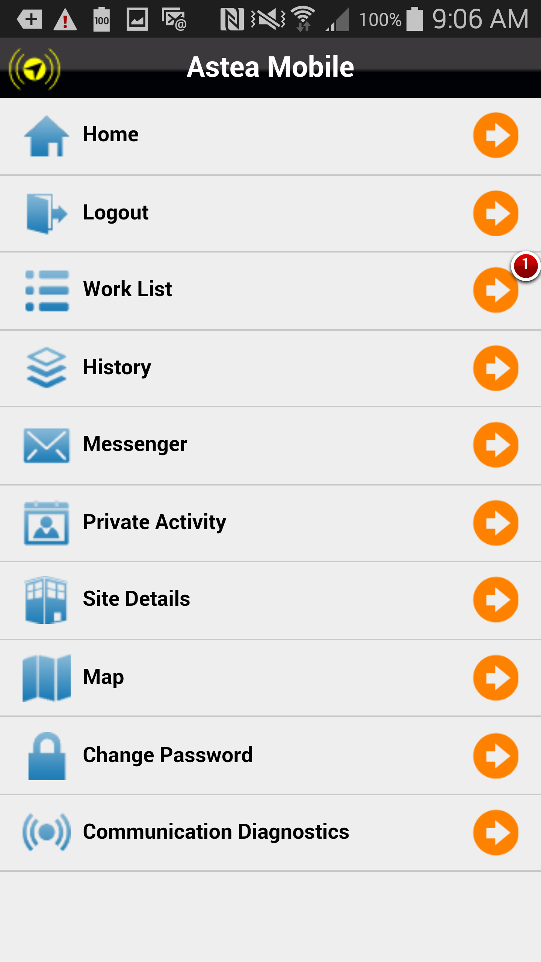
Lunch – Service Order is Complete
To add a Lunch activity, select the Private Activity menu option.
Action: Click on Private Activity
Previous
Home
End
Icon Legend

Slide 20
Lunch – Service Order is Complete
Add a lunch activity with the appropriate Start time. Complete the activity once your lunch break has ended. Work the next service order in your list by hitting the Start Travel button to indicate that you have started traveling to the site.
Note: Lunch activities show on the schedule board in the Dispatch Console so please make sure they are accurate and that you complete any Lunch activity that you add.
Action: Click on the Next button
Previous
Home
End
Next
Icon Legend

Slide 21
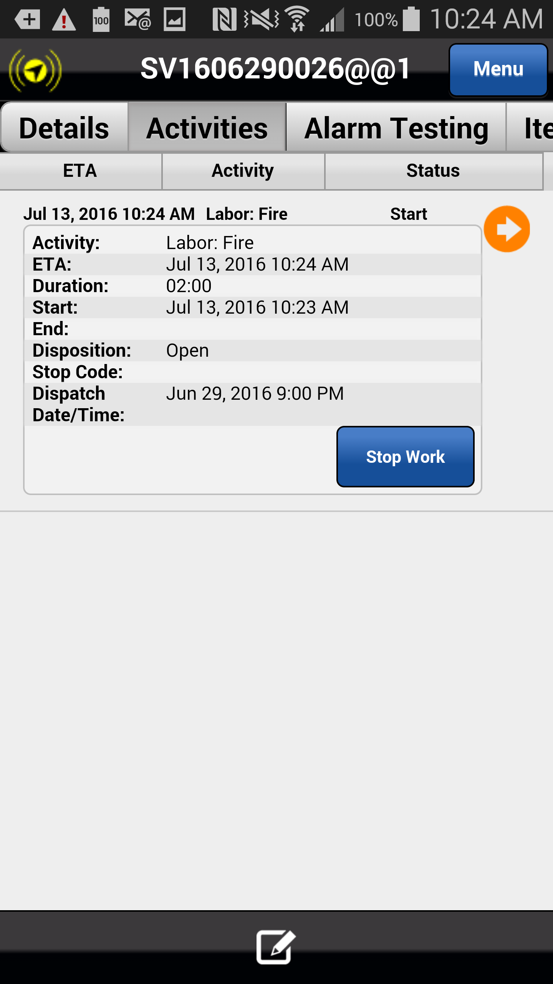
Lunch – Work Not Completed
Another scenario exists in which you are at a customer site and before you have completed the necessary repairs, it is time for your lunch break.
Open the service order and select the Activities tab. Select Stop Work.
Action: Click on the Stop Work button
Previous
Home
End
Icon Legend

Slide 22
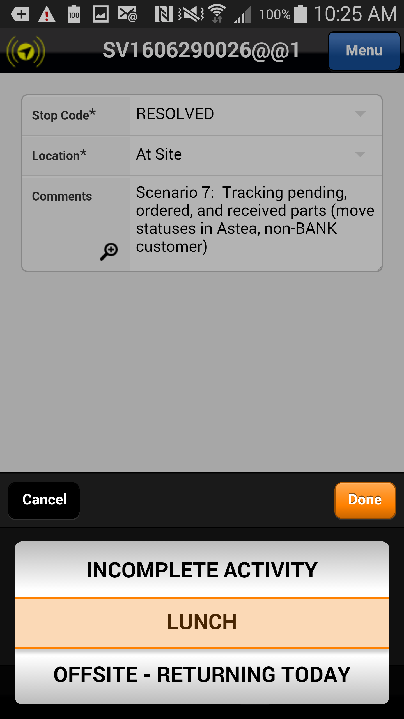
Lunch – Work Not Completed
IMPORTANT: Select the stop code LUNCH and select Done.
Action: Click on the Done button
Previous
Home
End
Icon Legend

Slide 23
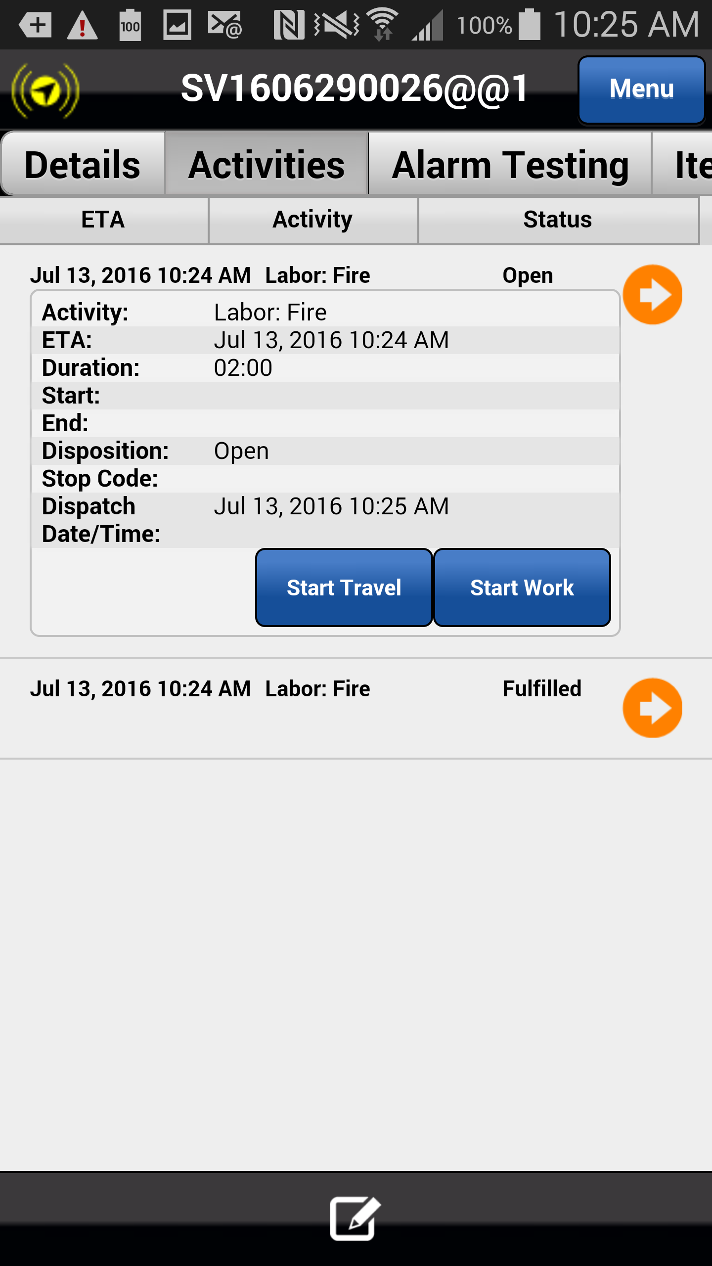
Lunch – Work Not Completed
A second labor activity is created and delivered to your mobile device. Click on the Completion tab and complete the ticket as necessary.
Select the Menu button to access the Private Activity feature. Add a Lunch activity and complete it with the appropriate Start and End times.
When you are ready travel back to the job site, select Start Travel and work the service order to completion.
This concludes this module.
Click on the Next button below
Previous
Home
End
Next
Icon Legend

Slide 24
Previous
Home
End

Slide 25
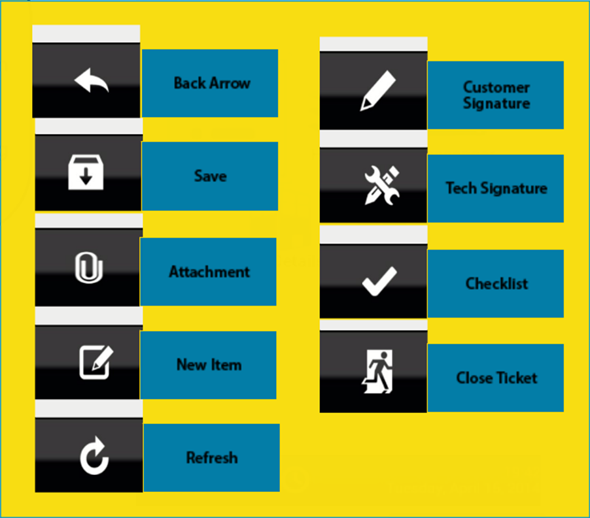
Icon Legend
Common icons used throughout the Astea application
Click on the Return button below to resume presentation
Return

