Slide 1
Service Dispatch & Ticket Creation Quick Reference Guide
Attach picture to service order

Slide 2
Attach a picture to Service Order
Astea has the ability for a technician to save pictures and attach them to the service order. This document will explain the process to save a picture and attach it to the service order.
Previous
Home
End
Next
Icon Legend
2

Slide 3
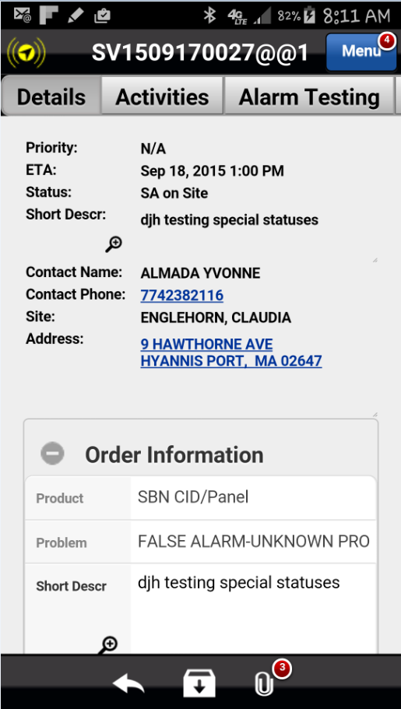
Attach a picture to the service order
The number of attachments associated with the service order is displayed in the red circle near the paperclip icon.
From the Details Tab, select the Attachments icon. The Attachments page will be displayed.
Previous
Home
End

Slide 4
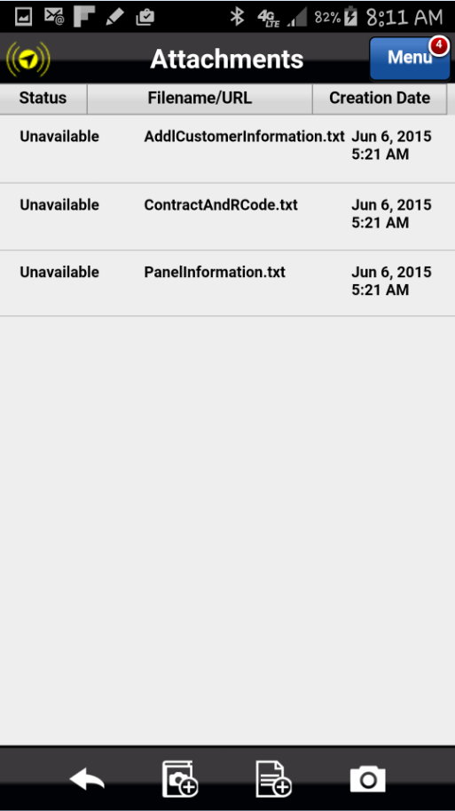
Attach a picture to the service order
Select the camera icon. The camera is activated. Select the camera icon again to take the picture.
Select Save. The Attachments page is displayed.
Previous
Home
End

Slide 5
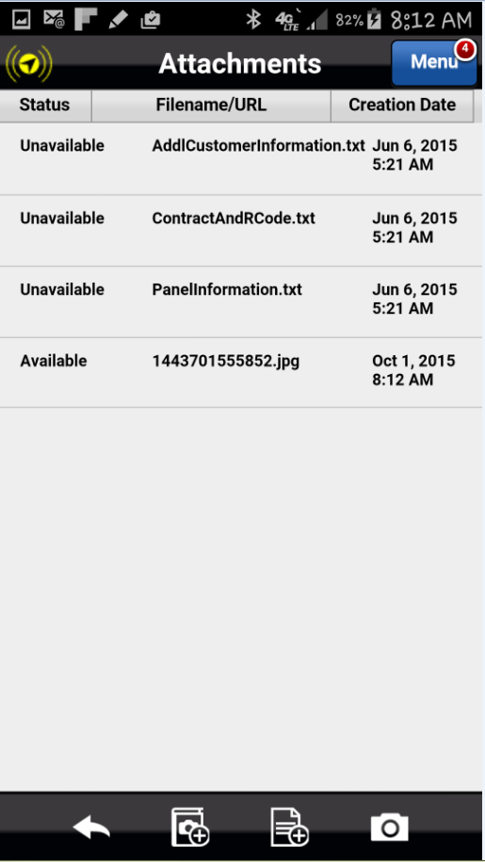
Attach a picture to the service order
To open the picture, select the file.
Previous
Home
End

Slide 6
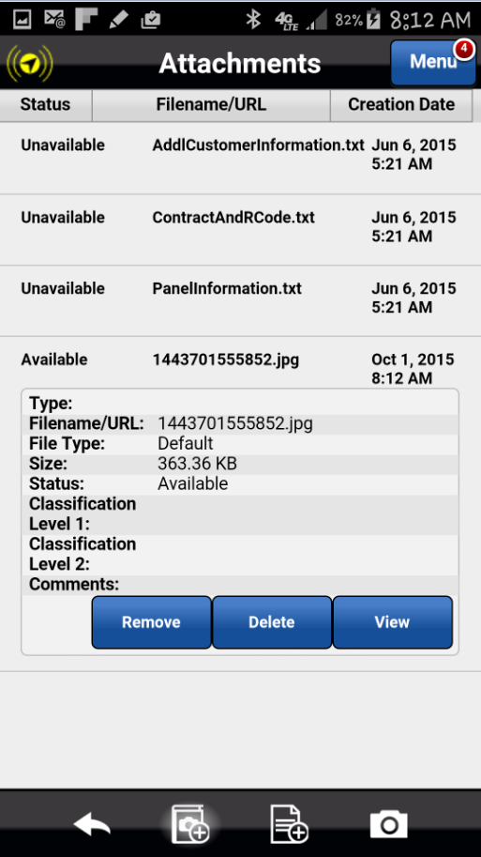
Attach a picture to the service order
The Attachment details will be displayed.
Select View.
To return to the service order, select the back button on the phone. The Details Page will then be displayed.
Previous
Home
End

Slide 7
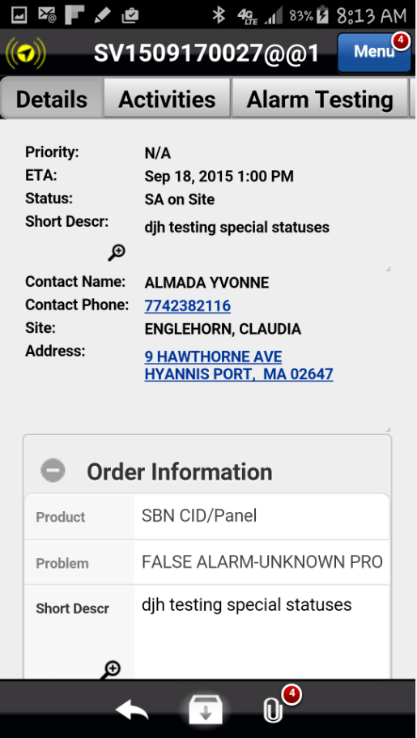
Attach a picture to the service order
The number of attachments associated with the service order is displayed in the red circle near the paperclip icon. The number has increased by the number of pictures taken and saved to the service order.
Previous
Home
End

Slide 8
Previous
Home
End

Slide 9
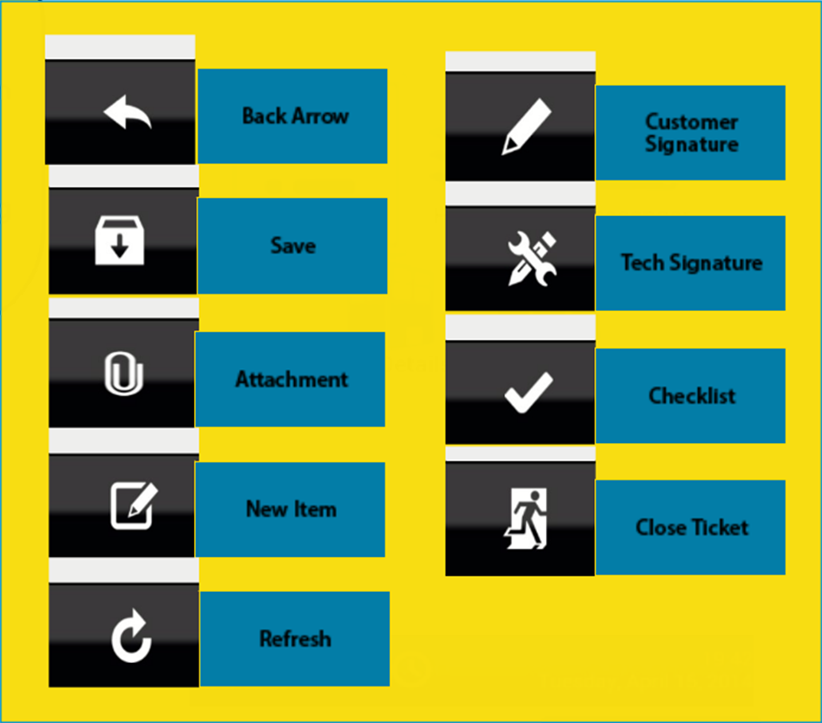
Icon Legend
Common icons used throughout the Astea application
Click on the Return button below to resume presentation
Return

