Slide 1
Astea Mobile App Training
Using and Returning a Lift
Start

Slide 2
Using and Returning a Lift
Module Overview
In this module you will learn one of the special part scenarios – adding and returning a Lift.
When using a Lift, remember to post the Lift Return as well to accurately reflect the parts used and the state of the customer site.
Logging the return helps eliminate unnecessary charges.
Click on the Next button below
Previous
Home
End
Next
Icon Legend

Slide 3
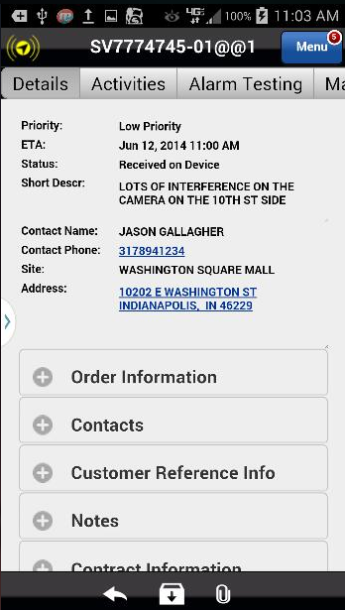
Using and Returning a Lift
The Astea Mobile App combines special parts like Lifts with other parts on the Materials tab.
To add a Lift used at a customer site, navigate to the Materials tab.
Action: Click on the Materials tab on the far right
Previous
Home
End
Icon Legend

Slide 4
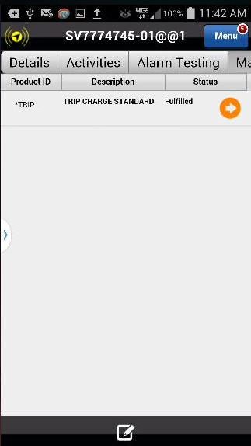
Using and Returning a Lift
Add the Lift Rental to the Service Order.
Action: Click on the Add Item Icon in the footer
Previous
Home
End
Icon Legend

Slide 5
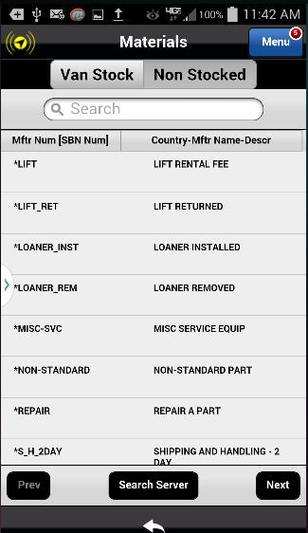
Using and Returning a Lift
Parts lookup uses the Non-Stocked tab.
Action: Click on the Non-Stocked tab.
Previous
Home
End
Icon Legend

Slide 6
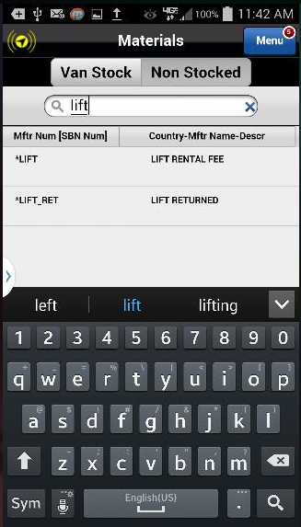
Using and Returning a Lift
Type Lift in the Search box.
Tip: Notice as you type, the parts list minimizes to included only terms that match the search criteria.
Action: Click on the Lift Rental Fee to select the part
Previous
Home
End
Icon Legend

Slide 7
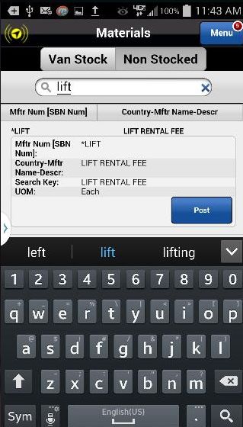
Using and Returning a Lift
Post the Lift Rental Fee to the Service Order.
Action: Click on the Post button
Previous
Home
End
Icon Legend

Slide 8
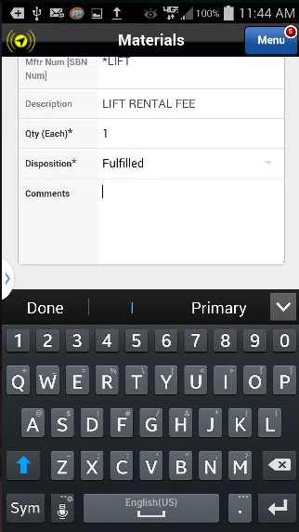
Using and Returning a Lift
Add comments related to the Lift Rental.
Action: Click on the Comments section
Previous
Home
End
Icon Legend

Slide 9
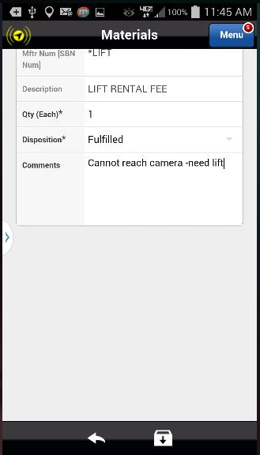
Using and Returning a Lift
To apply the Lift Rental Fee to the Service Order, you must save the part.
Action: Click on the Save icon in the footer
Previous
Home
End
Icon Legend

Slide 10
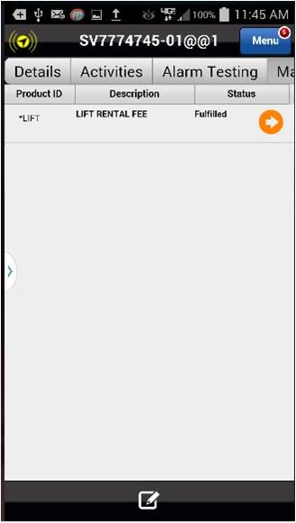
Using and Returning a Lift
The Lift Rental Fee has been added to the Service Order. The Fulfilled status indicates the part was used.
The next section of this training covers posting the Lift Return to the Service Order.
Action: Click the Add Item Icon in the footer
Previous
Home
End
Icon Legend

Slide 11
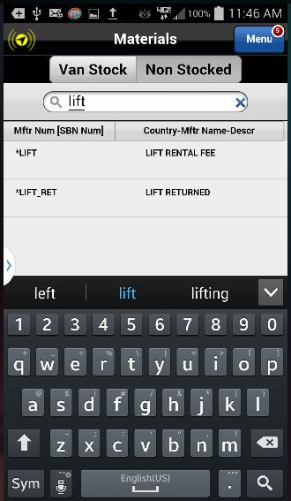
Using and Returning a Lift
Once again, with the Non-Stocked tab highlighted, type lift to begin the search.
Action: Click the Lift Returned part to select
Previous
Home
End
Icon Legend

Slide 12
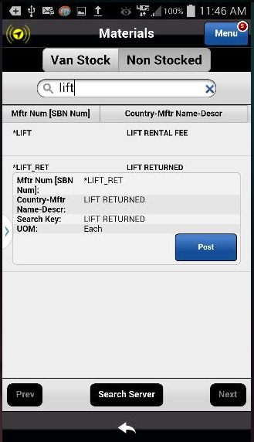
Using and Returning a Lift
Click on the Post button to log the Returned Lift to the Service Order.
Action: Click on the Post button
Previous
Home
End
Icon Legend

Slide 13
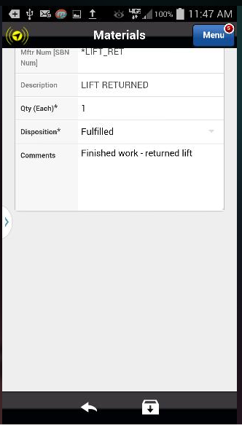
Using and Returning a Lift
Add any necessary comments then Save the changes.
Action: Click on the Save icon in the footer
Previous
Home
End
Icon Legend

Slide 14
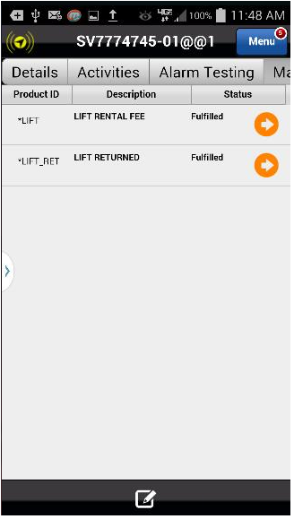
Using and Returning a Lift
Both the Lift Rental and Return have been posted to the Service Order.
This concludes this module.
Click on the Next button below
Previous
Home
End
Next
Icon Legend

Slide 15
Previous
Home
End

Slide 16
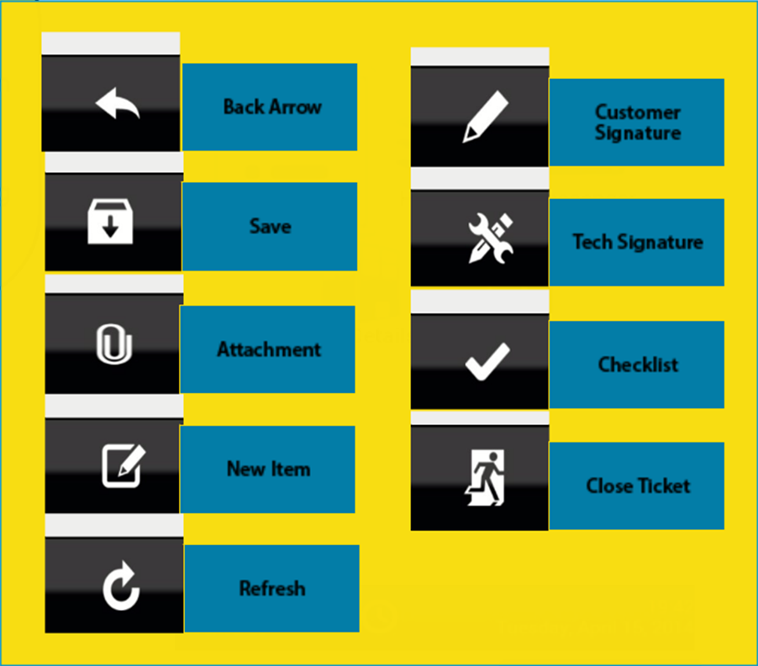
Icon Legend
Common icons used throughout the Astea application
Click on the Return button below to resume presentation
Return

